Slide 1
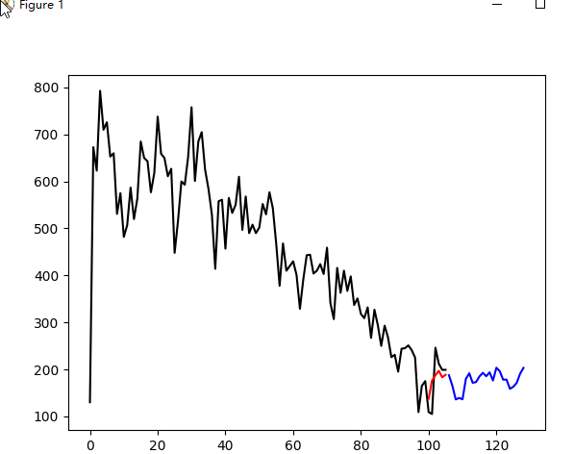
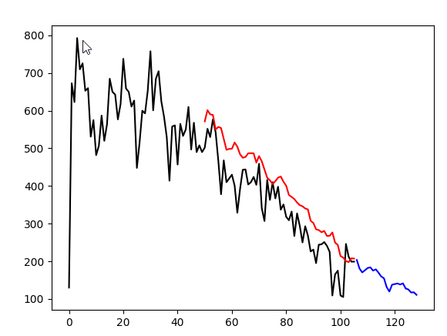
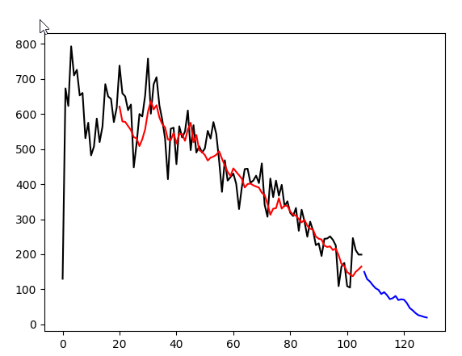
RMSE=40
RMSE=76
Lookback=100
Lookback=50
RMSE=54
Lookback=20

