Slide 1
A New Probabilistic Algorithm for Approximate Model Counting
Cunjing Ge
2017.7.7

Slide 2
Outline
Backgournd
Coin-flipping Strategy
Previous Works
Our Approach
Evaluation
Conclusion

Slide 3
Outline
Backgournd
Coin-flipping Strategy
Previous Works
Our Approach
Evaluation
Conclusion

Slide 4
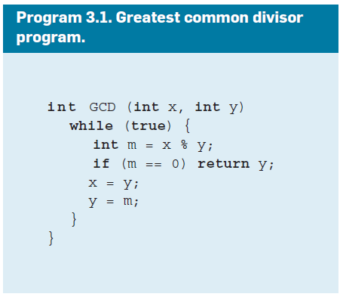
Background
Program analysis: symbolic execution, …

Slide 5
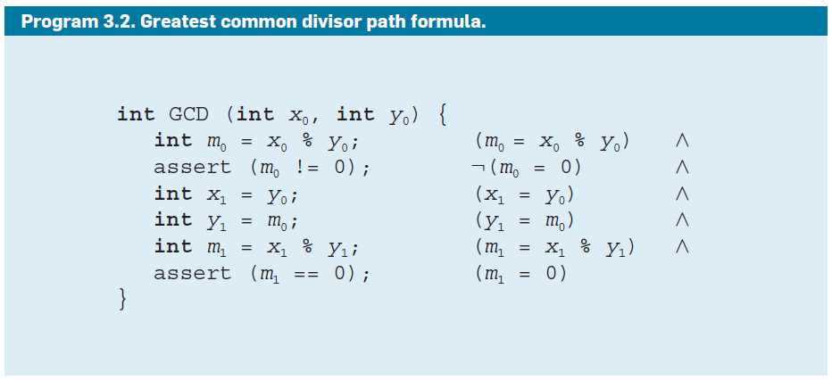
Background
sat
# solutions? Ratio? Hot path?

Slide 6
Background
Software engineering
Program analysis
Compiler optimization (memory, cache, execution time, …)
Probabilistic inference
“If there are clouds, the rain has probability 0.2”
--- Pr(Rain=True | Clouds=True) = 0.2
--- Pr(Rain=True) = ?
Unweighted (weighted) model counting

Slide 7
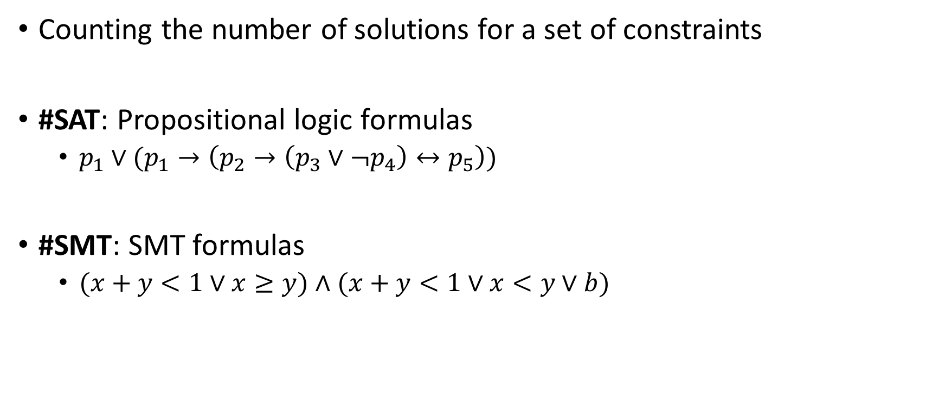
Model Counting
Counting the number of solutions for a set of constraints
#SAT: Propositional logic formulas
$p_{1}∨(p_{1}→\left(p_{2}→\left(p_{3}∨¬p_{4}\right)↔p_{5}\right))$
#SMT: SMT formulas
$(x+y<1∨x≥y)∧(x+y<1∨x<y∨b)$

Slide 8
Outline
Backgournd
Coin-flipping Strategy
Previous Works
Our Approach
Evaluation
Conclusion

Slide 9
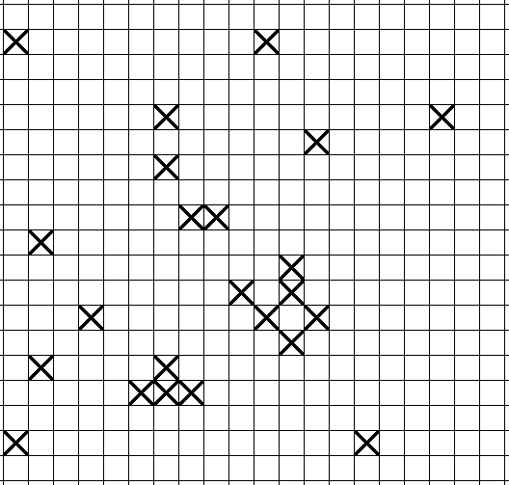
A Distributed Coin-Flipping Strategy
23 solutions
Tosses a coin on each
block. If heads, color the
block.

Slide 10
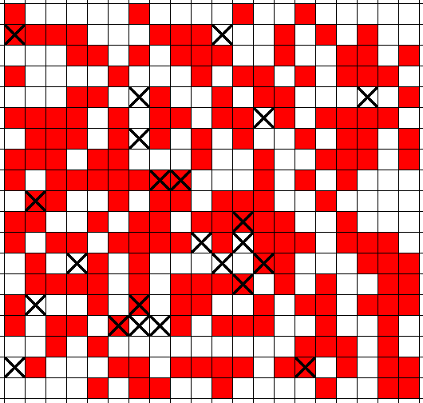
A Distributed Coin-Flipping Strategy
1st cut
13/23 solutions
Tosses a coin on each
block. If heads, color the
block.

Slide 11
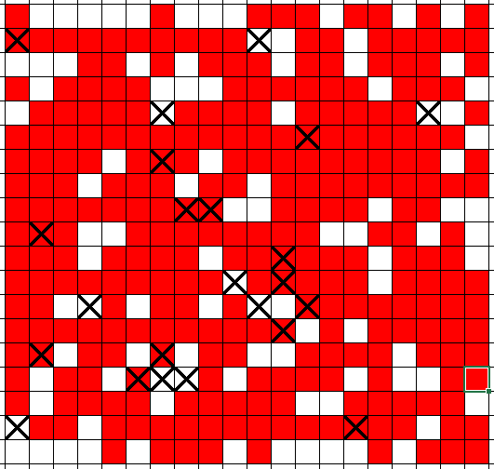
A Distributed Coin-Flipping Strategy
2nd cut
8/23 solutions
Tosses a coin on each
block. If heads, color the
block.

Slide 12
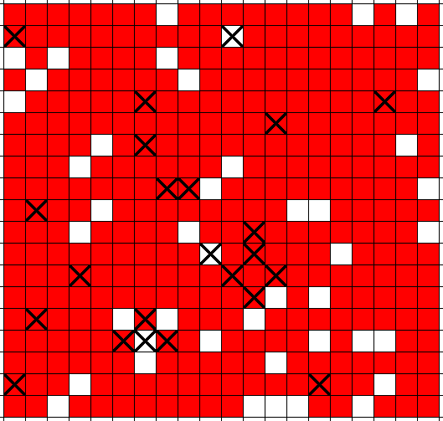
A Distributed Coin-Flipping Strategy
3rd cut
3/23 solutions
Tosses a coin on each
block. If heads, color the
block.

Slide 13
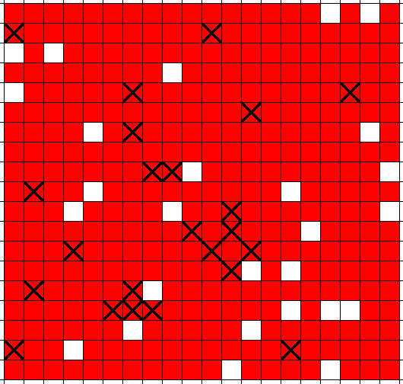
A Distributed Coin-Flipping Strategy
4th cut
0/23 solutions
Unsat!
Intuition:
There are approximately
2^{depth} solutions.

Slide 14
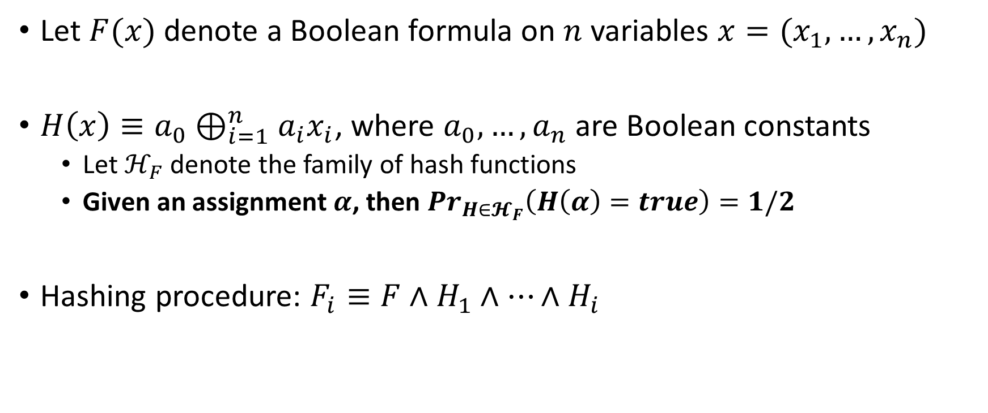
XOR Hash Functions
Let $F(x)$ denote a Boolean formula on $n$ variables $x=(x_{1},…,x_{n})$
$H\left(x\right)≡a_{0}⊕_{i=1}^{n}a_{i}x_{i}$, where $a_{0},…,a_{n}$ are Boolean constants
Let $ℋ_{F}$ denote the family of hash functions
Given an assignment $α$, then ${Pr}_{H{∈𝓗}_{F}}\left(H\left(α\right)=true\right)=1/2$
Hashing procedure: $F_{i}≡F∧H_{1}∧…∧H_{i}$

Slide 15
Outline
Backgournd
Coin-flipping Strategy
Previous Works
Our Approach
Evaluation
Conclusion

Slide 16
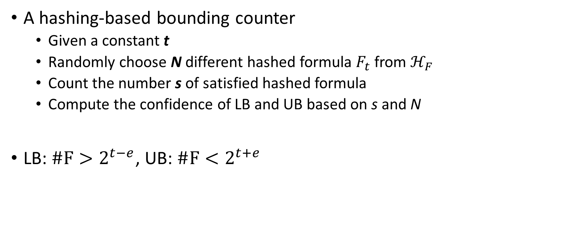
MBound*
A hashing-based bounding counter
Given a constant t
Randomly choose N different hashed formula $F_{t}$ from $ℋ_{F}$
Count the number s of satisfied hashed formula
Compute the confidence of LB and UB based on s and N
LB: $\#F>2^{t−e}$, UB: $\#F<2^{t+e}$
*C. P. Gomes, A. Sabharwal, and B. Selman. Model counting: A new strategy for obtaining good bounds. In Proc. of AAAI, pages 54–61, 2006.

Slide 17

MBound
Example: Given a formula F, where #F = 2¹⁵
Try $t=5≪15$, return $LB>2^{4}$
…
Try $t=10<15$, return $LB>2^{9}$
…
Try $t=13<15$, return $LB>2^{12}$
Try $t=14<15$, return unknown
…

Slide 18
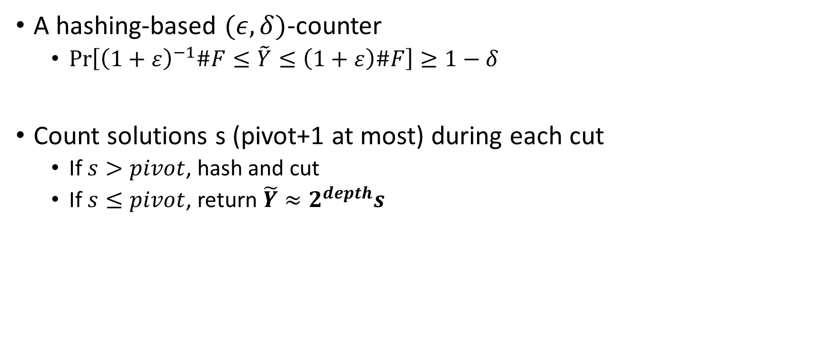
ApproxMC*
A hashing-based $(ε,δ)$-counter
$\operatorname{Pr}\left[{\left(1+ε\right)}^{−1}\#F≤\tilde{Y}≤\left(1+ε\right)\#F\right]≥1−δ$
Count solutions s (pivot+1 at most) during each cut
If $s>pivot$, hash and cut
If $s≤pivot$, return $\tilde{Y}≈2^{depth}s$
*S. Chakraborty, K. S. Meel, and M. Y. Vardi. A scalable approximate model counter. In Proc. of CP, pages 200–216, 2013.

Slide 19
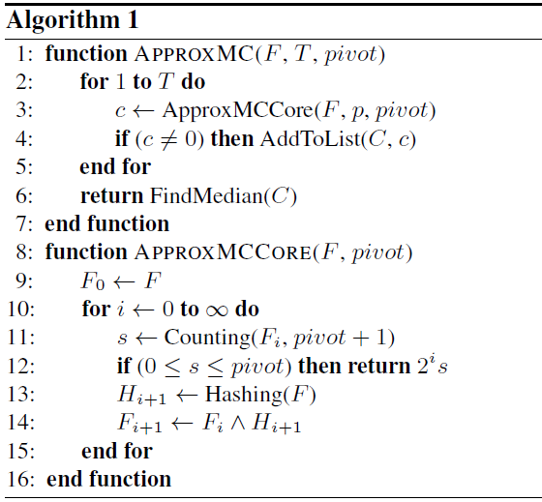
Repeat T times and
return the median
Coin-flipping procedure
with bounded counting

Slide 20
Outline
Backgournd
Coin-flipping Strategy
Previous Works
Our Approach
Evaluation
Conclusion

Slide 21
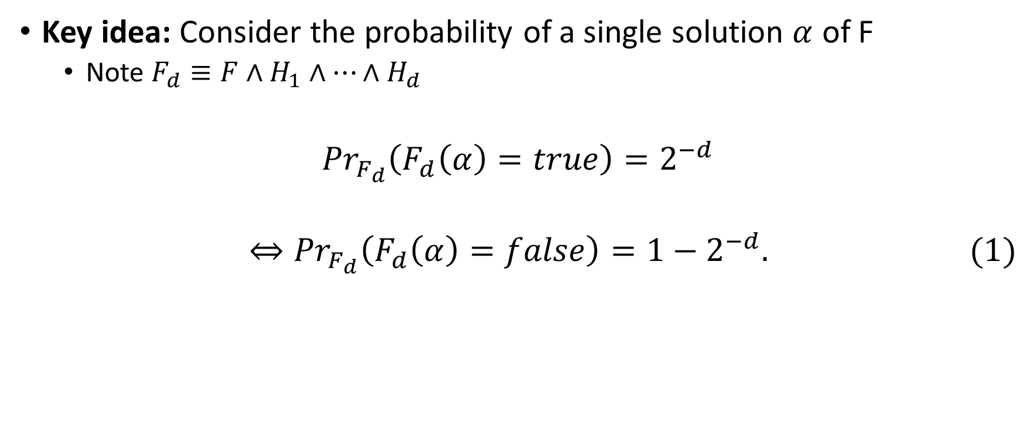
Our approach
Key idea: Consider the probability of a single solution $α$ of F
Note $F_{d}≡F∧H_{1}∧…∧H_{d}$
$${Pr}_{F_{d}}\left(F_{d}\left(α\right)=true\right)=2^{−d}$$
$$⇔{Pr}_{F_{d}}\left(F_{d}\left(α\right)=false\right)=1−2^{−d}. (1)$$

Slide 22
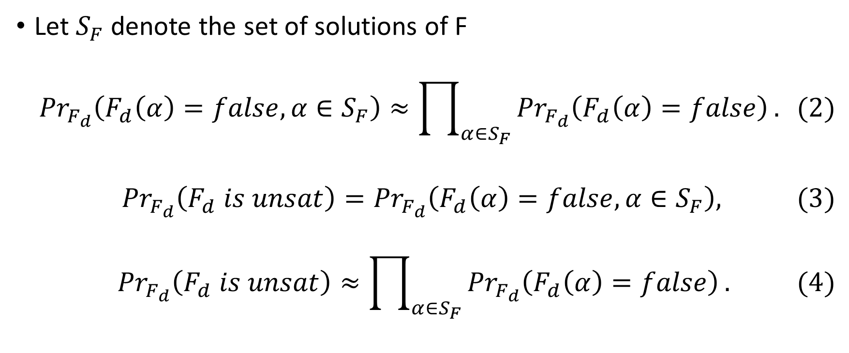
Our approach
Let $S_{F}$ denote the set of solutions of F
$${Pr}_{F_{d}}\left(F_{d}\left(α\right)=false,α∈S_{F}\right)≈\prod_{α∈S_{F}}{{Pr}_{F_{d}}\left(F_{d}\left(α\right)=false\right)}. (2)$$
$${Pr}_{F_{d}}\left(F_{d} is unsat\right)={Pr}_{F_{d}}\left(F_{d}\left(α\right)=false,α∈S_{F}\right), (3)$$
$${Pr}_{F_{d}}\left(F_{d} is unsat\right)≈\prod_{α∈S_{F}}{{Pr}_{F_{d}}\left(F_{d}\left(α\right)=false\right)}. (4)$$
?
?

Slide 23
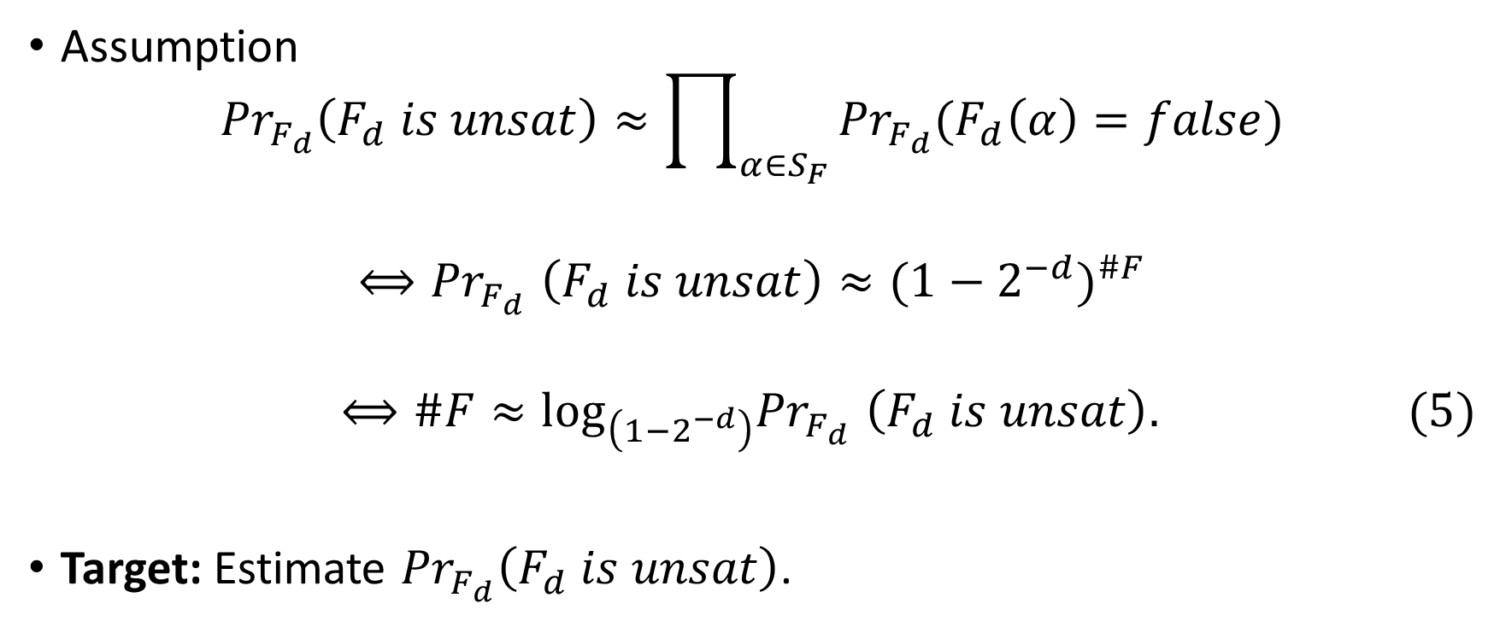
Our approach
Assumption
$${Pr}_{F_{d}}\left(F_{d} is unsat\right)≈\prod_{α∈S_{F}}{{Pr}_{F_{d}}(F_{d}\left(α\right)=false)}$$
$${⟺Pr}_{F_{d}}\left(F_{d} is unsat\right)≈{(1−2^{−d})}^{\#F}$$
$${⟺\#F≈\log_{\left(1−2^{−d}\right)}Pr}_{F_{d}}\left(F_{d} is unsat\right). (5)$$
Target: Estimate ${Pr}_{F_{d}}\left(F_{d} is unsat\right)$.

Slide 24
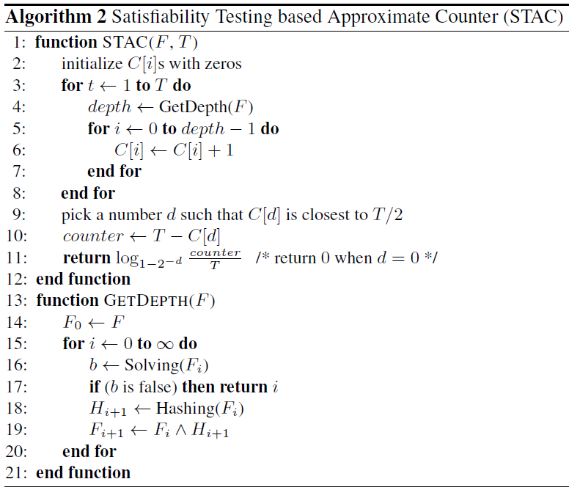
Coin-flipping procedure

Slide 25
 | C[0] | C[1] | C[2] | C[3] | C[4] | …
init | 0 | 0 | 0 | 0 | 0 | 0
Coin-flipping procedure

Slide 26
Depth=4
t | C[0] | C[1] | C[2] | C[3] | C[4] | …
init | 0 | 0 | 0 | 0 | 0 | 0
1 | 1 | 1 | 1 | 1 | 0 | 0
Coin-flipping procedure

Slide 27
Depth=2
t | C[0] | C[1] | C[2] | C[3] | C[4] | …
init | 0 | 0 | 0 | 0 | 0 | 0
1 | 1 | 1 | 1 | 1 | 0 | 0
2 | 2 | 2 | 1 | 1 | 0 | 0
Coin-flipping procedure

Slide 28
Depth=3
t | C[0] | C[1] | C[2] | C[3] | C[4] | …
init | 0 | 0 | 0 | 0 | 0 | 0
1 | 1 | 1 | 1 | 1 | 0 | 0
2 | 2 | 2 | 1 | 1 | 0 | 0
3 | 3 | 3 | 2 | 1 | 0 | 0
Coin-flipping procedure

Slide 29

t | C[0] | C[1] | C[2] | C[3] | C[4] | …
10 | 10 | 9 | 7 | 4 | 1 | 0
$${≈log}_{1−2^{−3}}\frac{10−4}{10}≈3.86$$
Coin-flipping procedure

Slide 30
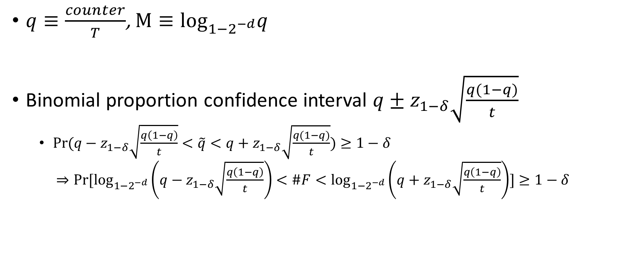
Dynamic Stopping Criterion
$q≡\frac{counter}{T}$, $M≡\log_{1−2^{−d}}q$
Binomial proportion confidence interval $q±z_{1−δ}\sqrt{\frac{q(1−q)}{t}}$
$Pr⁡(q−z_{1−δ}\sqrt{\frac{q\left(1−q\right)}{t}}<\tilde{q}<q+z_{1−δ}\sqrt{\frac{q(1−q)}{t}})≥1−δ$
$⇒Pr⁡[\log_{1−2^{−d}}\left(q−z_{1−δ}\sqrt{\frac{q\left(1−q\right)}{t}}\right)<\#F<\log_{1−2^{−d}}\left(q+z_{1−δ}\sqrt{\frac{q\left(1−q\right)}{t}}\right)]≥1−δ$

Slide 31
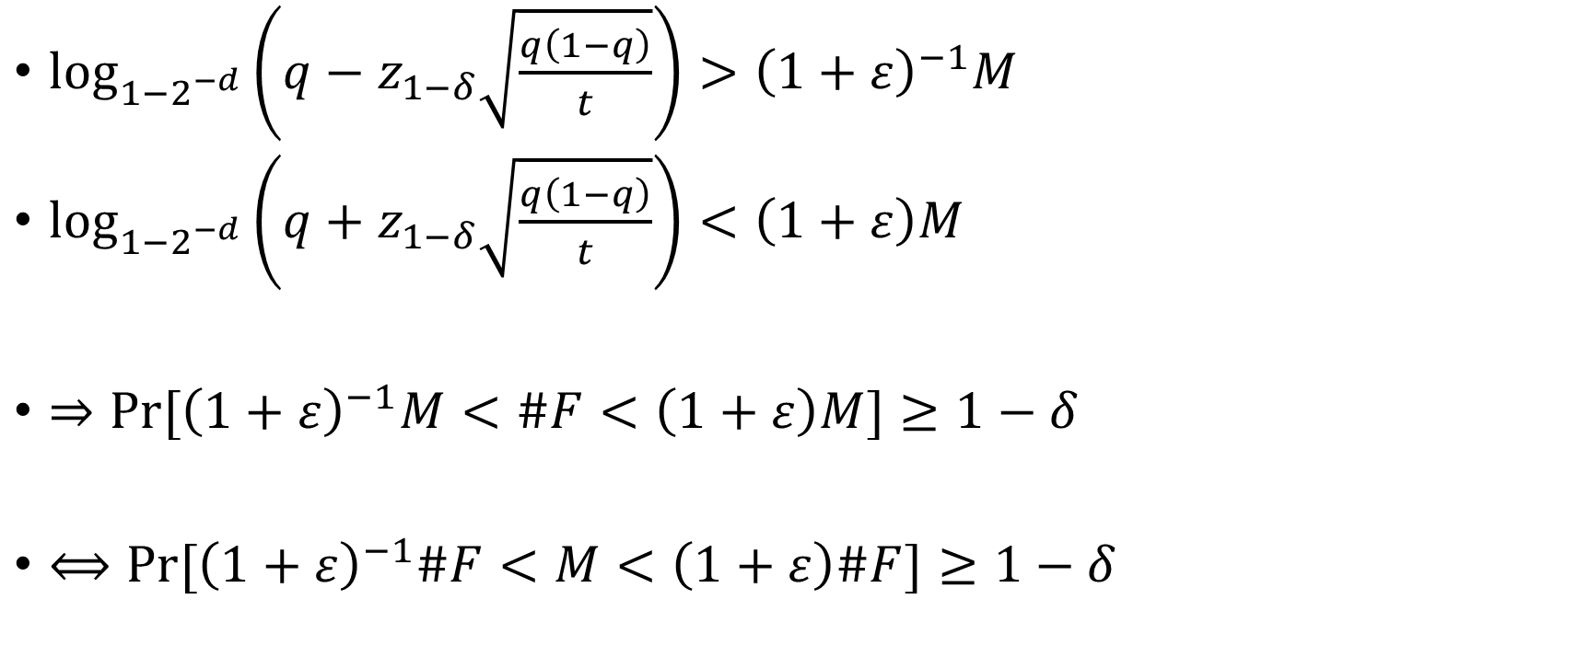
Dynamic Stopping Criterion
$\log_{1−2^{−d}}\left(q−z_{1−δ}\sqrt{\frac{q\left(1−q\right)}{t}}\right)>{\left(1+ε\right)}^{−1}M$
$\log_{1−2^{−d}}\left(q+z_{1−δ}\sqrt{\frac{q\left(1−q\right)}{t}}\right)<\left(1+ε\right)M$
$⇒Pr⁡[{\left(1+ε\right)}^{−1}M<\#F<\left(1+ε\right)M]≥1−δ$
$⟺Pr⁡[{\left(1+ε\right)}^{−1}\#F<M<\left(1+ε\right)\#F]≥1−δ$

Slide 32
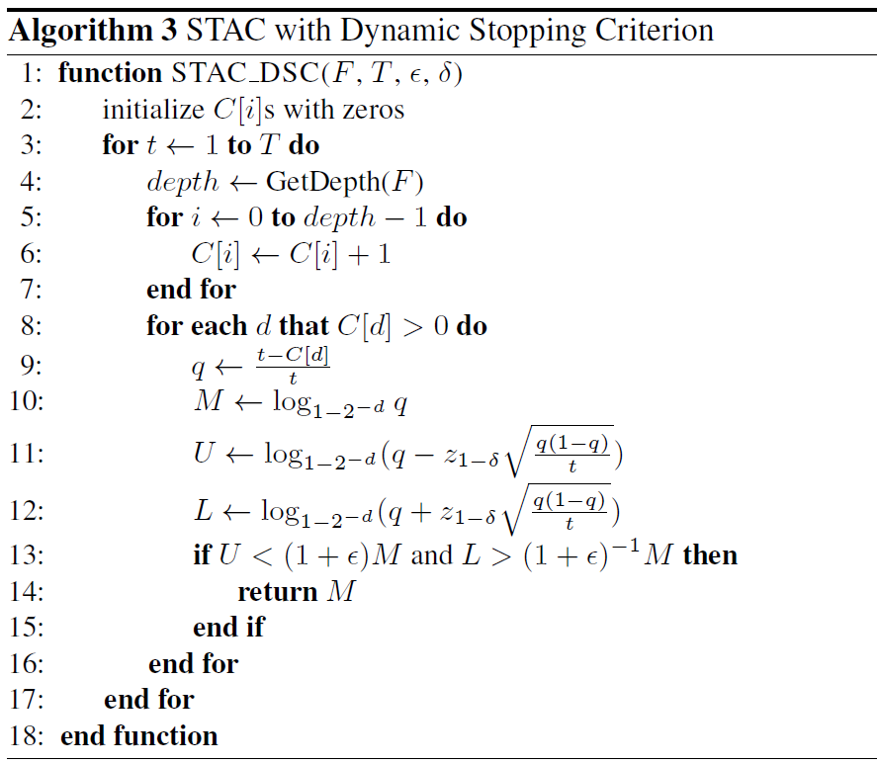

Slide 33

Leap-frogging Strategy
Insight: The depth computed by GetDepth lies in $[\tilde{d}, \tilde{d}+7]$ with probability over 90%, where $\tilde{d}=\log_{2}\#F$.
Average depth $\overline{d}$, loop of GetDepth start from $\overline{d}−offset$

Slide 34
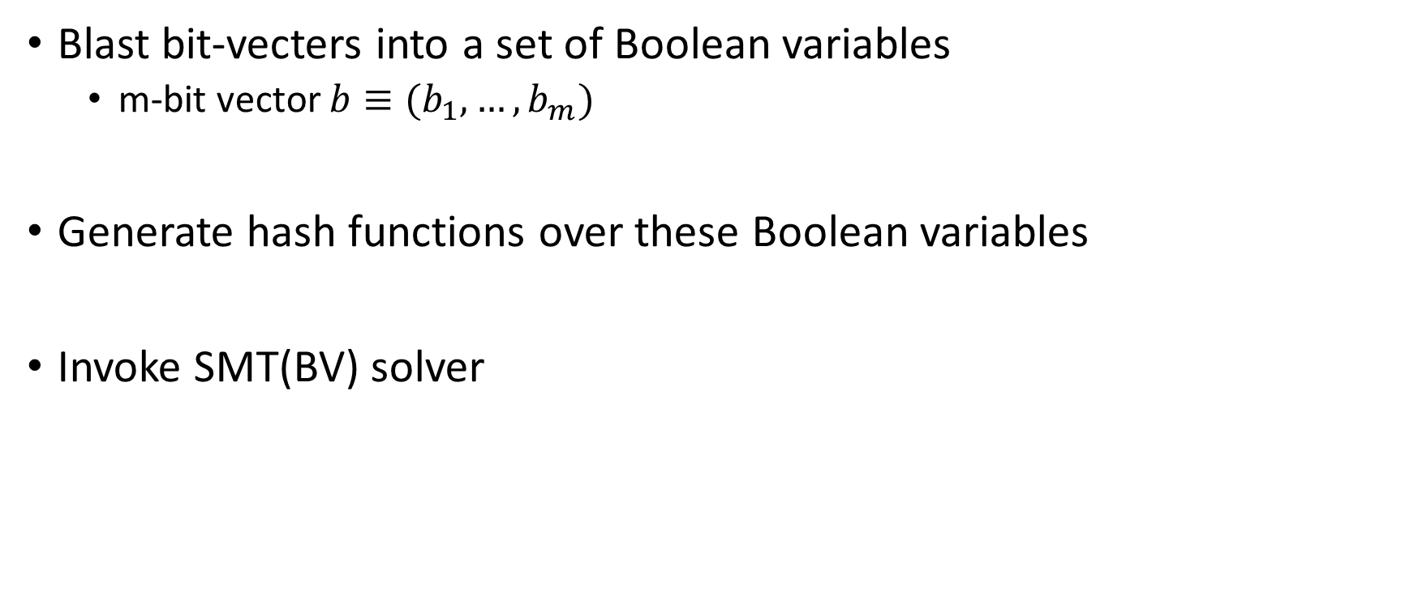
#SMT(BV)
Blast bit-vecters into a set of Boolean variables
m-bit vector $b≡(b_{1},…,b_{m})$
Generate hash functions over these Boolean variables
Invoke SMT(BV) solver

Slide 35
Outline
Backgournd
Coin-flipping Strategy
Previous Works
Our Approach
Evaluation
Conclusion

Slide 36
Evaluation
Benchmarks from different domains:
grid networks
plan recognition
DQMR networks
Langford sequences
circuit synthesis
random 3-CNF
logistics problems
program synthesis

Slide 37
Evaluation
Implementation
STAC_CNF for #SAT
STAC_BV for #SMT(BV)

Slide 38
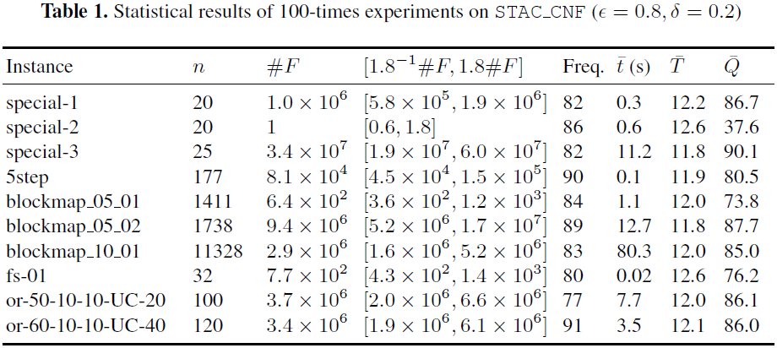
Quality of Approximation

Slide 39
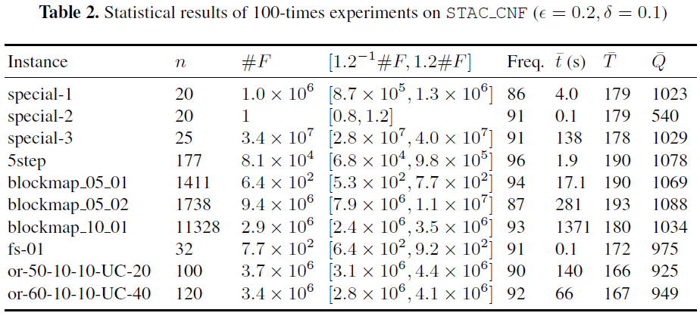
Quality of Approximation

Slide 40
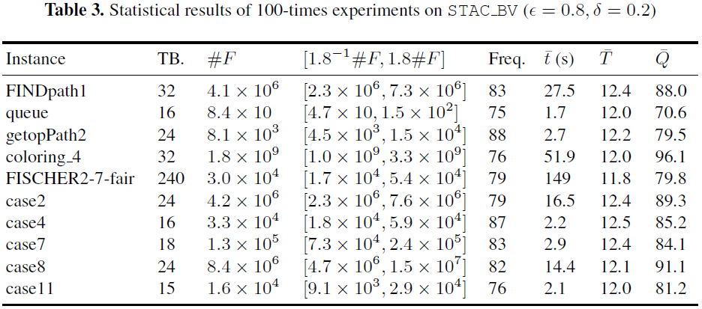
Quality of Approximation

Slide 41

Comparison with $(ε,δ)$-counters
ApproxMC2 (S. Chakraborty et al., IJCAI16)
vs STAC_CNF
SMTApproxMC (S. Chakraborty et al., AAAI16)
vs STAC_BV

Slide 42
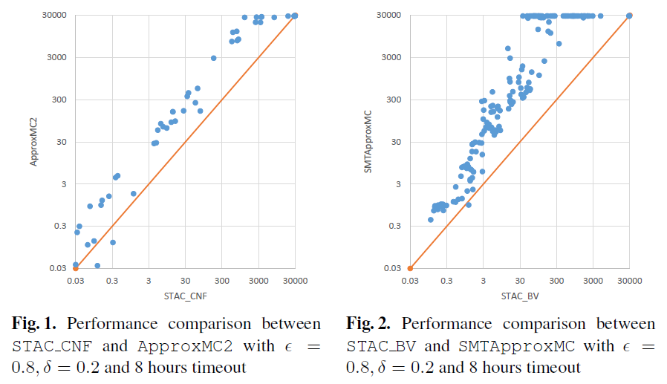
Comparison with $(ε,δ)$-counters

Slide 43
Comparison with other counters
Bounding counters
Samplecount (C. P. Gomes et al., IJCAI07)
Mbound (C.P. Gomes et al., AAAI06)
Guarantee-less counters
ApproxCount (W.Wei et al., SAT05)
SampleTreeSearch (S.Ermon et al., UAI12)

Slide 44
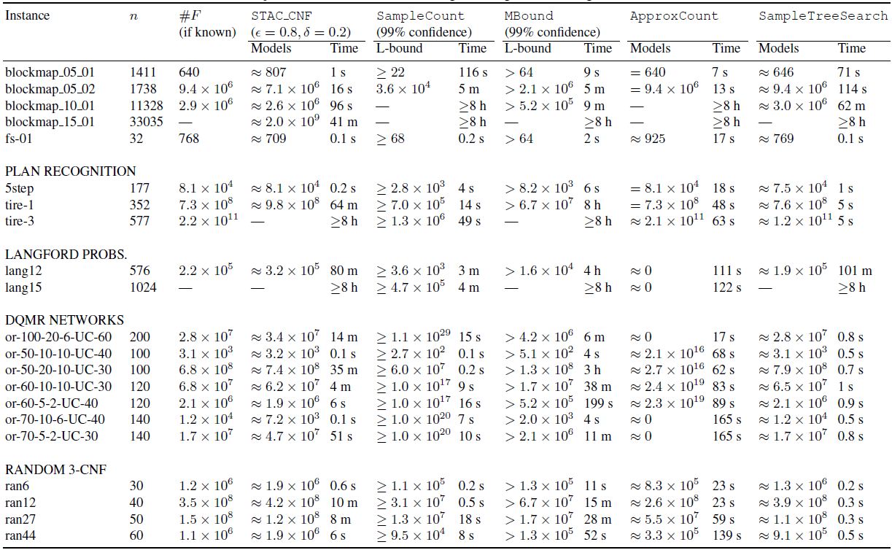

Slide 45
Outline
Backgournd
Coin-flipping Strategy
Previous Works
Our Approach
Evaluation
Conclusion

Slide 46
Conclusion
A new hashing-based approximate algorithm with dynamic stopping criterion, it has two key strength:
Require only one satisfiability query for each cut
Terminate once meeting the theoretical guarantee of accuracy
Extensive experiments demonstrate that our approach is efficient and promising.

Slide 47
Future Works
Further study the hidden properties of the hash functions, e.g., the assumption we proposed.
Extending the idea to count solutions of other formulas.

Slide 48
Thanks!

