Slide 1
Locality of Weighted Bipartite Matchings with Low Rank Data
刘兴武 (合作者：滕尚华)
中国科学院计算技术研究所
2017.7.7

Slide 2



Outline
Motivation
Special case: finite domain
General case: unit interval domain
Perturbation Analysis
Summary

Slide 3


Motivation
Local search for optimization
Annoying local optimal trap
The bigger, the worse
Perfect if we can
Evaluate the traps
Eliminate/weaken the traps
Matching problem as the start point
Classical and actively studied
$$f(x)$$
$$x$$

Slide 4









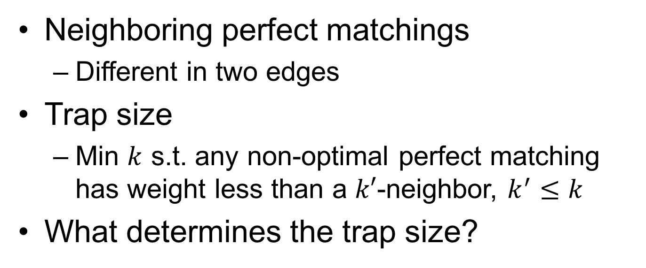
$$u_{1}$$
$$u_{2}$$
$$u_{i}$$
$$u_{n}$$
…
…
$$w_{ij}$$
…
…
$$v_{1}$$
$$v_{2}$$
$$v_{j}$$
$$v_{n}$$
Neighboring perfect matchings
Different in two edges
Trap size
Min $k$ s.t. any non-optimal perfect matching has weight less than a $k′$-neighbor, $k^{′}≤k$
What determines the trap size?

Slide 5
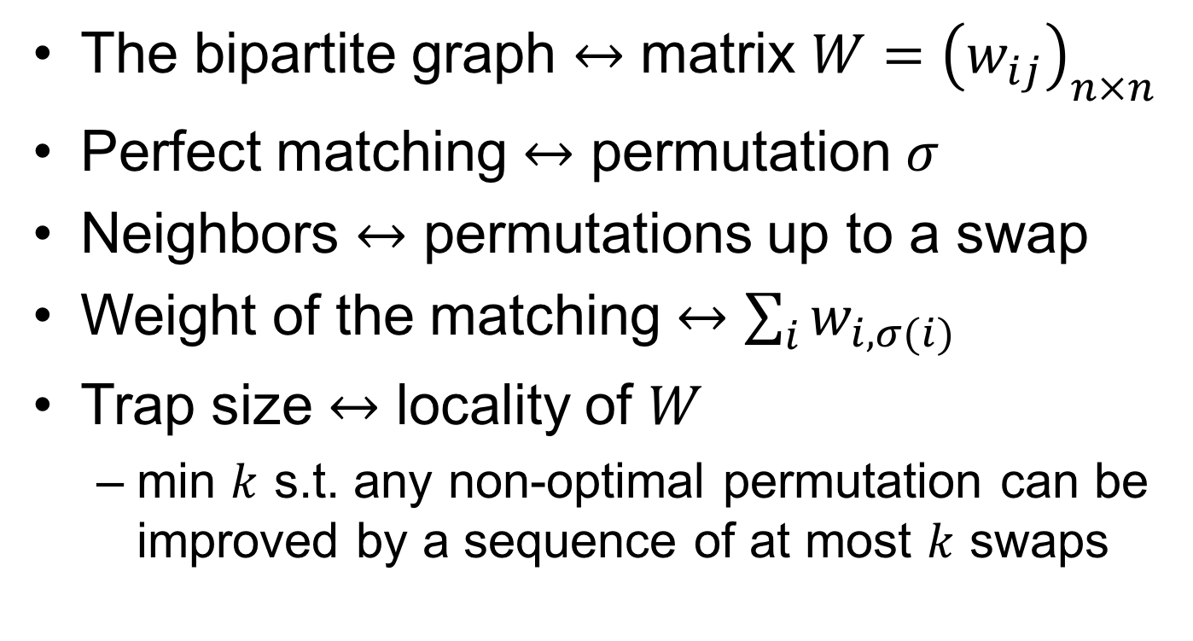
In terms of matrices
The bipartite graph $↔$ matrix $W={\left(w_{ij}\right)}_{n×n}$
Perfect matching $↔$ permutation $σ$
Neighbors $↔$ permutations up to a swap
Weight of the matching $↔$ $\sum_{i}{w_{i,σ(i)}}$
Trap size $↔$ locality of $W$
min $k$ s.t. any non-optimal permutation can be improved by a sequence of at most $k$ swaps

Slide 6

Conjecture
Locality is determined by rank of $W$
There is a function $f$ such that for any $n$ and $W∈ℝ^{n×n}$, locality$(W)≤$ $f(rank(W))$

Slide 7

Trivial Case
True when $rank(W)=1$
But remained open for 3 years

Slide 8
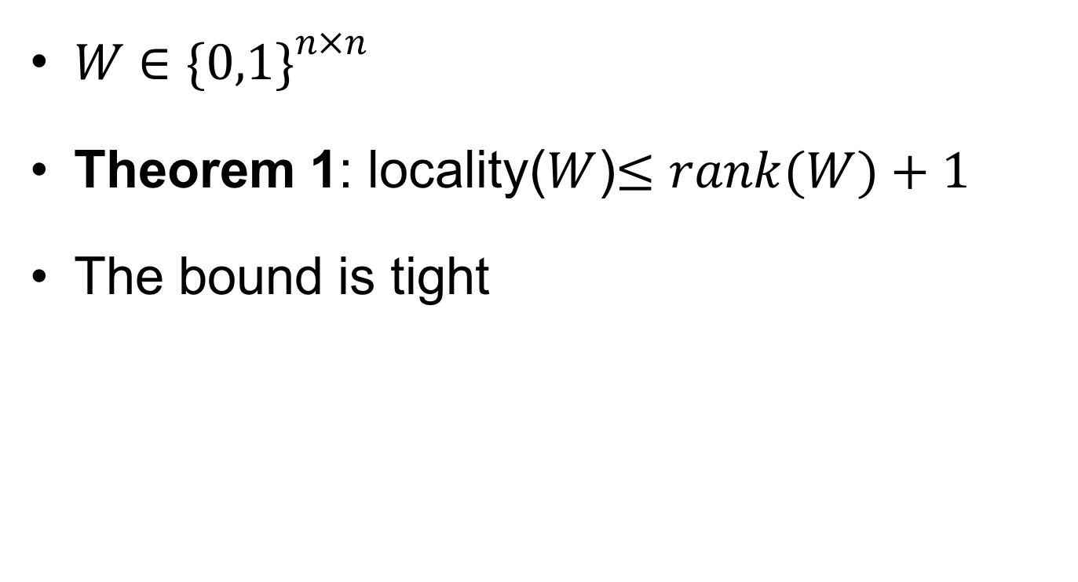
Special case: binary domain
$W∈{\{0,1\}}^{n×n}$
Theorem 1: locality($W$)$≤rank(W)+1$
The bound is tight

Slide 9
Basic idea: normalization
Non-zero rows
Non-zero columns
rank(W)≥2t+1 or rank(W)≥2t+2

Slide 10
Basic idea: improving cycle

Slide 11
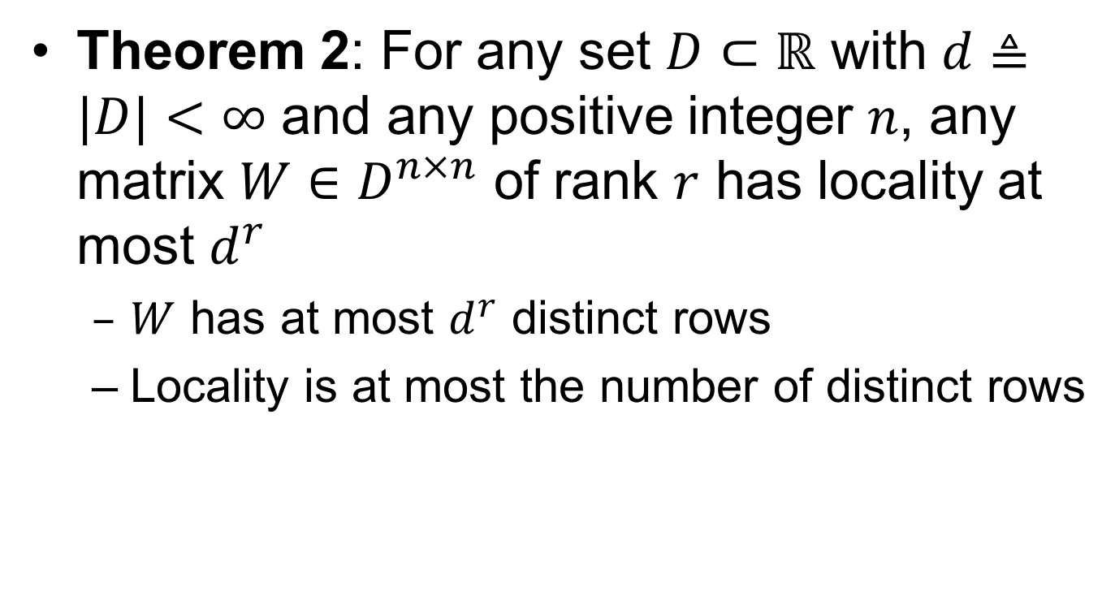
Special case: finite domain
Theorem 2: For any set $D⊂ℝ$ with $d≜|D|<∞$ and any positive integer $n$, any matrix $W∈D^{n×n}$ of rank $r$ has locality at most $d^{r}$
$W$ has at most $d^{r}$ distinct rows
Locality is at most the number of distinct rows

Slide 12
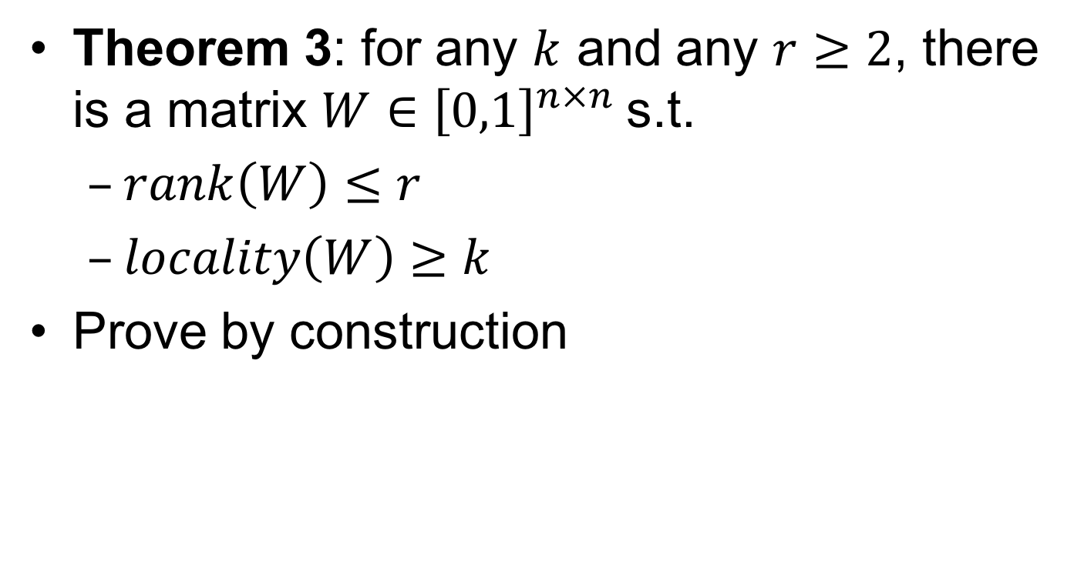
General case: unit interval domain
Theorem 3: for any $k$ and any $r≥2$, there is a matrix $W∈{\left[0,1\right]}^{n×n}$s.t.
$rank\left(W\right)≤r$
$locality\left(W\right)≥k$
Prove by construction

Slide 13
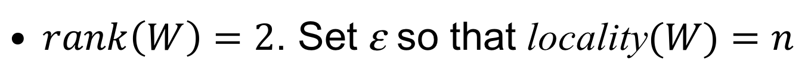
Counter-example
$rank\left(W\right)=2$. Set ε so that locality$(W)=n$

Slide 14
Counter-example
Set ε so that locality(W)=n

Slide 15

I don’t want to be Mr. No!

Slide 16
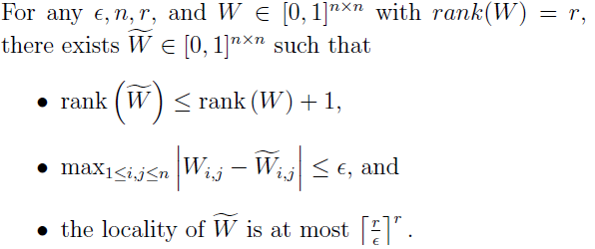
Perturbation Analysis
Is the conjecture true up to ε–perturbation?
Theorem 4:

Slide 17
Basic idea of the proof
Rounding for perturbation
Preserve rank under rounding
rounding based on rank decomposition
Small error under rounding
decomposition over bounded domain
Small locality after rounding
low rank matrices over finite domains

Slide 18
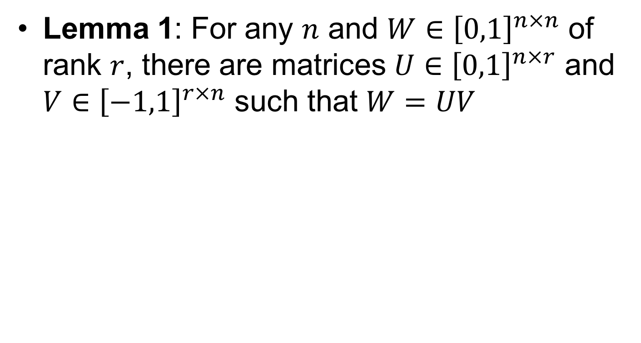
Matrix decomposition over bounded domain

Slide 19
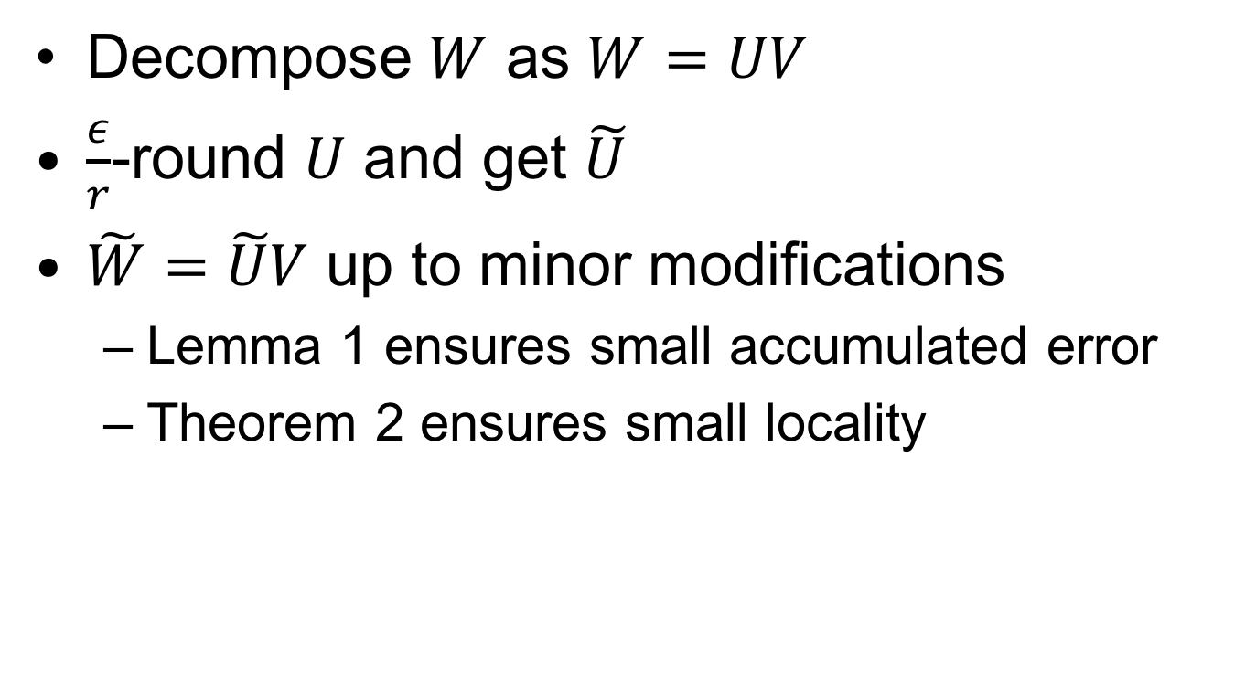
Proof of theorem 4
Decompose $W$ as $W=UV$
$\frac{ε}{r}$-round $U$ and get $\tilde{U}$
$\tilde{W}=\tilde{U}V$ up to minor modifications
Lemma 1 ensures small accumulated error
Theorem 2 ensures small locality

Slide 20
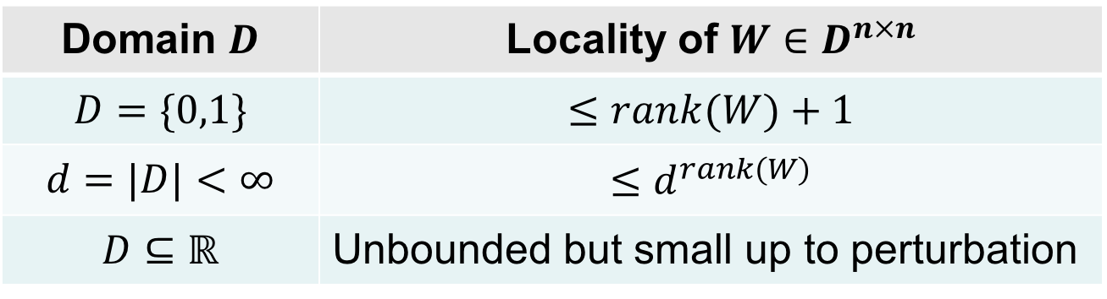
Summary
Domain $D$ | Locality of $W∈D^{n×n}$
$$D=\{0,1\}$$ | $$≤rank(W)+1$$
$$d=|D|<∞$$ | $$≤d^{rank(W)}$$
$$D⊆ℝ$$ | Unbounded but small up to perturbation
Open problems
improve finite domain case
smoothed analysis for general case
low rank analysis for other problems

Slide 21
Thanks

