Slide 1
CONV
11x11.
stride=4，
96 kernels
Overlapping
Max POOL
3x3,
stride=2
CONV
5x5,pad=2
256 kernels
Overlapping
Max POOL
3x3,
stride=2
CONV
3x3,pad=1
374 kernels
CONV
3x3,pad=1
384 kernels
CONV
3x3,pad=1
256 kernels
Overlapping
Max POOL
3x3,
stride=2
FC
FC

Slide 2
3
CONV
11x11，
stride=4，
96 kernels
Overlapping
Max POOL
3x3,
stride=2
CONV
5x5,pad=2
256 kernels
Overlapping
Max POOL
3x3,
stride=2
CONV
3x3,pad=1
384 kernels
227
11
55
256
96
27
96
27
256
11
13
55
27
27
13
227
CONV
3x3,pad=1
384 kernels
CONV
3x3,pad=1
256 kernels
Overlapping
Max POOL
3x3,
stride=2
FC
FC
384
384
256
256
13
6
13
13
6
1000
softmax
13
13
13
4096
4096

Slide 4
CONV
3x3，
stride=1，
32 kernels
Max POOL
2x2,
stride=2
CONV
3x3，
stride=1，
64 kernels
3
SENet
3
32
3
32
32
32
16
32
16
64
32
32
32
32
16
16
16
16
Max POOL
2x2,
stride=2
CONV
3x3,
128 kernels
Max POOL
2x2,
stride=2
64
64
128
FC
FC
16
8
128
16
8
8
4
10
softmax
8
8
8
4
2048
512

Slide 5
CONV
3x3，
stride=1，
96 kernels
Max POOL
2x2,
stride=2
CONV
3x3,
256 kernels
Max POOL
2x2,
stride=2
CONV
3x3,
384 kernels
3
3
32
3
32
256
SENet
96
16
96
SENet
256
16
8
32
32
16
16
8
CONV
3x3,
384 kernels
CONV
3x3,
256 kernels
Max POOL
2x2,
stride=2
SENet
FC
FC
384
384
256
256
8
4
10
softmax
8
8
8
4
8
8
4096
512

Slide 6
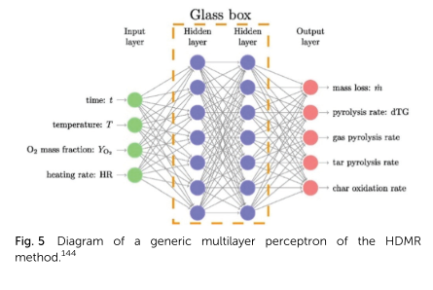
ML Visuals
Hidden Layers
Input Layer
a^{[1]}₁
a^{[2]}₁
a^{[3]}₁
Output Layer
a^{[1]}₂
a^{[2]}₂
a^{[3]}₂
a^{[4]}
Ŷ
X
a^{[1]}₃
a^{[2]}₃
a^{[3]}₃
a^{[1]}_{n}
a^{[2]}_{n}
a^{[3]}_{n}
X = A^{[0]}
A^{[1]}
A^{[2]}
A^{[3]}
A^{[4]}
Notes:
Created By @srvmshr
sourav@yahoo.com

Slide 7
ML Visuals
CONV operation
MxM
ReLU
+b1
+b1
MxMX2
+b2
+b2
NxNx3
MxM
ReLU
Notes:
Added by @srvmshr
Sourav @ yahoo.com

Slide 8
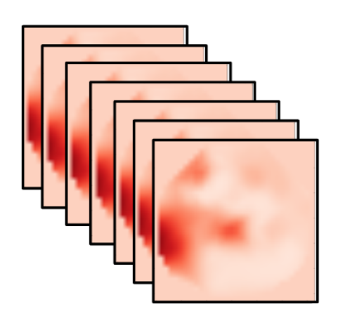
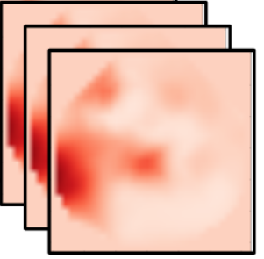
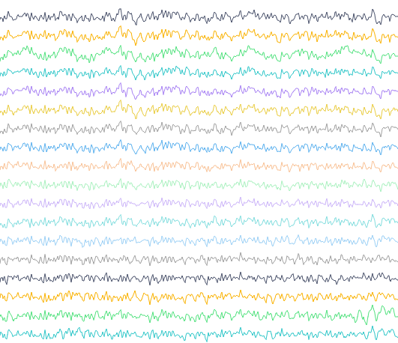
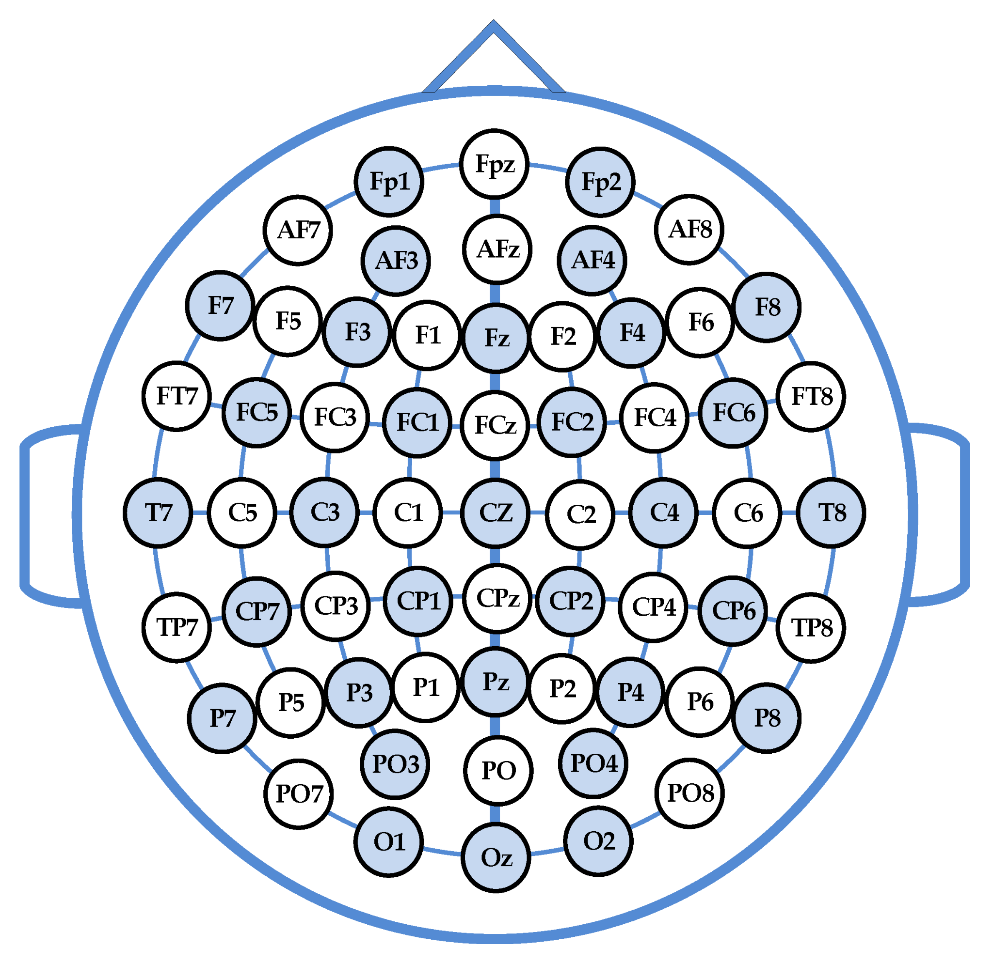
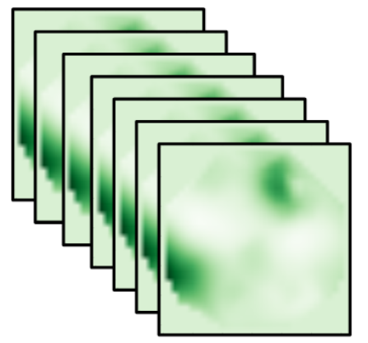
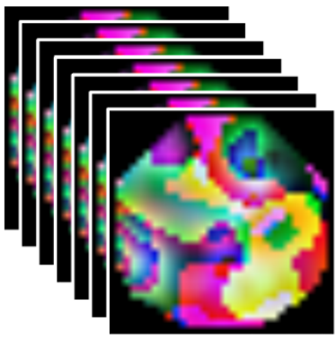
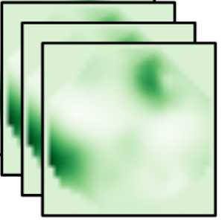
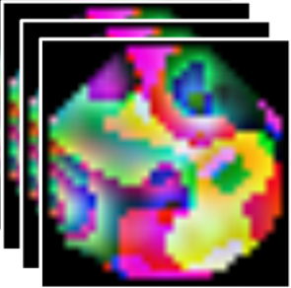
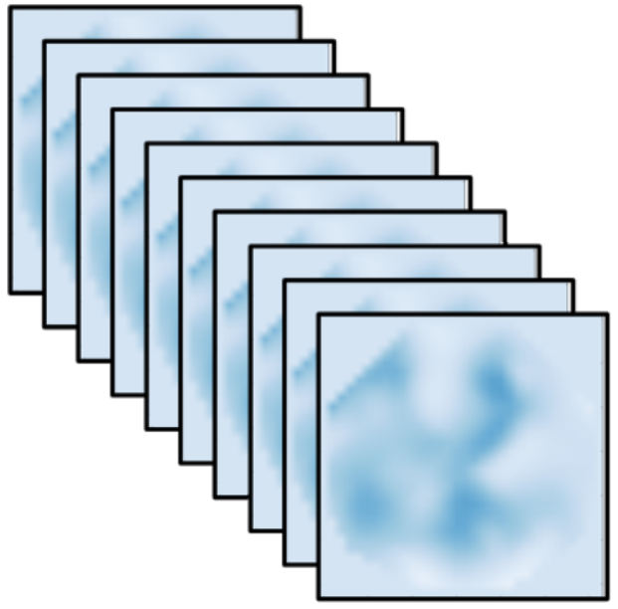
ML Visuals
Time slice
Alpha
Delta
CNN
CNN
ICA
Conv
RNN+ANN
CNN
Conv
CNN
Alpha
Conv
CNN
Conv
CNN
Conv
CNN
Conv
CNN
EEG
Cap
Band-Pass
Filter
Conv
Beta
CNN
CNN
Spectral-Temporal Feature Learning
Pain Intensity Assessment
Spatial Feature Learning
Spectral Topography Maps
EEG Images
EEG Time Series
Notes:
Note:
These visuals can represent a multi-directional array (3D)
Author: Elvis Saravia (ellfae@gmail.com)

