Slide 1
VLA AutoResearch
An autonomous research loop for robot policies, scored by closed-loop simulation — not open-loop loss
3-HOUR HACKATHON · 2× RTX 5090 · JUNE 2026
github.com/yanz-rf/vla-autoresearch
66→82 % task success, discovered by the loop in 30 min | 25 scored experiments across 2 GPUs | 2.5 min per inference experiment

Slide 2
Motivation
• The inspiration: karpathy/autoresearch (Mar 2026): a coding agent runs LM-pretraining experiments autonomously — one idea per run, fixed budget, keep/revert by val_bpb, ~100 experiments overnight.
• The robotics gap: VLA / imitation policies are mostly iterated with open-loop metrics (action prediction error) — but low prediction error ≠ task success.
• Our port: The experiment score is closed-loop sim success rate : the policy controls the robot, mistakes compound, only finished tasks count. No public robotics port existed. Now one does.

Slide 3
System design — same loop, new scoring
 | autoresearch (LM) | ours (robotics)
mutable surface | train.py | policy code (LeRobot, editable) + CLI overrides
read-only scorer | val bits-per-byte | 50 sim episodes, fixed seeds → % success
protocol | program.md | program.md, thresholds tuned for eval noise
audit trail | results.tsv + git | results.tsv + git + rollout videos
• Eval isolation: scorer + seeds live outside the mutable surface — the agent can't game the metric. Economics: train+eval ≈ 12 min · inference-only ≈ 2.5 min per experiment.

Slide 4
Testbed
• Task — ALOHA TransferCube (MuJoCo): right arm picks a cube, hands it to the left arm.
• Data — 50 public human teleop demos ( lerobot/aloha_sim_transfer_cube_human ).
• Policy — ACT, 52M params: predicts 100-action chunks from camera + joint state (from scratch; ImageNet-initialized ResNet-18 encoder).
• Score — % of 50 fixed-seed episodes completed; staged reward (0-4) as dense secondary signal.
• Hackathon move — train once (20k steps ≈ 10 min, 66%), freeze weights, research inference-time behavior at 2.5 min/experiment.

Slide 5
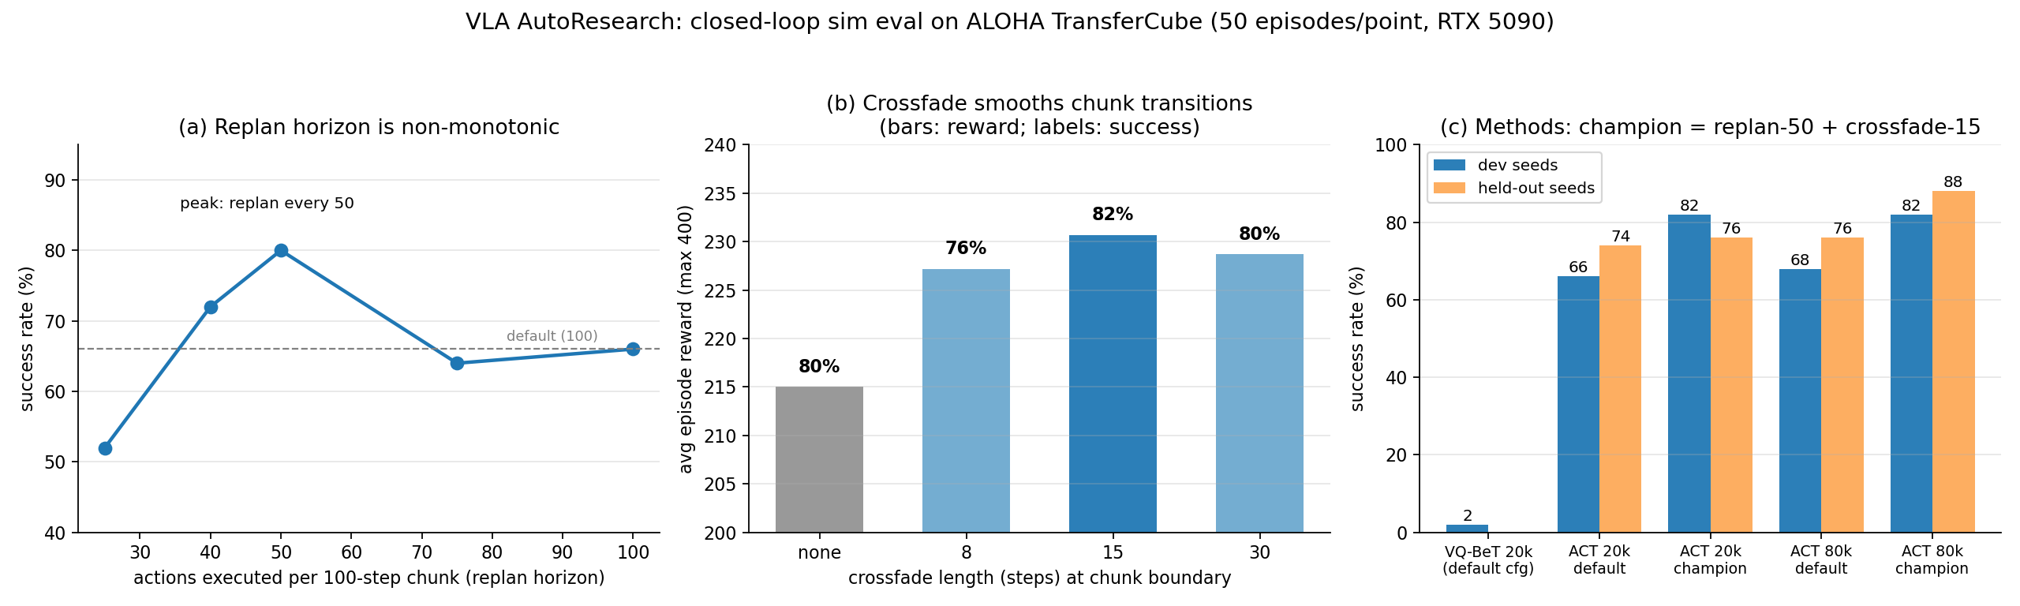
What the loop found — 11 experiments, ~30 min compute

Slide 6
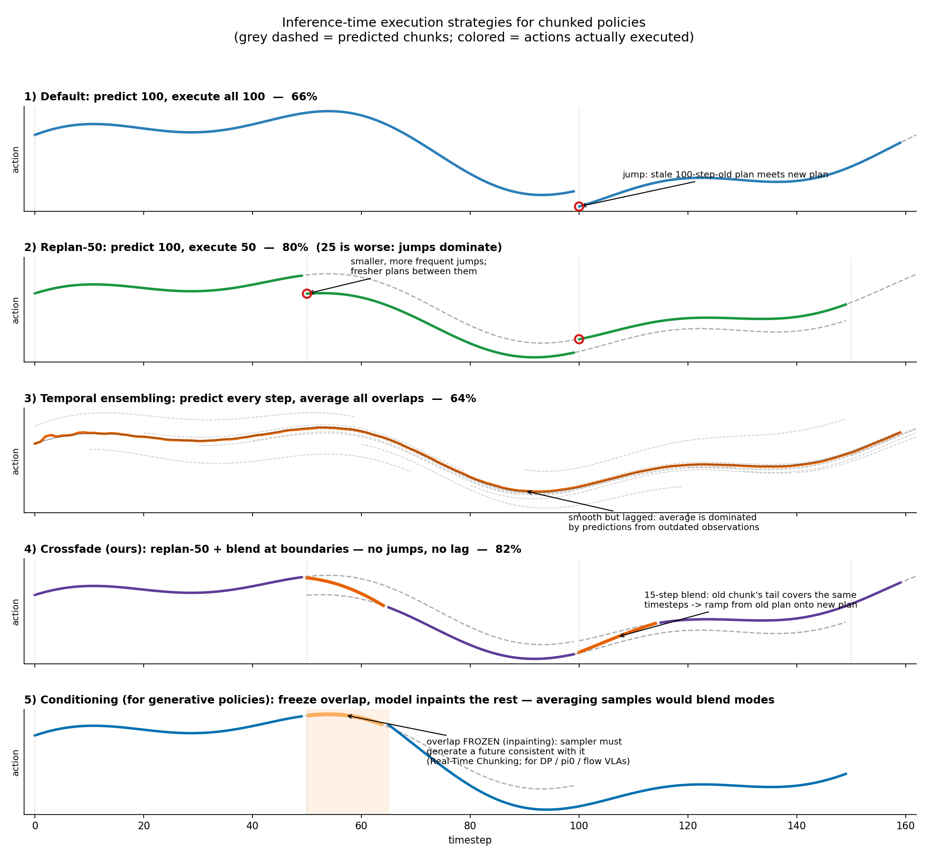
How the execution strategies differ

Slide 7

Closed-loop rollouts — champion config, held-out seeds
• every experiment saves 10 rollout videos — failures are debuggable, not just countable

Slide 8
Does it hold up? — the slide most demos skip
config | dev seeds | held-out seeds
ACT 20k, default | 66% | 74%
ACT 20k, champion | 82% | 76%
ACT 80k, default | 68% | 76%
ACT 80k, champion | 82% | 88%
• 4× more training barely moved default inference (~70→72%) — the inference research was worth more (+13).
• Dev gain (+16) shrank on held-out seeds at 20k: 50-episode evals carry ~7% std — loops must validate on held-out seeds or they overfit the eval.

Slide 9
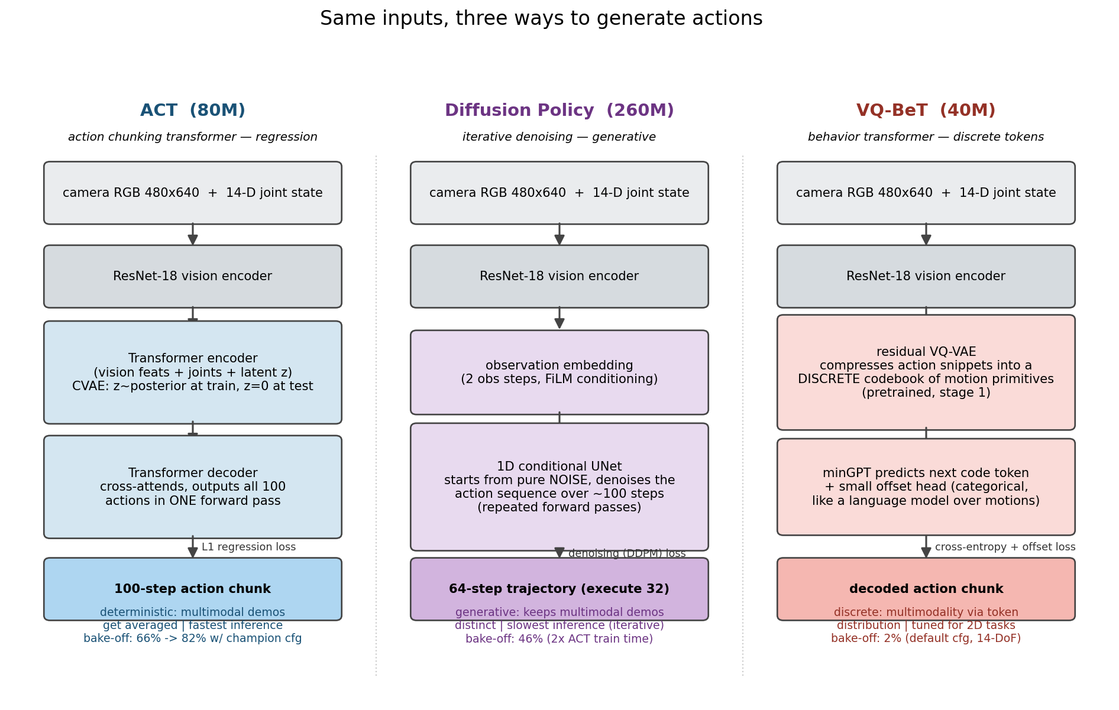
Architecture bake-off — same data, same budget, same eval

Slide 10
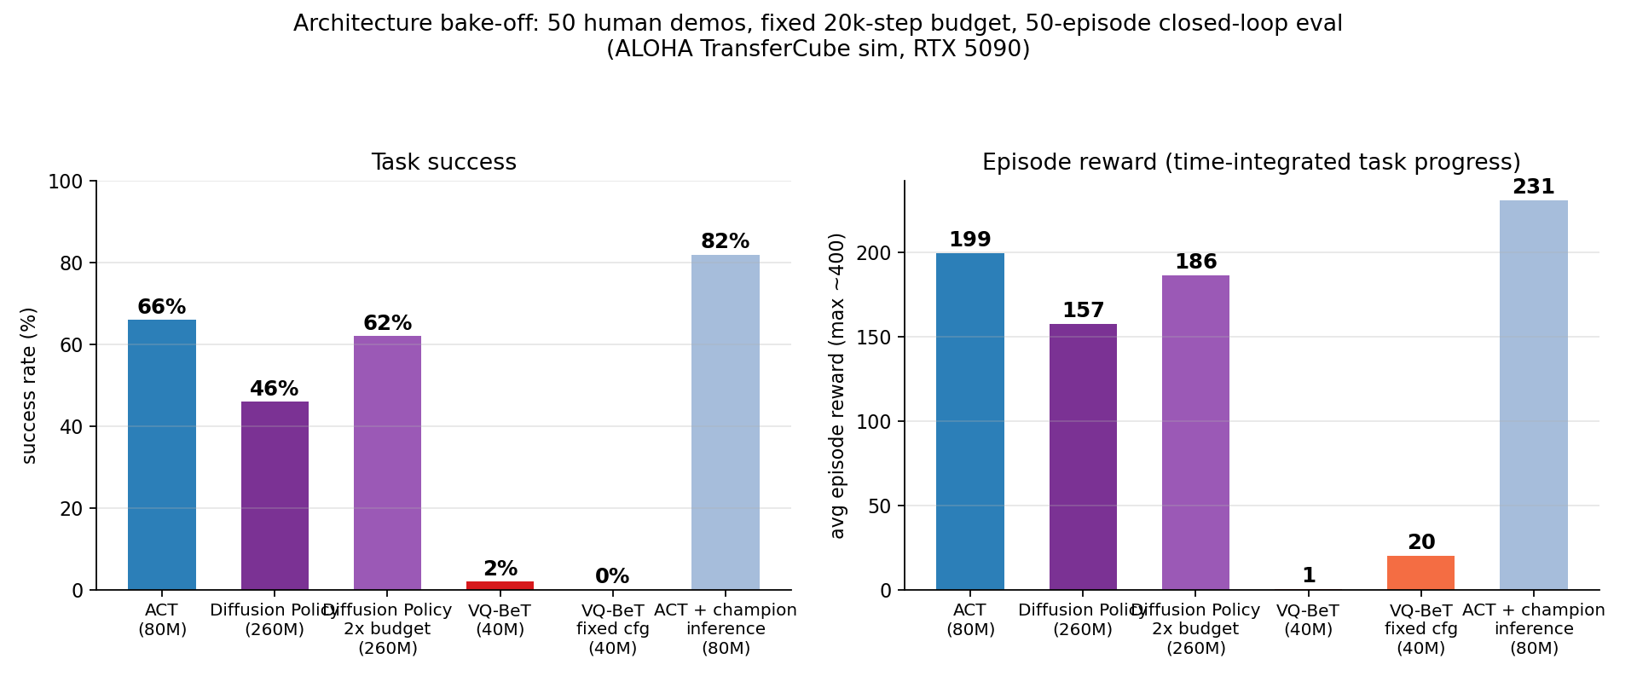
Bake-off results
• DP/VQ-BeT ran library defaults tuned on simpler benchmarks (floor, not ceiling). Follow-ups the loop already chased: DP 2× budget → 62% (+16: it was underfit — ACT wins per unit compute , DP scales with budget) · diagnosed VQ-BeT config fix running.

Slide 11
Scaling out — 2nd GPU over Tailscale + a harder task
• Horizontal scaling: Second RTX 5090 bootstrapped from the public repo in ~10 min (clone → patches → uv install → run); results merge back as git rows.
• New benchmark row (remote): ACT on ALOHA Insertion (peg-in-socket, both arms), same 20k budget: 18% — independently reproduces the ACT paper's ~20%; confirms Insertion as the high-headroom target.
• Diagnosed, fixed, still negative (local): VQ-BeT's 2% traced to an 84×84 crop (2.3% of the frame — nearly blind) and a two-phase schedule where the whole 20k budget trained only the codebook. Fix: reward 0.5→20 (now engages the task) but 0% success — residual failure is structural (15-step horizon, 16-code vocabulary). A negative result with a sharpened hypothesis.

Slide 12
Learnings
• Closed-loop eval is the right loop signal — the wins came from execution-time behavior open-loop loss cannot see.
• At fixed budget, inference-time research beat architecture search (+16 dev / +13 pooled vs −20 for swapping to DP).
• Eval noise is the central methodological issue — conservative keep/revert, dense reward tiebreaker, held-out seeds.
• Defaults don't transfer across embodiments (VQ-BeT: 2% on bimanual with PushT-tuned config).
• Agent-as-orchestrator works for robotics : every claim traceable to a git commit + results row + videos.
• Appendix — A1 open-loop vs closed-loop alignment data · A2 smoothing × architecture · A3 mean-vs-mode

Slide 13
What's next
• Harder target: RoboTwin 2.0 — 50 bimanual ALOHA tasks, public leaderboard, baselines at 10-40% under domain randomization.
• Small VLAs in the loop: SmolVLA (450M) fine-tunes on one 5090; pi0-LoRA fits in 32GB.
• Cross-architecture inference research: does crossfade help every chunked policy?
• Overnight run: ~100 train+eval experiments/night at the 20k budget.

Slide 14
A1 Open-loop loss vs closed-loop success: poor alignment
train step | open-loop L1 loss | closed-loop success (dev / held-out)
20k | ~0.11 | 66% / 74%
80k | 0.052 (2.3× better) | 68% / 76% (statistical tie)
• Evidence 1: loss fell for 60k more steps; success didn't move — gradients improved frame imitation, not task completion.
• Evidence 2: all inference configs share frozen weights → identical open-loop loss, yet closed-loop ranged 52→82% . The dimension we mined is invisible to open-loop eval by construction.
• Why: open-loop = "predict the human's action in states the human visited"; closed-loop = "recover in states your own mistakes created". Low loss is ~necessary, far from sufficient.

Slide 15
A2 Which inference smoothing fits which architecture
policy type | output is... | safe smoothing | examples
regression (ACT) | point estimate (cond. mean) | averaging in action space | temporal ensembling, our crossfade
generative (DP, π0, flow VLAs) | one sample of a multimodal dist. | conditioning or selection — never sample-averaging | warm-start / inpainting: RTC (2506.07339); selection: BID (2408.17355)
• Averaging two samples can blend two modes → the invalid in-between action generative models exist to avoid.
• Within "averaging is safe": heavy ensembling lags and hurt (64%); short boundary-only crossfade helped (82%).
• Caveat: our task is near-unimodal — crossfade might also help DP here; a 3-min loop experiment.

Slide 16
A3 Why regression averages modes and diffusion doesn't
• Regression: L1/L2 training is minimized by the conditional mean/median. With "grasp left" and "grasp right" in the demos, the optimal single output is between them — and the average of two valid actions is generally not valid. (ACT's CVAE z mitigates in training; z=0 at inference collapses it.)
• Diffusion: the denoising objective learns the shape of p(action|obs). Sampling starts from noise that lands nearer one mode; each step conditions on the current iterate and commits to that basin — a ball rolling into one of two valleys. One clean strategy out, mush from none.
• Why DP still lost (46% vs 66%): near-unimodal demos, slow-converging training under a fixed budget, PushT-tuned defaults, decoding noise at the precision handoff. Budget hypothesis confirmed : 2× steps → 62% (+16) — most of the gap was underfitting.

Slide 17
Bonus track — mini pi-0.6: learning from labeled failures
• What we did: added pi-0.6 / RECAP advantage conditioning to openpi — a text-only Advantage: positive | negative tag appended to the prompt. Failures aren't discarded; they're labeled, and the model is asked for high-advantage behavior at inference.
• Data: generated a real synthetic LeRobot dataset (UR5 single-arm, 48 episodes) with per-frame advantage labels, then LoRA-finetuned a production pi-0.5 checkpoint on it (one 32 GB 5090).
• Claim: same observation, same task — flipping only the Advantage tag changes the policy's behavior from success to failure. No architecture change.

Slide 18
Pick-and-place in sim: same start, opposite advantage
• Advantage: positive picks the cube and places it in the box (success) · Advantage: negative fumbles and misses (failure) — identical start state.

Slide 19
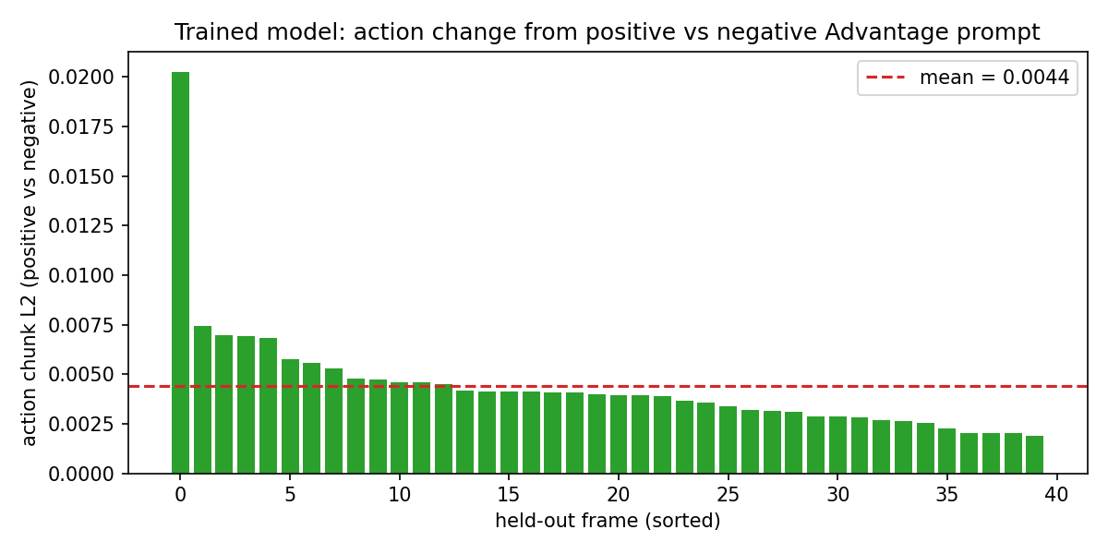
Real trained model conditions on the label
• pi-0.5 LoRA @ 2k steps. On 40 held-out frames, the predicted action chunk shifts between the positive and negative prompt on every frame (mean L2 0.0044) — the model is reading the tag.

Slide 20
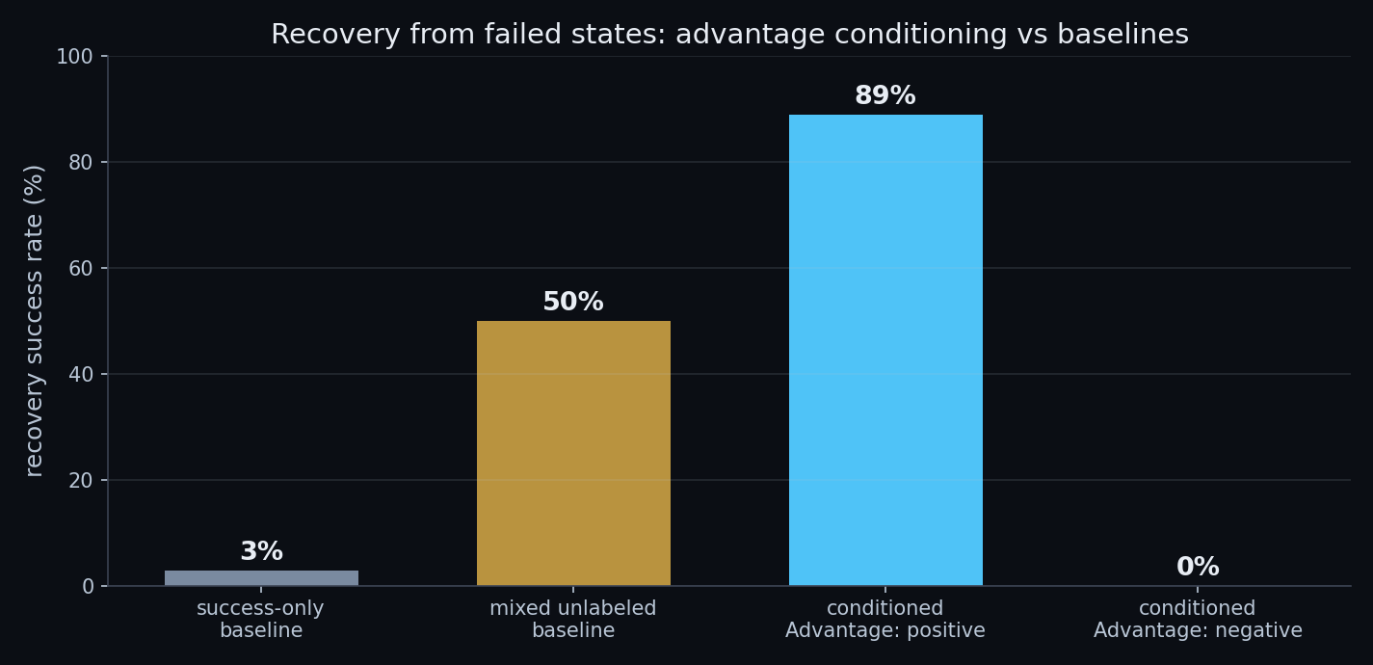
Why the label helps: recovery from failed states
• Controlled mechanism study: with the advantage label, the same model recovers from failure states 88.9% of the time under positive and 0% under negative — vs a mixed unlabeled baseline stuck at 50% (it can't tell success from failure).
• Honest scope: open-loop / controlled-sim evidence of the conditioning mechanism on synthetic data, not a real-robot closed-loop success rate.

