Slide 1
Amazon Movie Reviewer
By: David, Shafeeq, Freddie and Oliver

Slide 2
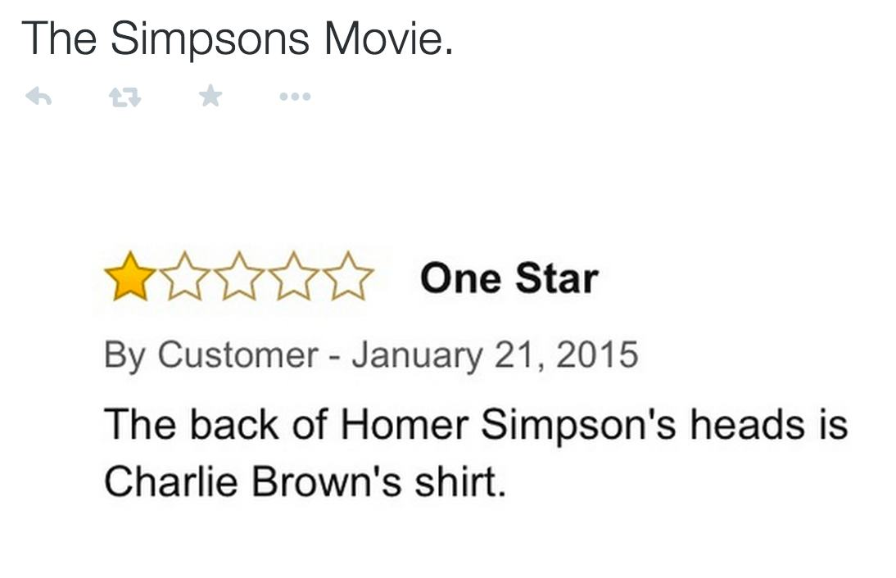

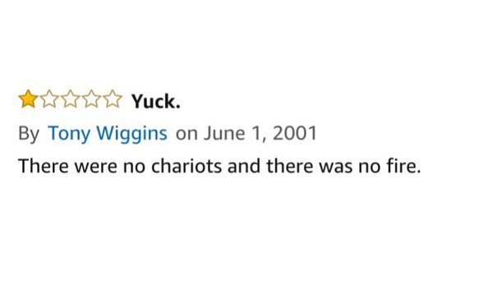
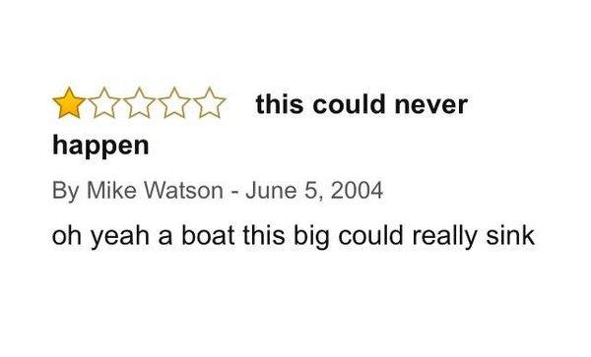
Motivation

Slide 3
About the Project...
Project Objective
Give users a movie recommendation derived from Amazons movie ratings and reviews dataset
Project Scope
The app must be able to run in a reasonably fast time and use little space
A simple GUI allows users to use the functions of the app easily
The use of a cloud server allows greater power for our app

Slide 4
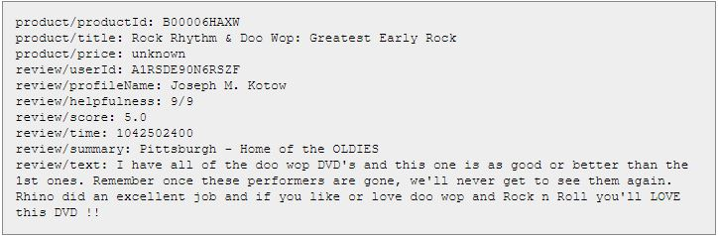
The Data Set...
Dataset statistics
Number of reviews | 7,911,684
Number of users | 889,176
Number of products | 253,059
Users with > 50 reviews | 16,341
Median no. of words per review | 101
Timespan | Aug 1997 - Oct 2012
Over ...

Slide 5

Requirements Specification...
Functional:
Accept Product ID as input
Output 2 reviews with the highest helpfulness rating
Output other movies which these reviewers have rated highly
Non-Functional:
Reliable
Robust
Performance
Human-Computer interface issues
Integrity
Accuracy of Results

Slide 6
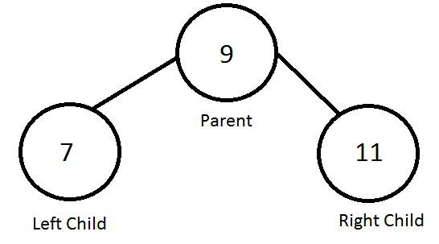
Design Specifications
Algorithmic Challenges:
Insertion Sort
Binary Search
Binary Search Tree
Input:
Product ID (the Amazon Standard Identification Number)
Output:
If Movie is in dataset;
2 Highest rated reviews for that movie
Other movies by users who made the 2 highest helpfulness rating

Slide 7
Methods of Verification and Validation...
Blackbox testing
Whitebox testing with the implementation of Junit test
Static testing in the early product development
Dynamic testing with various inputs
GUI testing

