Slide 1

PageRank算法
我们毕业啦
其实是答辩的标题地方
答辩人：闫增辉
NORTHWESTERN POLYTECHNICAL UNIVERSITY

Slide 2
1.历史发展
(1) 分类目录
(2) 文本检索
(3) 文本检索
NORTHWESTERN POLYTECHNICAL UNIVERSITY

Slide 3
2.算法思路
给每个网页一个PageRank（以后简称为PR）值。
通过投票算法不断迭代，直至达到平稳分布为止。
NORTHWESTERN POLYTECHNICAL UNIVERSITY

Slide 4
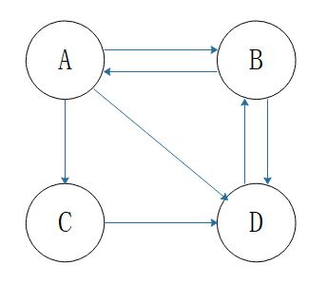
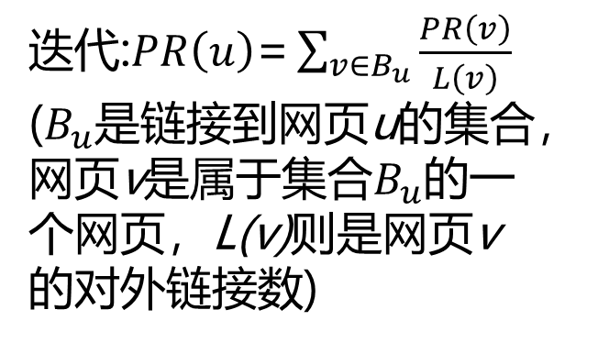

2.算法思路
初始: $\frac{1}{N}$ (N为网页总数)
迭代:$PR\left(u\right)\text{=}\sum_{v∈B_{u}}{\frac{PR\left(v\right)}{L\left(v\right)}}$
($B_{u}是$链接到网页u的集合，网页v是属于集合$B_{u}$的一个网页，L(v)则是网页v的对外链接数)
NORTHWESTERN POLYTECHNICAL UNIVERSITY

Slide 5
2.算法思路
# 测试代码
let iter = function(A, B, C, D, times) {
let newA = A,
newB = B,
newC = C,
newD = D;
for (let i = 0; i < times; i++) {
newA = B/2;
newB = A/3+D/1;
newC = A/3;
newD = A/3+B/2+C/1;
A = newA;
B = newB;
C = newC;
D = newD;
}
return [A, B, C, D];
}
1次
iter(0.25, 0.25, 0.25, 0.25, 1)
结果：[0.125, 0.333, 0.083, 0.458]
100次
iter(0.25, 0.25, 0.25, 0.25, 100)
结果： [0.200, 0.400, 0.067, 0.333]
10000次
iter(0.25, 0.25, 0.25, 0.25, 10000)
结果：[0.200, 0.400, 0.067, 0.333]
A | B | C | D
0.125 | 0.333 | 0.083 | 0.458
0.200 | 0.400 | 0.067 | 0.333
0.200 | 0.400 | 0.067 | 0.333
NORTHWESTERN POLYTECHNICAL UNIVERSITY

Slide 6
谢谢

