Slide 1
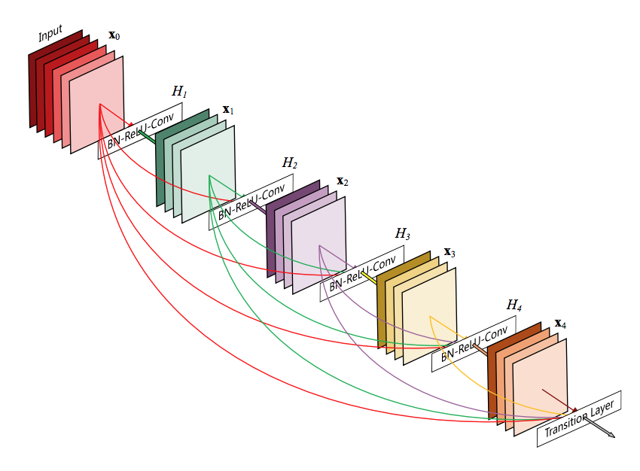
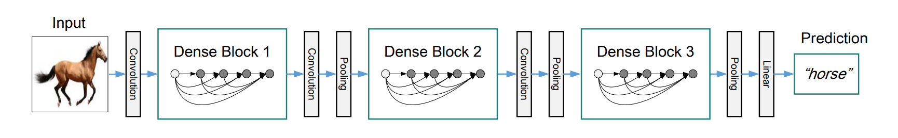
learning_rate, weight_decay,
num_epochs, factor ...
Bayesian Optimization
test accuracy
Input
Output

