Slide 1
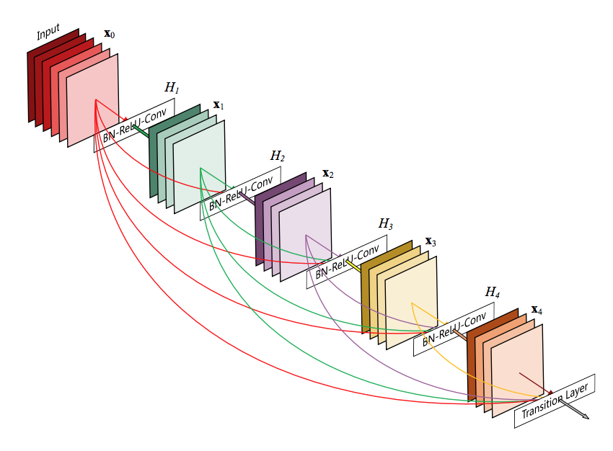
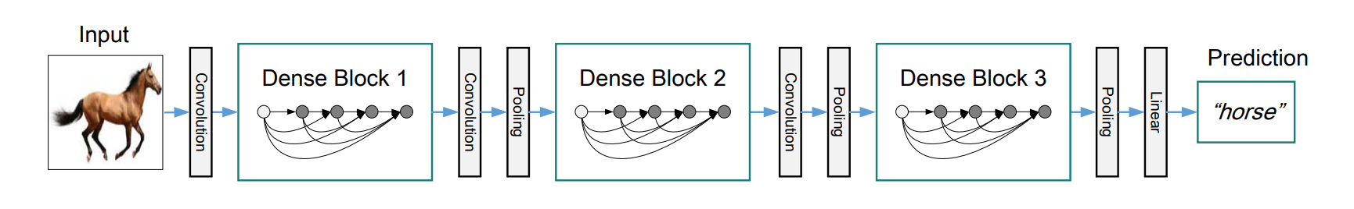
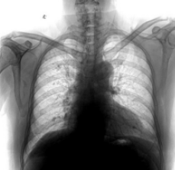
Bayesian Optimization
Optimize over
Learning rate
Weight decay
Number of epochs
Sampling ratio
Optimized
test accuracy
Disease
type

