Slide 1
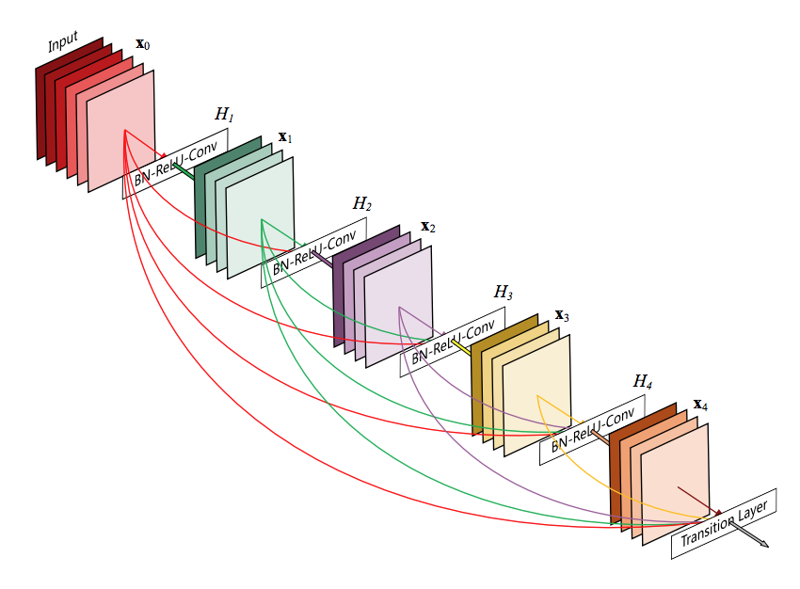
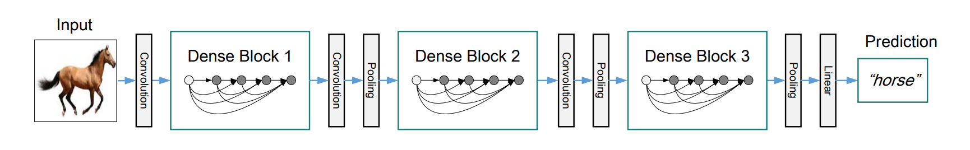
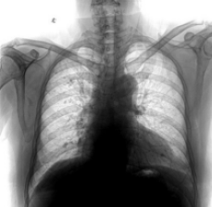
Hyperparameters
Learning rate
Weight decay
Number of epochs
Sampling ratio
Bayesian Optimization
Test accuracy
Disease
type

