Slide 1
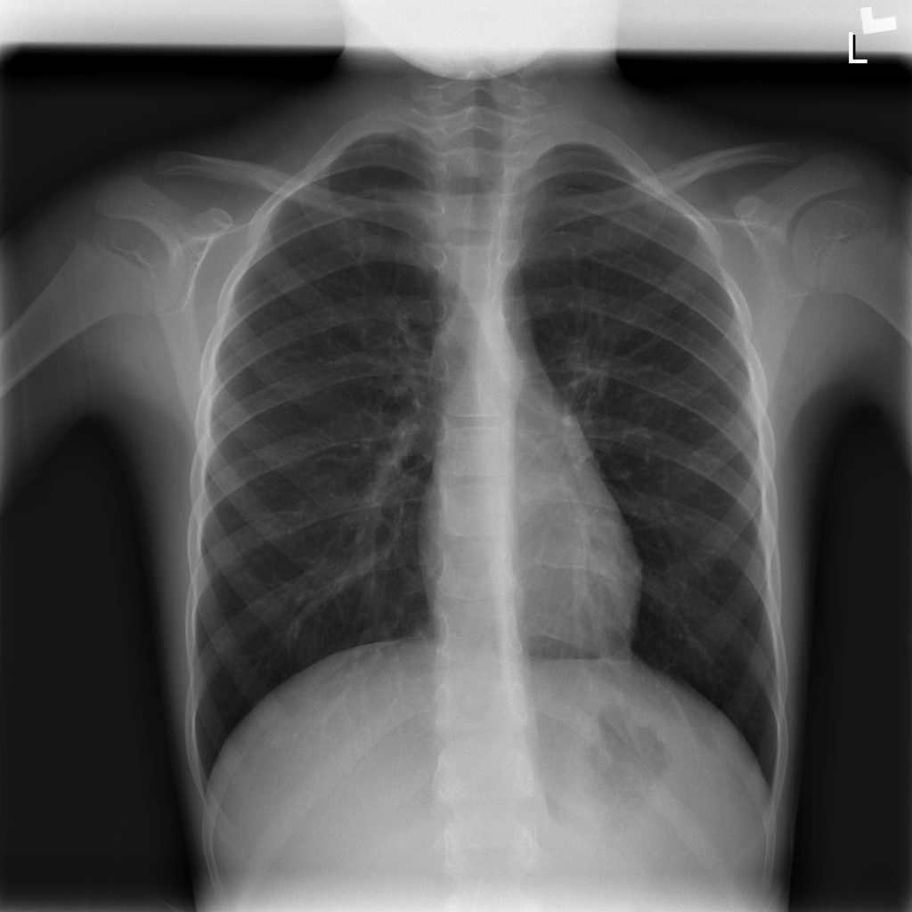
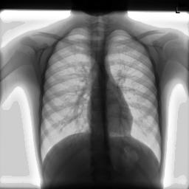
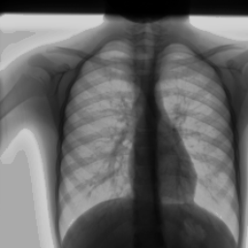
Pre-processing:
Improve contrast: EH + MinMax + Invert
Down sampling 1024 -> 256
Duplicate channels 1 -> 3
Data augmentation:
Random crop 224 -> resize 256
Rotation, Flip with probability
Brightness

