Slide 2
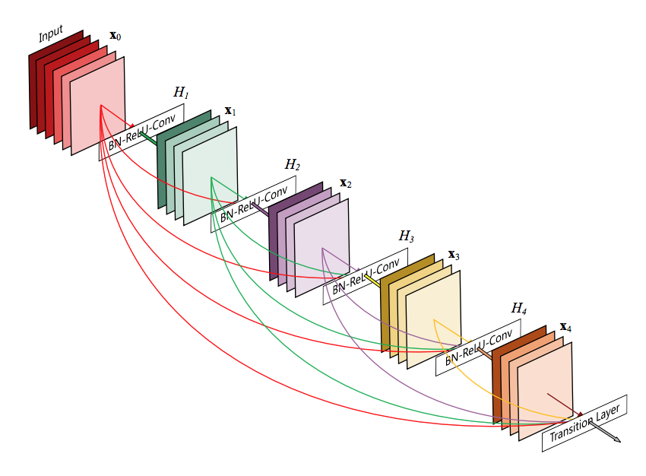
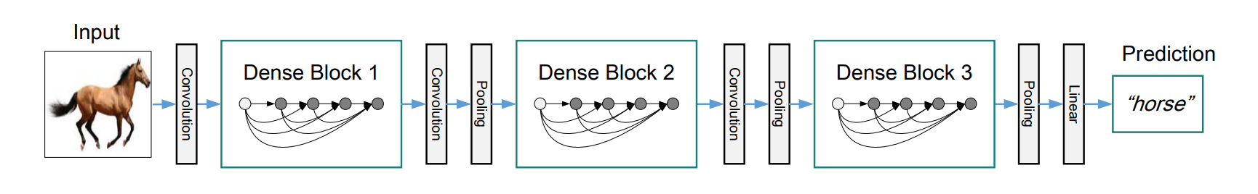
Optimize over parameters: learning_rate, weight_decay, num_epochs, factor ...
Bayesian Optimization
Improve objective value: test accuracy
Input
Output

