Slide 1
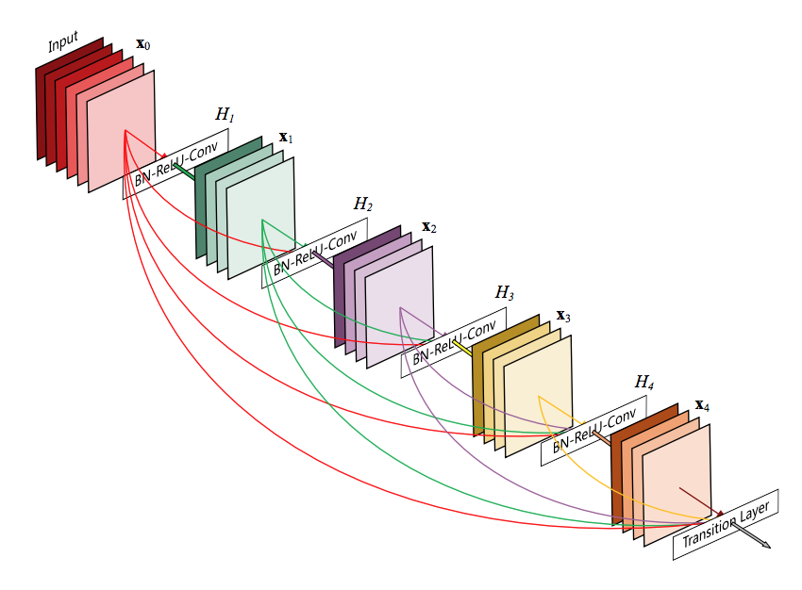


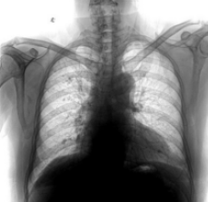
Bayesian Optimization
Learning rate
Weight decay
Number of epochs
Sampling ratio
Test
accuracy
Disease
type

