Slide 1
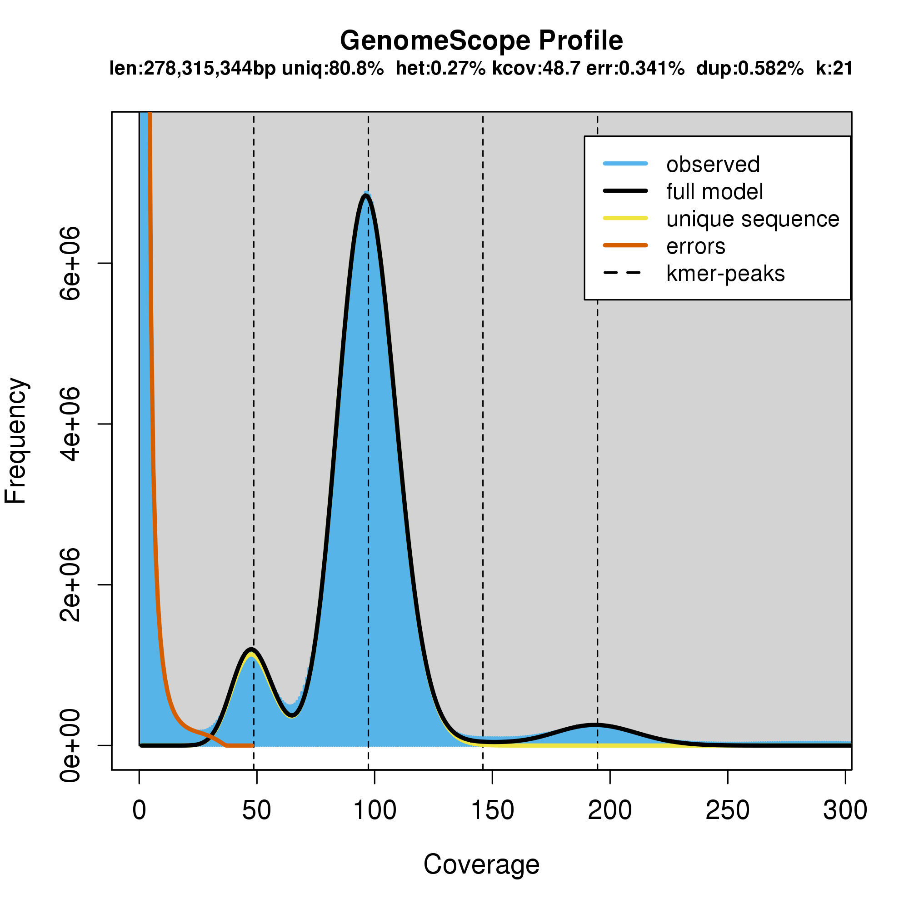
Genome length/size unique percent heterozygosity kmer coverage error rate duplications rate kmer
(not repetitive) of reads of reads
错误峰
Error-peak
纯合峰
Homo-peak
杂合峰
Hetero-peak
重复序列峰
Repetitive peak

