Slide 1

Predicting Student Dropout Risk
Isabella Marashi
Kubra Abbrasova
Tseveengerel Amgalan
Yan Zhuang

Slide 2
Objective: Predicting students at risk of dropping out.
Why It Matters:
Impacts academic success and financial stability.
Enables proactive intervention and resource planning.
Guiding Questions:
What factors are most predictive of dropout?
Can we uncover useful patterns and student segments?
How accurate and interpretable are the models?

Slide 3
Data Overview
Target Variable
y: Student dropout status( yes/no)
01
Key Predictors:
02
Academic: Admission grade, 1st & 2nd semester grades
Economic: Unemployment rate, Inflation rate, GDP
Demographic/Admin: Gender, Scholarship holder, Tuition status, Attendance mode
Preprocessing:
03
Convert categorical variables as factors
Standardized continuous features
Split: 70% Training | 30% Testing

Slide 4

Methodology
Methods Used:
Logistic Regression
Predicted dropout using academic, financial, and demographic factors.
Classification Trees
Identified key predictors like grades and tuition status.
Principal Component
Reduced data to key components for simpler analysis
K-Means Clustering
Grouped students into two distinct profiles.

Slide 5
Logistic Regression
Strong Model Fit: low AIC (2484) indicate a well-fitting model.
Balanced Performance: Positive predictive value = 83.3%, negative predictive value = 85.2%.
No Multicollinearity: All VIFs < 5; academic grades showed acceptable correlation.
Top Predictors of Negative Outcomes: 1. Tuition not up to date → strongest risk factor (odds ratio = 0.069). 2. No scholarship and evening attendance also linked to higher risk. 3. Low 2nd semester grades and lower admission grades increase dropout likelihood. High Predictive Power: AUC = 0.87; accuracy = 84.7%, sensitivity = 65.5%, specificity = 93.8%.

Slide 6
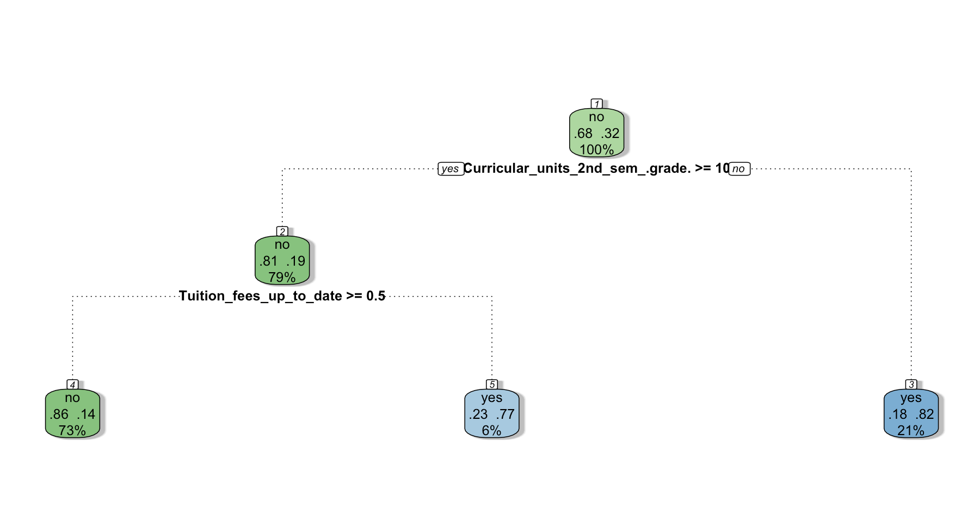
Classification Tree
Key Takeaways:
3 leaf nodes
Academic Performance is Key: Second semester grades were the most important predictor of student outcomes.
High-Risk Group Identified: Students with grades below 10 had an 82% chance of a negative outcome.
Tuition Status Matters: Among high-performing students, those current on tuition had an 86% chance of success, while those behind had a 77% chance of a negative outcome.
Early Intervention Tool: The model is reliable for identifying low-risk students and reasonably effective at flagging at-risk students, making it useful for targeted support.

Slide 7
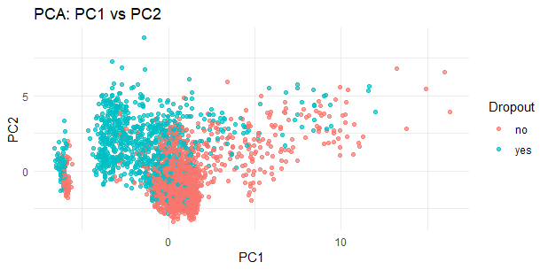
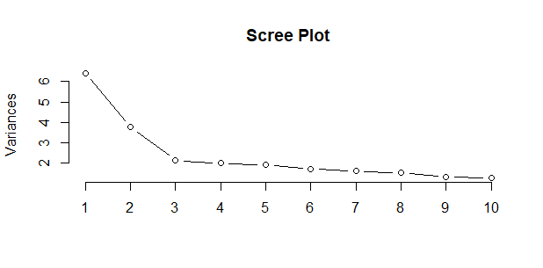
Principal Component Analysis
Overview
Objective: Understand data structure and explore dimensionality reduction
Dataset: 37 numeric predictors, including outcome (dropout)
Split: 70% training / 30% testing for model validation
Results
PC1 variance explained: 17.3%
PC2 variance explained: 10.2%
Cumulative (PC1–PC17): ~81% of total variance
PC1 (Academic performance):
Curricular units approved, enrolled, evaluated, credited, and admission grades
PC2 (Demographic/Administrative):
Age, application mode, enrollment, marital status, displaced or attending classes during the day or evening
PC3 (Administrative):
Parental education and occupations, the student's admission grade

Slide 8
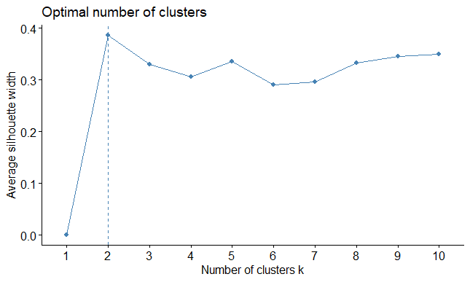
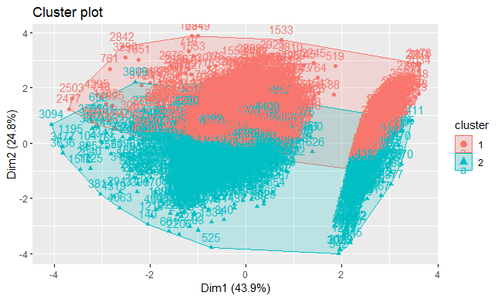
Clustering
Overview
Admission grade
Age at enrollment
Curricular unit 1st semester approved
First semester grade
Clustering Summary
2 Clusters:
Cluster 1 (n = 1808), Avg. Silhouette = 0.31
Cluster 2 (n = 2596), Avg. Silhouette = 0.41
3 Clusters:
Cluster 1 (n = 2212), Avg. Silhouette = 0.43
Cluster 2 (n = 1312), Avg. Silhouette = 0.22
Cluster 3 (n = 880), Avg. Silhouette = 0.25
Cluster 1: 1,808 students
Cluster 2: 2,596 students

Slide 9
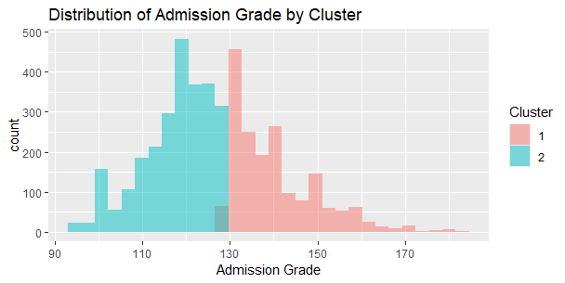
Clustering
Variable | Cluster 1 | Cluster 2
Admission Grade | 140.24 | 117.60
Age at Enrollment | 23.38 years | 23.07 years
Curricular Units Approved (1st Sem) | 4.94 | 4.51
Grade Average (1st Sem) | 10.96 | 10.40

Slide 10
Conclusion & Findings
Tuition status and grades are the most important factors in predicting dropout.
Students with low grades and unpaid tuition are most at risk.
Our models can help schools spot these students early.
Early support can improve student success and retention.
With the right data and early action, schools can help more students stay enrolled and succeed.

Slide 11

THANK YOU!

