Slide 1

Paper Replication: Empirical Asset Pricing via Machine Learning
Chan Wing Chun
https://www.youtube.com/watch?v=u5s7br2Ijbo

Slide 2


Machine Learning
Big data helps us to obtain sufficient information to carry out analysis.
Machine learning serves as the tool to conduct the analysis.
Credits: https://1on1.today/blog/big-data-applications/
Credits: https://becominghuman.ai/an-introduction-to-machine-learning-33a1b5d3a560?gi=ba52436eaede

Slide 3
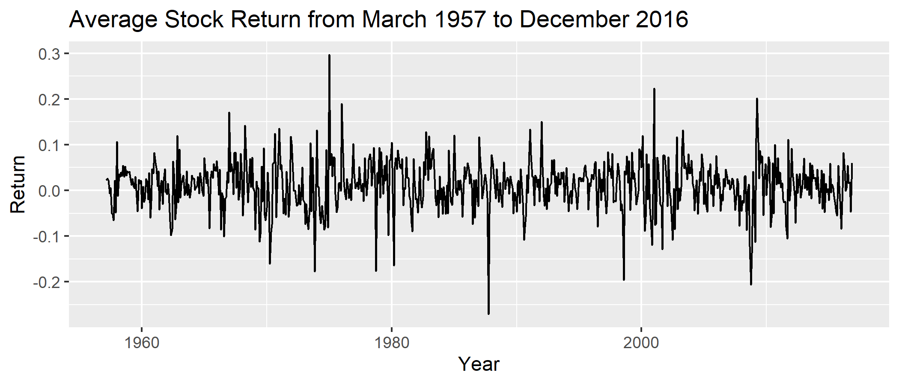
Data in Finance
A common type of data we study in Finance is the returns of stock.
In our analysis, we consider the monthly equity returns of around 30,000 stocks from March 1957 to December 2016.
We would like to predict the equity returns with of 94 stock level predictive characteristic and 8 macroeconomic predictors.

Slide 4

Tools to study Financial data
In our study, we would like to find out which machine learning techniques perform the best in predicting the future stock price.
In our analysis, we would like to use R instead of Python.
Credits: https://www.geeksforgeeks.org/7-best-r-packages-for-machine-learning/

Slide 5
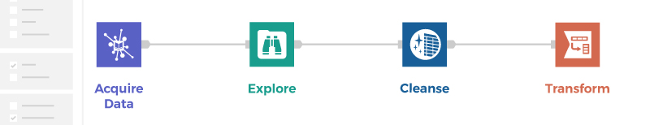
Data Preparation
94 stock level predictive characteristic and 8 macroeconomic predictors .
Due to limitation on computation power, we selected those predictors with less than 10% of overall missing rate. 19 predictors are left.
We impute the missing by the median.
These predictors are transformed so that they are bounded between -1 and 1.
Credits: https://www.alteryx.com/glossary/data-preparation

Slide 6
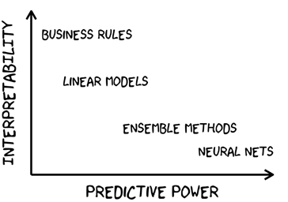
Machine Learning Technique
We have selected 6 different approaches to predict the future stock price.
Ordinary least square (OLS),
Case 1: All covariates.
Case 2: Preselects size, book-to-market, and momentum as the only covariates,
Elastic net (ENet),
Principal components regression (PCR)
Partial least squares (PLS),
Gradient boosted regression trees (GBRT), and
Random Forest (RF).
Credits: https://medium.com/manomano-tech/improve-business-decisions-with-three-machine-learning-interpretability-tools-bb2021fa1d11

Slide 7
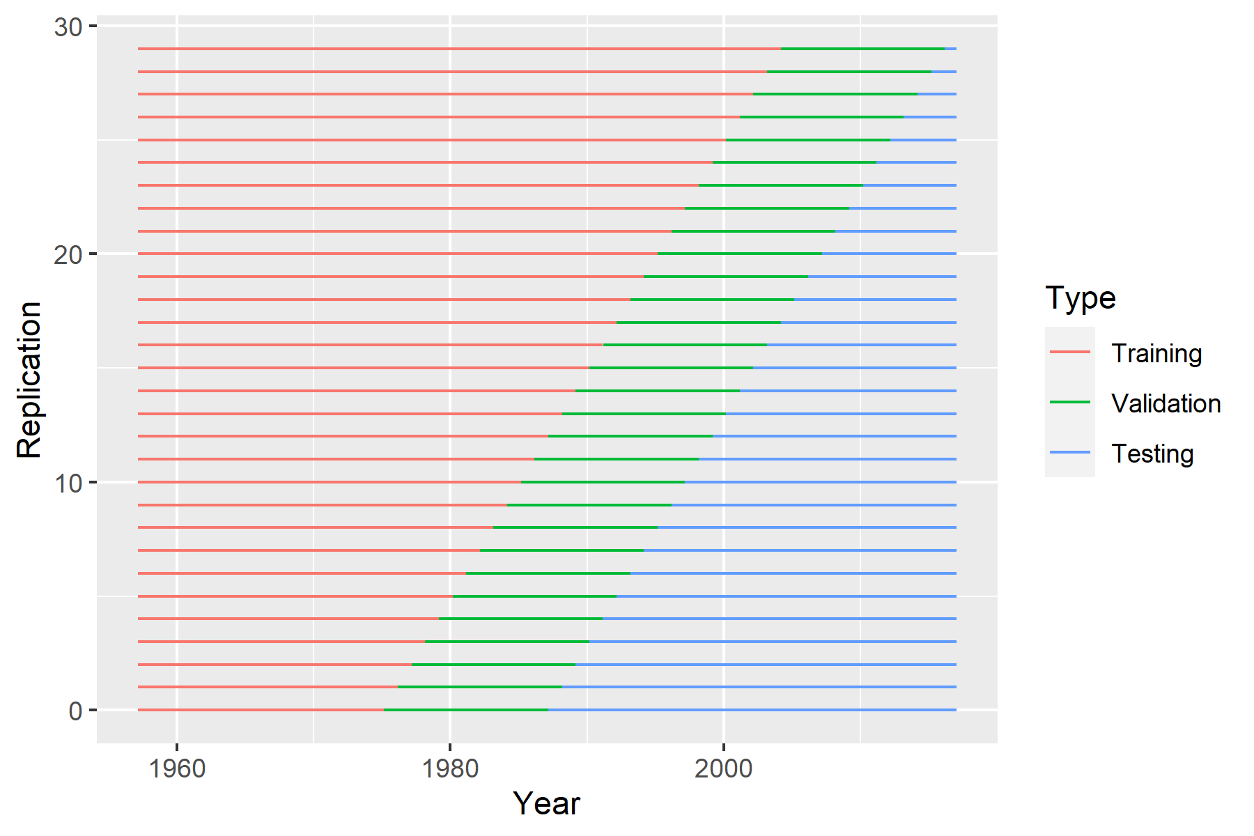
Data Splitting
Rolling sample analysis
First 18 years of training, next 12 years of validating, and last 30 years + of testing.
Repeat the experiment by including one more year of training and shifting the validation by one year until we have used up all the data.
First 19 years of training, next 12 years of validating, and last 29 years + of testing.
First 20 years of training, next 12 years of validating, and last 28 years + of testing.
…

Slide 8
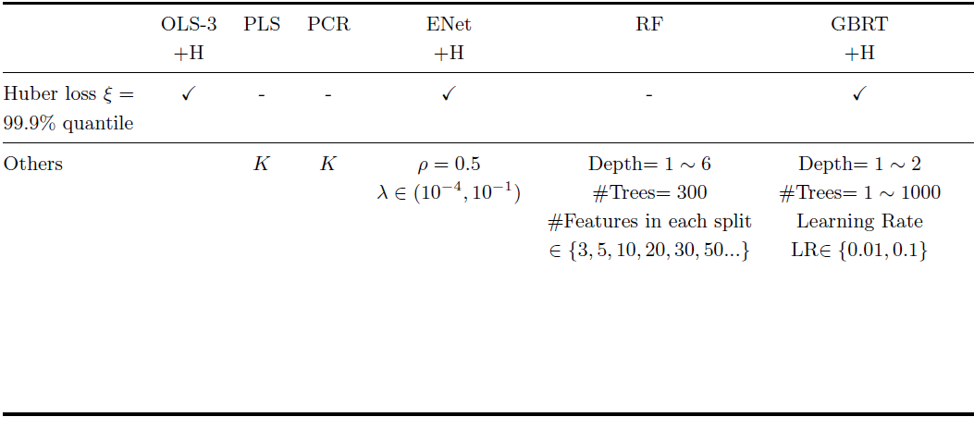
Hyperparameter Tuning
Following the suggestion in the appendix of Gu, S., Kelly, B., & Xiu, D. (2020), we use our validation data to select the best model.
”+H” in the following figure means that we have used a robust objective function: Huber loss in our analysis.
Credits: Gu, S., Kelly, B., & Xiu, D. (2020)

Slide 9
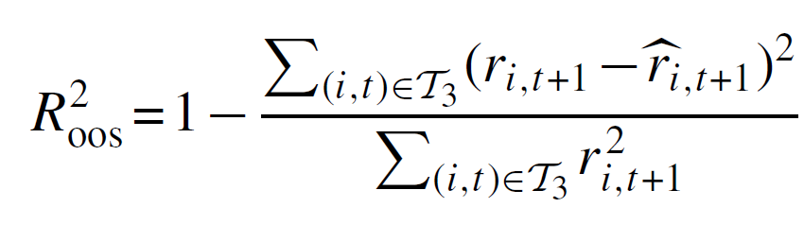
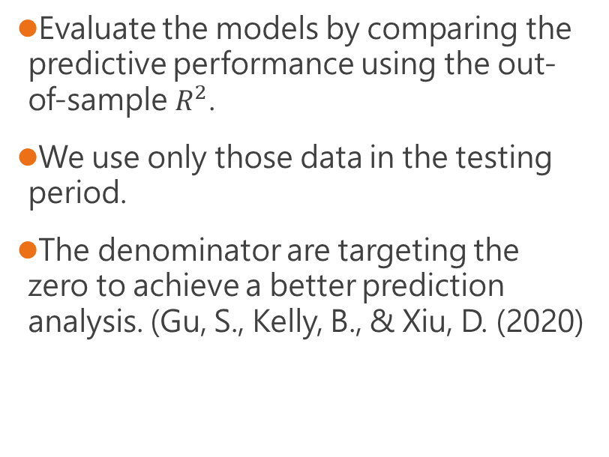
Prediction Analysis
Evaluate the models by comparing the predictive performance using the out-of-sample $R^{2}$.
We use only those data in the testing period.
The denominator are targeting the zero to achieve a better prediction analysis. (Gu, S., Kelly, B., & Xiu, D. (2020)
Credits: Gu, S., Kelly, B., & Xiu, D. (2020)

Slide 10
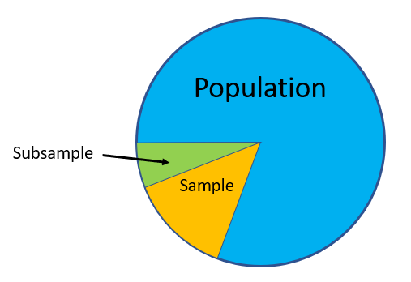
Sample of choice
We consider three sample of choices.
All stocks,
Top 1000 in market value only, and
Bottom 1000 stocks in market value only.
Credits: https://www.statisticshowto.com/subsample-definition/

Slide 11
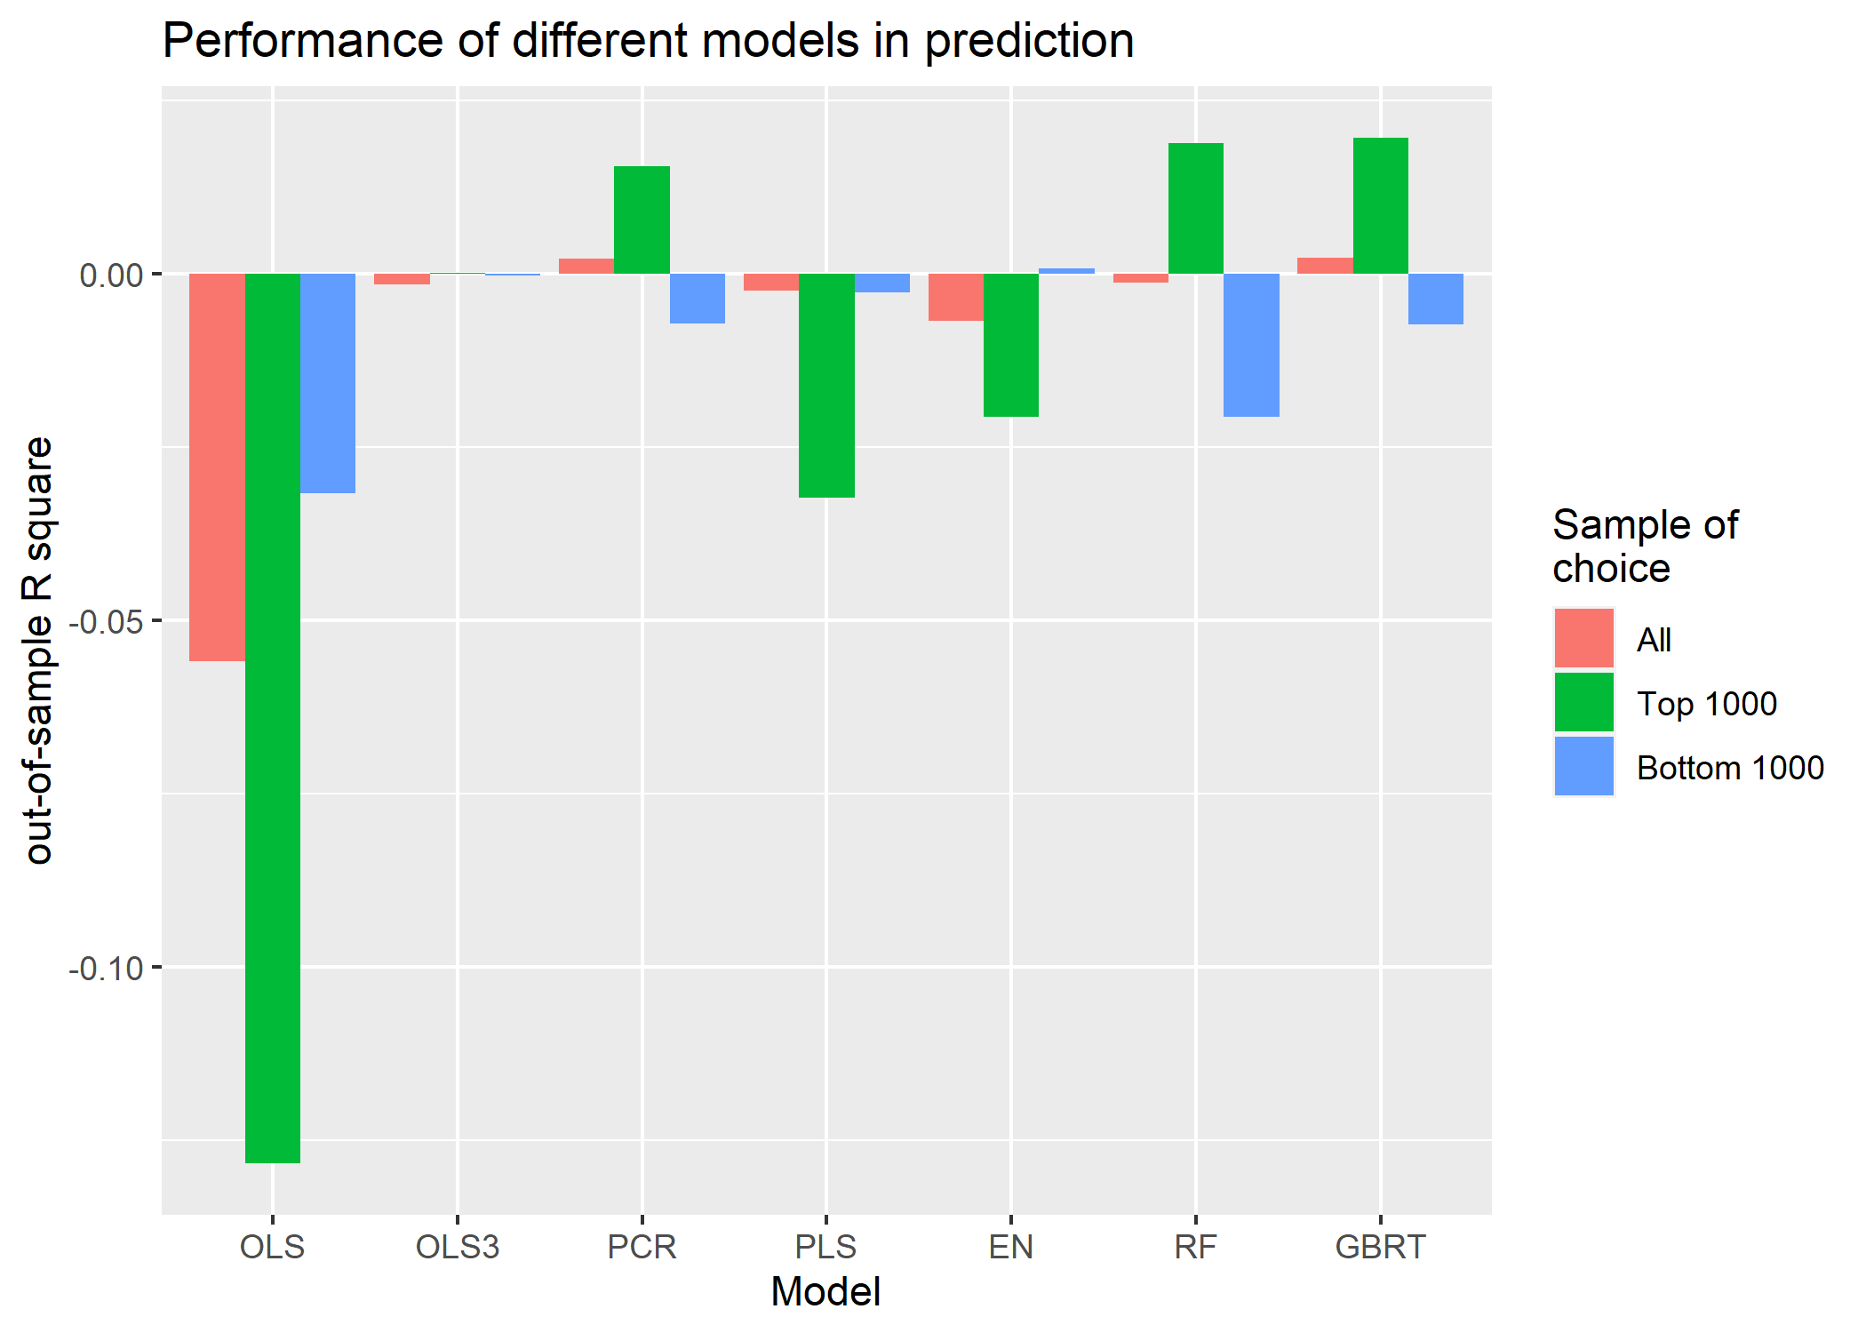
Prediction Result
All stocks
Best: Gradient boosted regression trees
Worst: Ordinary least square
Top 1000
Best: Gradient boosted regression trees
Worst: Ordinary least square
Bottom 1000
Best: Elastic Net
Worst: Ordinary least square

Slide 12
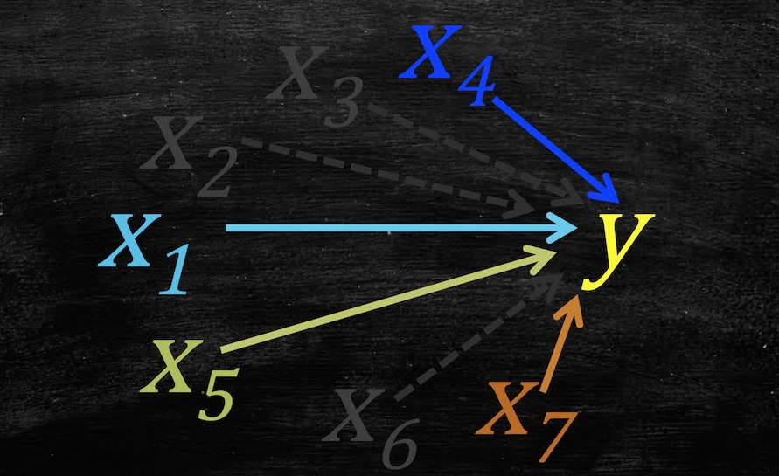
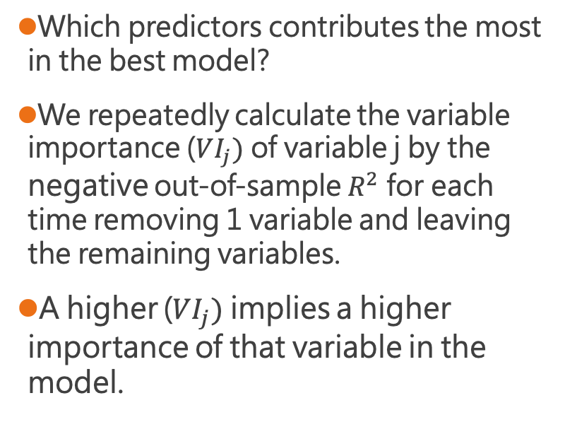
Variable Importance
Which predictors contributes the most in the best model?
We repeatedly calculate the variable importance ($VI_{j})$ of variable j by the negative out-of-sample $R^{2}$ for each time removing 1 variable and leaving the remaining variables.
A higher ($VI_{j})$ implies a higher importance of that variable in the model.
Credits: https://www.youtube.com/watch?v=tPykSMHpgHw

Slide 13
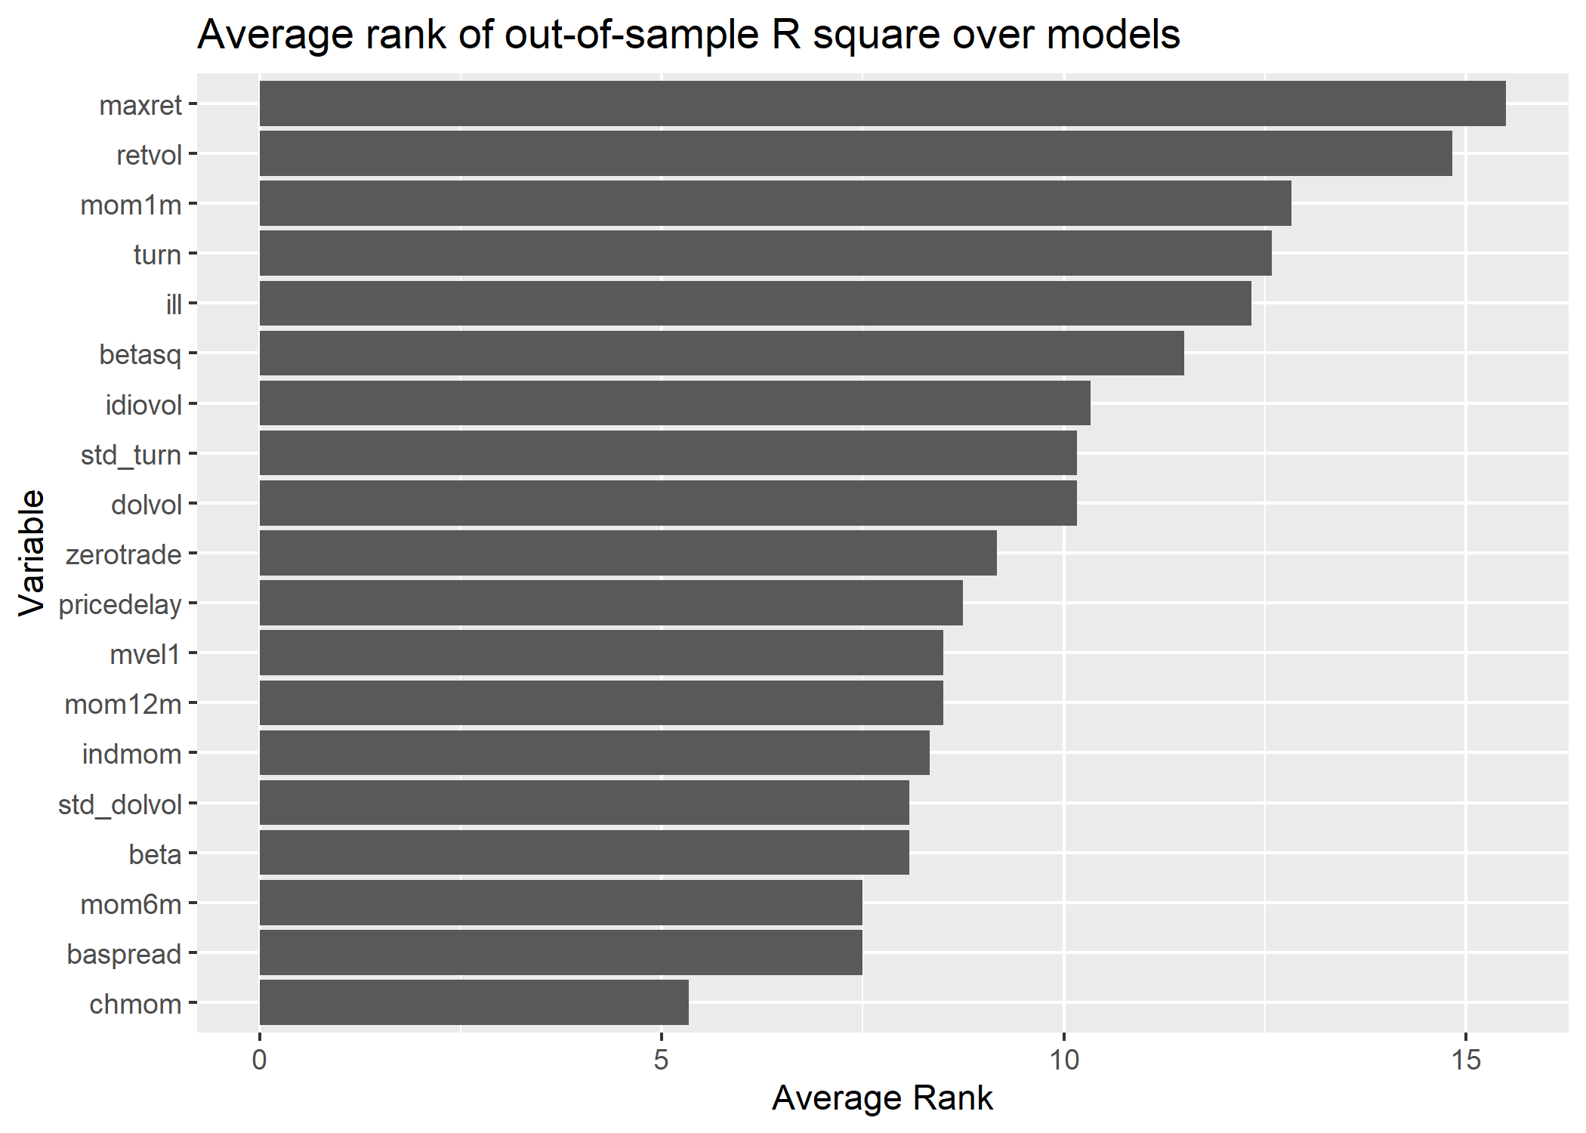
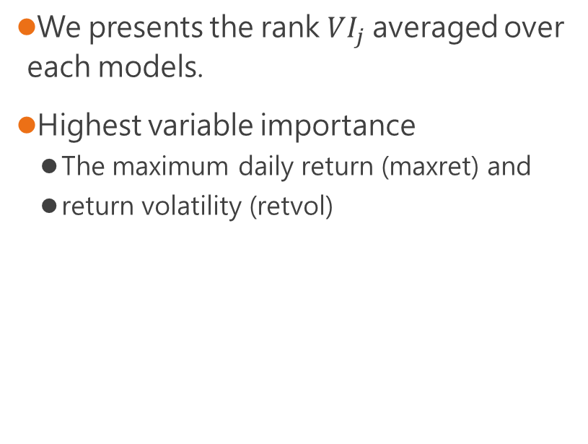
Variable Importance
We presents the rank $VI_{j}$averaged over each models.
Highest variable importance
The maximum daily return (maxret) and
return volatility (retvol)

Slide 14
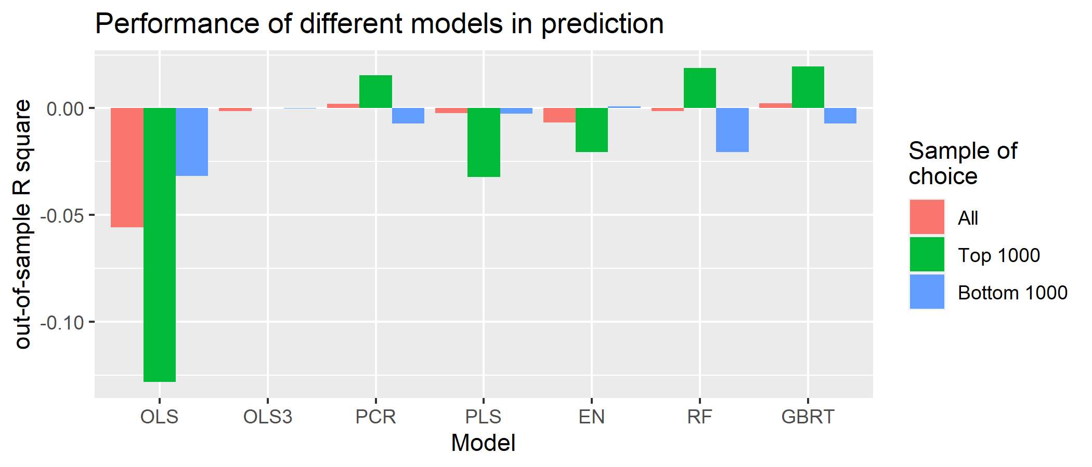
Discussion
GBRT took the longest time in training, followed by RF.
Taking more time in training a model would give a better prediction performance.
An exceptional case would be the PCR in the subsample of top 1000 stocks.
The two most important variables are related to the variation of returns in the last month.
The fluctuation of returns characterized the data.

Slide 15
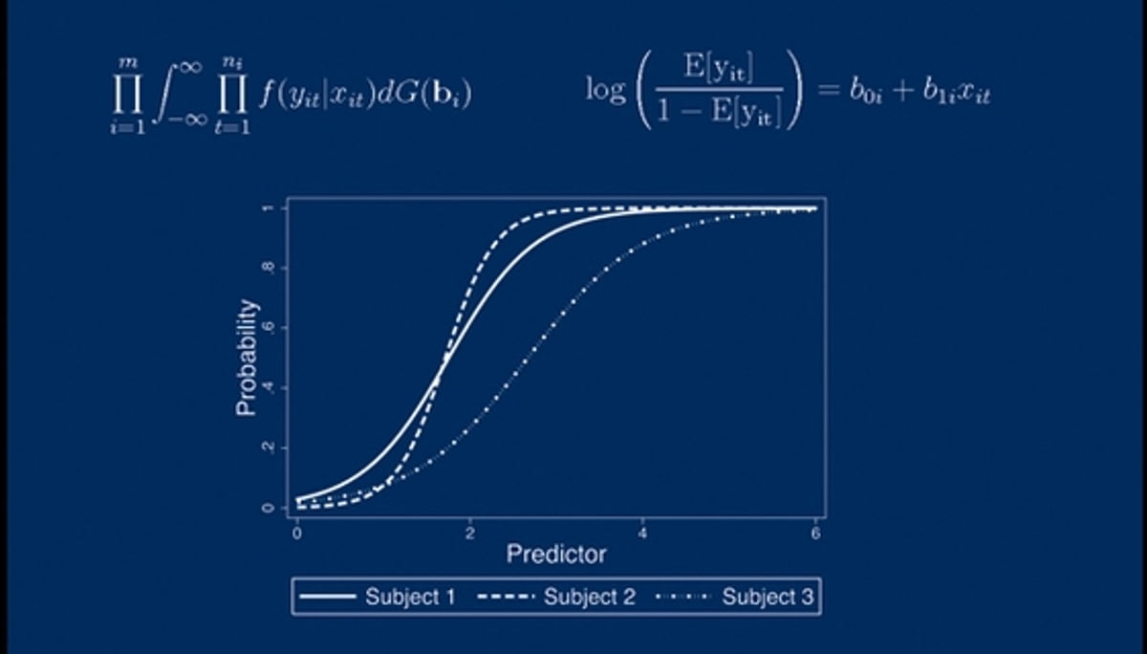
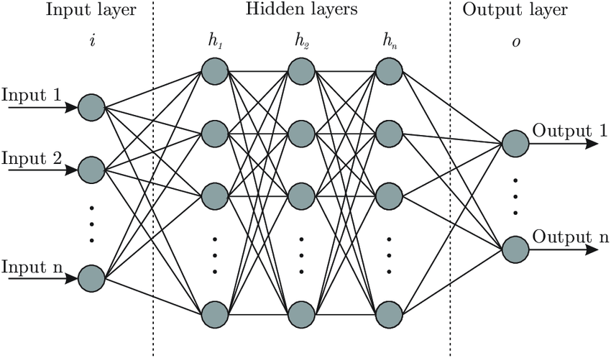
Conclusion
Machine learning successfully helps us in predicting the stock prices.
We need to strike a balance between computation time, accuracy, and interpretability.
More models are available (Generalized linear and Neural Network) in literature but not in this study due to the time and manpower constraints.
Credits: https://www.kobo.com/tw/zh/ebook/generalized-linear-and-mixed-models
Credits: https://ithelp.ithome.com.tw/articles/10270932

