Slide 1

Kaggle Contest: Home Credit Default Risk
MATH5470 Project
Hao WU, Yiming ZHU, Jihong TANG, Xian WANG
Notes:
Hello everyone our project topic is Home Credit default risk, and our team members are Hao WU, Yiminng ZHU, Jihong TANG and Xian Wang.

Slide 2

Introduction & Problem Description
Some people are unable to get loans from banks because they do not have enough credit.
Groups with fixed incomes may also not have adequate credit histories.
It can be very time consuming for lenders to look at applicants' historical credit history.
Is it possible to predict in some way the capability of the borrower to repay the loan?
Home Credit provides a large dataset and stimulates researchers to come up with techniques for building predictive models through a Kaggle competition.
Notes:
Some people need to borrow from lenders when they are pursuing education or starting a business, but may not be able to apply for a loan because they do not have sufficient credit history, such as the student population. And as the number of applicants increases, it can be very time-consuming for lending organizations to look at an applicant‘s historical credit history. If the borrower’s repayment ability could be predicted in some way, it would help customers who already have a regular income but lack a credit history. To achieve this, Home Credit provides a large dataset and stimulates researchers to come up with techniques for building predictive models through a Kaggle competition.

Slide 3
Introduction & Problem Description
Supervised Learning Classification Problem
Contains training data points and associated category labels.
Binary Classification
Only positive (1) and negative (0).
Imbalanced Dataset
Defaulters are in the minority of applicants.
We use the ROC AUC metric → The metric is insensitive to category imbalance.
Notes:
This is a supervised learning classification problem that contains training data points and relevant category labels. For a given user data, we need to predict the category labels associated with that client. And this is a binary classification with only positive (1) and negative (0). In addition to that, this is an imbalanced dataset, so we use the ROC AUC metric. The metric is insensitive to category imbalance. It ranks the probability of predicting a positive category label and calculates the area under the ROC curve.

Slide 4
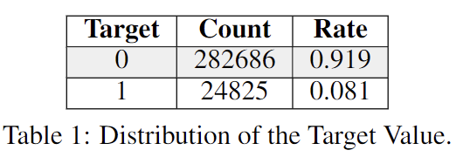
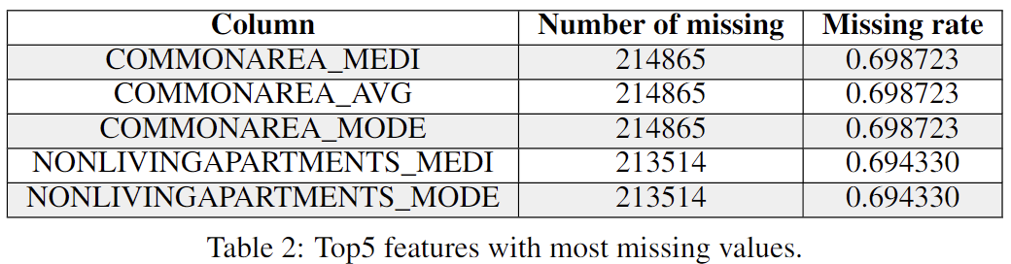
Exploratory Data Analysis (EDA)
Target distribution: significant imbalance
Imbalanced class problem
Weight the classes when training models
Missing values: 67 columns.(121 in total)
Fill in these missing values
Consider about models that can hadle missing values.
Drop those with high missing rate.
Notes:
This analysis aims to find out potential relationship between pridiction target and other features.
We going to present some typical analysis results here.
First, we overviewed the basic information of the whole training data set.
We found that there was a significant imbalance on the distribution of the target label, which may cause imbalanced class problem.
Thus, in the model training process, we will weight the classes by their representation in the data to reflect this imbalance.
Second, we also explored the missing values in each columns.
We found that there are 121 columns in training set but 67 of them had missing values.
Therefore, When building the learning models, we have to fill in these missing values or consider the models such as XGBoost that can handle missing values with no need for imputation.

Slide 5
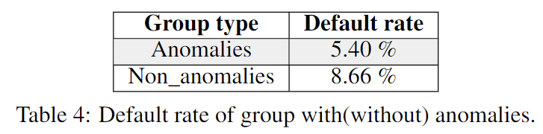
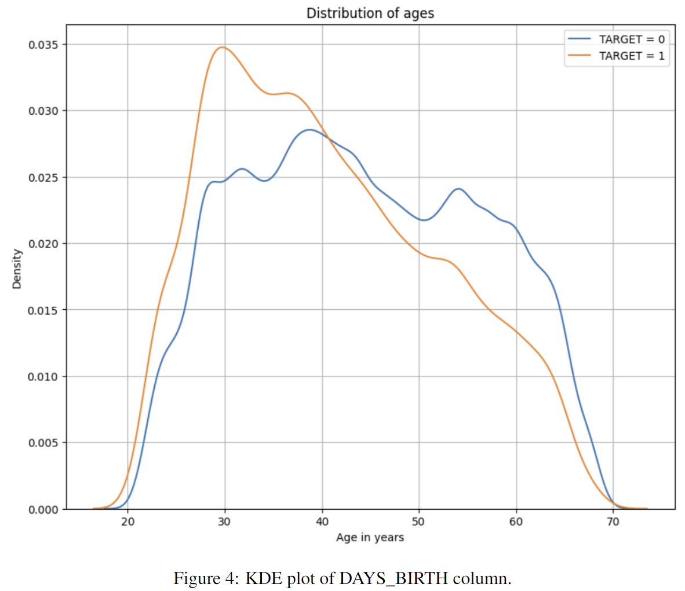
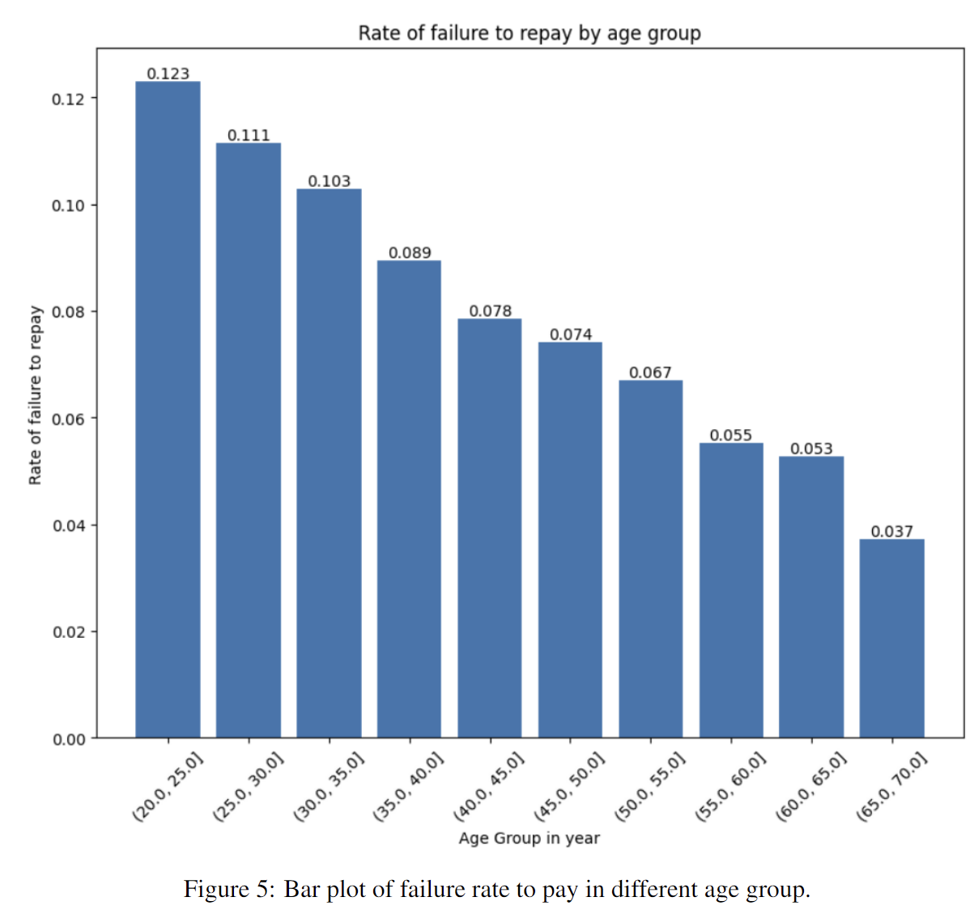
Exploratory Data Analysis (EDA)
Anomalies: Anomalies analysis for high correlated columns. DAYS_EMPLOYED as example:
Value statistics: Max value up to 1000 years.
Group comparison: Anomalies group has lower default rate of loans.
Process: Replace anomalies with np.nan; Add a flag column.
Correlation: Pearson correlation for each columns.
Choose highest-correlation column as example: DAYS_BIRTH
KDE: Target == 1 curve skews towards the younger end of the range.
Bin age data: Younger groups are more likely to not repay the loan.
Notes:
We also analyzed the anomalies for typical columns with high correlationship to the target label.
Here we present Days_employed as an example.
The value statistics shows that this column has the max value up to 1000 years, which is definately impossible in real life.
Before dealing with these anomalies, we made a comparison on two groups with and without outliers.
Suprisely, it shows that Anomalies group has lower default rate of loans.
As for the process, Replace anomalies with np.nan; Add a flag column.
What’s more we also caculate Pearson correlation for each columns
We chooes the columns with highest result to do further analysis.

Slide 6
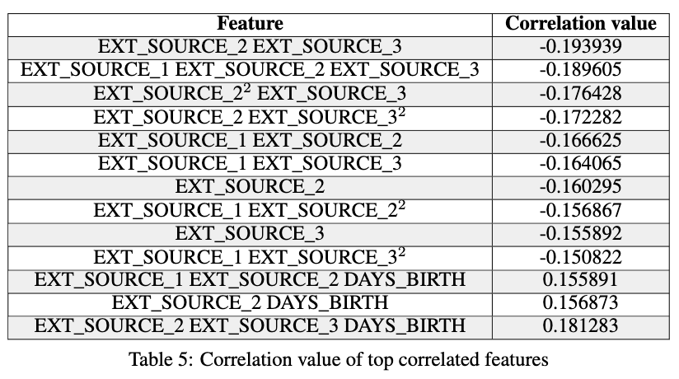
Feature Engineering
Polynomial Methods
Feature Engineering
Aiming at feature construction or feature selection
Inprove the correlation
Prior Knowledge Based Methods
Polynomial Methods
EXT_SOURCE variables and DAYS_BIRTH
Degree of 3
Top 10 negative and 3 positive correlated features

Slide 7
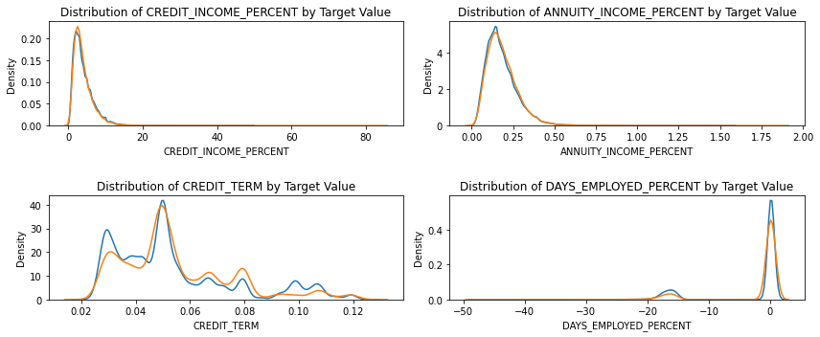
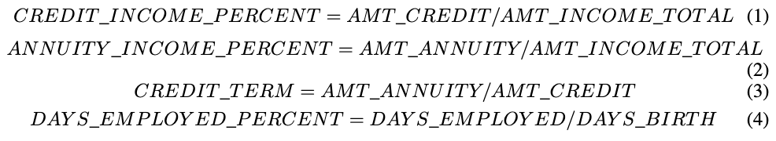
Feature Engineering
Prior Knowledge Based Methods
Finance-based knowledge
Different features generation
CREDIT_TERM

Slide 8
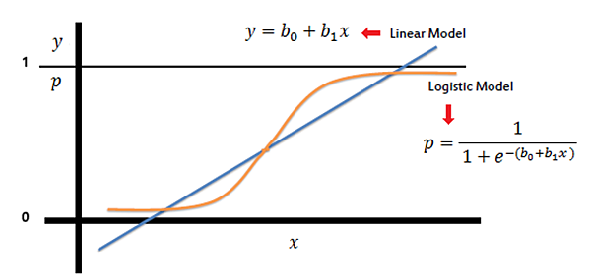
Baseline - Logistic Regression
Baseline
Not good performance
Simple and fast
Private score: 0.68107
Public score: 0.67715

Slide 9
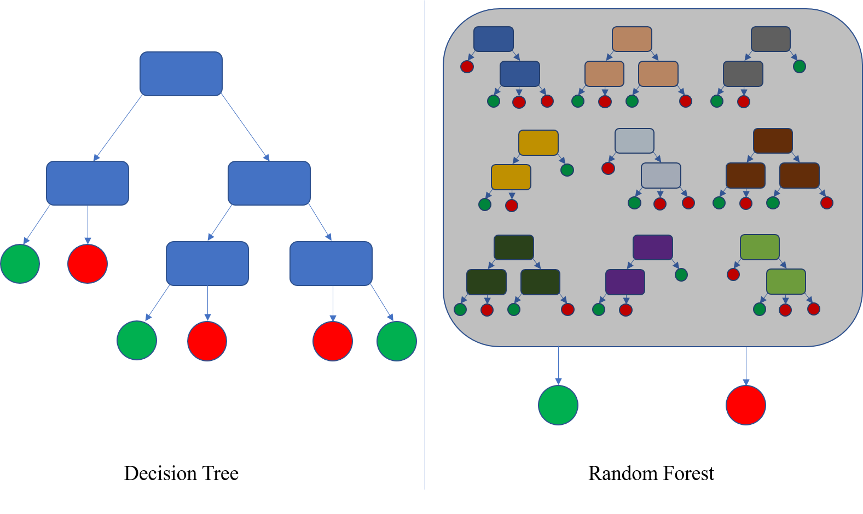
Baseline - Random Forest
Baseline
A little better than Logistic Regression
Performance affect by various features
Private score: 0.68009
Public score: 0.67877

Slide 10
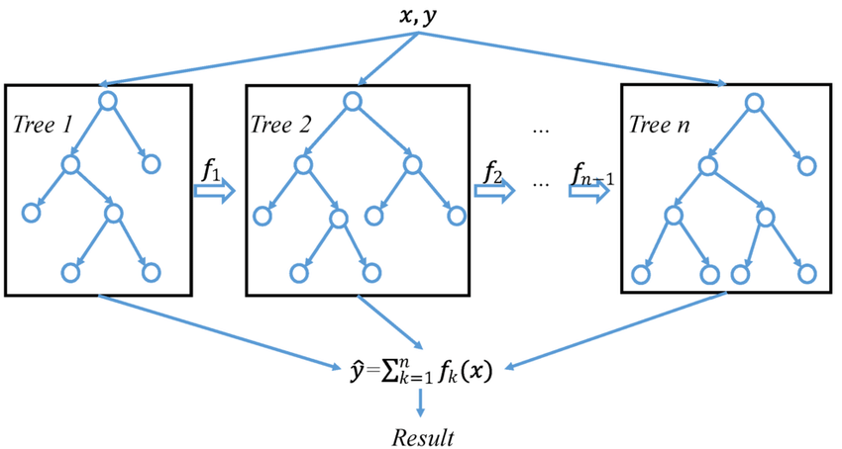
XGBoost
Good in complex features
Better than baselines
Private score: 0.72356
Public score: 0.72278

Slide 11
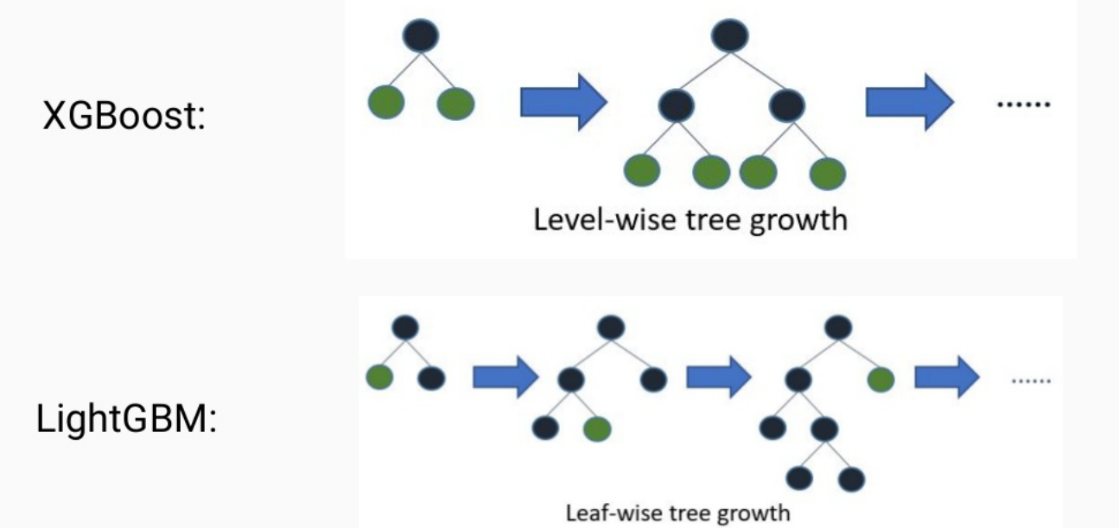
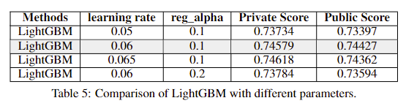
LightGBM
Best performance
Leaf-wise is better in this dataset.
Private score: 0.74579
Public score: 0.74427
Experiment in parameters

Slide 12
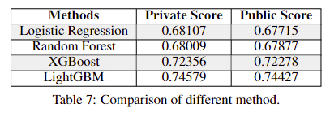
Conclusion
LightGBM is SOTA
Aggregation model is unless in the SOTA model
Exploratory data analysis help clean the data and analyze the correlation.
Polynomial features and Domain knowledge help analyze the features in the dataset.

Slide 13
Thanks for listening!

