Slide 1
MATH 5470 project- Home Credit Default Risk
Peng YE
Dept. of CSE
https://hkustconnect-my.sharepoint.com/:v:/g/personal/pyeac_connect_ust_hk/EaglxoSXp1FDnHo71alDGa8BuqhGlikzQBM6qbFQqiif6g

Slide 2
Competition overview
Goal: use data provided by Home Credit to predict their clients' repayment abilities (whether they will repay on time or not)
Evaluation metric: AUC (area under the ROC curve)
Submit probabilities instead of 0-1 predictions

Slide 3
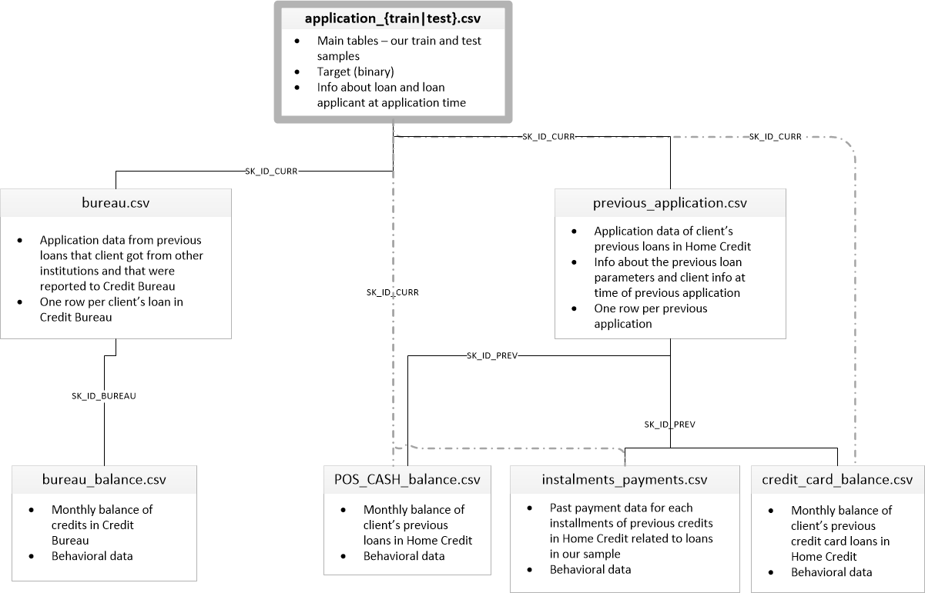
Dataset overview
Supervised binary classification task
Labels are unbalanced (less than 1% are positive)
More than 200 origin features distributed in 7 tables

Slide 4
Scientific questions
Can we use machine learning models to predict applicants’ repayment abilities?
Can table merging and feature engineering improve our models’ performance?
Can we use feature selection or dimensionality reduction techniques to reduce the number of features?

Slide 5
Models
Logistic regression
Random forest
Ridge regression (clip output to [0, 1])
Neural network (3 hidden layers)
Light Gradient Boosting Machine

Slide 6
Results on main table (application)
One-hot encoding for categorical features
Median imputation for missing values
Scale each feature’s values to be in range [0, 1]

Slide 7
Table merging and feature engineering
Aggregation by IDs (loan IDs, bureau IDs, etc.) and compute some statistics (e.g. sum, mean, maximum value) as new features
Join tables together
Remove features with more than 70% missing values
One-hot encoding, imputation and scaling
More details can be found in report and code

Slide 8
Results on merged table
By weighted averaging, can achieve a final private score of 0.782.

Slide 9
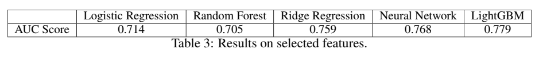
Attempt 1: feature selection
Delete variables that have high correlation coefficients with others
Train a LightGBM, delete features with zero importance
989 features to 610 features

Slide 10
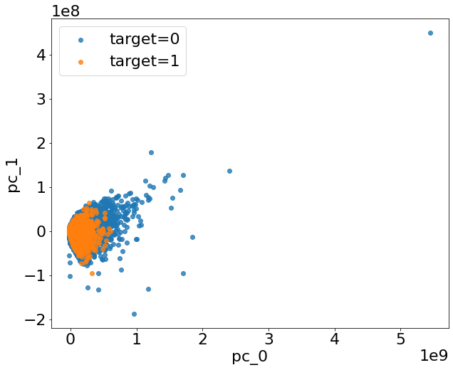
Attempt 2: Principal Component Analysis
First principal component accounts 95% explained variance
However, the performance is not good even we choose 610 principal components

Slide 11
Conclusion
Machine learning models are powerful in predicting applicants’ repayment abilities.
Merging more tables and feature engineering can enhance models’ performance.
For this dataset, feature selection can significantly reduce the number of features without sacrificing AUC, but PCA can’t.

Slide 12
Thanks for listening!

