Slide 1
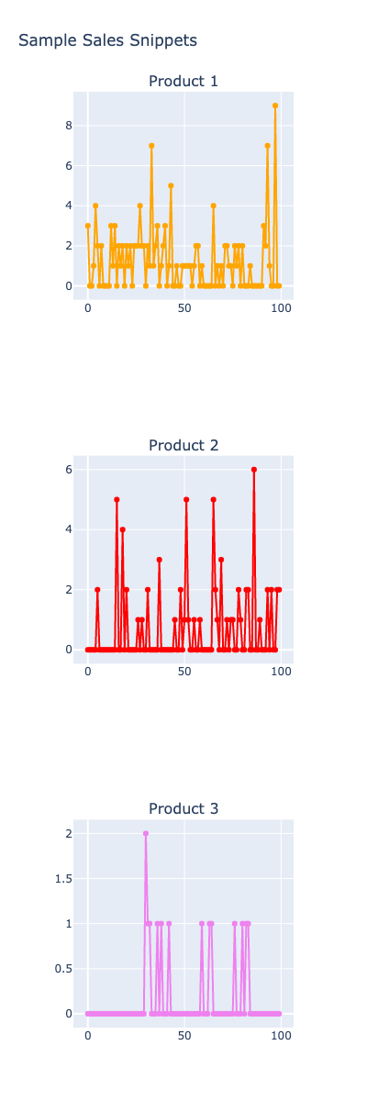
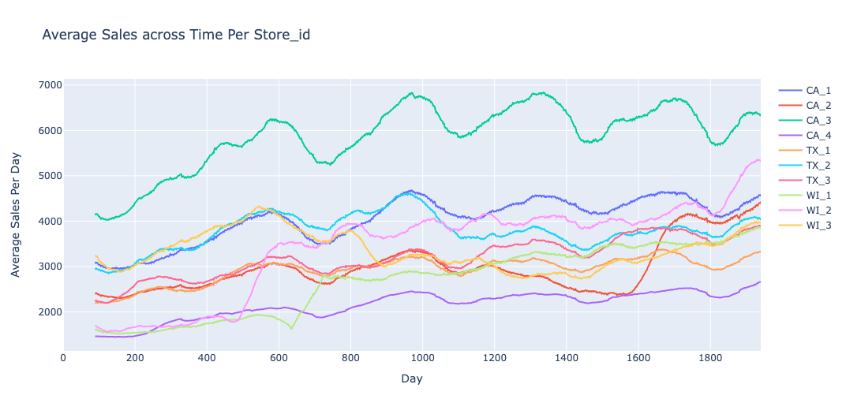
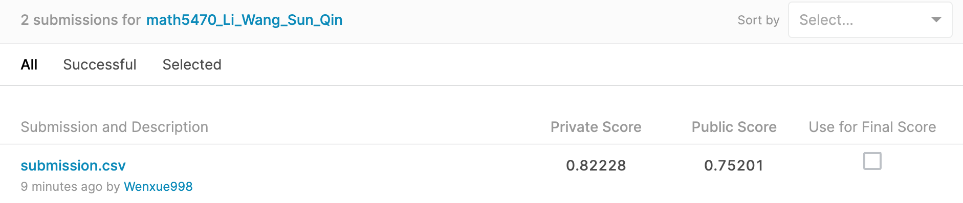
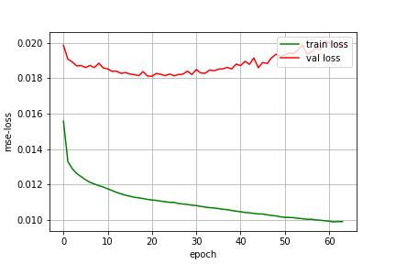
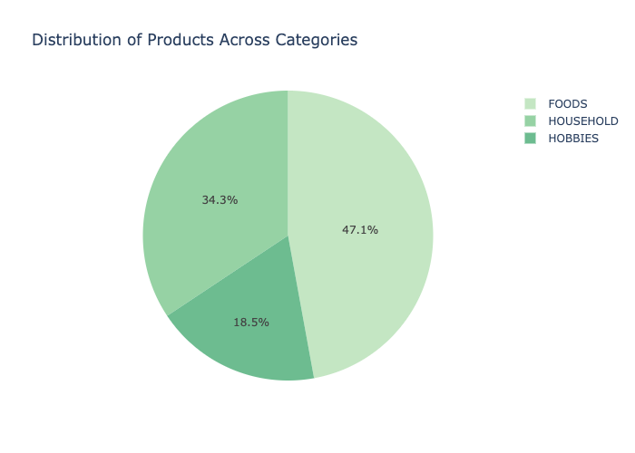
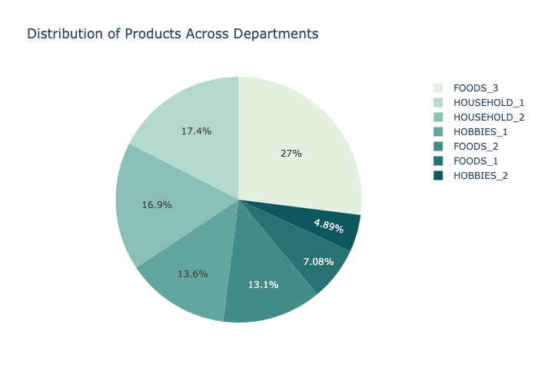
MATH 5470 Project: M5 Forecasting - Accuracy
Yuxuan Qin, Wenxue Li, Yubo Wang, Decang Sun {yqinam, wlicv, ywangnx, dsunak}@connect.ust.hk
Department of Computer Science and Engineering, HKUST
Talk Video: https://www.bilibili.com/video/BV1uZ4y1y7wS/
1. Introduction
From the distribution of products across discrete features, we find category and department are highly related to sales.
From the distribution of products along the time, we find the average sales in stores have a time-related pattern. Even looking at each product, values often appear in the group, i.e., remaining at a value range for a few days, which motivates us to use the LSTM model for training.
5. Result & Analysis
M5 Forecasting - Accuracy uses Walmart's sales data from 2011-01-29 to 2016-06-19 to predict the sales of different products in the next 28 days.
Our work mainly consists of the following 2 parts: exploratory data analysis (EDA) and LSTM model training.
The LSTM model was proven to be effective on the time-series predicting task, since its RNN structure could memorize the past state which could help it to capture the time related pattern.
In the experiment, we chose to use a 3-layer LSTM model to carry out the prediction. For the dataset, we use 90% of the dataset (1709 data) as the training set, and 10% (190 data) as the validation set.
2. Dataset Introduction
M5 Forecasting - Accuracy challenge mainly consists 3 types of files that can be used as input features.
Sales_train_evaluation/validation.csv
These two files are the main feature files, which contain the historical daily unit sales data per product and store.
Calendar.csv
Contains information about the dates on which the products are sold.
Sell_prices.csv
Contains information about the price of the products sold per store and date.
6. Conclusion
Our project trains an LSTM model to predict product sales for the next 28 days. The method relies on feature data, and we create feature data based on time series data to make the model present better prediction results.
After training the LSTM model for 20 epochs we get a satisfactory Kaggle score of 0.82.
4. Model Training
3. EDA (Exploratory Data Analysis)
We first normalize the features into range [0,1], and then train the data with 32 epochs using our 3-layer LSTM model (40, 300, 300 neurons and 0.2 dropout rate for each layer), with Adam optimizer with 0.01 learning rate.
In EDA, we focus on the distribution of products across discrete features, such as categories & departments, and along the time.
7. References
We use Mean Squared Error (MSE) as the loss function. At last, we chose the model trained at epoch 20 since it has the minimum vali has the minimum validation loss. (0.181)
Hochreiter, S., & Schmidhuber, J. (1997). Long short-term memory. Neural computation, 9(8), 1735-1780.
8. Contribution
EDA (Exploratory Data Analysis): LI, Wenxue
Model Training: WANG, Yubo & SUN, Decang
10mins Presentation: QIN, Yuxuan

