Slide 1

Revisiting (Re-)imag(in)ing Price Trends
YU Wentao
CAO Ruoxiao
Course Project, MATH 5470
https://hkustconnect-my.sharepoint.com/personal/rcaoah_connect_ust_hk/_layouts/15/onedrive.aspx?id=%2Fpersonal%2Frcaoah%5Fconnect%5Fust%5Fhk%2FDocuments%2FPhD1S%2FMATH5470%2FProject&ga=1
Notes:
Good evening everyone, we are yuwentao and caoruoxiao. The title of our presatation is Kalman Channel Prediction for TDD Massive MIMO Systems

Slide 2

Outline
Problem statement
Price trend image dataset
Paper replication
Further improvement: attention-aided CNN
MATH5470 Project
Notes:
The MIMO system has been paid more and more attention in modern wireless communication system. Here is a simple example of uplink and downlink signals model in our today presentation. For uplink system, signals are from 𝐾 different user equipments to the single base station with M antennas. For downlink system, signals are from this base station to K user equipments. We mainly consider uplink system today, and there are 3 key components. The transmitter is UEs, receiver is BS and the most important thing, transmission medium is channel.

Slide 3
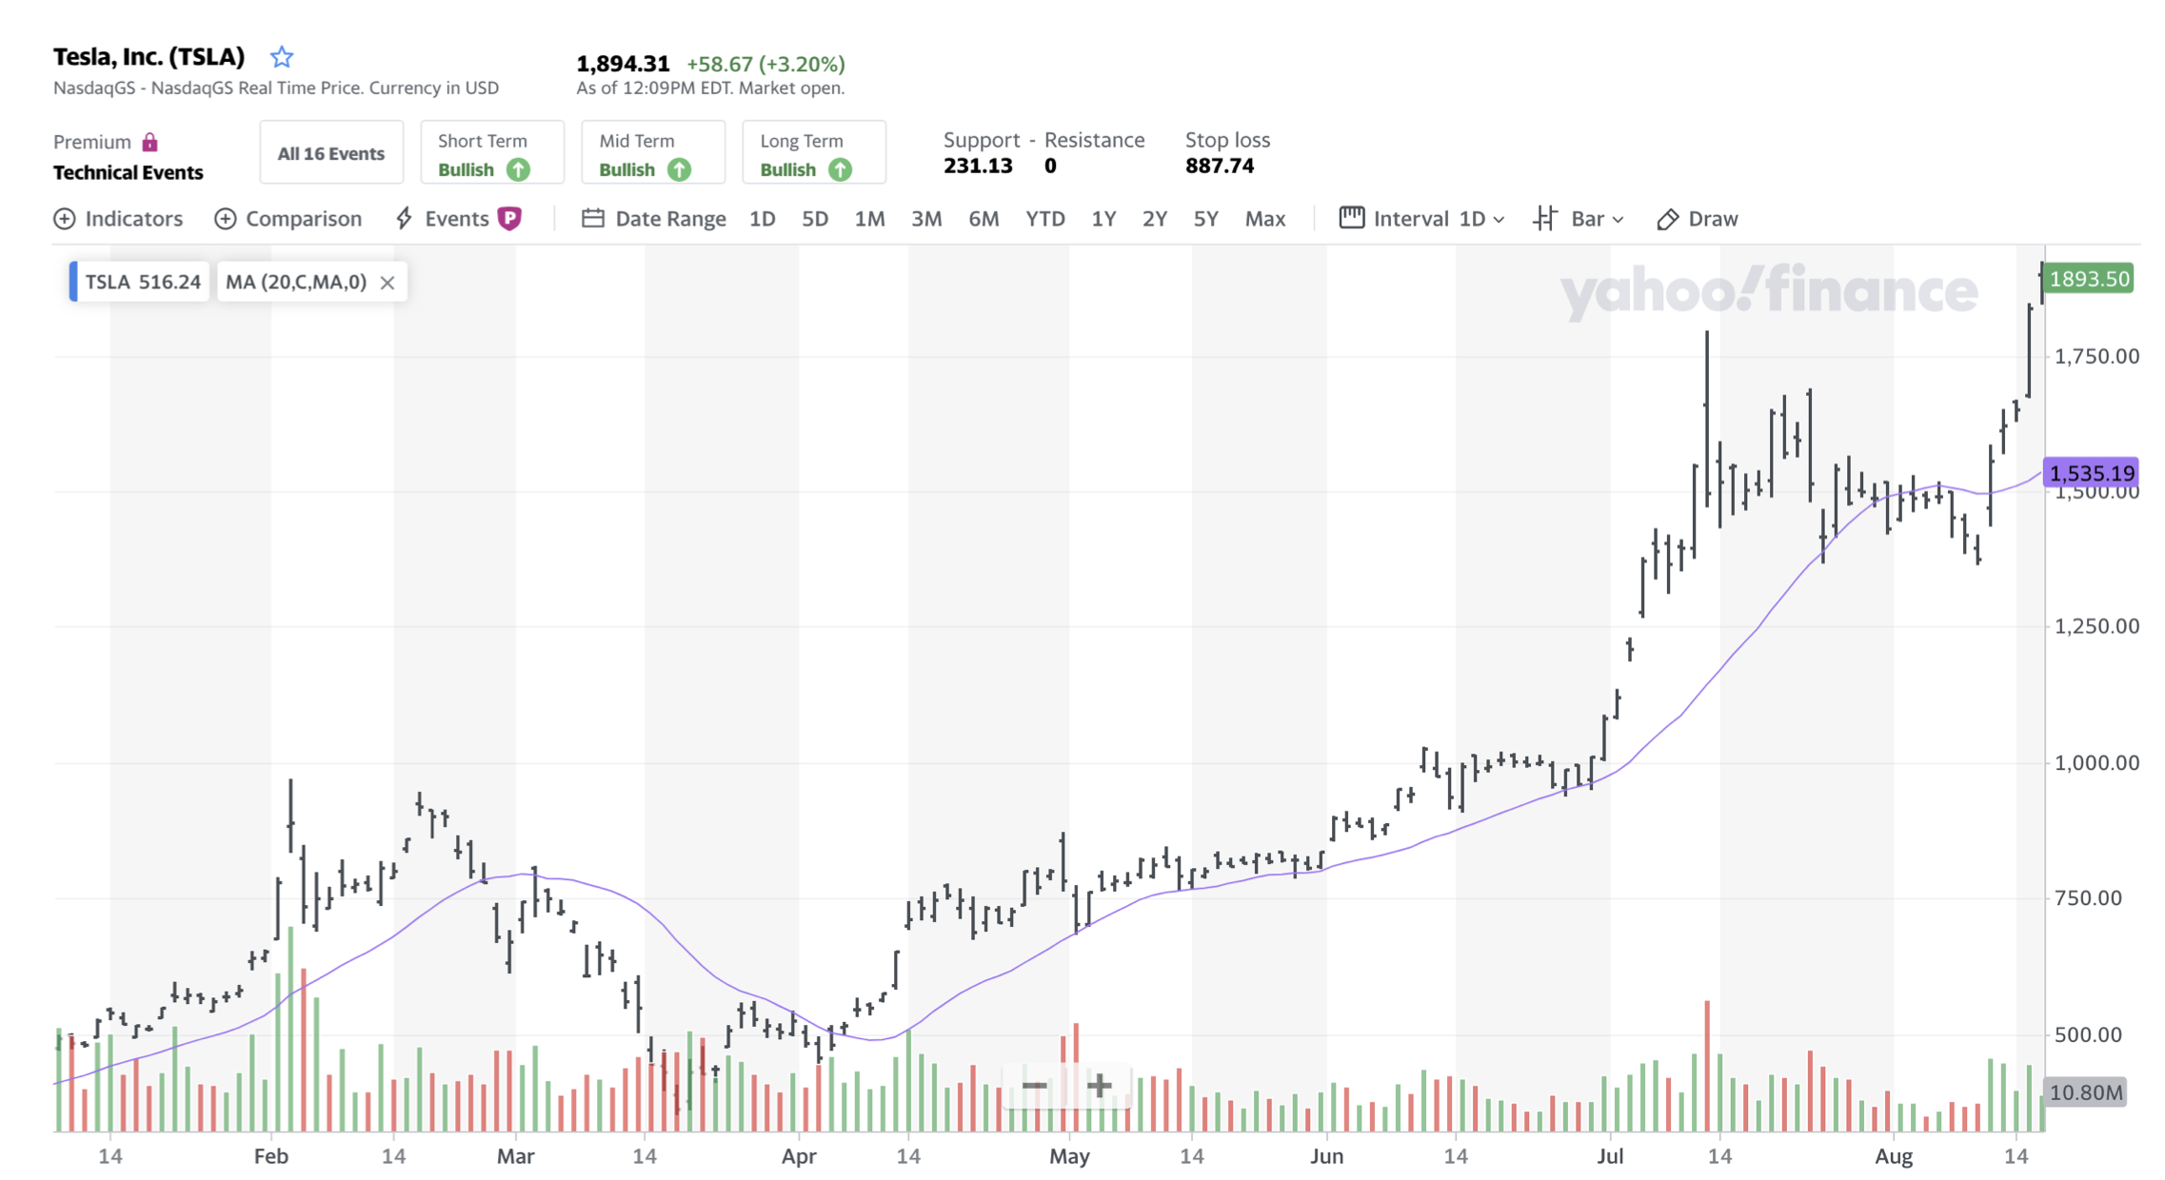
Problem statement
Can we predict future price trends based purely on historical data?
MATH5470 Project
Notes:
The MIMO system has been paid more and more attention in modern wireless communication system. Here is a simple example of uplink and downlink signals model in our today presentation. For uplink system, signals are from 𝐾 different user equipments to the single base station with M antennas. For downlink system, signals are from this base station to K user equipments. We mainly consider uplink system today, and there are 3 key components. The transmitter is UEs, receiver is BS and the most important thing, transmission medium is channel.

Slide 4
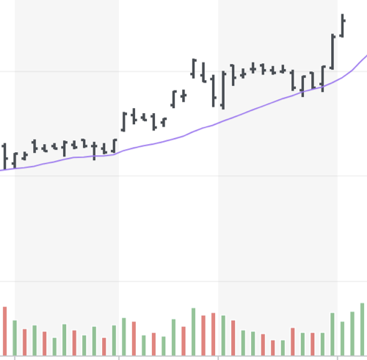

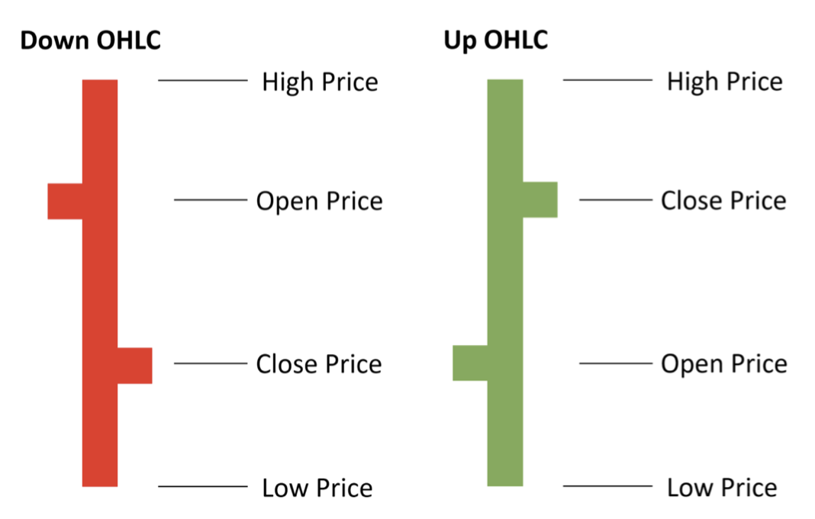
Price trend image dataset
MATH5470 Project
Notes:
The MIMO system has been paid more and more attention in modern wireless communication system. Here is a simple example of uplink and downlink signals model in our today presentation. For uplink system, signals are from 𝐾 different user equipments to the single base station with M antennas. For downlink system, signals are from this base station to K user equipments. We mainly consider uplink system today, and there are 3 key components. The transmitter is UEs, receiver is BS and the most important thing, transmission medium is channel.

Slide 5

Price trend image dataset (cont’d)
Price data of past 20 days
Will I gain profit in the next
5 days (I20R5 task)
20 days (I20R20 task)
60 days (I20R60 task)
Train on historical data (1997-2000),
Test on future data (2001-2019).
MATH5470 Project
Notes:
The MIMO system has been paid more and more attention in modern wireless communication system. Here is a simple example of uplink and downlink signals model in our today presentation. For uplink system, signals are from 𝐾 different user equipments to the single base station with M antennas. For downlink system, signals are from this base station to K user equipments. We mainly consider uplink system today, and there are 3 key components. The transmitter is UEs, receiver is BS and the most important thing, transmission medium is channel.

Slide 6
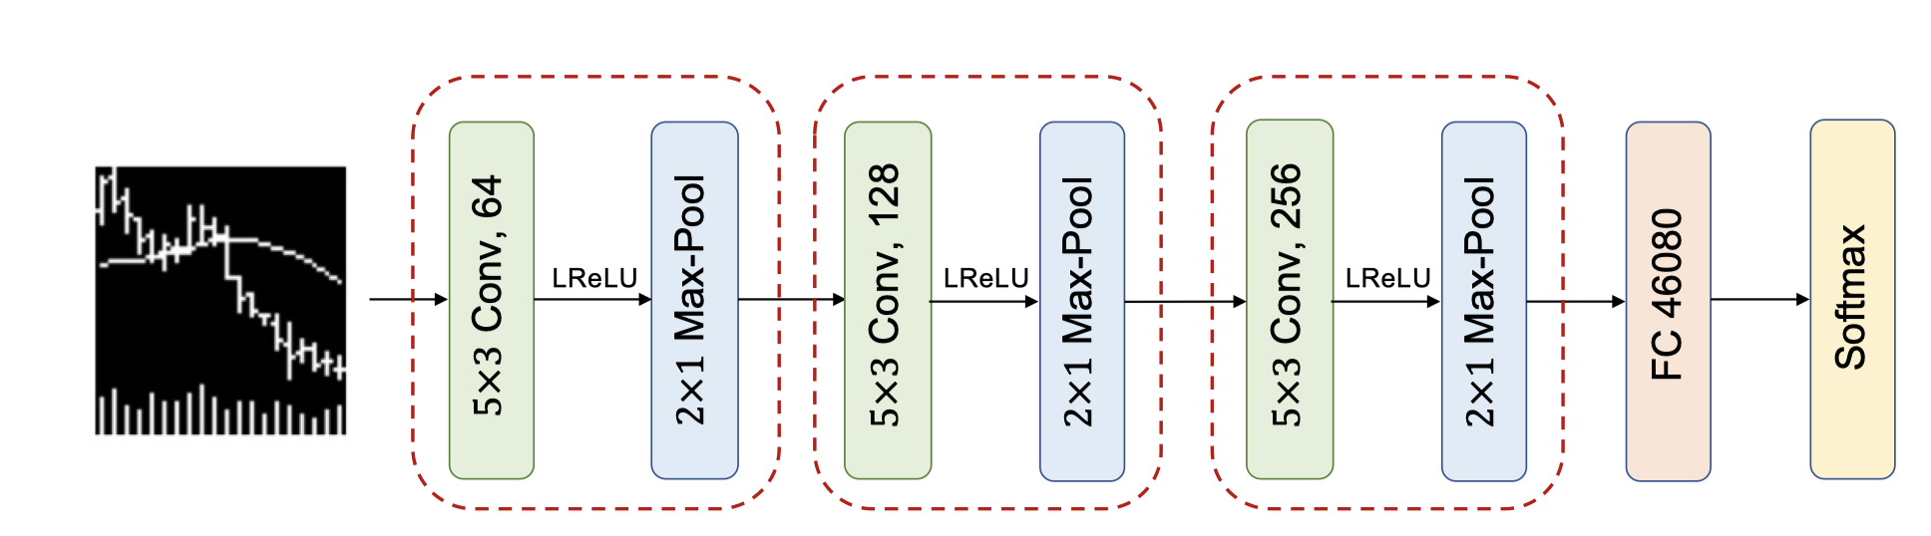
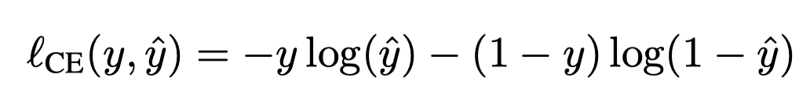
Baseline CNN model
MATH5470 Project
Notes:
The MIMO system has been paid more and more attention in modern wireless communication system. Here is a simple example of uplink and downlink signals model in our today presentation. For uplink system, signals are from 𝐾 different user equipments to the single base station with M antennas. For downlink system, signals are from this base station to K user equipments. We mainly consider uplink system today, and there are 3 key components. The transmitter is UEs, receiver is BS and the most important thing, transmission medium is channel.

Slide 7
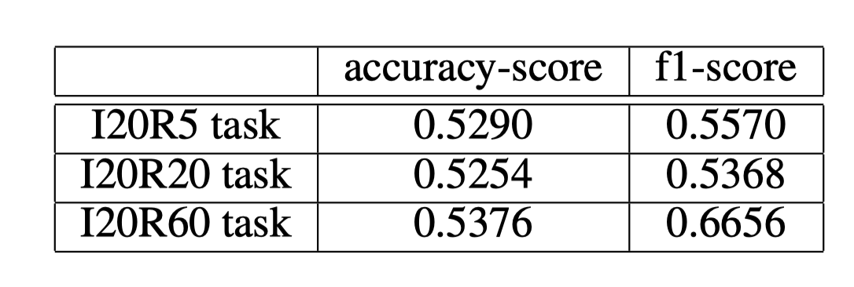
Experimental results
Results on the whole test dataset (2001-2019, 19 years)
Every 0.5% increase in accuracy will result in a roughly 0.1 increase in annualized Sharpe ratio, which means huge profits.
MATH5470 Project
Notes:
The MIMO system has been paid more and more attention in modern wireless communication system. Here is a simple example of uplink and downlink signals model in our today presentation. For uplink system, signals are from 𝐾 different user equipments to the single base station with M antennas. For downlink system, signals are from this base station to K user equipments. We mainly consider uplink system today, and there are 3 key components. The transmitter is UEs, receiver is BS and the most important thing, transmission medium is channel.

Slide 8
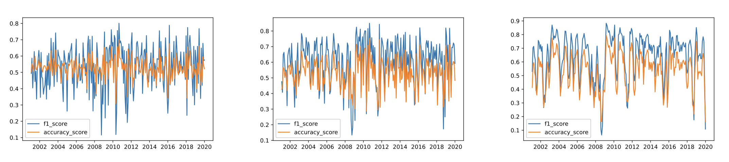
Experimental results (cont’d)
Results over each month from year 2001 to 2019
MATH5470 Project
Notes:
The MIMO system has been paid more and more attention in modern wireless communication system. Here is a simple example of uplink and downlink signals model in our today presentation. For uplink system, signals are from 𝐾 different user equipments to the single base station with M antennas. For downlink system, signals are from this base station to K user equipments. We mainly consider uplink system today, and there are 3 key components. The transmitter is UEs, receiver is BS and the most important thing, transmission medium is channel.

Slide 9
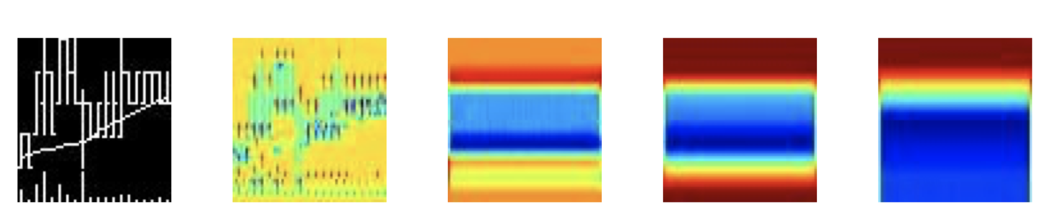
Interpretation via Grad-CAM visualization
Grad-CAM++ heatmap visualization
MATH5470 Project
Notes:
The MIMO system has been paid more and more attention in modern wireless communication system. Here is a simple example of uplink and downlink signals model in our today presentation. For uplink system, signals are from 𝐾 different user equipments to the single base station with M antennas. For downlink system, signals are from this base station to K user equipments. We mainly consider uplink system today, and there are 3 key components. The transmitter is UEs, receiver is BS and the most important thing, transmission medium is channel.

Slide 10
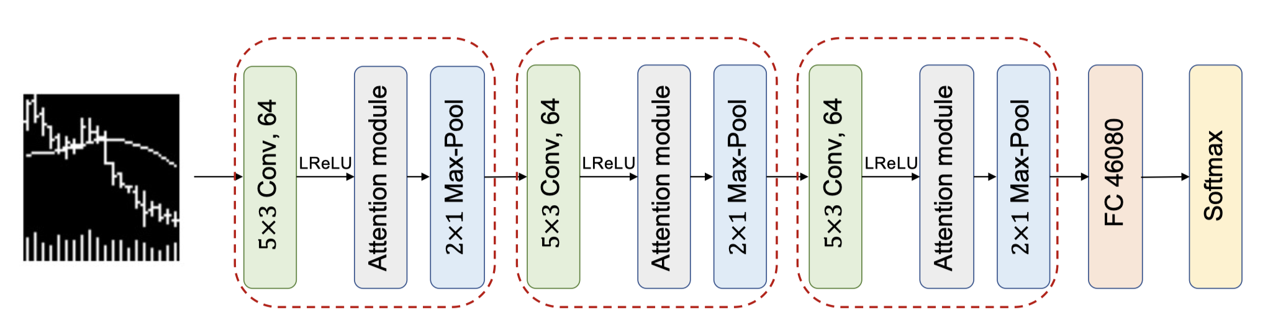
Improvement: attention-aided CNN
MATH5470 Project
Notes:
The MIMO system has been paid more and more attention in modern wireless communication system. Here is a simple example of uplink and downlink signals model in our today presentation. For uplink system, signals are from 𝐾 different user equipments to the single base station with M antennas. For downlink system, signals are from this base station to K user equipments. We mainly consider uplink system today, and there are 3 key components. The transmitter is UEs, receiver is BS and the most important thing, transmission medium is channel.

Slide 11
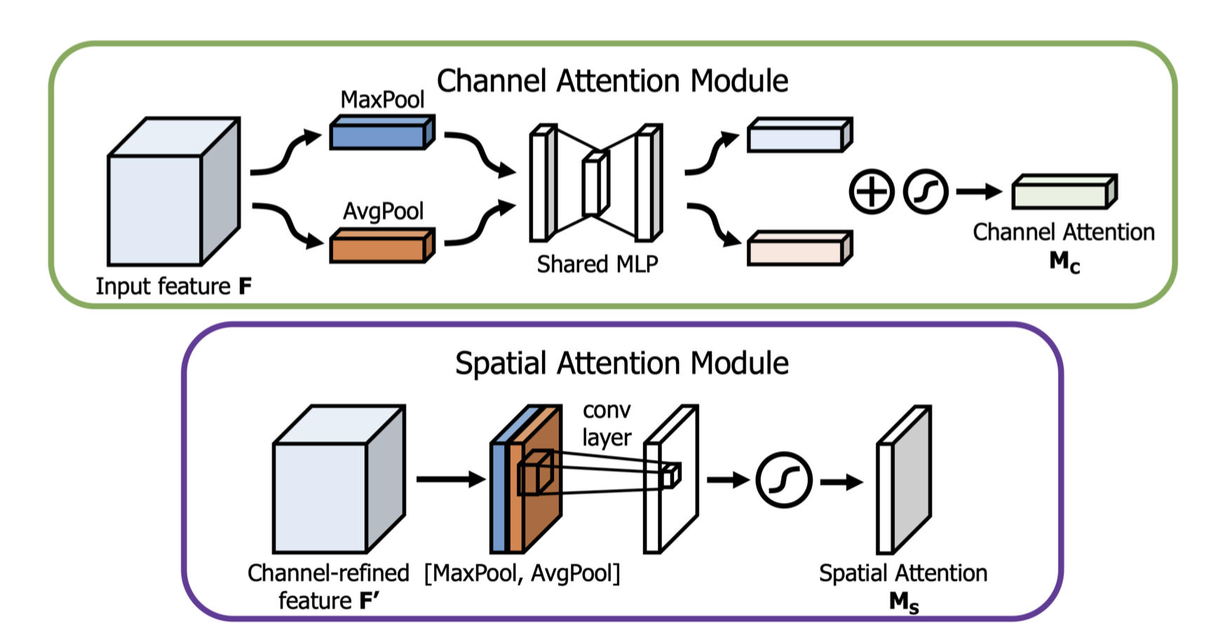
Improvement: attention-aided CNN (Cont’d)
MATH5470 Project
Notes:
The MIMO system has been paid more and more attention in modern wireless communication system. Here is a simple example of uplink and downlink signals model in our today presentation. For uplink system, signals are from 𝐾 different user equipments to the single base station with M antennas. For downlink system, signals are from this base station to K user equipments. We mainly consider uplink system today, and there are 3 key components. The transmitter is UEs, receiver is BS and the most important thing, transmission medium is channel.

Slide 12
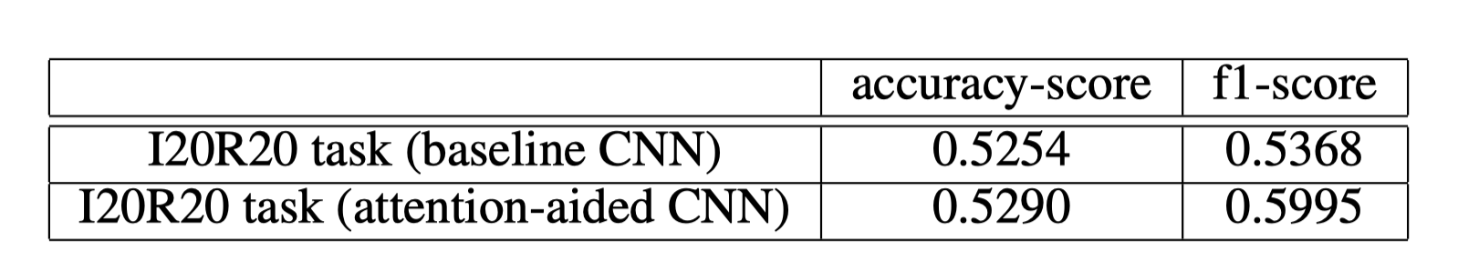
Experimental results
Results on the whole test dataset (2001-2019, 19 years)
Every 0.5% increase in accuracy will result in a roughly 0.1 increase in annualized Sharpe ratio, which means huge profits.
MATH5470 Project
Notes:
The MIMO system has been paid more and more attention in modern wireless communication system. Here is a simple example of uplink and downlink signals model in our today presentation. For uplink system, signals are from 𝐾 different user equipments to the single base station with M antennas. For downlink system, signals are from this base station to K user equipments. We mainly consider uplink system today, and there are 3 key components. The transmitter is UEs, receiver is BS and the most important thing, transmission medium is channel.

Slide 13
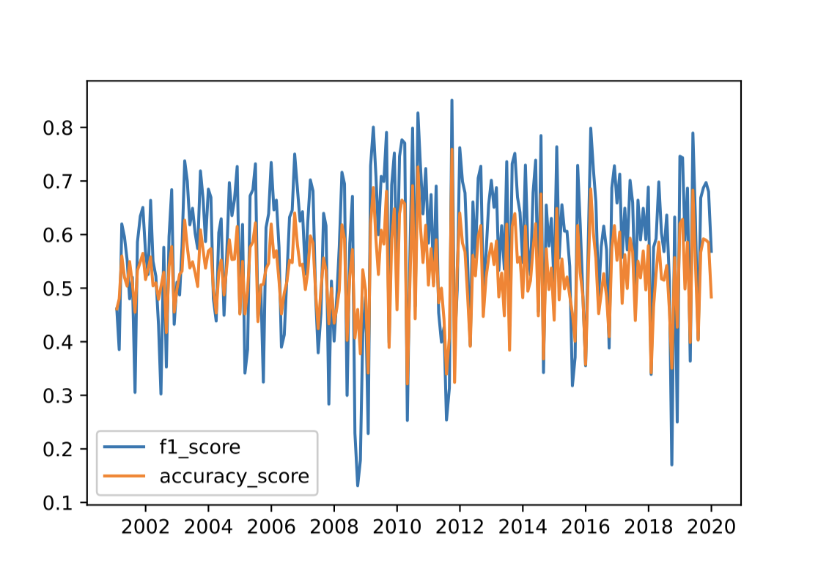
Experimental results
Results over each month from year 2001 to 2019
Baseline CNN
Attention-aided CNN
MATH5470 Project
Notes:
The MIMO system has been paid more and more attention in modern wireless communication system. Here is a simple example of uplink and downlink signals model in our today presentation. For uplink system, signals are from 𝐾 different user equipments to the single base station with M antennas. For downlink system, signals are from this base station to K user equipments. We mainly consider uplink system today, and there are 3 key components. The transmitter is UEs, receiver is BS and the most important thing, transmission medium is channel.

Slide 14
Interpretation via Grad-CAM visualization
Grad-CAM++ heatmap visualization
Baseline CNN
Attention-aided CNN
MATH5470 Project
Notes:
The MIMO system has been paid more and more attention in modern wireless communication system. Here is a simple example of uplink and downlink signals model in our today presentation. For uplink system, signals are from 𝐾 different user equipments to the single base station with M antennas. For downlink system, signals are from this base station to K user equipments. We mainly consider uplink system today, and there are 3 key components. The transmitter is UEs, receiver is BS and the most important thing, transmission medium is channel.

Slide 15
Thank you!
MATH5470 Project

