Slide 1
Paper Replication: (Re-)Imag(in)ing Price Trends Bo Huang

Slide 2
The motivation of MAE
The strategy of masked autoencoding has achieved great success in NLP task
Vision Transformers (ViT) have been introduced to bridge the gap that Convolution Networks (CNNs) cannot directly integrate mask tokens or positional embedding into model training
By ViT, MAE can be applicable in computer vision
MAE break through previous performance bottlenecks in image recognition recently
We ask: what will happen when MAE meets our task?

Slide 3
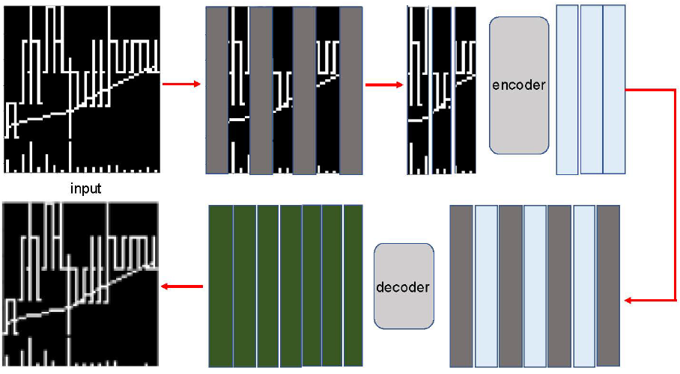
Overall MAE framework

Slide 4
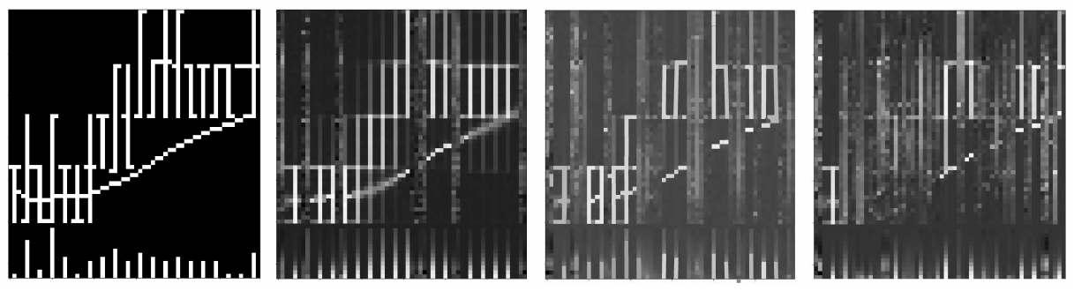
Reconstruction results
Original image
Mask ratio (0.75)
Mask ratio (0.50)
Mask ratio (0.25)

Slide 5
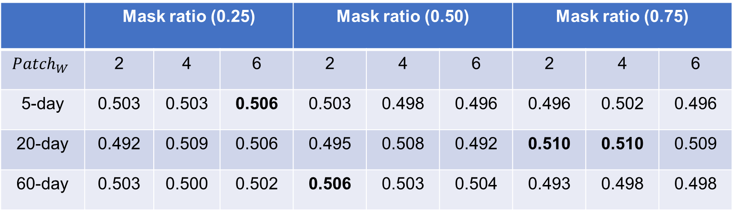
Accuracy on finetuning MAE
Accuracy for the classification model finetuned on pretrained MAE encoder
 | Mask ratio (0.25) |  |  | Mask ratio (0.50) |  |  | Mask ratio (0.75)
$${Patch}_{W}$$ | 2 | 4 | 6 | 2 | 4 | 6 | 2 | 4 | 6
5-day | 0.503 | 0.503 | 0.506 | 0.503 | 0.498 | 0.496 | 0.496 | 0.502 | 0.496
20-day | 0.492 | 0.509 | 0.506 | 0.495 | 0.508 | 0.492 | 0.510 | 0.510 | 0.509
60-day | 0.503 | 0.500 | 0.502 | 0.506 | 0.503 | 0.504 | 0.493 | 0.498 | 0.498

Slide 6
Thank you！

