Slide 1
Paper Replication: (Re-)Imag(in)ing Price Trends Bo Huang, Mingyang Chen Presented for MATH 5470 Final Project
https://youtu.be/pv6aGg8k8Go

Slide 2
Outline
Background and Motivation
CNN-based Return Trend Classifier
Classification Accuracy and Correlation
Verifying Sensitivity against Model Structure Variation
Interpreting the Patterns Captured by the Model for Prediction

Slide 3
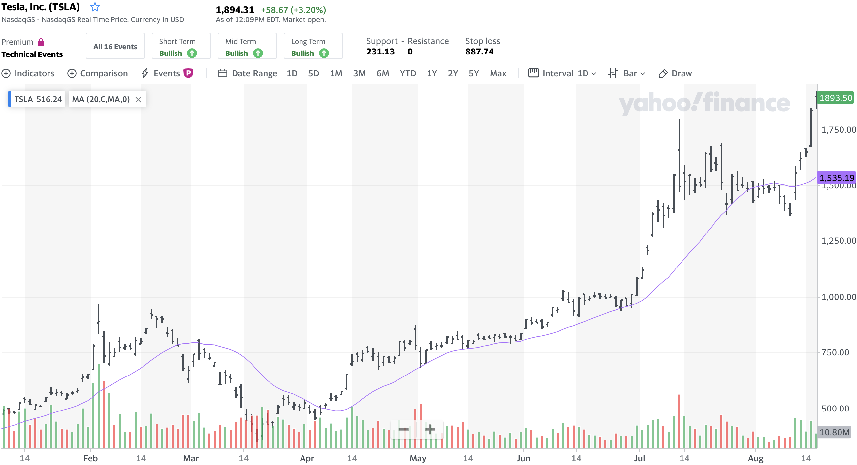
Learn 1-D Stock Data by 2-D image representation
Why data visualization is well-studied for stock analysis?
For human, data visualization is necessary for better analysis.
Comparing to series data, vision can capture abstract feature pattern.
Tesla OHLC Chart from Yahoo! Finance

Slide 4
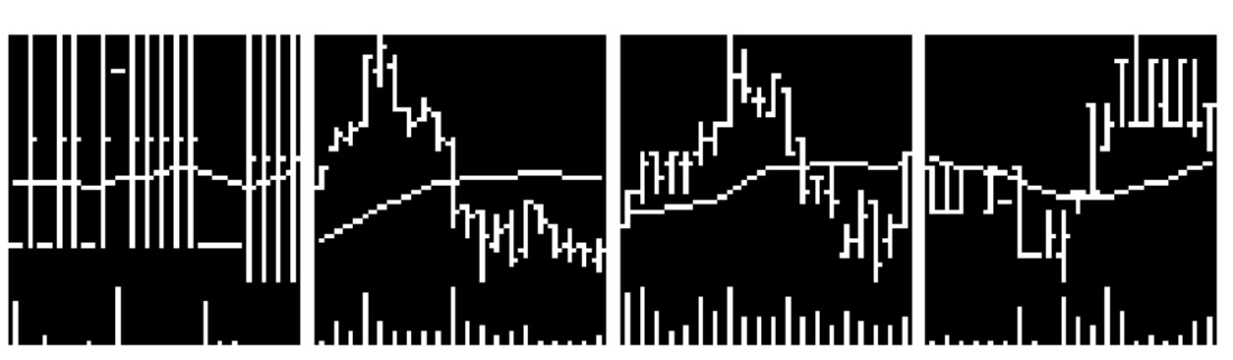
Learn 1-D Stock Data by 2-D image representation
Why the authors of [1] construct 2-D image data for machines to learn:
Deep learning models, especially RNN, are widely used for time series data.
The information implied by the numerical series data is complex, redundant.
They want to explore the feasibility of predicting the return trend by only referencing the patterns within the data:
20-day OHLC-like image data including: open-close prices, price fluctuation and volume bars
[1] Jingwen Jiang, Bryan T. Kelly, and Dacheng Xiu. (re-)imag(in)ing price trends. Chicago Booth Research Paper, No. 21-01, December 1, 2020.

Slide 5
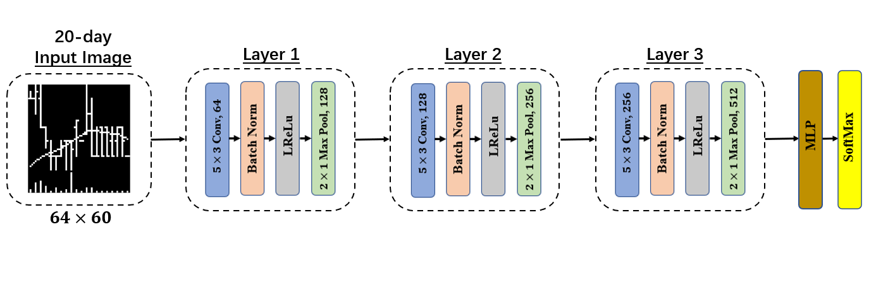
CNN-based Return Trend Classifier
The baseline model of the CNN-based return trend classifier:
Constituted by a feature extractor (3 convolutional blocks) and a MLP classifier.
Each block contains: a convolutional layer, a Batch Normalization layer, an Activation function (Leaky ReLu) and a Max-Pooling layer.
For speeding up the convergence, Xavier initialization is employed for weights.
[1] Jingwen Jiang, Bryan T. Kelly, and Dacheng Xiu. (re-)imag(in)ing price trends. Chicago Booth Research Paper, No. 21-01, December 1, 2020.

Slide 6
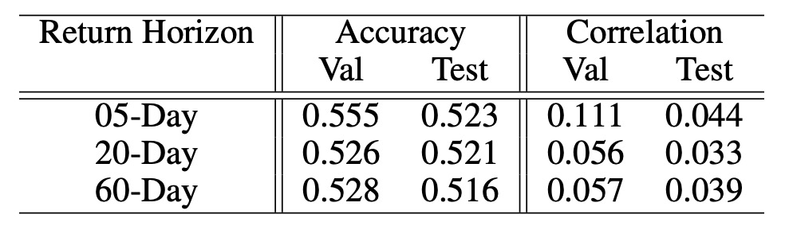
Accuracy and Correlation for Predicting Return Trend
Training and Validation data are collected from the US historical stock prices from the year 1993 to the year 2000.
Test data are collected from the US historical stock prices from the year 2001 to the year 2019.
We basically test the Accuracy and Correlation between the predicted labels and true labels on Validation set and Test set.
[1] Jingwen Jiang, Bryan T. Kelly, and Dacheng Xiu. (re-)imag(in)ing price trends. Chicago Booth Research Paper, No. 21-01, December 1, 2020.

Slide 7
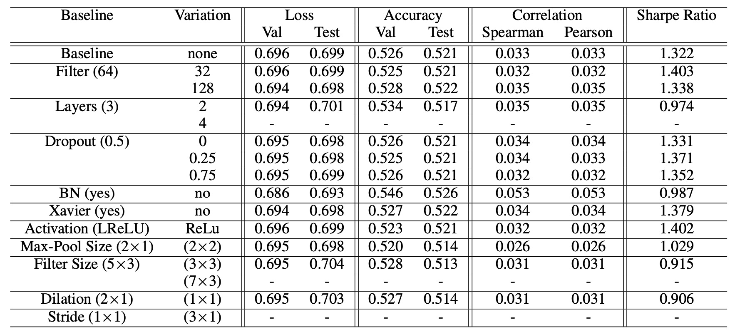
Verifying Sensitivity against Model Structure Variation
We explore the robustness of model structure in multiple dimensions:
[1] Jingwen Jiang, Bryan T. Kelly, and Dacheng Xiu. (re-)imag(in)ing price trends. Chicago Booth Research Paper, No. 21-01, December 1, 2020.

Slide 8
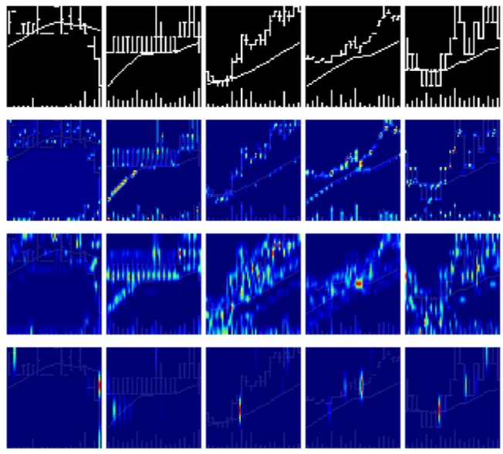
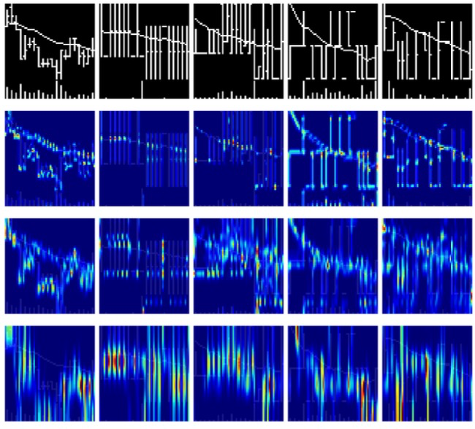
Interpreting the Patterns Captured by the Model for Prediction
Visualizing the model prediction by the activation heatmaps generated by Grad-CAM:
Predicted as up
Predicted as down
Conv.1
Conv.1
Conv.2
Conv.2
Conv.3
Conv.3
Shallow layers pay more attention on the open-close price points.
Deeper layers pay more attention on the bar-like information.
When price fluctuation is large, the model cares more about the moving average line.
[1] Jingwen Jiang, Bryan T. Kelly, and Dacheng Xiu. (re-)imag(in)ing price trends. Chicago Booth Research Paper, No. 21-01, December 1, 2020.

