Slide 1
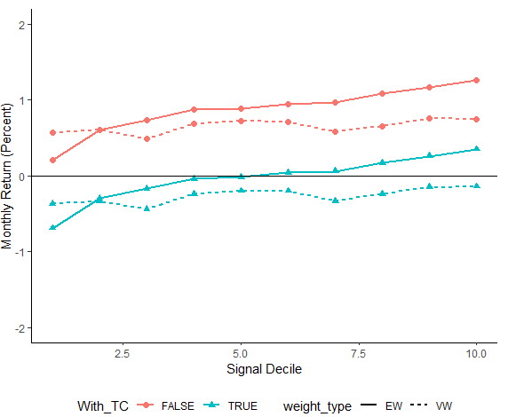
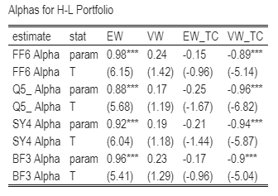
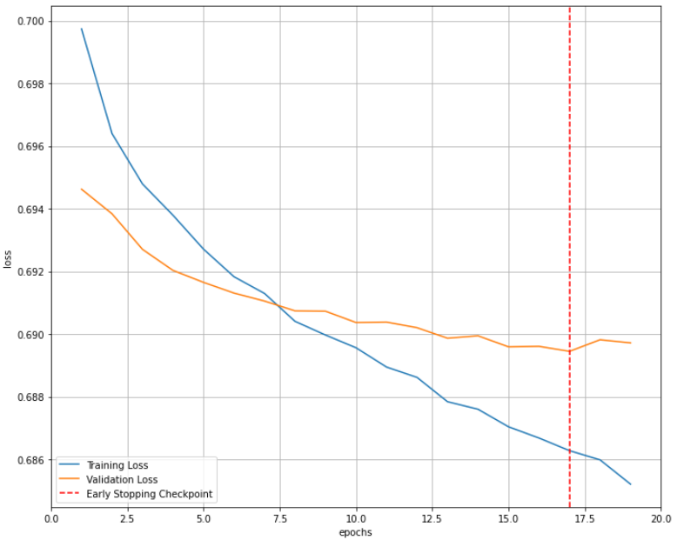
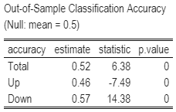
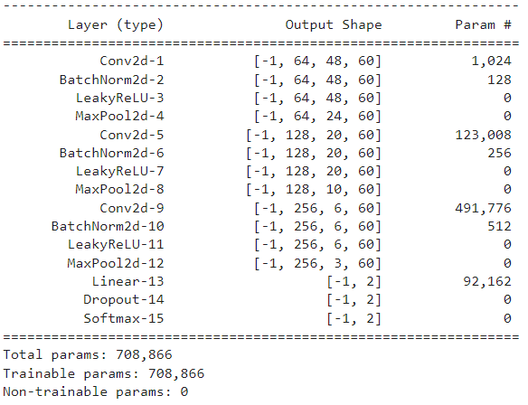
MATH 5470 Final Project: Replicate (Re-)Imag(in)ing Price Trend
Zhuang Chu¹ and Zilan Yang² {zchu, zyangbn}@connect.ust.hk
¹: Department of Finance, HKUST ²: Department of Accounting, HKUST
1. Introduction
4. Workflow
We replicate Jiang, Kelly, and Xiu (2021). Specifically, we apply CNN to 20-day stock-level price charts and predict the direction of next 20-day return. We find that consistent with Jiang, Kelly, and Xiu (2021), the CNN learned price pattern give more accurate return predictions than random guess and translate into profitable investment strategies.
Data split: use 1993-2000 data to train model. We randomly select 70% as training set and 30% as validation set. We test model using 2001-2019 data.
Loss and optimizer: we use cross-entropy loss function and Adam algorithm with learning rate = 1e5
Training: the training stops once the validation loss function fails to improve for two consecutive epochs.
2. Data Preparation
Average Return of All Portfolio
Alpha of H-L Portfolio
We use sample from 1993 to 2019. The dataset comprises 64*60 OHLC images. Image labels are 1 for positive future returns and 0 for non-positive ones. We drop images if future returns are missing.
6. Conclusion
We find that 2D images can provide useful information in predicting price trends, as the CNN model can beat random guesses and form profitable portfolios.
Portfolio, having the lowest probability of a positive future return, indeed realize lowest return. Average return increase monotonically across predicted "up" probability deciles. Long-short H-L strategies earn 1.05% return per month. Those returns can not be explained by current asset pricing model. However, the positive returns attenuates/disappears when using value weighted/trading cost.
The predictability of CNN model may mainly origin from small stocks, and a high turnover rate may dry out the profits.
3. Model Design
We follow the basic architecture in Jiang, Kelly, and Xiu (2021). Considering the sparsity in the vertical dimension, we make some modifications:
Convolution layers: vertical dilation of 4 to learn larger regions outside of filters.
Pool layers: vertical stride of 2 to shrink the size vertically by 2.
Training Loss and Validation Loss
Out-of-Sample Classification Accuracy
5. Performance Evaluation
We apply trained model to test data and obtain the predicted next 20-day return. The overall classification accuracy is 0.52, with 0.46 for positive return and 0.57 for non-positive return.
Portfolio sorting. we sort stocks into equal/value weighted 10 decile portfolios on estimates for probability of a positive return. The holding period for each portfolio is one month.
Performance measure: average return, Sharpe ratio, turnover rate, and Alphas. Alpha is calculated based on the cutting-edge asset pricing model 1) FF6 (Fama, French, 2018), 2) Q5 (Hou et al., 2018), 3) SY4 (Stambaugh, Yuan, 2017), 4) BF3 (Daniel et al., 2018).
Trading Cost: the strategy based on CNN forecast has a very high turnover rate, thus we reconduct the analysis with transaction fees of 0.5% / dollar traded.
Our model has the same parameters as Jiang, Kelly, and Xiu (2021).
We apply the same regularization as Jiang et al. (2021): Xavier initializer, batch normalization, 50% dropout, and early stopping.
7. References
Jiang, Jingwen, Bryan T. Kelly, and Dacheng Xiu. "(Re-) Imag (in) ing Price Trends." Chicago Booth Research Paper 21-01 (2020).
8. Contribution
Data Preparation, Model design, and Training: Zhuang Chu, Zilan Yang
Performance Evaluation:
Classification accuracy: Zhuang Chu, Zilan Yang
Portfolio analysis: Zhuang Chu
Our CNN Model

