Slide 1


Ubiquant Market Prediction Project Presentation
MATH 5470 LIN, Zizheng. YAO,Duanyi
Presenter: LIN, Zizheng
https://youtu.be/FUp46AfsEgU

Slide 2
Content
Introduction
Background
Data overview
Model
Model structure
Experiments
Setting
Baseline
Main results
Hyper parameter analysis
Feature importance analysis

Slide 3
Content
Introduction
Background
Data overview
Model
Model structure
Experiments
Setting
Baseline
Main results
Hyper parameter analysis
Feature importance analysis

Slide 4
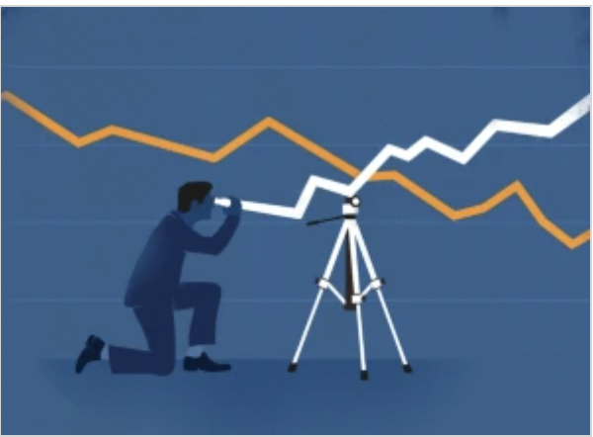
Introduction
Regardless of your investment strategy, fluctuations are expected in the financial market. Despite this variance, professional investors try to estimate their overall returns. Risks and returns differ based on investment types and other factors, which impact stability and volatility.
Notes:
PCA is a classical and well-known statistical linear method for extracting the most influential features from a high-dimensional data space.
Besides PCA methods, variants of ensemble decision trees (DTs) are also effective methods for handling multi-dimension dataset in financial prediction.
In this competition, we use TabNet which is proposed by GoogleAI for processing the financial tabular data and predicting the return. The input of TabNet is over 300 features and the model can achieve end-to-end learning with sequential attention to choose the most valuable features.

Slide 5
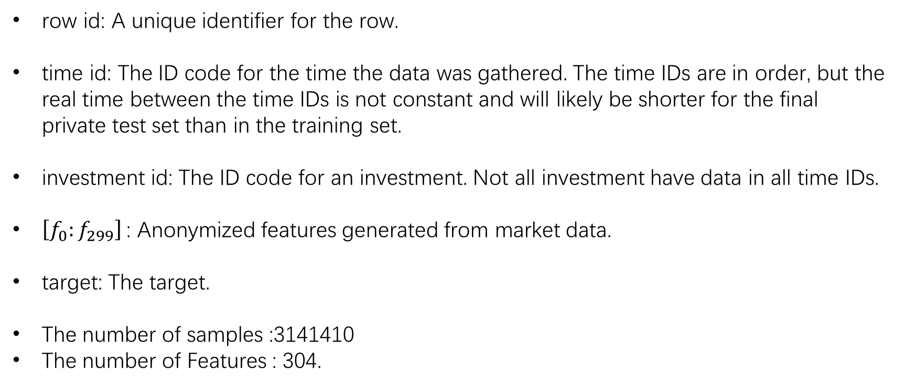
data overview
row id: A unique identifier for the row.
time id: The ID code for the time the data was gathered. The time IDs are in order, but the real time between the time IDs is not constant and will likely be shorter for the final private test set than in the training set.
investment id: The ID code for an investment. Not all investment have data in all time IDs.
$\left[f_{0}:f_{299}\right]$: Anonymized features generated from market data.
target: The target.
The number of samples :3141410
The number of Features : 304.
Notes:
This dataset contains features derived from real historic data from thousands of investments. Our challenge is to predict the value of an obfuscated metric relevant for making trading decisions. This is a forecasting competition, where we need to use the train dataset to predict the return.
The train data set contains following features and target:

Slide 6
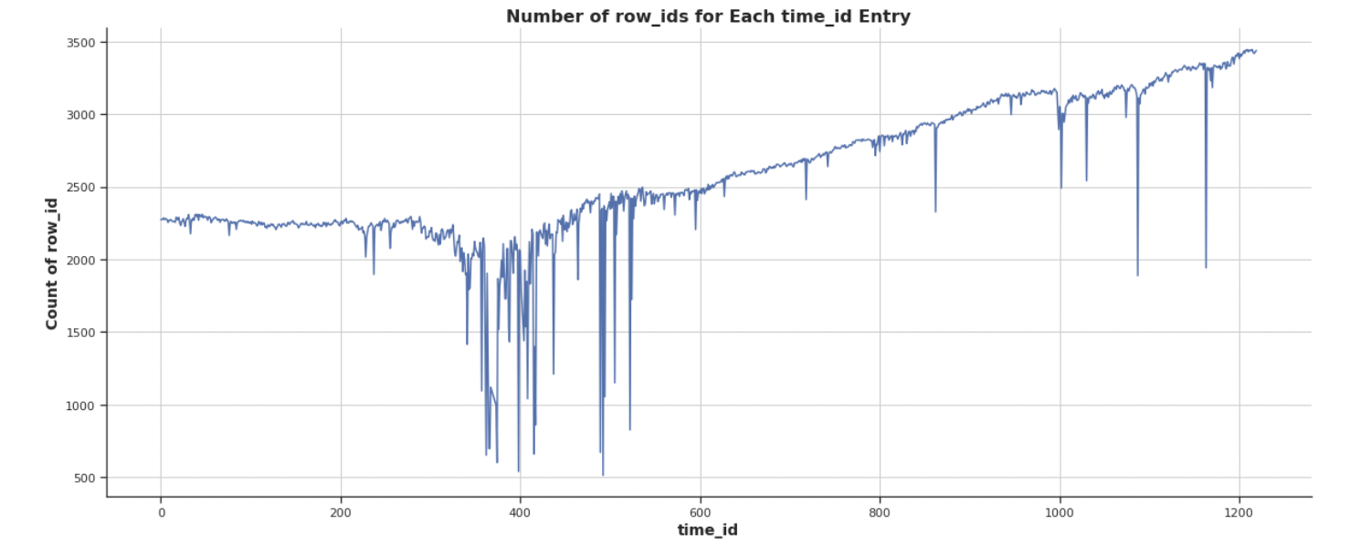
Data overview
1211 unique time_ids and its samples
Notes:
From above information, we counted the number of samples 3141410 and number of Features 304. There are only 1211 unique time_id's. A relatively small number compared to the number of samples. Now let's understand how many entries (samples) we have for each time_id

Slide 7
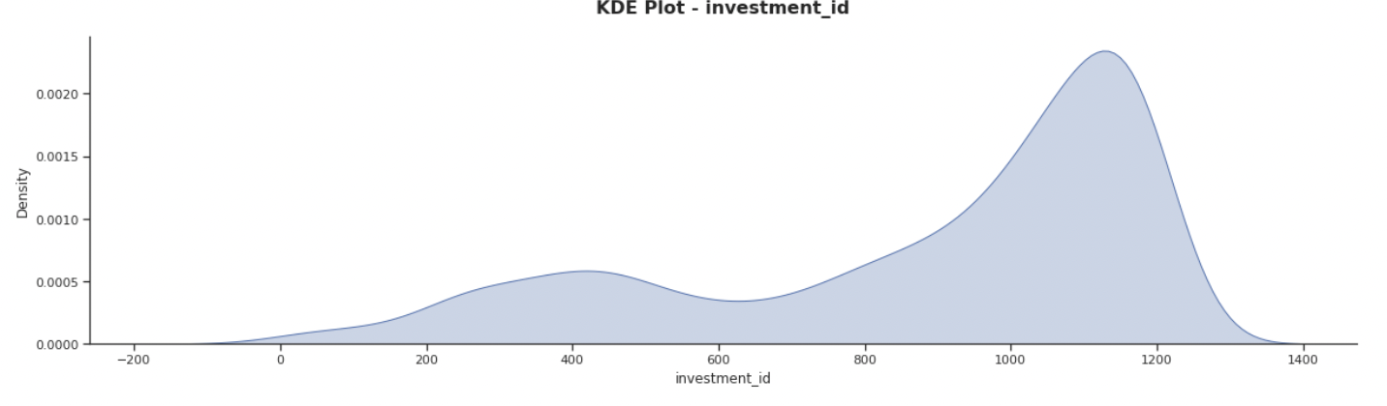
Data overview
3597 unique investment_ids and its samples
Notes:
There are 3579 unique investment\_id, each has different entries. The figure shows the relationship between investment\_id and the number of entries.

Slide 8
Content
Introduction
Background
Data overview
Model
Model structure
Experiments
Setting
Baseline
Main results
Hyper parameter analysis
Feature importance analysis

Slide 9
TabNet
TabNet is a new canonical DNN architecture for tabular data, which combines DNNs with DTs.
Benefits:
TabNet inputs raw tabular data without any preprocessing and is trained using gradient descent-based optimization, enabling flexible integration into end-to-end learning.
TabNet uses sequential attention to choose which features to reason from at each decision step, enabling interpretability and better learning as the learning capacity is used for the most salient features.
TabNet outperforms on other tabular learning models on various datasets for classification and regression problems from different domains.
TabNet enables two kinds of interpretability: local interpretability that visualizes the importance of features and how they are combined, and global interpretability which quantifies the contribution of each feature to the trained model.

Slide 10
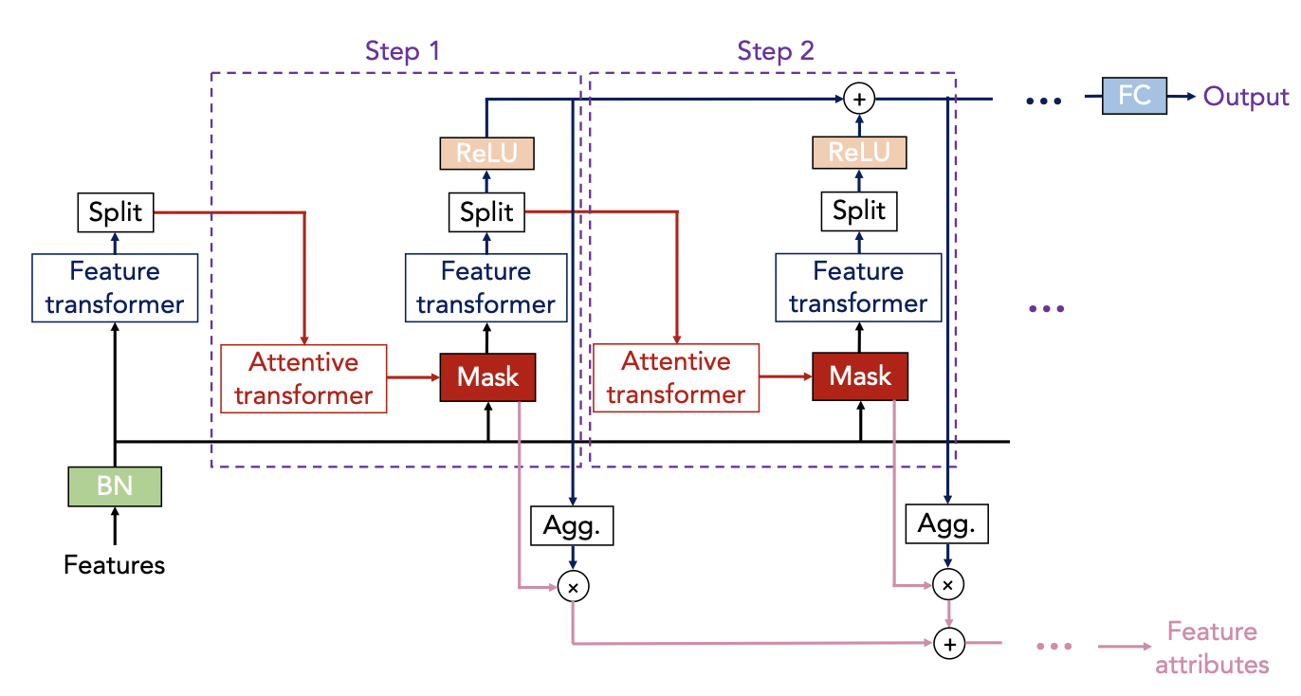
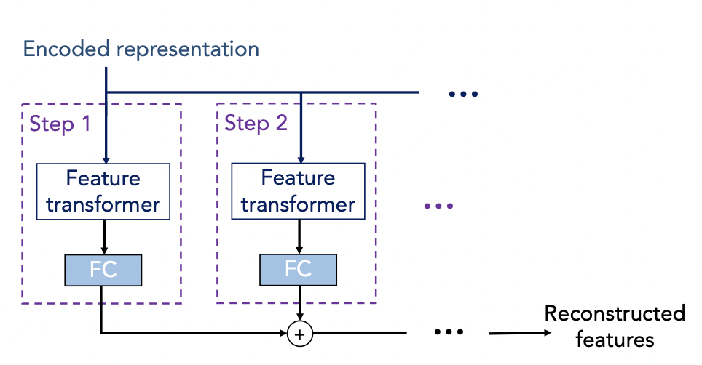
TabNet Structure
TabNet Encoder
TabNet Decoder
Notes:
The TabNet encoder is composed of a feature transformer, an attentive transformer and feature masking. A split block divides the processed representation to be used by the attentive transformer of the subsequent step as well as for the overall output. For each step, the feature selection mask provides interpretable information about the model’s functionality, and the masks can be aggregated to obtain global feature important attribution. The TabNet decoder is composed of a feature transformer block at each step.

Slide 11
Content
Introduction
Background
Data overview
Model
Model structure
Experiments
Setting
Baseline
Main results
Hyper parameter analysis
Feature importance analysis

Slide 12
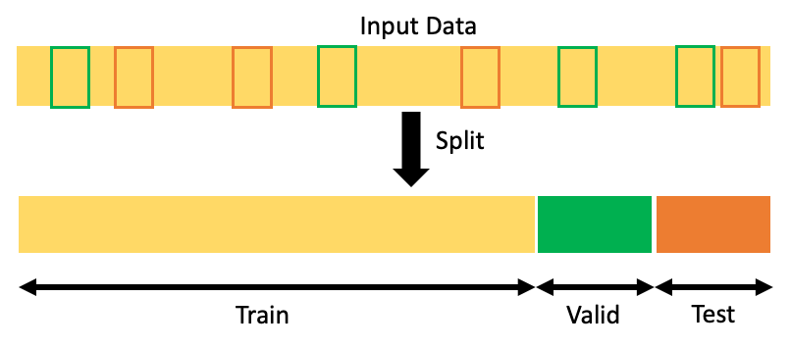

Experiments setting
split the dataset based on the timestamp
smaller than 1126 are in the train set while the others are in the test set.
Evaluation metric:

Slide 13
Hyperparameters
batch size: 1024
width of the decision prediction layer: 8
width of the attention embedding for each mask: 8
number of decision steps: 3
gamma (coefficients for feature reusage in the masks): 1.3
number of independent Gated Linear Units layers at each step: 2
number of shared Gated Linear Units at each step: 2
momentum for batch normalization: 0.02
sparsity loss coefficient: 0.001

Slide 14
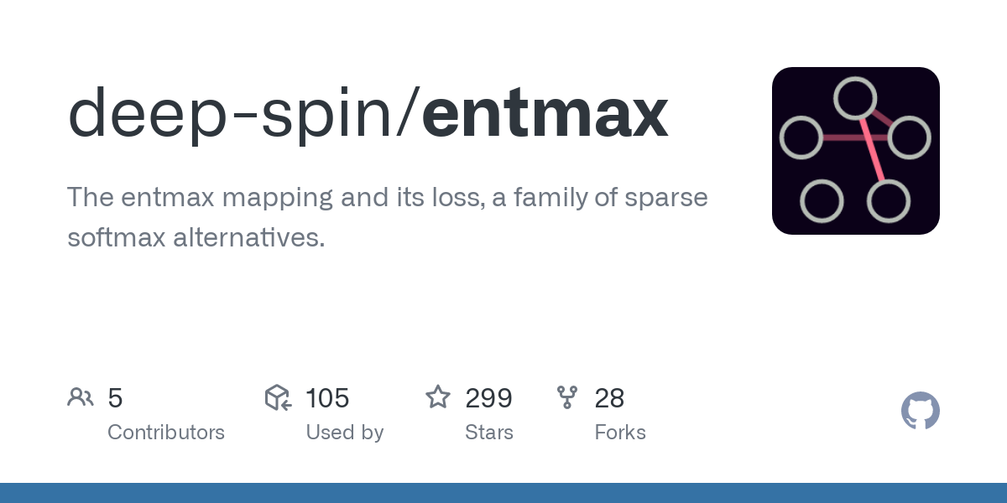
Setting
Masking fuction:
entmax for selecting features
Optimization:
Adam algorithm with 0.0249 learning rate
Notes:
In addition, we adopt entmax function as the masking function to use for selecting features since it can generalize softmax and sparsemax functions. As for optimization algorithm, we use Adam with 0.0249 learning rate which is adjusted by Cosine Annealing Warm Restarts scheme.

Slide 15
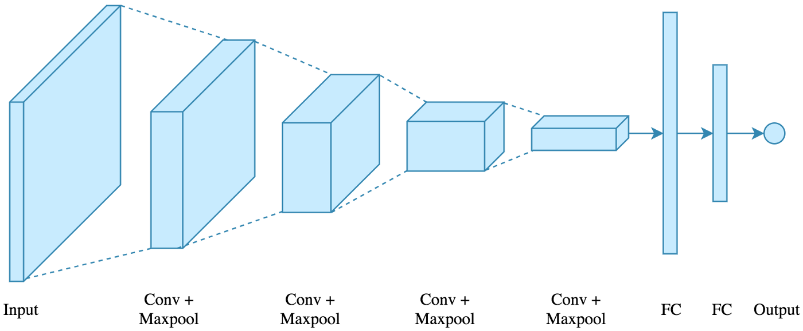
Baseline
Linear Regression (LR)
canonical algorithm for handling regression tasks in machine learning/statistics.
Light Gradient Boosting Machine (LGBM)
efficient and light-scale gradient boosting framework based on decision trees algorithm.
Multi-Layer Perceptron (MLP) + Convolutional Neural Network (CNN) Ensemble
constructed by aggregating the predictions from four MLP models and a one-dimensional CNN model.

Slide 16
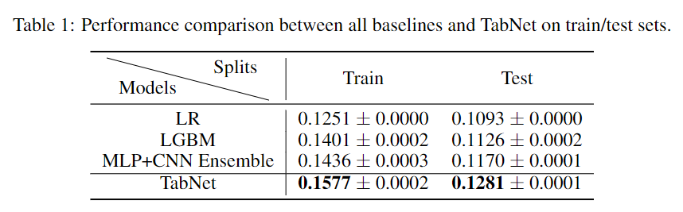
Main results
TabNet outperforms all baselines on both train and test set.
The standard deviation of the TabNet is small compared to the LGBM and MLP+CNN baselines
Without using any ensemble technique, TabNet still outperforms the ensemble baseline (MLP+CNN Ensemble).
Notes:
All results are obtained by three repetitive experiments under three different random seeds. The performance of all baselines and TabNet on train/test sets is shown in Table where we have the following observations: 1.TabNet outperforms all baselines on both train and test set. This demonstrates that TabNet is indeed more powerful than the baselines in tackling tabular datasets. 2.The standard deviation of the TabNet is small compared to the LGBM and MLP+CNN baselines, which shows that TabNet is very stable with respect to different random seeds, making it a suitable solution to various real-life challenges involving tabular datasets. 3.Without using any ensemble technique, TabNet still outperforms the ensemble baseline (MLP+CNN Ensemble). This shows that TabNet is a desirable choice for solving various learning problems about tabular datasets since it is already powerful when being used as a single model, saving tremendous efforts of building complicated ensemble models.

Slide 17
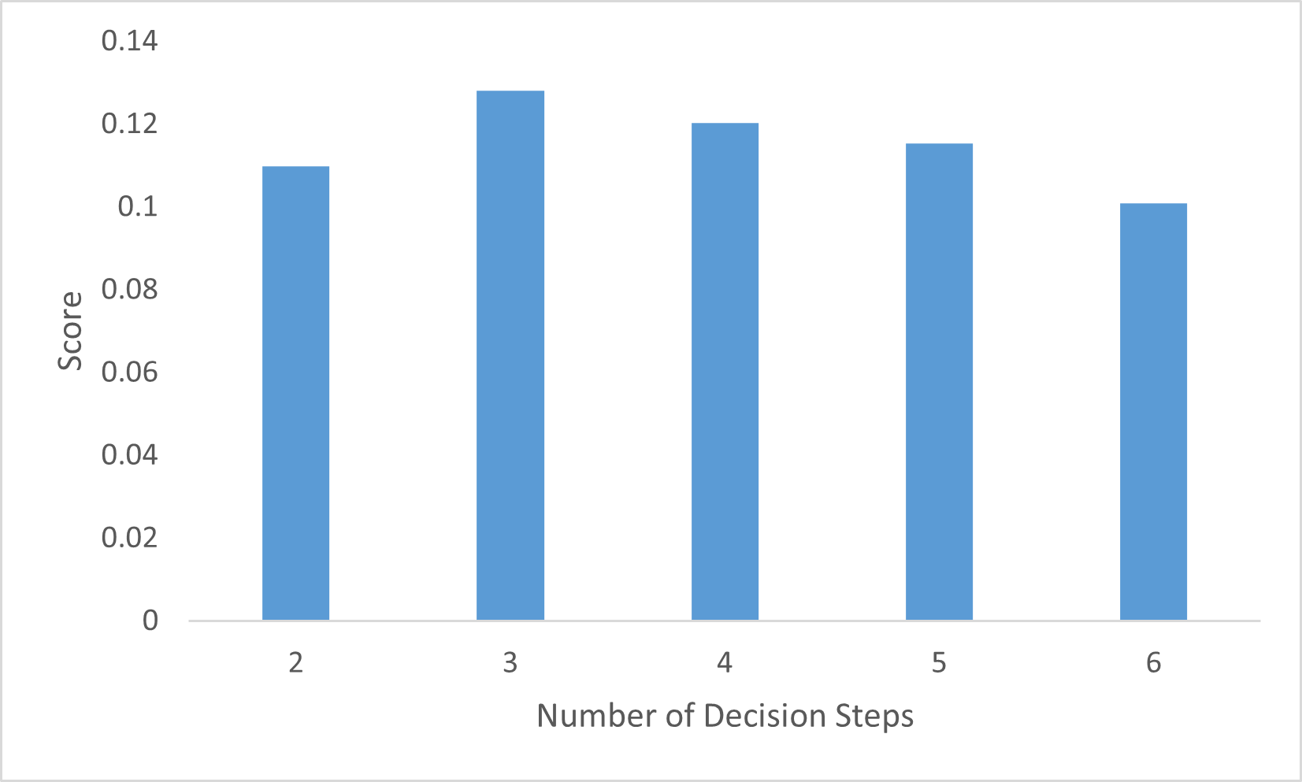
Hyper-Parameter analysis
When taking 3 decision steps in encoder and decoder, TabNet achieves the optimal performance. The performance degrades when taking less or more decision steps.
The performance drops monotonically when increasing the number of decision steps starting from 3, and the performance in 6 steps is even worse than in 2 steps.
The performance of 2, 3, 4, 5, 6 steps
Notes:
his hyper-parameter specifies how many times the TabNet would process the features in the encoder and decoder. We investigate the effect of this parameter by checking its performance when taking the values in $\{2, 3, 4, 5, 6\}$. The mean scores of all configurations on the test set are shown in Figure

Slide 18
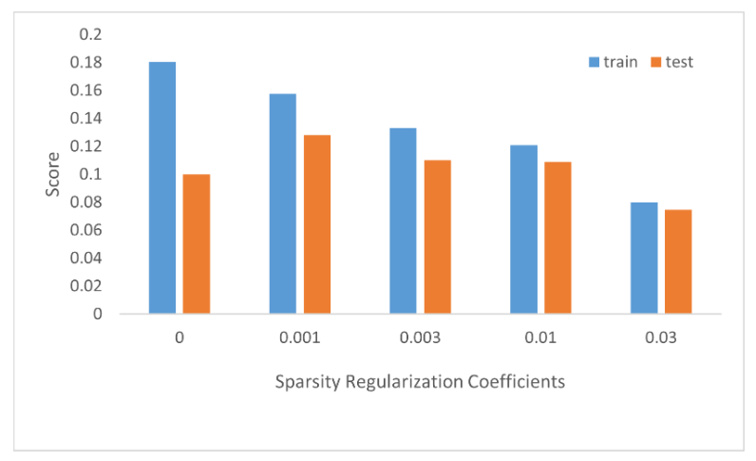
Sparsity Regularization Coefficient
The instance with the coefficient taking the value of 0.001 achieves the optimal generalization capability.
The gaps between the train scores and the corresponding test scores range from 0.0055 to 0.0802, where the value decreases monotonically as the coefficient increases.

Slide 19
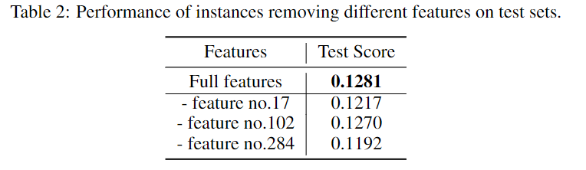
Feature Importance Analysis
All three features contribute positively to the performance of the model, where the feature no.284 has the greatest significance among the three features, whereas the feature no.102 has the smallest significance.
For features without significant influence on the model performance, it might be helpful to remove those features or aggregate them into one single feature to reduce both time and memory consumption.

Slide 20
Conclusion
Introduction of the competition
Data analysis and visualization
We explain the TabNet structure and its functionality
TabNet experiments with baselines. TabNet achieves the best performance.
We analyze some important hyper-parameters of TabNet and the importance of some features.
Notes:
We first introduce the background of market prediction and common models. Then we explain the TabNet structure and its functionality. We conduct the experiments by comparing the TabNet with some widely used baselines for Ubiquant task, where the TabNet achieves the best performance. Moreover, we analyze some important hyper-parameters of TabNet and the importance of some features.

