Slide 1
Exploring genetic variations among samples by dimensional reduction
Kewei Xiong Department of Life Science

Slide 2
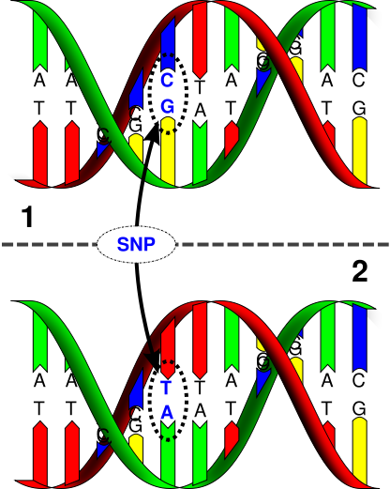
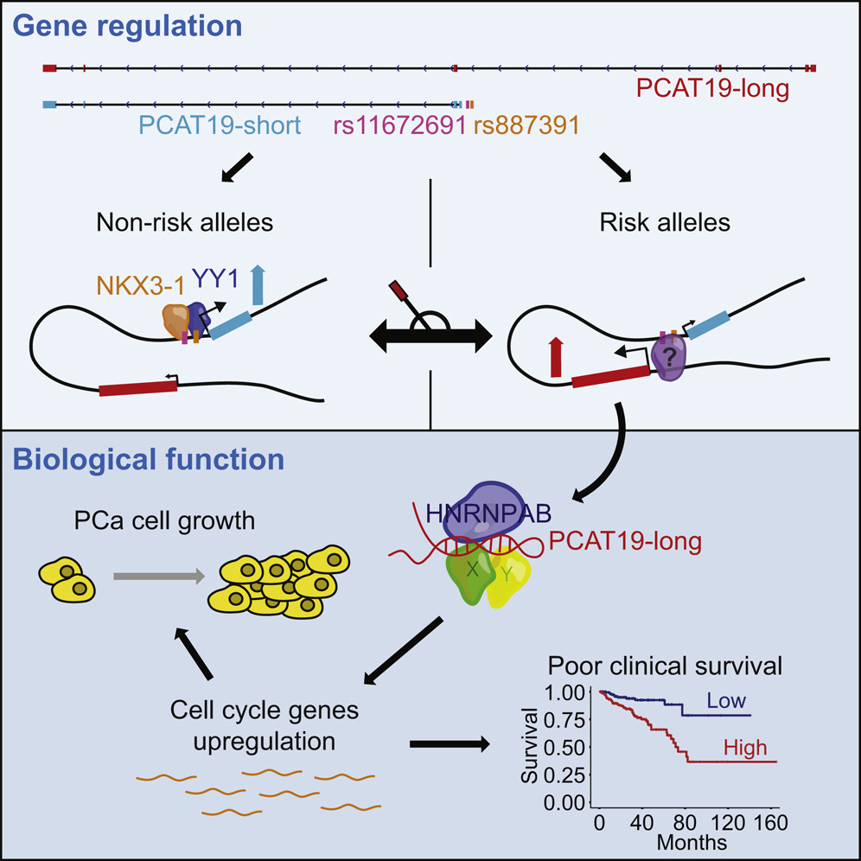
Single-nucleotide polymorphisms (SNPs) are highly associated with cancer susceptibility
Hua JT, et al. Cell. 2018.

Slide 3

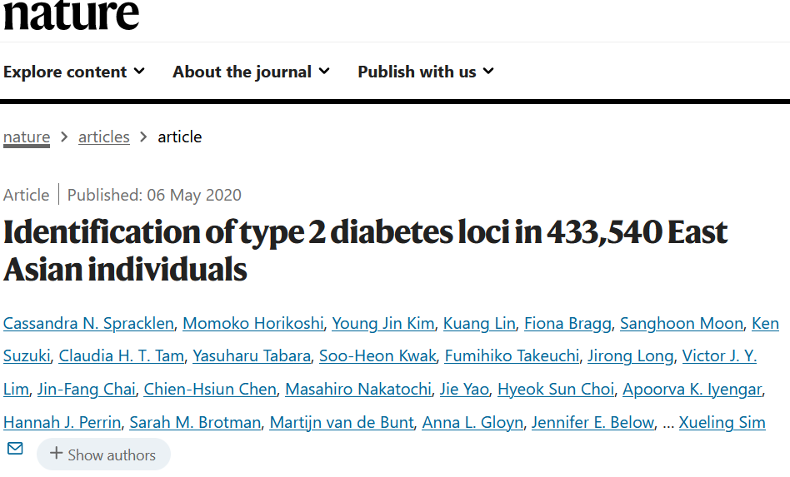
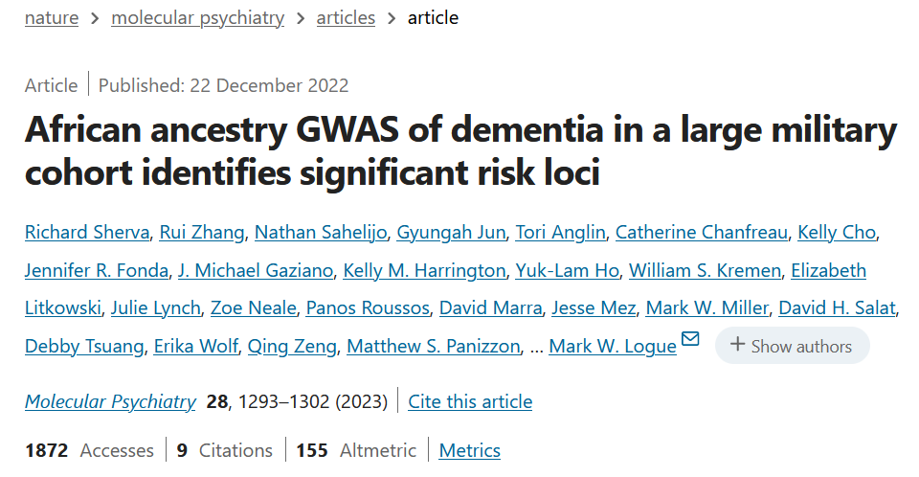
Disease risk alleles are population-specific

Slide 4
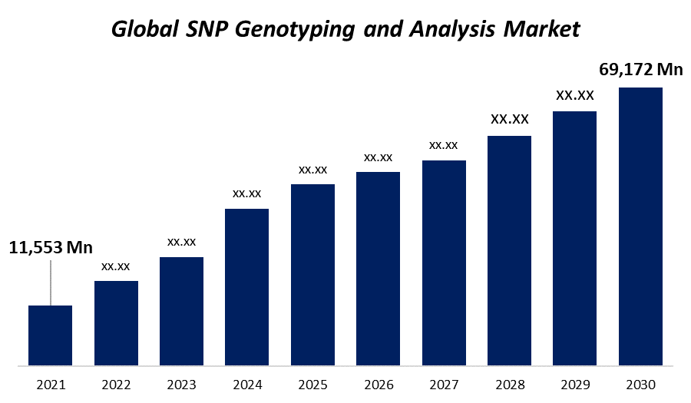
A large number of SNPs have been identified

Slide 5
Questions
How to visualize genetic variations across different populations by dimensional reduction?
Does clustering based on the low-dimensional space recover different populations?
Can we identify trait-associated population-specific SNPs using the simple method?

Slide 6
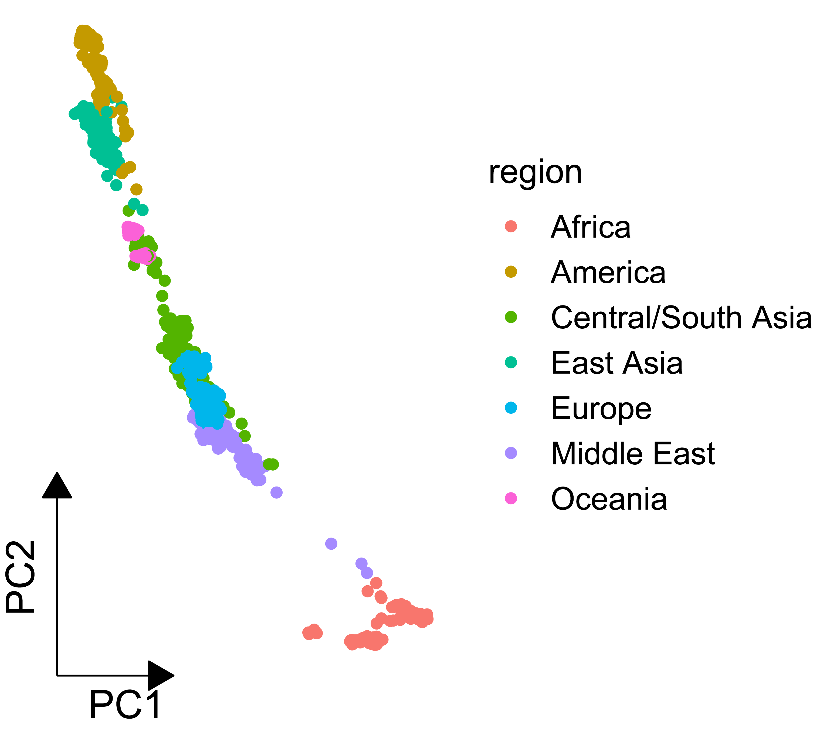
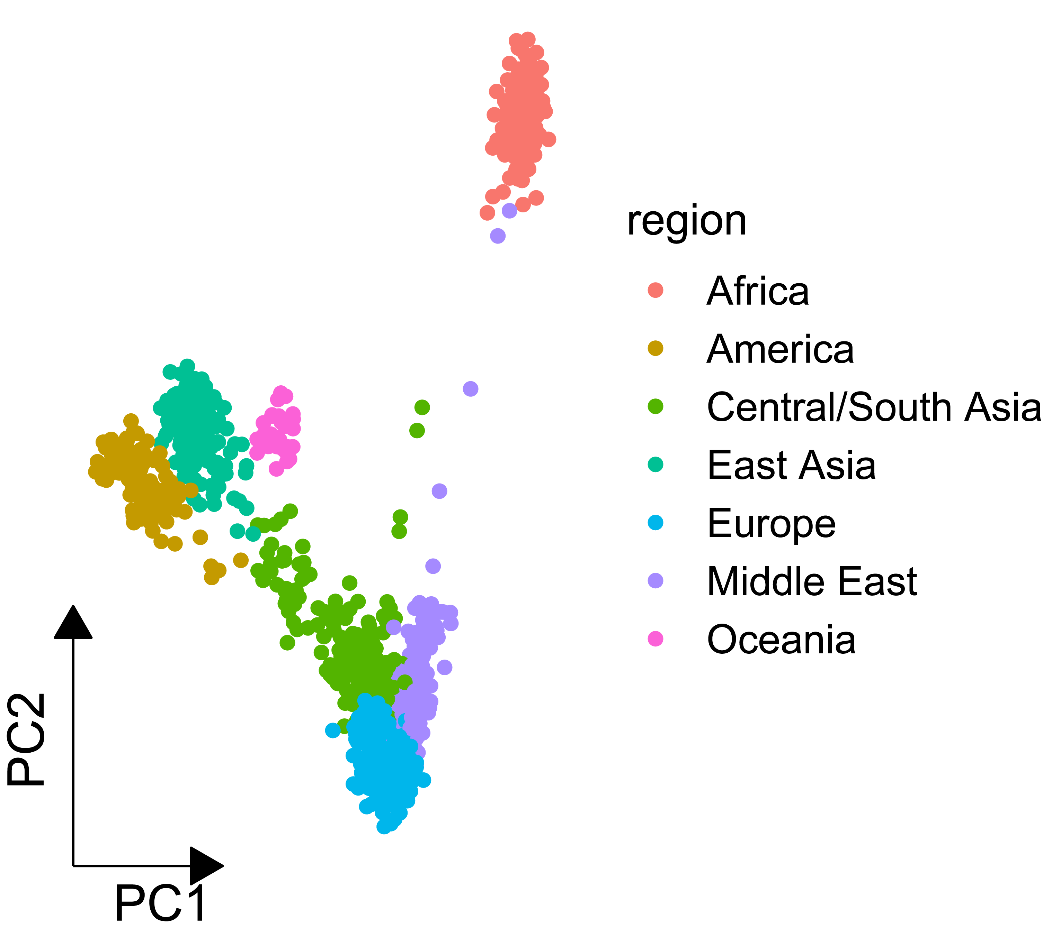
Incorporating random projection improved the results of PCA alone
1034 samples and 488919 SNPs
PCA only
Sparse random projection + PCA

Slide 7
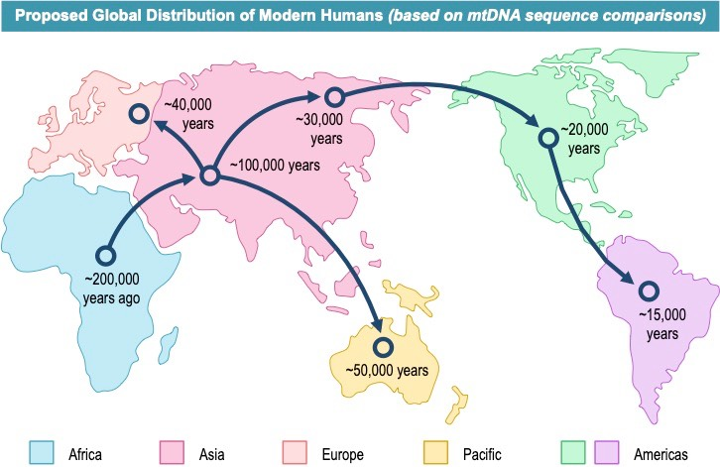
PCA accurately recovered human migration history

Slide 8
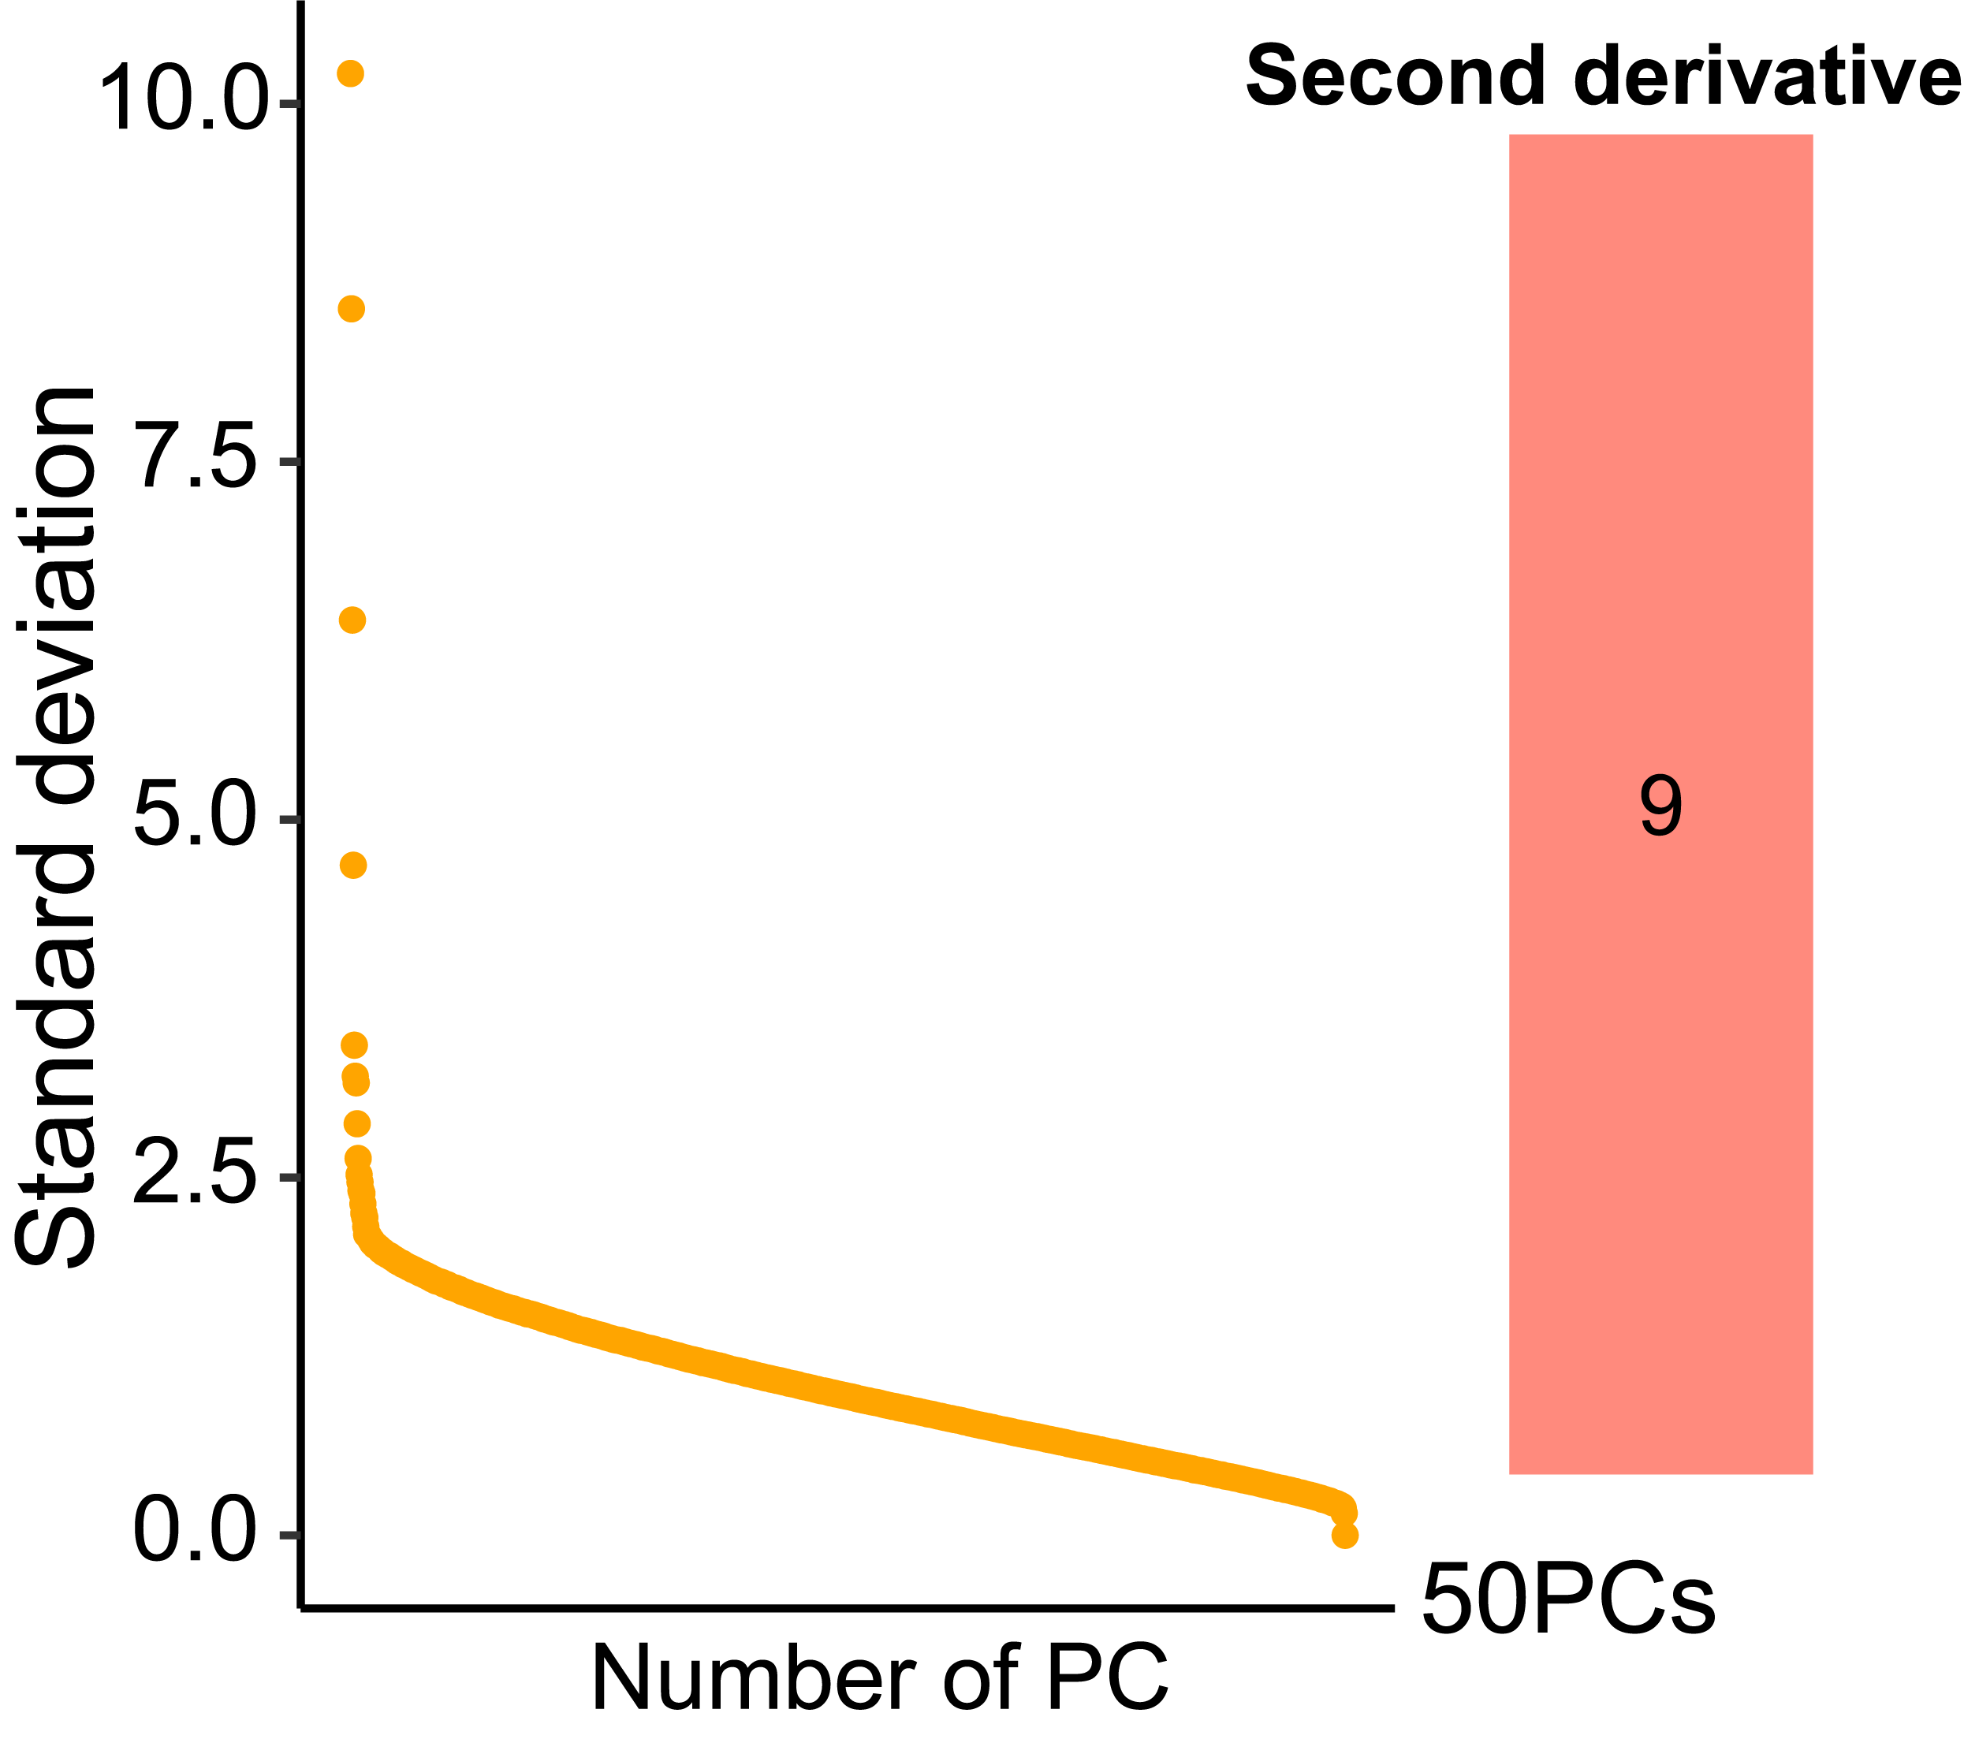
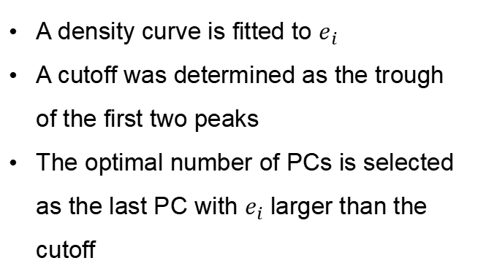
Nine optimal principal component number was determined by the ‘second derivative’ strategy
Define the second derivative as follows:
$$e_{i}=d_{i+1}−d_{i}=(s_{i+1}−s_{i})−(s_{i}−s_{i−1})$$
A density curve is fitted to $e_{i}$
A cutoff was determined as the trough of the first two peaks
The optimal number of PCs is selected as the last PC with $e_{i}$ larger than the cutoff

Slide 9
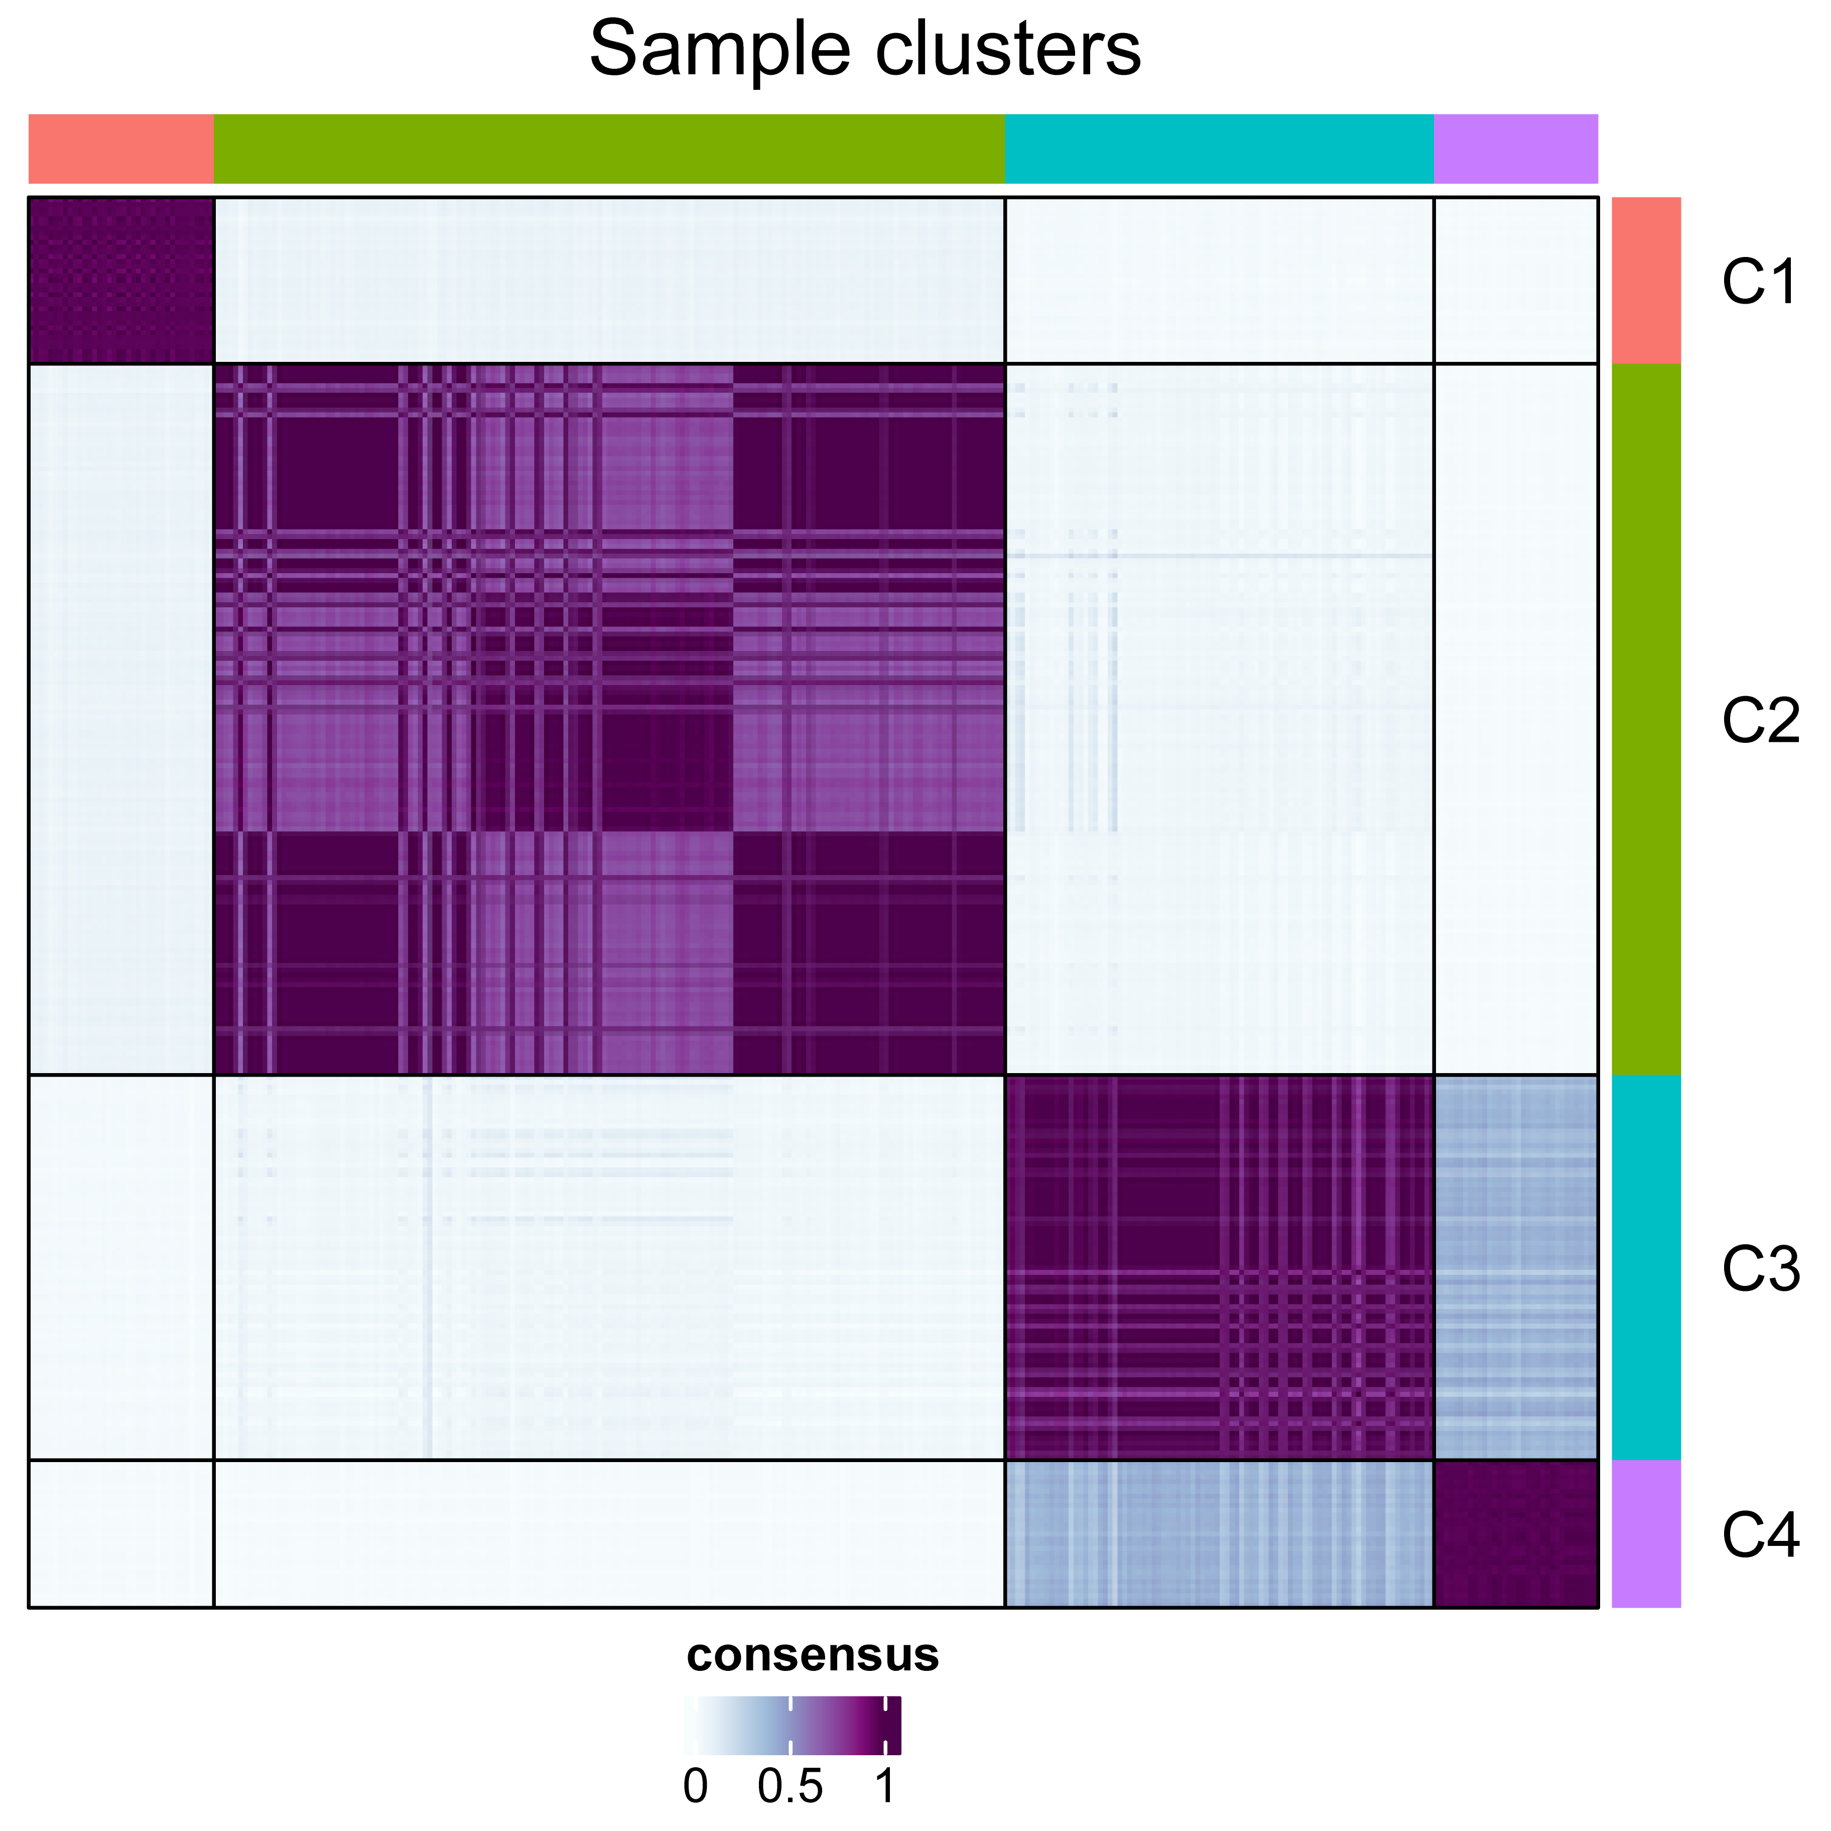
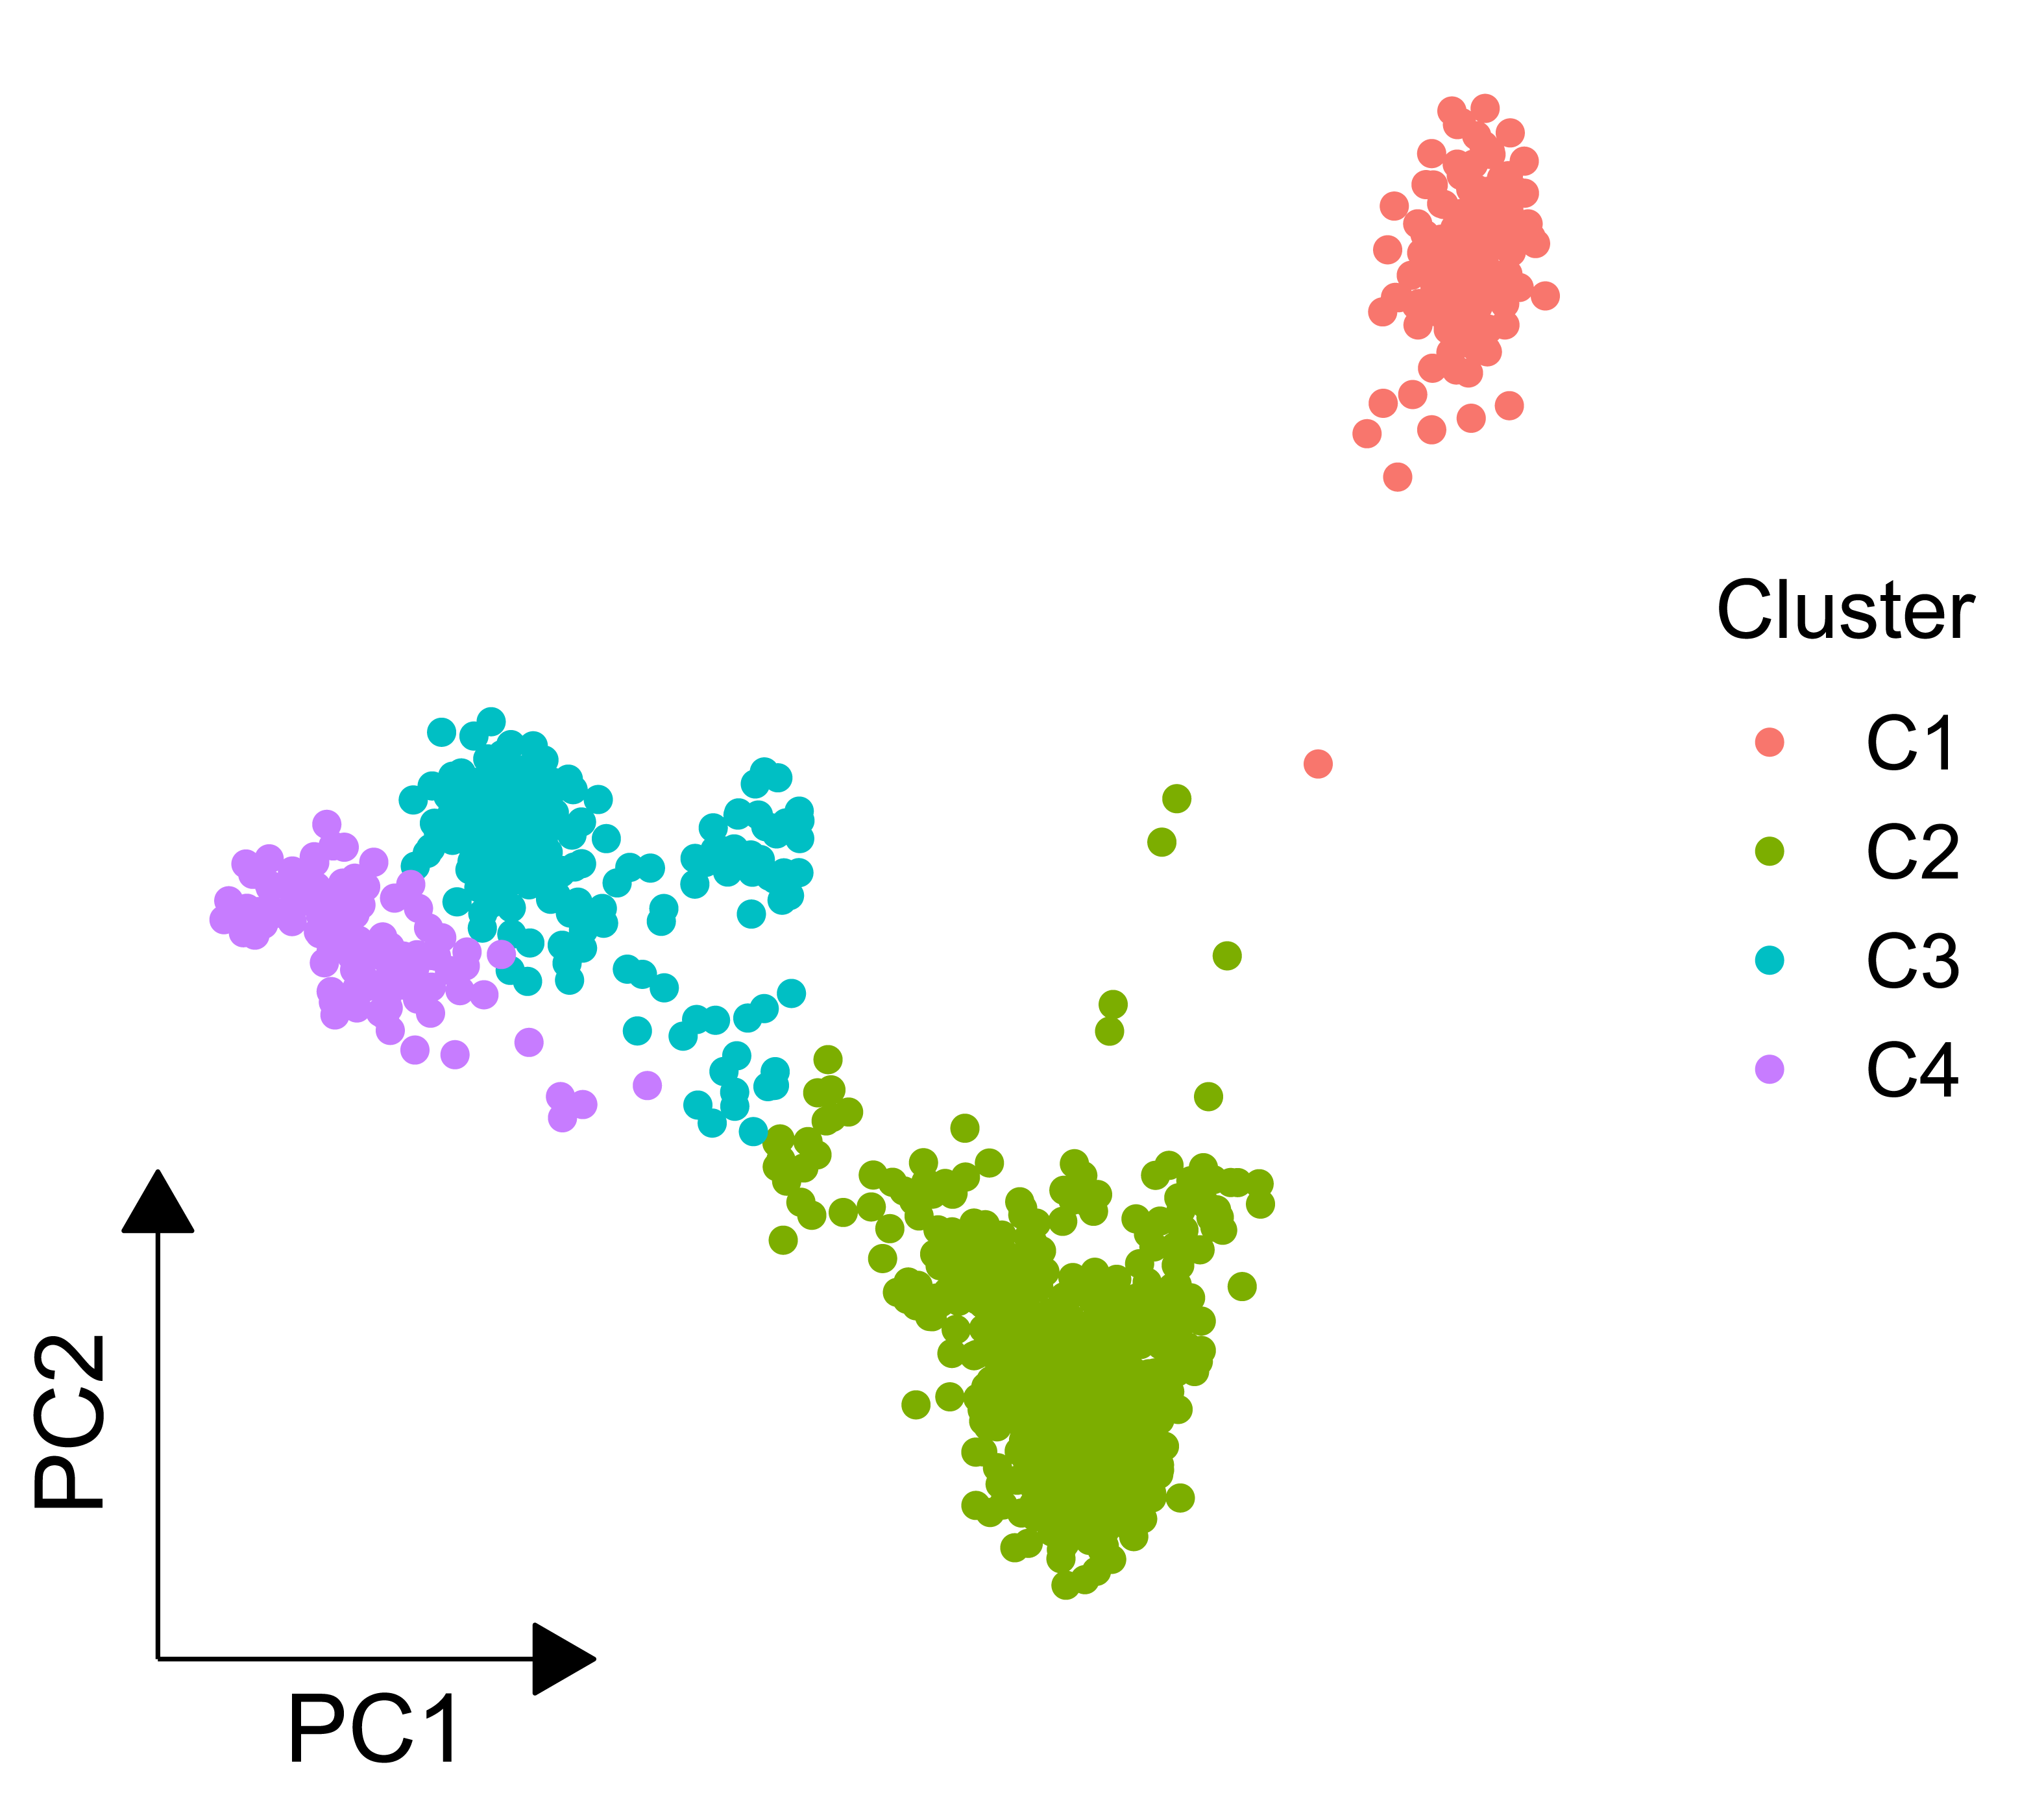
Four sample clusters were identified with different genetic profiles
Consensus K-means clustering with subsampling ratio of 0.8 and 100 iterations
East Asian
Oceania
Middle East
Central/South Asia
Europe

Slide 10
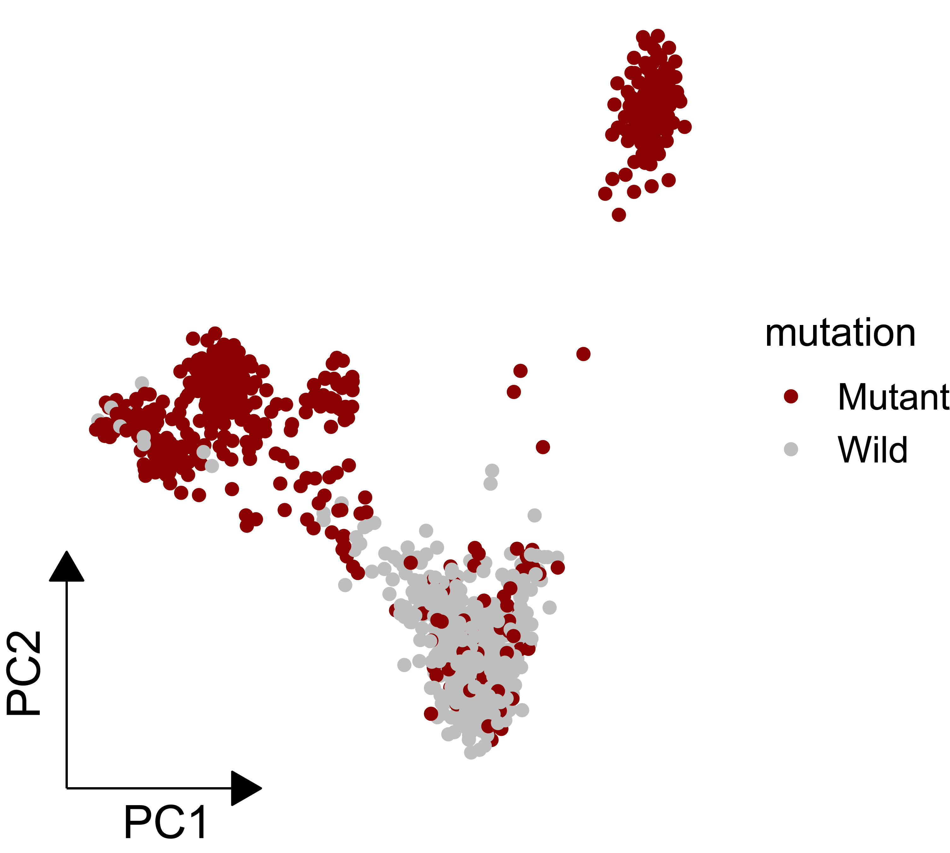
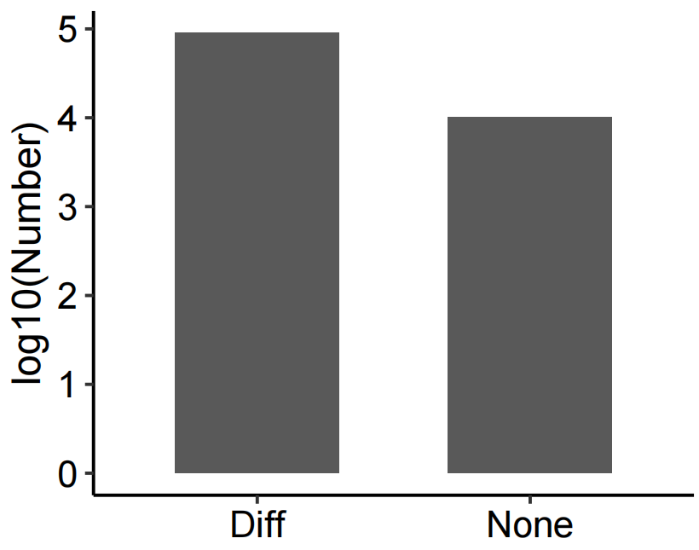
~90,000 out of 100,000 SNPs showed differnet mutation frequency across different clusters
Fisher’s exact test
rs2250072, FDR = 6.91e-166

Slide 11
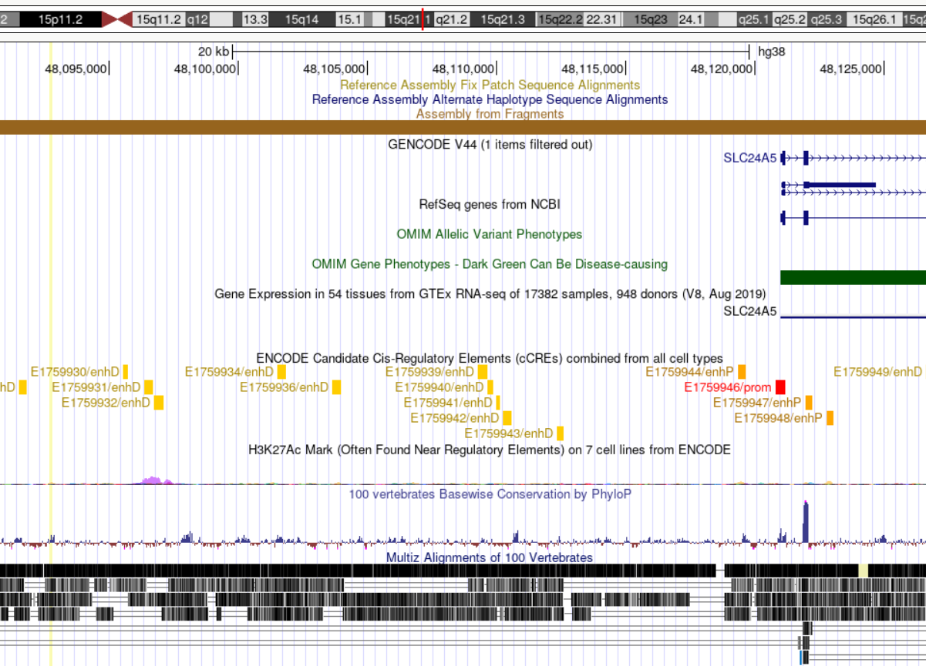

rs2250072 is a breast cancer risk allele in Africa, European, East Asia and Oceania

Slide 12
Conclusion
By comparing PCA alone and incorporating random projections, I found that in this SNP dataset, the combining strategy outperformed PCA alone, which clearly demonstrated geographic variations.
Consensus clustering analysis accurately identified ethnic substructure based on random projection-derived PCA embedding, and Oceanian and East Asian share similar genetic profile.
rs2250072 is the most differential SNP across the genetic clusters located near breast cancer susceptibility gene SLC24A5.

