Slide 1
Yeast Cell-Cycle Regulation Network inference
Wang Lin

Slide 2
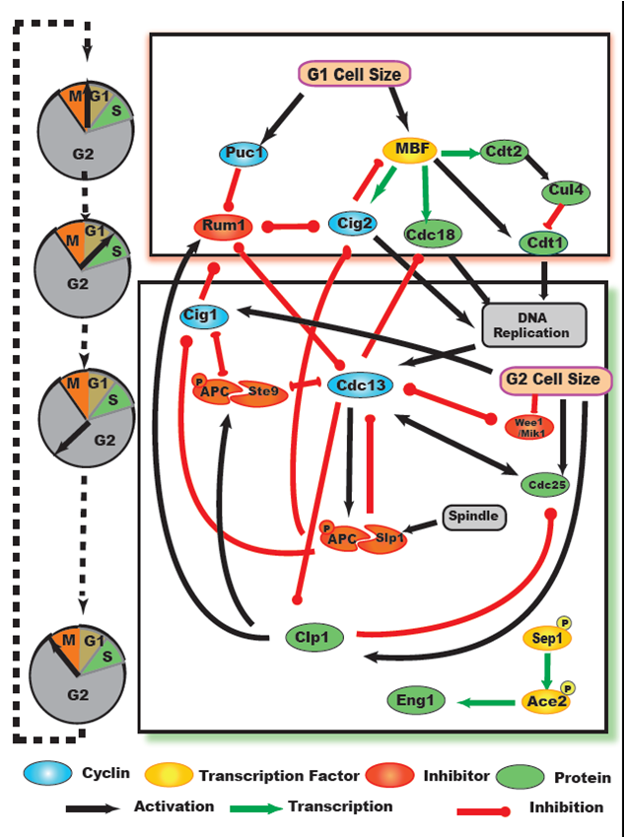
The topic we focus on--Genetic interactions.

Slide 3
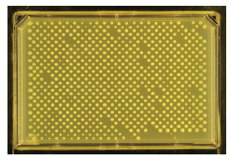
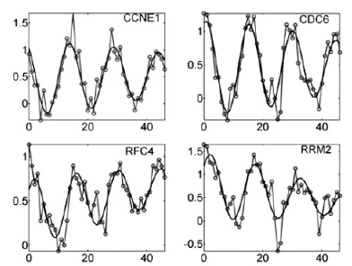
Experience Methods
EMAP(Epistatic Miniarray Profile)
Double mutant
Microarray
Gene expression

Slide 4
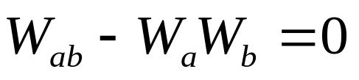
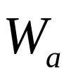
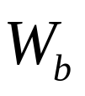
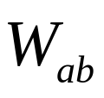
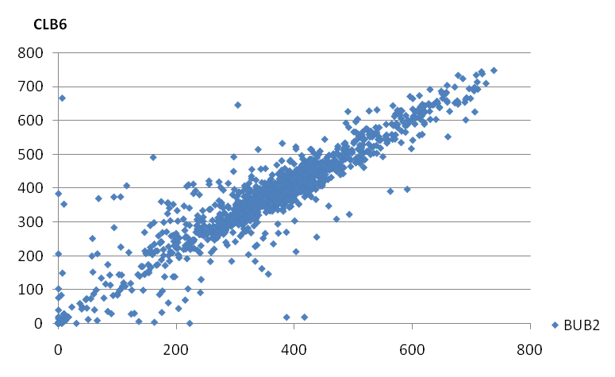
EMAP
Null hypothesis:
where , , and represent the fitnesses (or growth
rates) relative to wild-type organisms with mutation A, with
mutation B, and with both mutations, respectively.
-
+

Slide 5
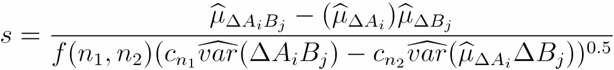
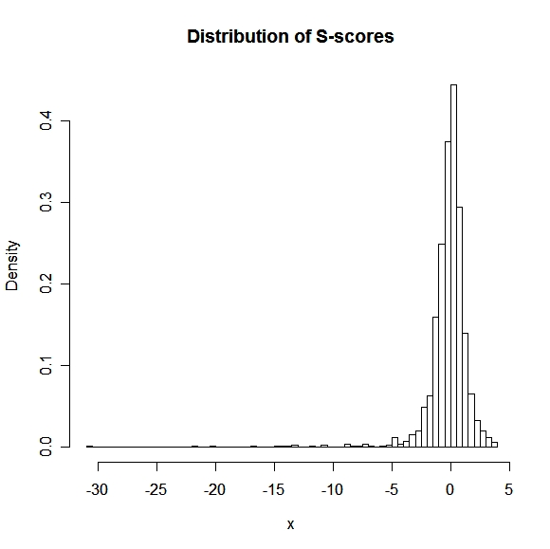
S score
The definition of S score

Slide 6
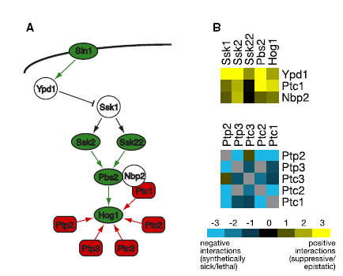
Cluster
Functional Organization of the S. cerevisiae Phosphorylation Network Dorothea Fiedler Cell 2009

Slide 7
Cluster
Problem1: Cluster using the whole data set always did not show good results because of the noise and the complex network.
Problem2: How to select a cluster method.
  Single, Complete, SVM(MCL, Diffusion Kernel)

Slide 8
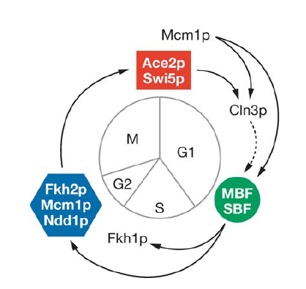
Problem1: Additional Information
Cell-Cycle Related Genes could be separated to 4 periods
- S, G1, M, G2

Slide 9
Microarray data
Time cause microarray experiments

Slide 10

RPM Model
From: “A random-periods model for expression of cell-cycle genes” Delong Liu et al. PNAS 2004
Model: A nonlinear regression model for quantitatively analyzing periodic gene expression

Slide 11
How to find cell cycle related genes?
Use estimates from fitting the RPM to known cell-cycle genes to inform a correlation approach for selecting other cell-cycle-related genes.

Slide 12
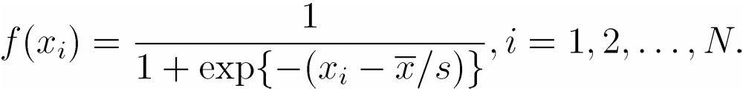



Another way to use microarray data
High positive S-score with microarray evidence
Time-lagged Correlation Analysis
The activation of a gene by a TF in a nonlinear (sigmodial) fashion
where is relative expression at the time point for a given TF, is the mean of the TF expression profile over all time points and s is the standard deviation

Slide 13

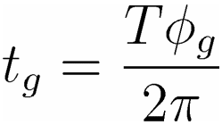

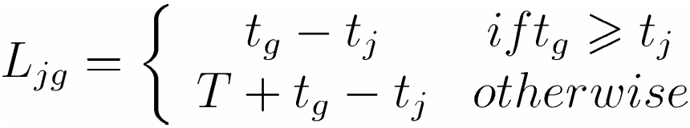
Time-lagged Correlation Analysis
The definition of time-lagged:
  T : denote the estimated cell cycle period of a particular experiment.
  : denote the estimated phase angle of gene g
  :

Slide 14



Time-lagged Correlation Analysis
The Correlation Analysis:
Calculate the spearman rank correlation of
and where

Slide 15
Combined EMAP and Microarray
Microarray cluster + S-score cluster
Significant S-score + Time-Lagged Correlation

Slide 16
Reference
Sean R Collins, A strategy for extracting and analyzing large-scale quantitative epistatic interaction data, Genome Biology 2006
Dorothea Fiedler, Functional Organization of the S. cerevisiae Phosphorylation Network, Cell 2009
Delong Liu, A random-periods model for expression of cell-cycle genes, PNAS 2004
Pierre R. Bushel, Dissecting the fission yeast regulatory network reveals phase-specific control , Systems Biology 2009

