Slide 1

Graph Embedding and Extensions:
A General Framework for Dimensionality Reduction
Keywords:
Dimensionality reduction, manifold learning, subspace learning, graph embedding framework.

Slide 2
1.Introduction
Techniques for dimensionality reduction
Linear: PCA/LDA/LPP...
Nonlinear: ISOMAP/Laplacian Eigenmap/LLE...
Linear → Nonlinear: kernel trick
Graph embedding framework
A unified view for understanding and explaining many popular algorithms such as the ones mentioned above.
A platform for developing new dimension reduction algorithms.

Slide 3
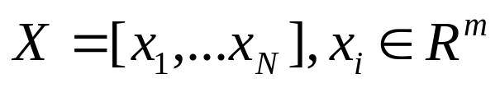
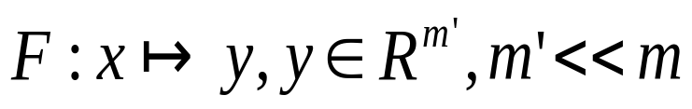
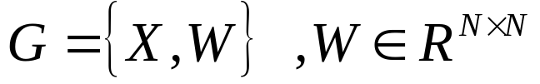
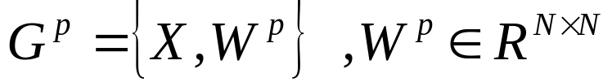
2.Graph embedding
2.1Graph embedding
Let m is often very large so we
need to find
Intrinsic graph: --similarity matrix
Penalty graph: --the similarity to be suppressed in the dimension-reduced feature space Y

Slide 4
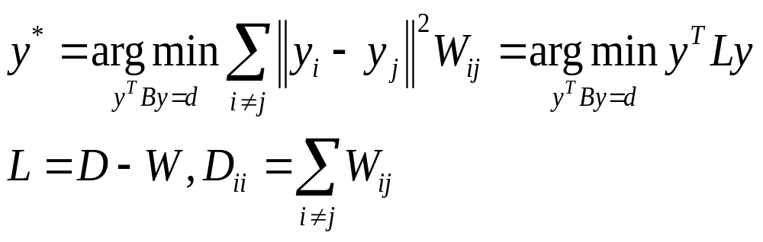
Our graph-preserving criterion is:
L is called Laplacian matrix
B typically is diagonal for scale normalization or L-matrix of the penalty graph

Slide 5
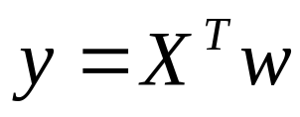
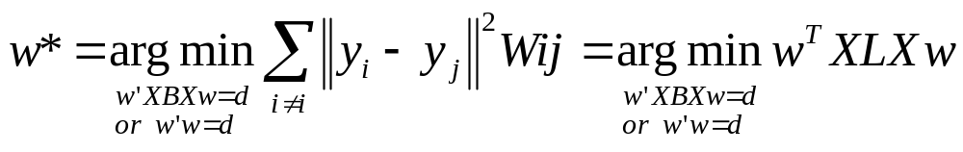
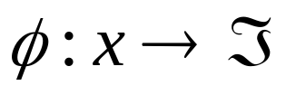
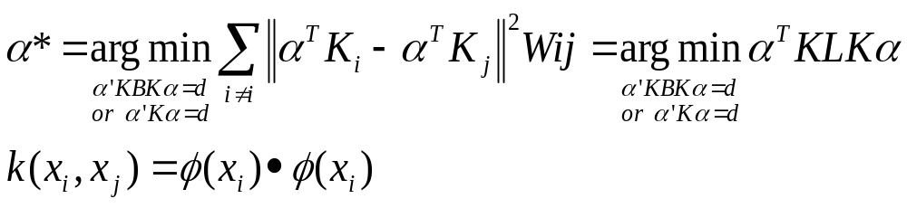
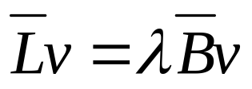
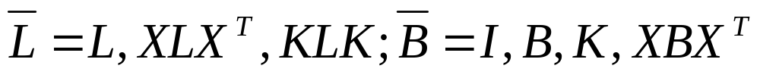
Linearization:
Kernelization:
Both can be obtained by solving:

Slide 6
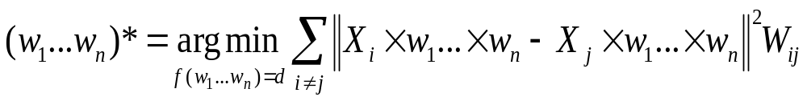

Tensorization:
2.2General Framework for Dimensionality Reduction

Slide 7
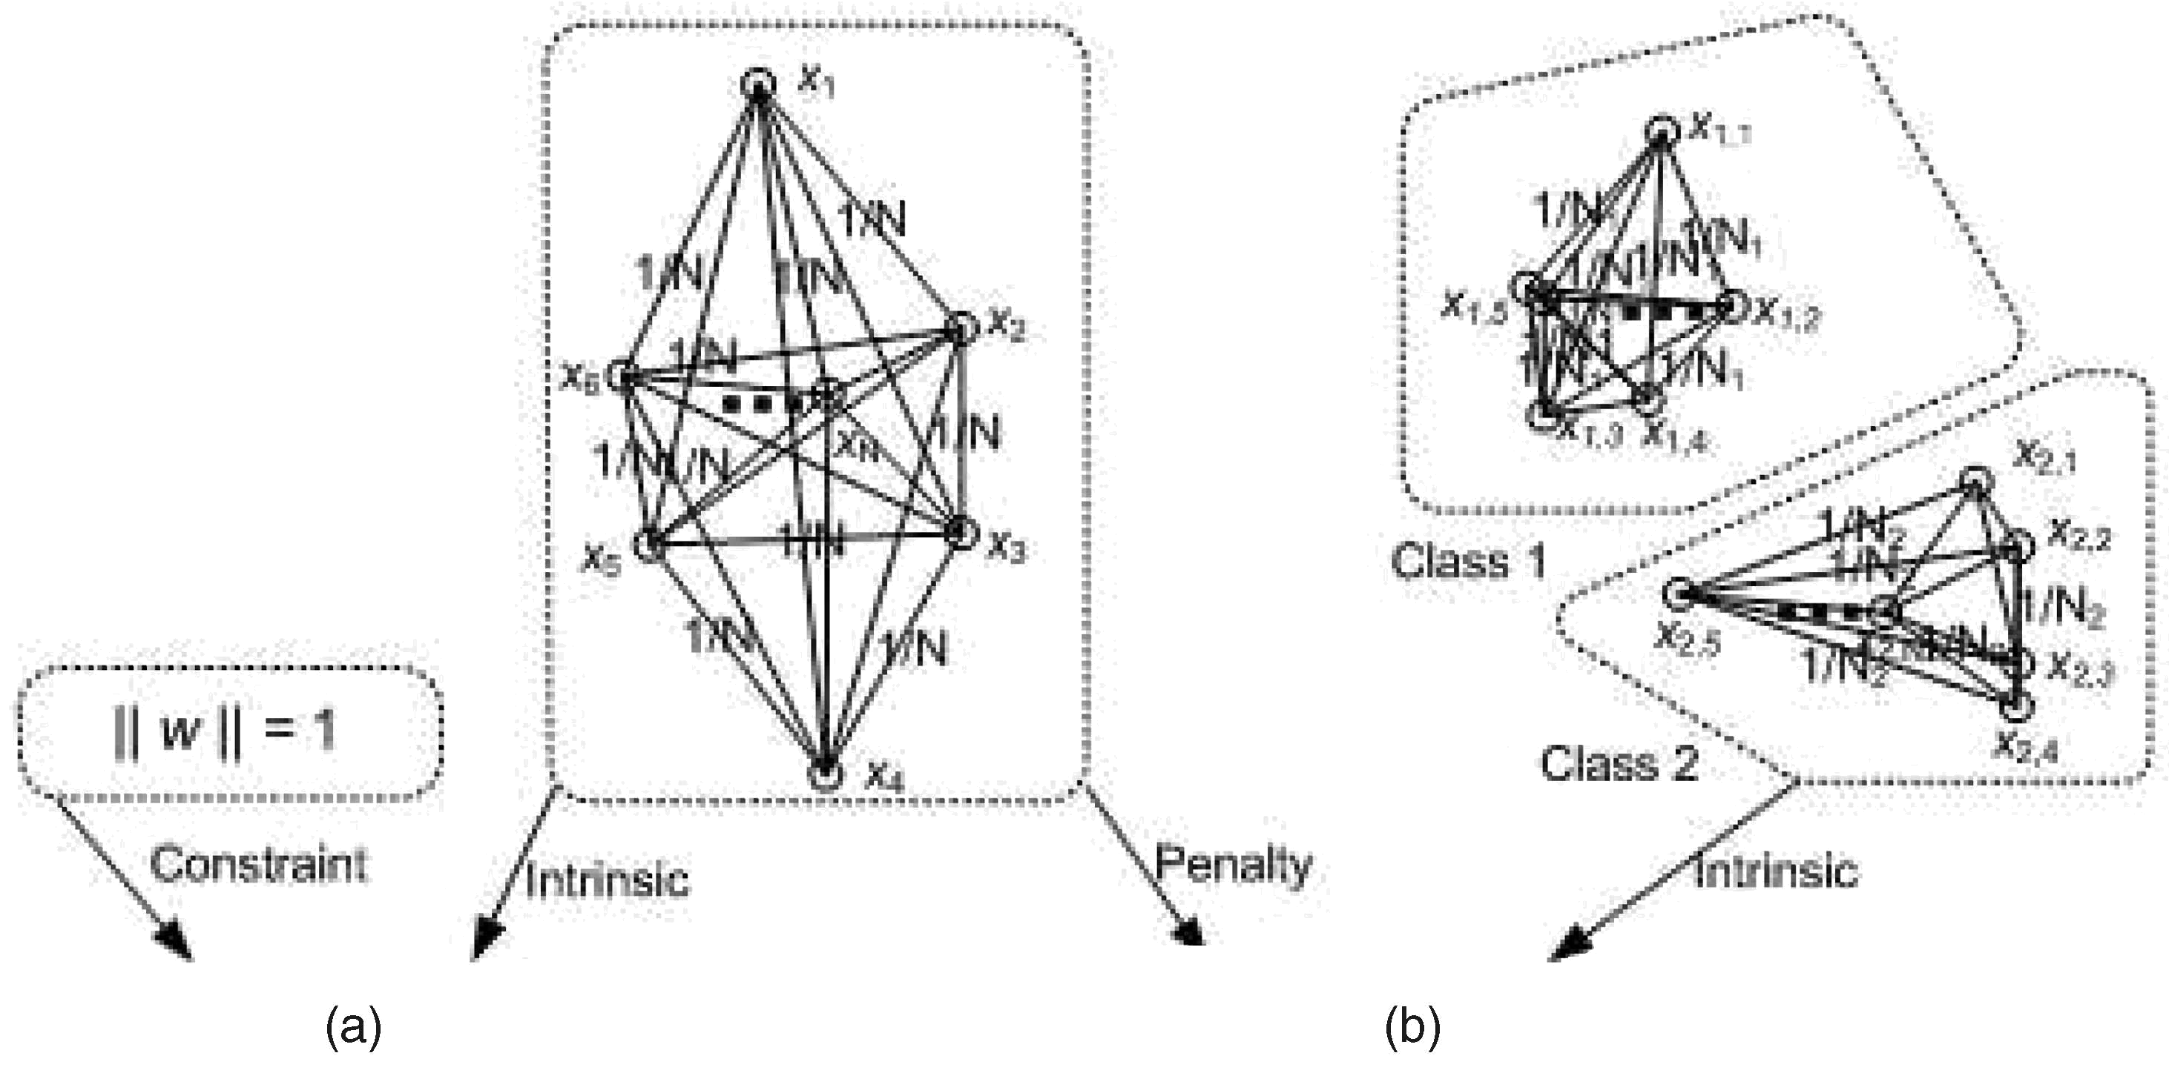
The adjacency graphs for PCA and LDA. (a) Constraint and intrinsic graph in PCA. (b) Penalty and intrinsic graphs in LDA.

Slide 8
2.3 Related Works and Discussions
2.3.1 Kernel Interpretation and Out-of-Sample Extension
Ham et al. [13] proposed a kernel interpretation of KPCA,ISOMAP, LLE, and Laplacian Eigenmap
Bengio et al. [4] presented a method for computing the low dimensional representation of out-of-sample data.
Comparison:
Kernel Interpretation Graph embeding
normalized similarity matrix laplacian matrix
unsupervised learning both supervised&unsupervised

Slide 9
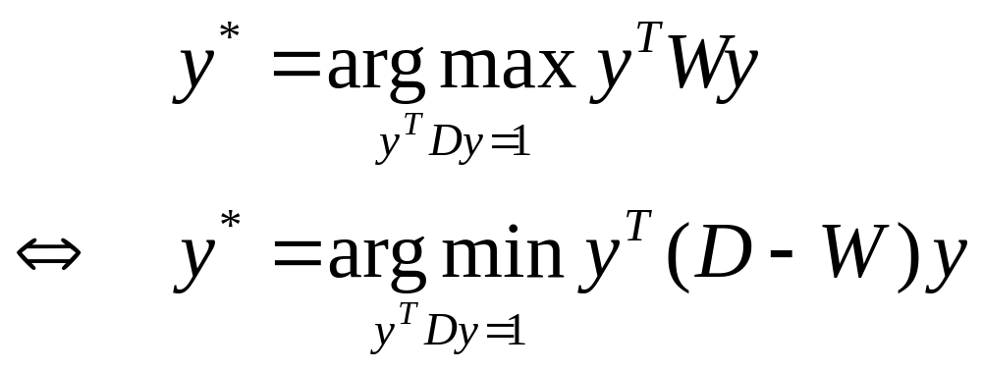
2.3.2 Brand’s Work [5]
Brand’s Work can be viewed as a special case of the graph embedding framework

Slide 10
2.3.3 Laplacian Eigenmap [3] and LPP [10]
Single graph B=D
Nonnegative similarity matrix
Although [10] attempts to use LPP to explain PCA and LDA, this explanation is incomplete.
The constraint matrix B is fixed to D in LPP, while the constraint matrix of LDA is comes from a penalty graph that connects all samples with equal weights;hence, LPP cannot explain LPP. Also,a minimization algorithm, does not explain why PCA maximizes the objective function.

Slide 11
3 MARGINAL FISHER ANALYSIS
3.1 Marginal Fisher Analysis
Limitation of LDA:data distribution assumption
limited available projection directions
MFA overcomed the limitation by characterizing intraclass compactness and interclass separability.
intrinsic graph: each sample is connected to its k1
nearest neighbors of the same class
(intraclass compactness)
penalty graph: each sample is connected to its k2
nearest neighbors of other classes
(interclass separability)

Slide 12
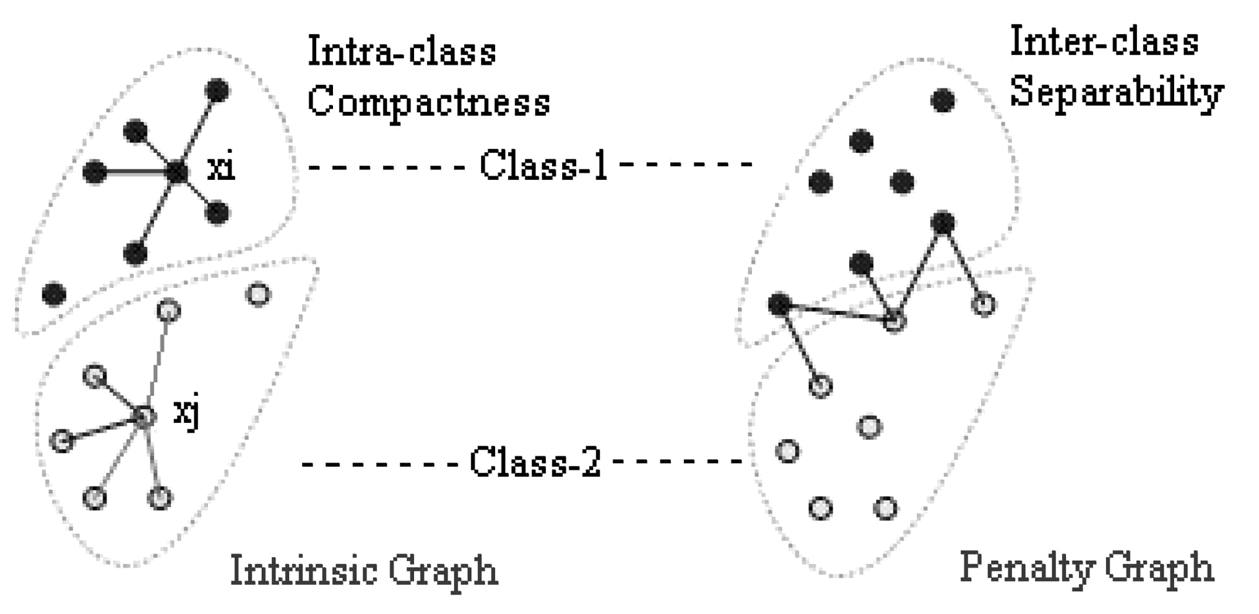

Slide 13
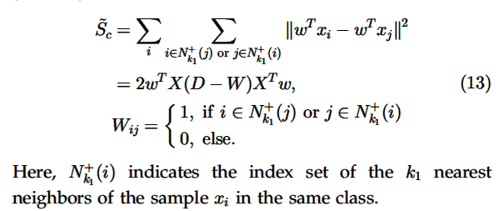
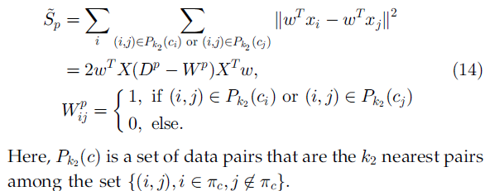

Slide 14

Procedure of MFA
PCA projection
Constructing the intraclass compactness and interclass separability graphs.
Marginal Fisher Criterion
Output the final linear projection direction

Slide 15
Advantages of MFA
The available projection directions are much greater than that of LDA
There is no assumption on the data distribution of each class
Without prior information on data distributions

Slide 16


KMFA
Projection direction:
The distance between sample xi and xj is
For a new data point x, its projection to the derived
optimal direction is obtained as

Slide 17
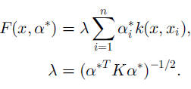

TMFA:

Slide 18
4.Experiments
4.1face recognition
4.1.1
MFA>Fisherface(LDA+PCA)>PCA
PCA+MFA>PCA+LDA>PCA
4.1.2
  Kernel trick
  KDA>LDA,KMFA>MFA
  KMFA>PCA,Fisherface,LPP

Slide 19
Trainingset
Adequate: LPP > Fisherface ,PCA
Inadequate: Fisherface > LPP>PCA
anyway, MFA>=LPP
Performance can be substantially improved by exploring a certain range of PCA dimensions first.
PCA+MFA>MFA,Bayesian face
>PCA,Fisherface,LPP
Tensor representation brings encouraging improvements compared with vector-based algorithms
it is critical to collect sufficient samples for all subjects!

Slide 20
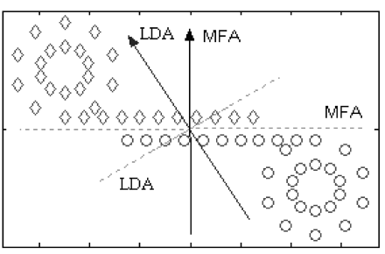
4.2 A Non-Gaussian Case

Slide 21
5.CONCLUSION AND FUTURE WORK
All possible extensions of the algorithms mentioned in this paper
Combination of the kernel trick and tensorization
The selection of parameters k1 and k2
How to utilize higher order statistics of the data set in the graph embedding framework?

