Slide 1

“
Presenter: WANG Zhongchen
”
G-Research Crypto Forecasting
WANG Lei
WANG Zhongchen
YE Xiaoyu
ZHANG Quandi

Slide 2
Contents
Introduction
Data Analysis & Modeling
Conclusion & Future Work
1
2
3
Dataset description
Exploratory data analysis
Feature engineering
Model building
Model enhancement: Box-Cox transformation
Model extension: new features

Slide 3

“
”
01
P A R T
Introduction

Slide 4


“
Task: Predict “Target” - 15-min log returns
Comparison Metric – Weighted Pearson Correlation
”
Kaggle contest “G-Research Crypto Forecasting”
Use high-frequency and real crypto assets data to do prediction
Two ML Models:
Linear regression
XGBoost
Model Enhancement： Box-Cox Transformation

Slide 5

“
”
02
P A R T
Data Analysis and Modeling

Slide 6

Content
Data Description
Exploratory Data Analysis
Feature Engineering
Model Building
Model Enhancement and Extension

Slide 7
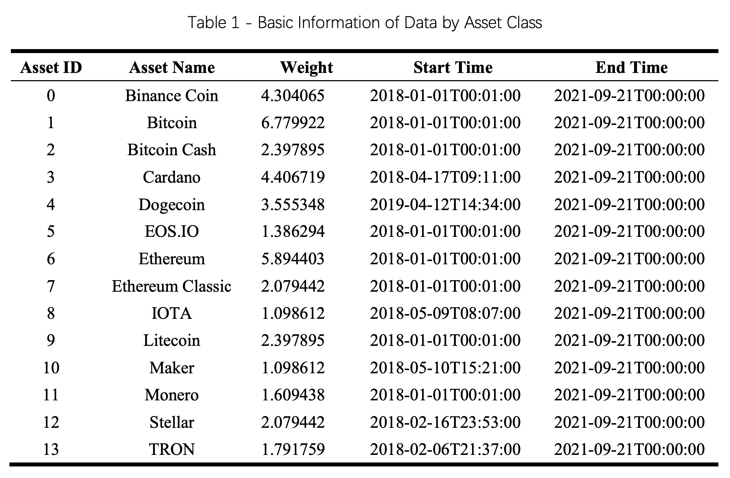
”
1
Data
Dataset Description
Dataset: 14 assets in total
Full data: from 2018 to 2021-09-21
Train period: 2018 – 2020
Test period: 2021
Size : 24,236,806 in total minute-level data for cryptos

Slide 8
Content
Presenter: YE Xiaoyu
Data Description
Exploratory Data Analysis
Feature Engineering
Model Building
Model Enhancement and Extension

Slide 9
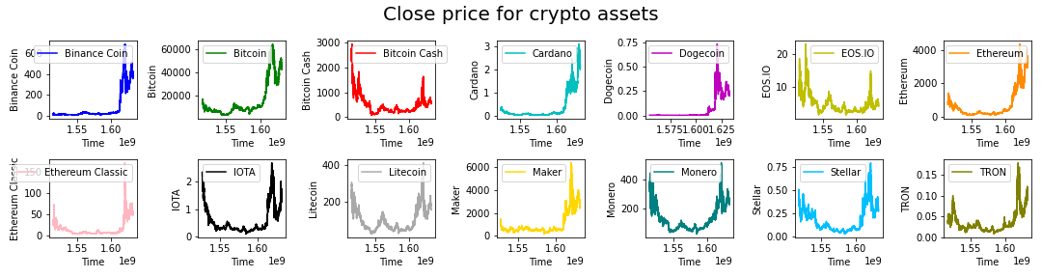
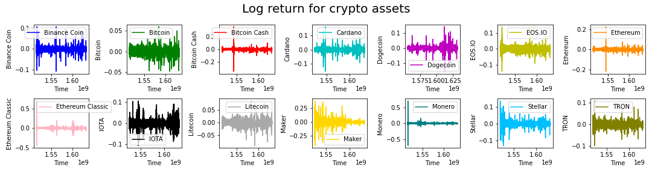
Exploratory data analysis
”
1
Data
Key observations:
surge in price and more volatile after year 2021
serious volatility clustering
Notes:
After know about the data at the first glance, we explore more about the data from different perspectives. Here are the plots of close prices and log returns of 14 crypto currencies. We observe that most of the currencies experienced price surge and the changes became much more volatile in 2021.while the plots of log returns for different asset have different level of volatility clustering over time, which to some extend explains the surge in the plot of close price.

Slide 10
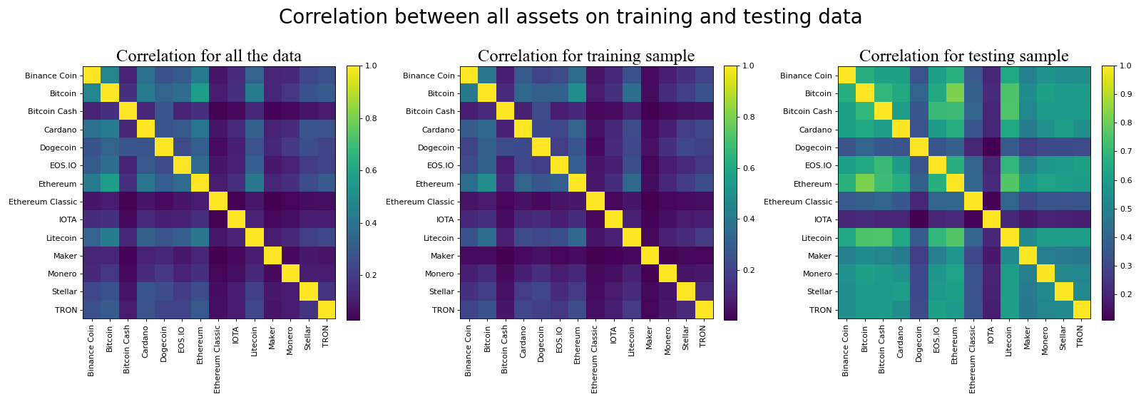
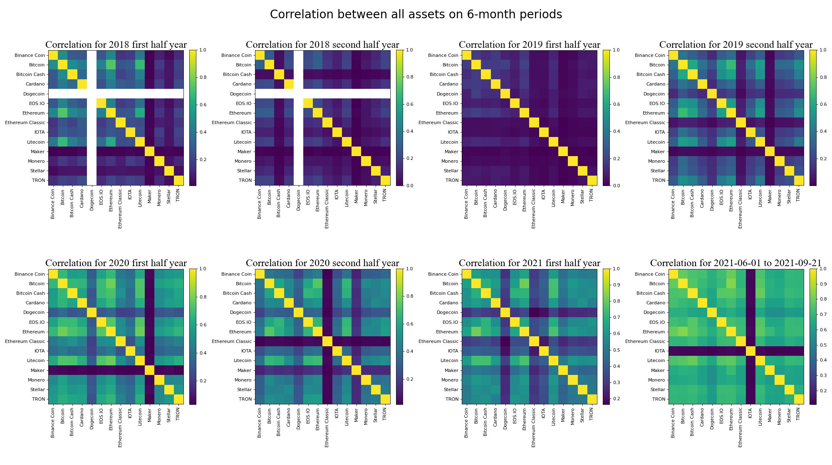
”
1
Data
Cross-assets Correlation:
insignificant correlation on train data
significant correlation on test data
shorter periods: increasingly correlated over time
Train & Test
6-month Periods
Notes:
We also look at the cross-asset return correlation and plot the heatmap for train and test periods. The results are quite opposite. The train data doesn’t have significant correlation while the test data are highly correlated. Therefore, we look more closely to shorter periods of 6 months to know whether it is the time horizon or the specific period that leads to the difference. Interestingly, there are increasingly correlations over time, indicating style change of crypto market.

Slide 11
Content
Data Description
Exploratory Data Analysis
Feature Engineering
Model Building
Model Enhancement and Extension
Notes:
Next，we constructed some new features based on our understanding of the given data.

Slide 12
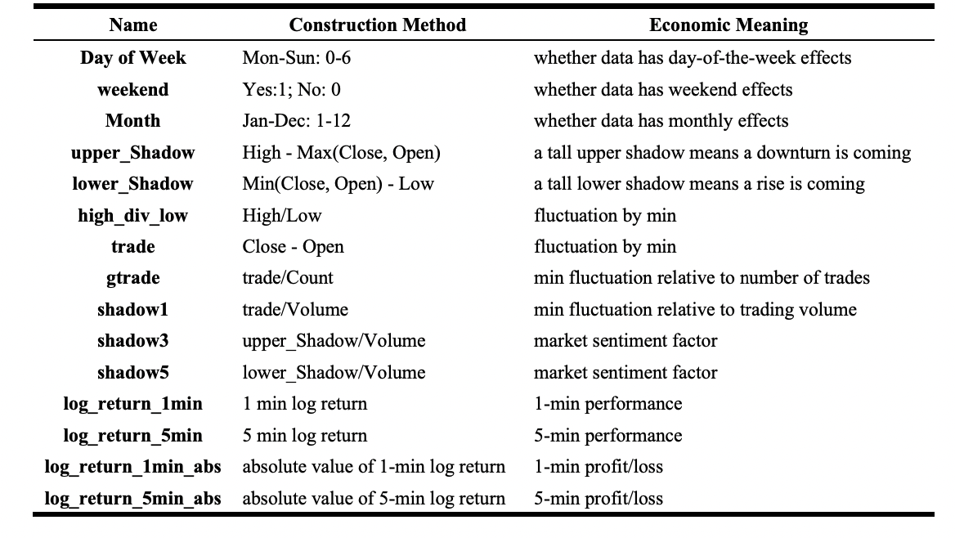
Feature Engineering
”
2
Features
2
Total 22 features
7 original features
15 new features
Notes:
The given data contains 7 features, with basic information of open-high-low-close prices, numbers and volume of trading and so on. We constructed another 15 new features with basically 4 categories: date factors, fluctuation factors, volume factors that can reflect market sentiment and return factors.

Slide 13
Content
Presenter: WANG Lei
Data Description
Exploratory Data Analysis
Feature Engineering
Model Building
Model Enhancement and Extension

Slide 14
Model Building
”
3
Models
1. Linear regression
Weighted Pearson correlation on test : 0.00865
Name | Binance Coin | Bitcoin | Bitcoin Cash | Cardano | Dogecoin | EOS.IO | Ethereum
Score | 0.0081 | 0.0086 | 0.0336 | 0.0202 | 0.0023 | -0.0020 | 0.0128
Name | Ethereum Classic | IOTA | Litecoin | Maker | Monero | Stellar | TRON
Score | -0.0220 | 0.00132 | 0.0210 | -0.0165 | 0.0019 | -0.0140 | 0.0198
2. XGBoost
Weighted pearson correlation on test : 0.0014129
Name | Binance Coin | Bitcoin | Bitcoin Cash | Cardano | Dogecoin | EOS.IO | Ethereum
Score | 0.0083 | -0.0055 | -0.0110 | 0.0034 | -0.0113 | -0.0018 | 0.0109
Name | Ethereum Classic | IOTA | Litecoin | Maker | Monero | Stellar | TRON
Score | -0.0220 | 0.00132 | 0.0210 | -0.0165 | 0.0019 | -0.0140 | 0.0198

Slide 15
Content
Data Description
Exploratory Data Analysis
Feature Engineering
Model Building
Model Enhancement and Extension

Slide 16
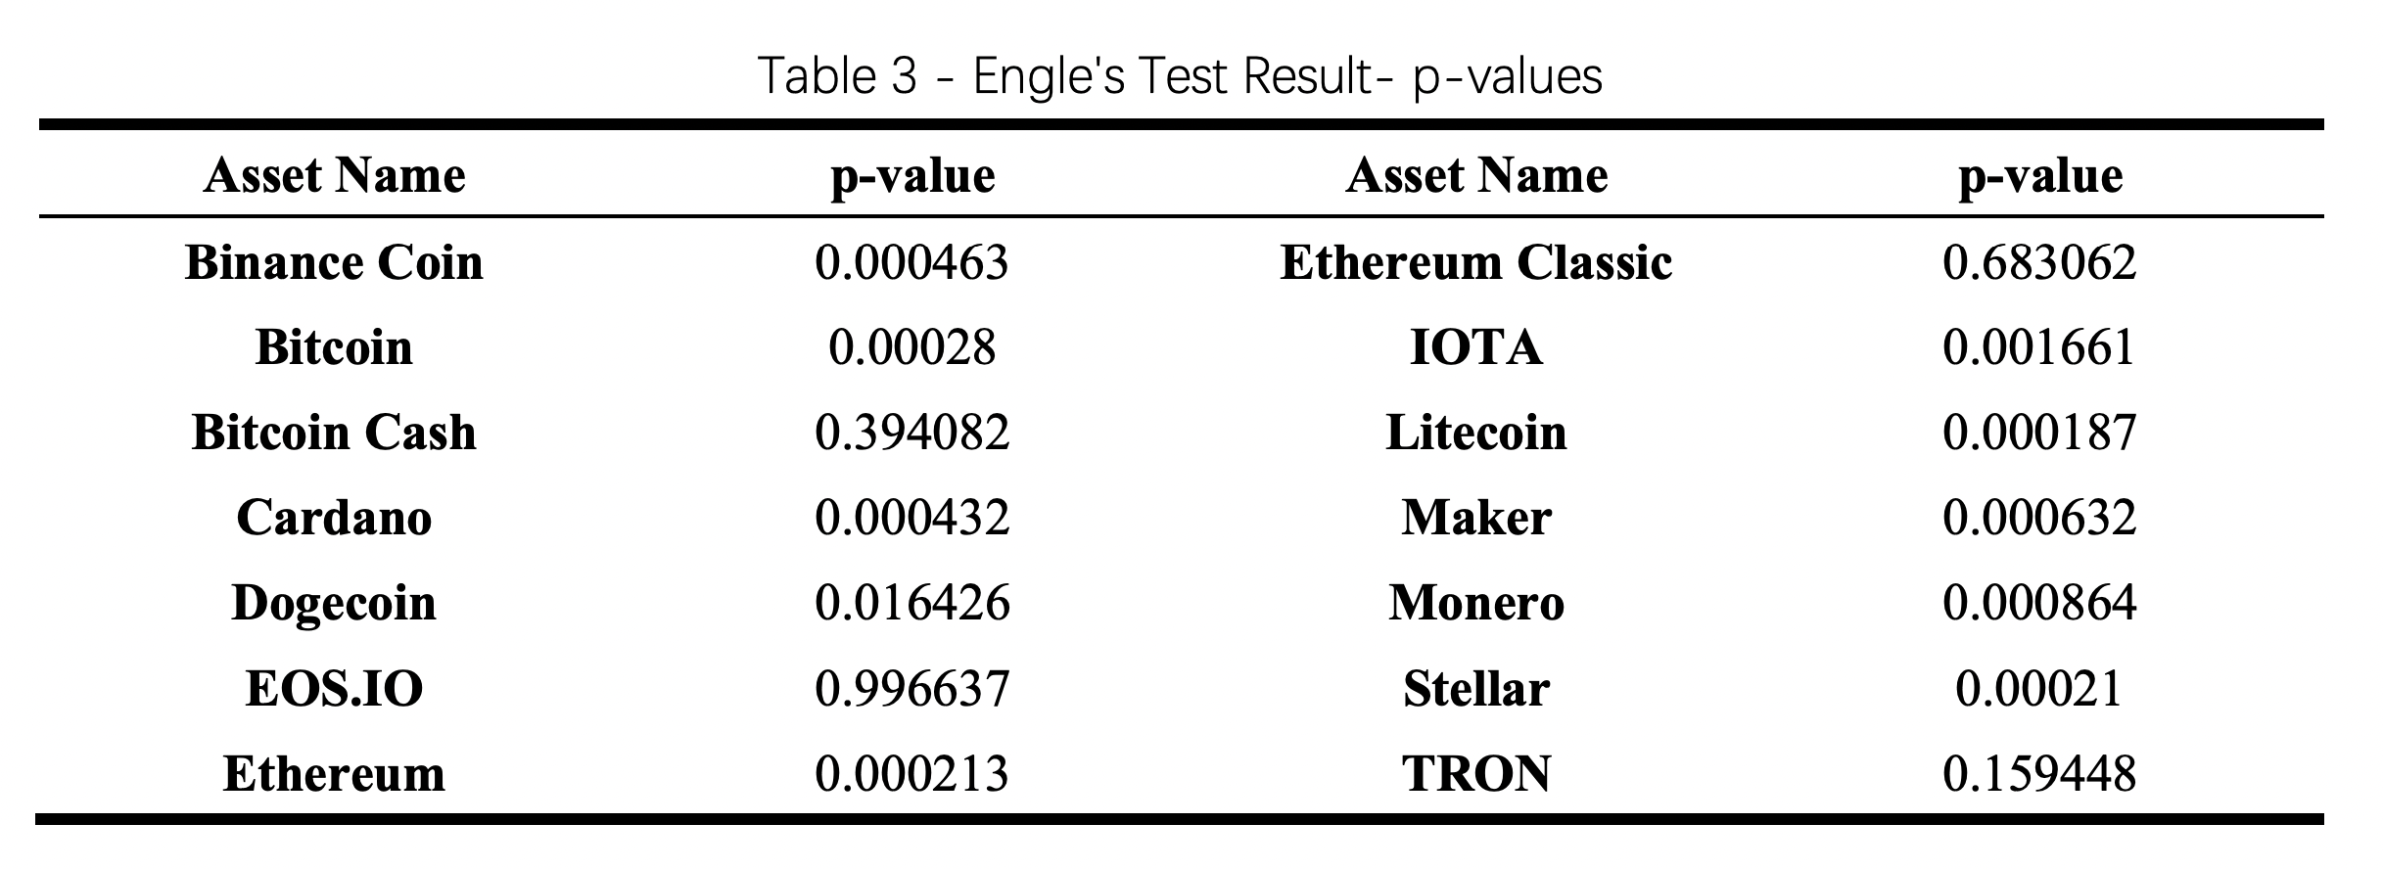

Model Enhancement
”
3
Models
Problem of volatility clustering: Engle’s ARCH test
$H_{0}$: The data are independently distributed, no autocorrelation.
$H_{a}$: The data are not independently distributed; they exhibit serial correlation.

Slide 17
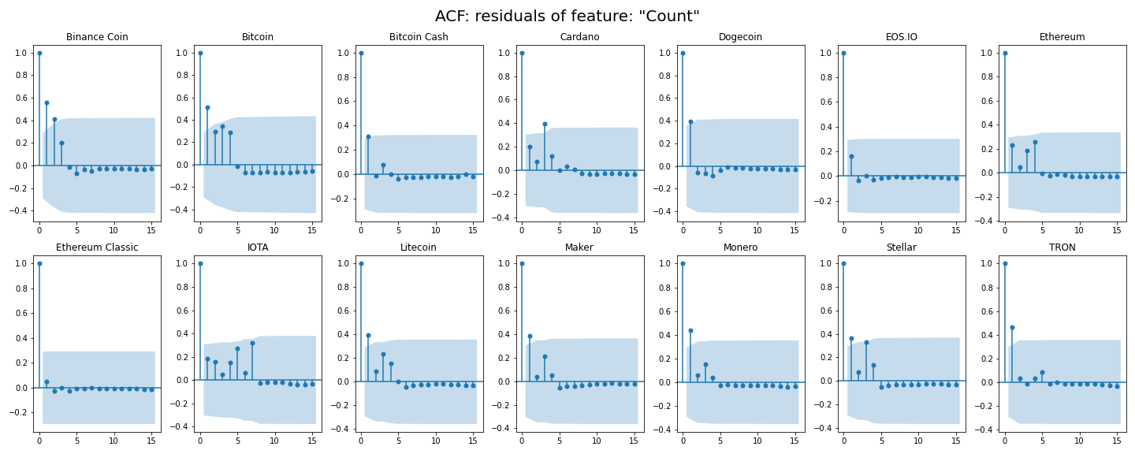

Model Enhancement
”
3
Models
Reject $H_{0}$: volatility clustering exists
→ Box-Cox transformation

Slide 18
Box-Cox Transformation
”
1
Model
Comparison
 | Linear Regression | XGBoost
No Box-Cox transformation | 0.008651 | 0.001413
With Box-Cox transformation | 0.010551 | 0.004459

Slide 19
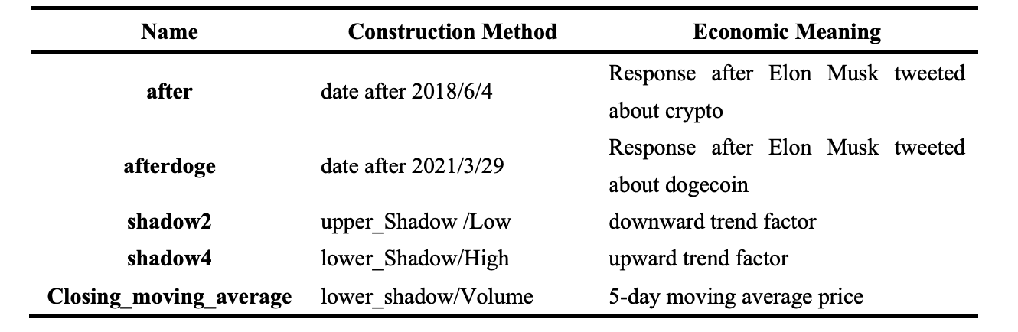
Presenter: Zhang Quandi
Model Extension: Try new features
”
5
Features
New features
Results
 | Linear Regression | XGBoost
Originally constructed features | 0.010551 | 0.004459
More features | 0.008894 | 0.004127

Slide 20

“
”
03
P A R T
Conclusion and Future Work

Slide 21
Conclusion & Future Work
1
2
Final Model:
Linear regression model with originally constructed features and Box-Cox transformation
2 Sources of Problems:
volatility clustering
high-frequency
 | Linear Regression | XGBoost
No Box-Cox transformation | 0.008651 | 0.001413
With Box-Cox transformation | 0.010551 | 0.004459
More features | 0.008894 | 0.004127

Slide 22
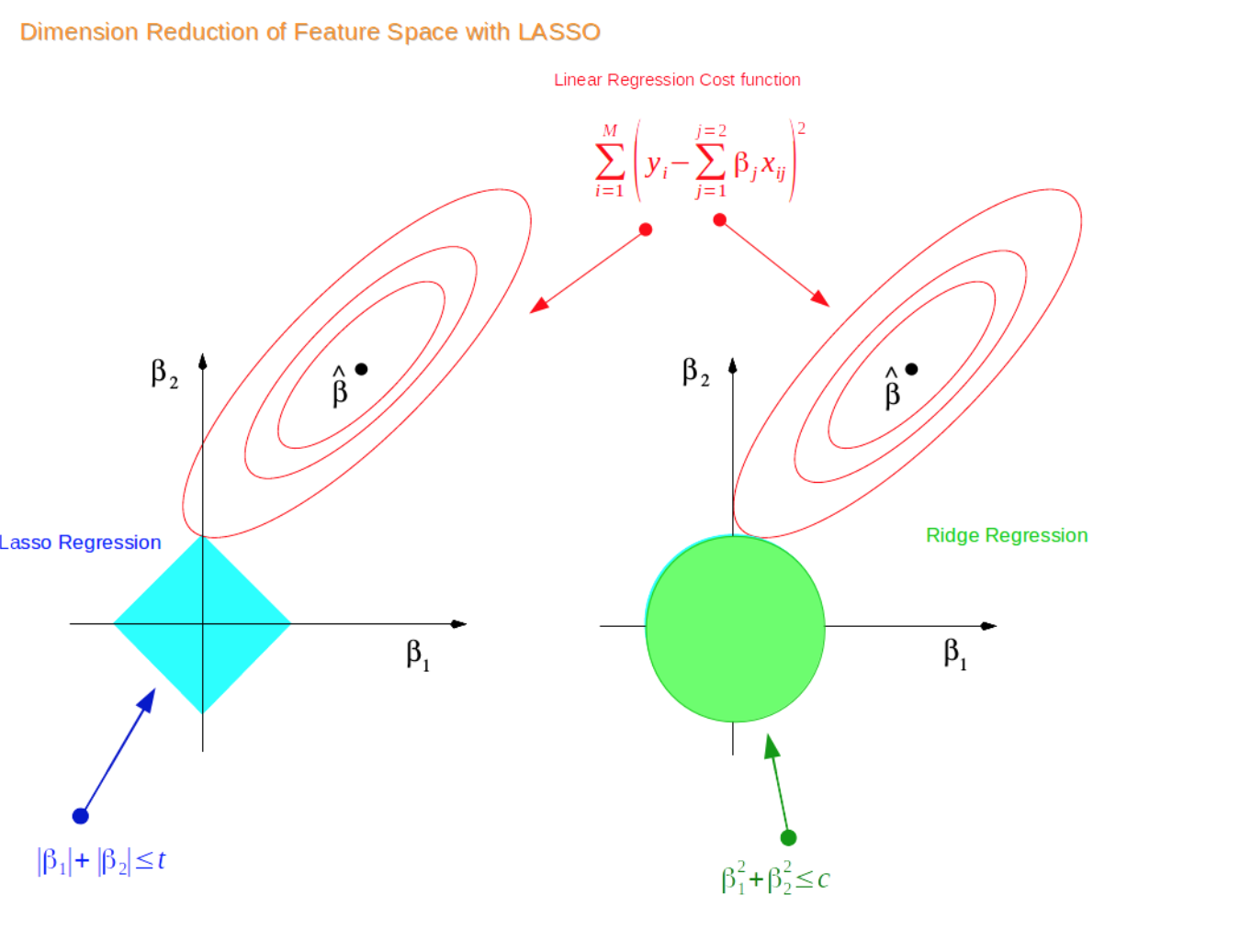
Conclusion & Future Work
3
Future Work: solve collinearity: LASSO and ridge regression

Slide 23
“
”
THANK YOU!
WANG Lei
WANG Zhongchen
YE Xiaoyu
ZHANG Quandi

