Slide 1
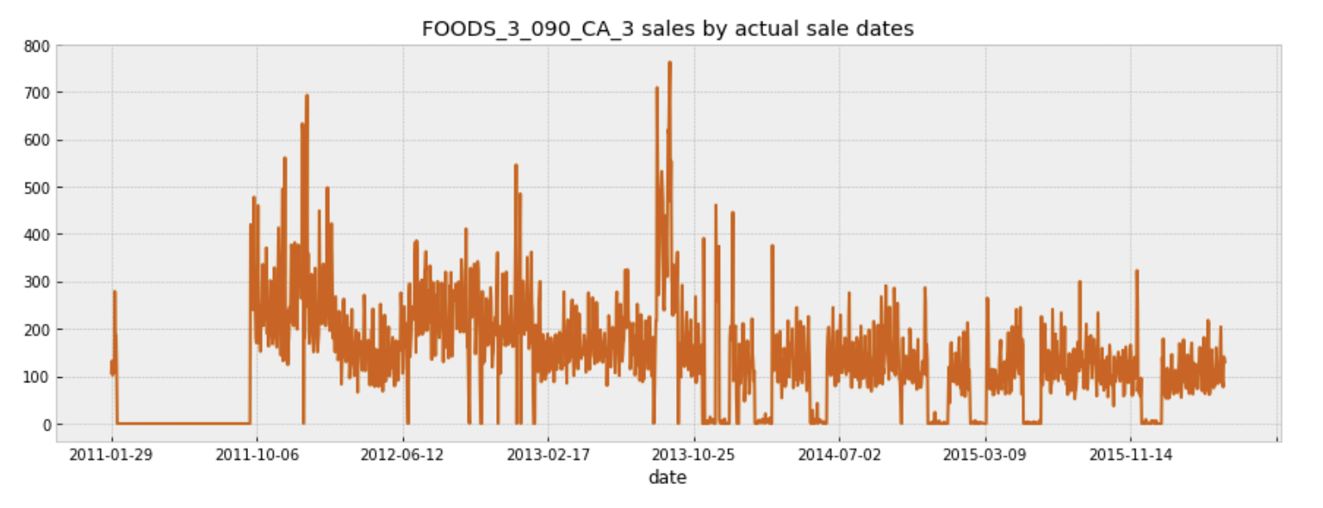
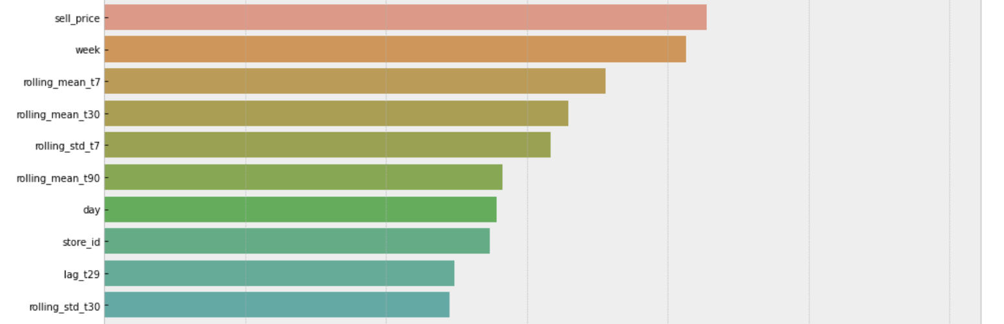
MAFS6010Z Mini-Project 3: M5 Forecasting
Ziyi WANG(20256265)¹ and Jixiang XIANG(20568852)¹ {zwangbn, jxiangae}@connect.ust.hk
¹: Department of Mathematics, HKUST
1. Introduction
3. Feature Engineering
5. Task 2: Predict Uncertainty
We use hierarchical sales data from Walmart, the worlds largest company by revenue, to forecast daily sales for the next 28 days and to make uncertainty estimates for these forecasts. The poster will be separated into two sections to explain accuracy and uncertainty estimation separately.
We have done below data pre-processing and feature engineering to make the training more efficient
Memory Usage Reduction: Based on the column value, if it is int, we try to reduce it to int 8/16/64. Same applied to float. We reduced the memory by 72% by applying this on training data
Adding seasonality features: Because we have found seasonality in data, we have added day of week, month of year, etc as features
Noise reduction: Because we found noise in the data, we applied rolling window to smooth the noise, using moving average and standard deviation of past 7/30/90/180 days
Using ‘price’ as a feature: As the sales may be affected by the prices or promotions, the price is added as a feature to be used for training.
Use weekday and month as features.
The second task of this assignment is sales uncertainty prediction. The data comprises 3049 individual products from 3 categories, sold in 10 stores and in 3 states.
As we can find that the weekly pattern of sales is strong, with Sat and Sun standing out prominently. Also Monday seems to benefit a bit from the weekend effect.
The months of Nov and Dec show clear dips, while the summer months May, Jun, and Jul suggest a milder secondary dip. Certain holidays, like the 4th of July, might somewhat influence these patterns; but over 5 years they should average out reasonably well.
Based on the above two finds, the weekday and month features are added into model for training.
While looking at the prices of the products, we can find the selling price may vary between two weeks. Hence the price information is also added into the model so that it can help generate predictions.
Different states are in different level of sales. California (CA) sells more items in general, while Wisconsin (WI) was slowly catching up to Texas (TX) and eventually surpassed it in the last months of our training data. Hence, in our research, we will build models for each time series. Therefore, overall, 30490 models will be built.
Limited by the computing power of the computer, we will not use complicated neural network to do the prediction. Instead, the simpler Prophet will be used.
Different levels of uncertainty are used, and the corresponding Weighted Scaled Pinball Loss (WSPL) are calculated.
2. Data
Data Overview
Base training data: sales_train_validation.csv - Contains the historical daily unit sales data per product and store
Other features: calendar.csv and sell_prices.csv
Data Characters
Seasonality: Plot against time period, we found that the data has strong seasonality, including monthly, daily and yearly
Affected by events: Plot against every store, we found that some store data increased drastically on a day, meaning there was some external events that affected the sales such as store closure or expansion
Upward trending: Plot against each item, we see an upward trend
With noise: some days there is 0 data, or only 1 sales. It will be affecting the model so we need to remove this noise
Different by category and stores: average sales by store and category is different
4. Task 1: Predict Accuracy
Before 2016-04-24 as training data, and after as validation data
LightGBM as the model to train, because it incorporate the technique of bagging and boosting to avoid over-fitting and does not require too much training source such as deep learning.
I have used 3-fold time series training and let the model to stop training when the performance does not improve for 50 rounds
The most important 10 features:
Metrics | Training Set | Validation Set
RMSE | 2.1740 | 2.2248
Uncertainty | 0.005 | 0.025 | 0.165 | 0.25
WSPL | 0.47226 | 0.47416 | 0.48745 | 0.49552
6. Contribution
Accuracy Model: Ziyi WANG
Uncertainty Model: Jixiang XIANG

