Slide 1
MATH 5473 Final Project: Dimension Reduction and Visualization on MNIST Data Series
LEE Young Kyu¹, KIM Jaehyeok², MA Jiabo² and JIN Cheng²
¹: Department of Mathematics, HKUST ²: Department of Computer Science and Engineering, HKUST

Slide 2
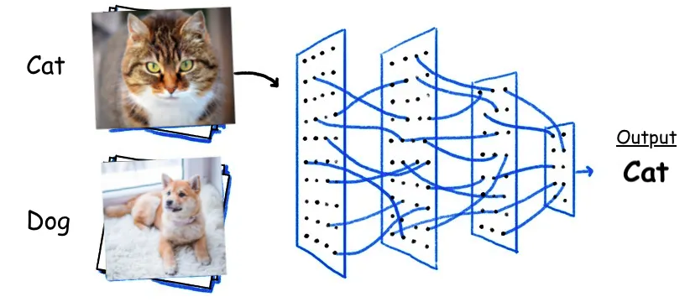
Introduction
e.g., binary classification (class size of 2)
Problem: Image Classfication
Assign a label or class to each input image
Objective:
To explore effectiveness of manifold learning in conventional image classification tasks (i.e., handwritten digit classification & clothing classification)
https://docs.clarifai.com/tutorials/how-to-evaluate-an-image-classification-model/

Slide 3
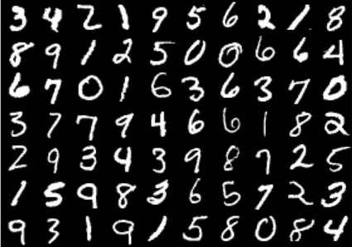
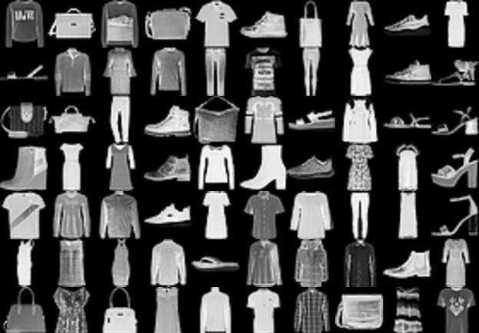
Datasets
MNIST
large collection of handwritten digits
60,000 training and 10,000 testing 28x28 grayscale images
Fashion-MNIST
large collection of 10 fashion products
60,000 training and 10,000 testing 28x28 grayscale images
https://paperswithcode.com/dataset/mnist
https://paperswithcode.com/dataset/fashion-mnist

Slide 4
Methods
5 different manifold learning methods:
Multidimensional scaling (MDS)
Isometric Mapping (ISOMAP)
Locally Linear Embedding (LLE)
t-Distributed Stochastic Neighbor Embedding (t-SNE)
Uniform Manifold Approximation and Projection (UMAP)

Slide 5
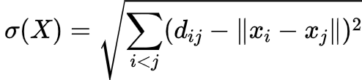

Methods
MDS: Multidimensional scaling
seeks to minimize the stress function where $d_{ij}$ are the distances in the original space and $x_{i}, x_{j}$ are the coordinates in the reduced space.

Slide 6
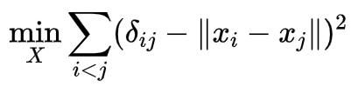
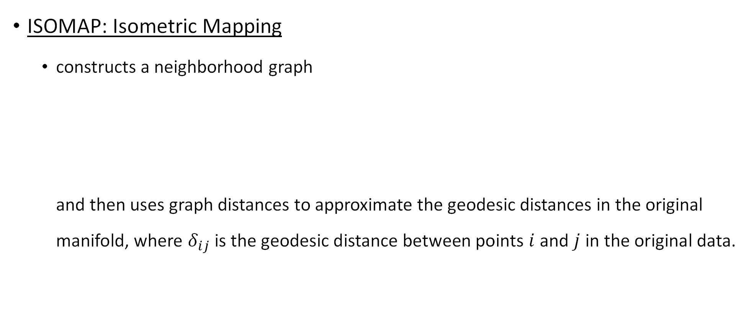
Methods
ISOMAP: Isometric Mapping
constructs a neighborhood graph and then uses graph distances to approximate the geodesic distances in the original manifold, where $δ_{ij}$ is the geodesic distance between points $i$ and $j$ in the original data.

Slide 7

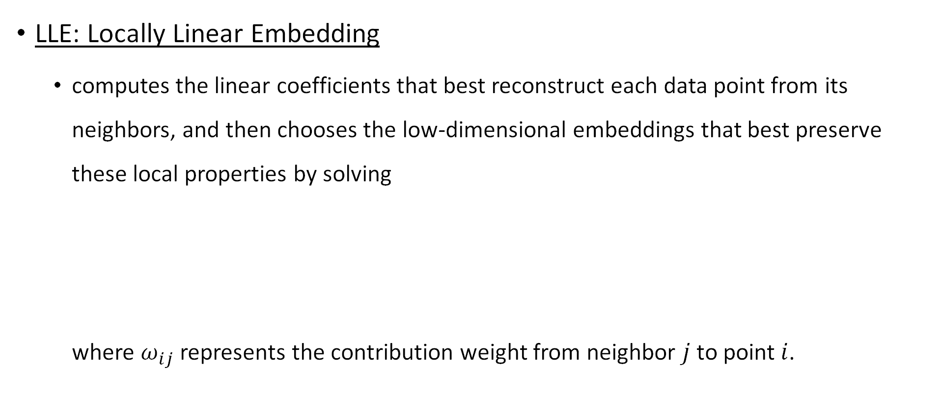
Methods
LLE: Locally Linear Embedding
computes the linear coefficients that best reconstruct each data point from its neighbors, and then chooses the low-dimensional embeddings that best preserve these local properties by solving where $ω_{ij}$ represents the contribution weight from neighbor $j$ to point $i$.

Slide 8

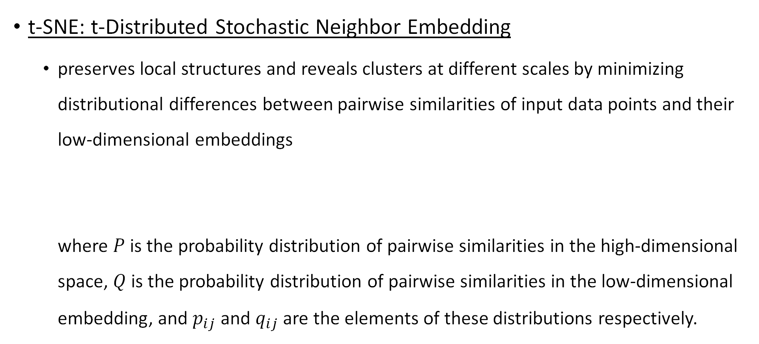
Methods
t-SNE: t-Distributed Stochastic Neighbor Embedding
preserves local structures and reveals clusters at different scales by minimizing distributional differences between pairwise similarities of input data points and their low-dimensional embeddings where $P$ is the probability distribution of pairwise similarities in the high-dimensional space, $Q$ is the probability distribution of pairwise similarities in the low-dimensional embedding, and $p_{ij}$ and $q_{ij}$ are the elements of these distributions respectively.

Slide 9
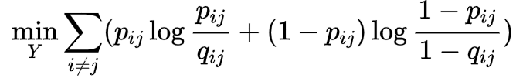
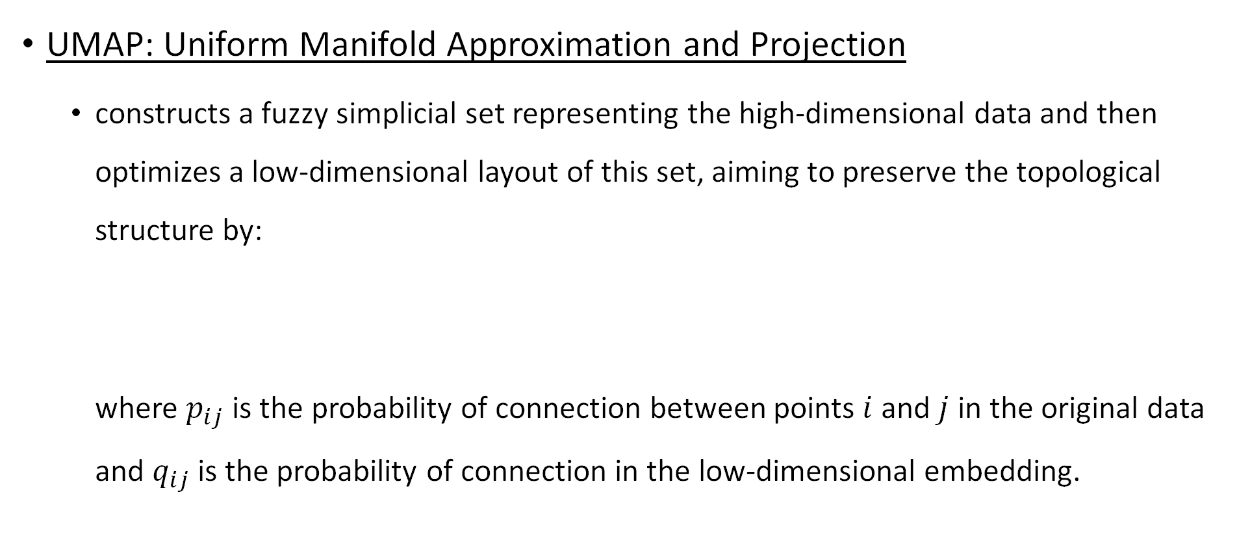
Methods
UMAP: Uniform Manifold Approximation and Projection
constructs a fuzzy simplicial set representing the high-dimensional data and then optimizes a low-dimensional layout of this set, aiming to preserve the topological structure by: where $p_{ij}$ is the probability of connection between points $i$ and $j$ in the original data and $q_{ij}$ is the probability of connection in the low-dimensional embedding.

Slide 10
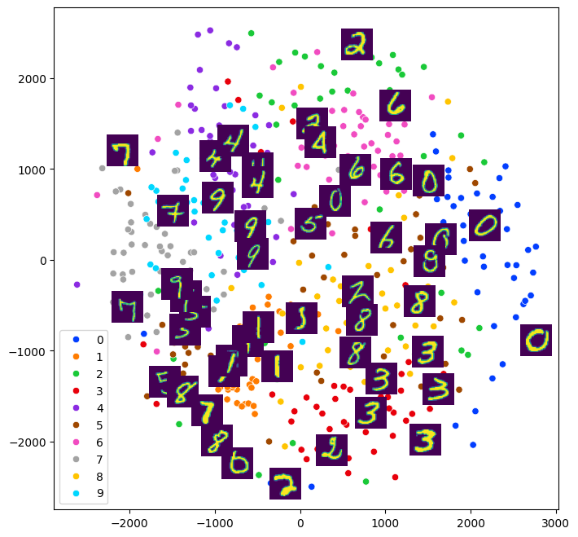
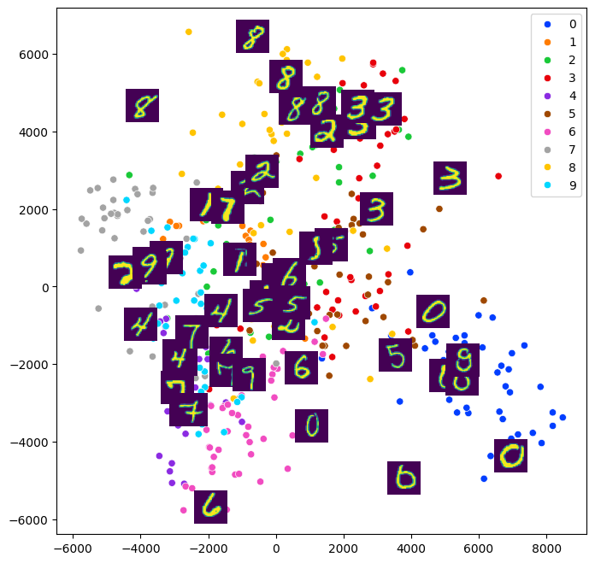
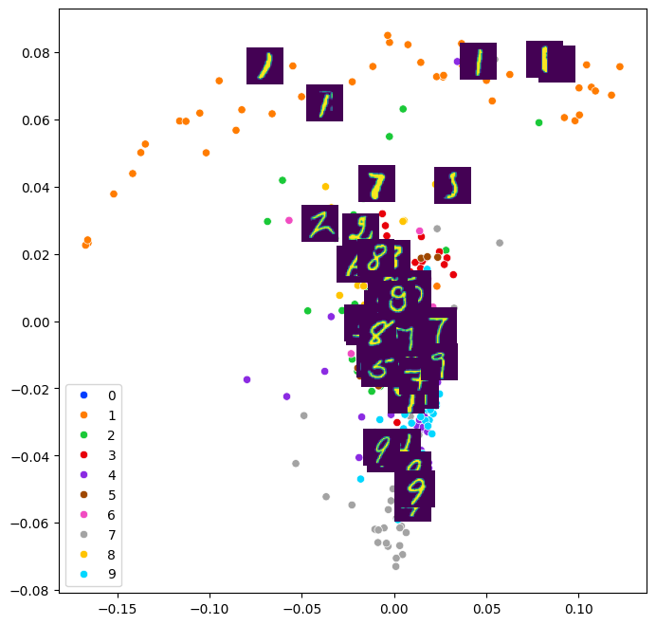
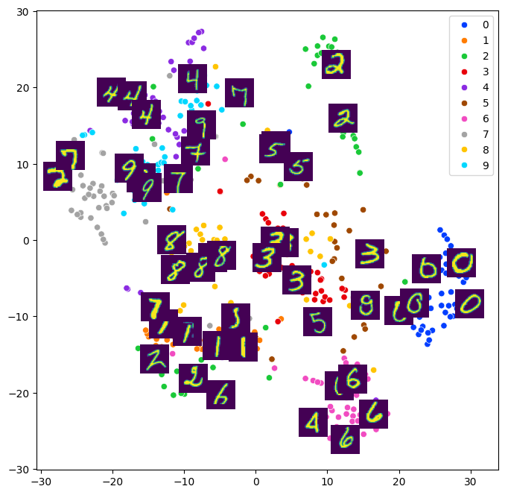
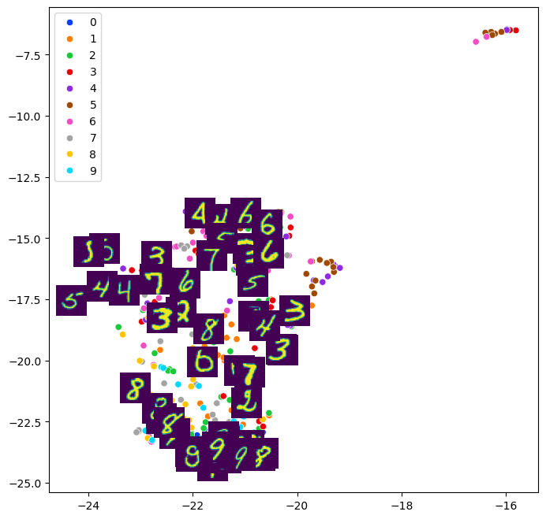
Results on MNIST Images
MDS
ISOMAP
LLE
t-SNE
UMAP

Slide 11
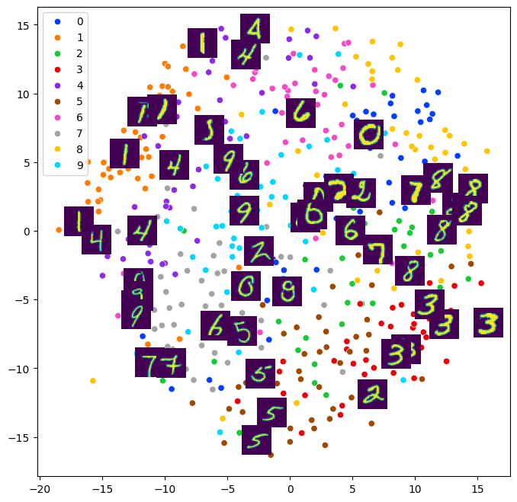
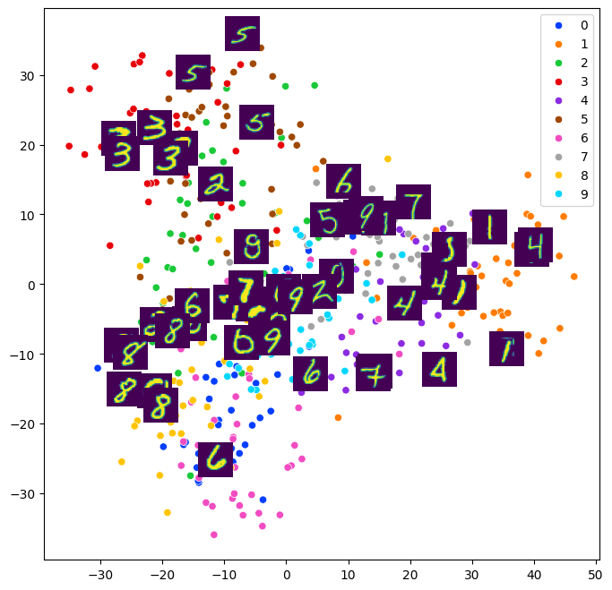
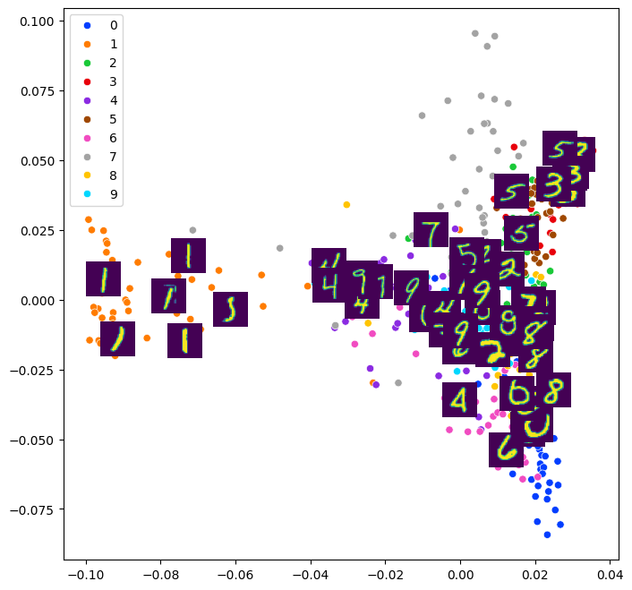
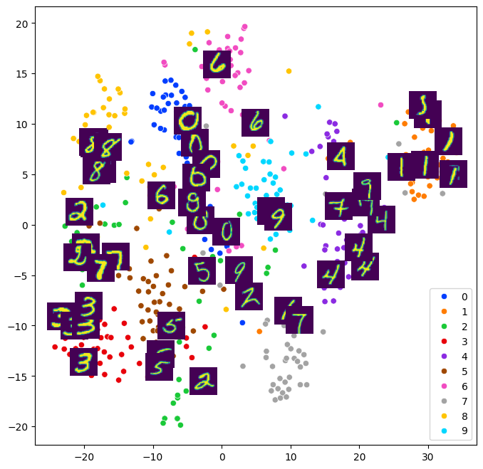
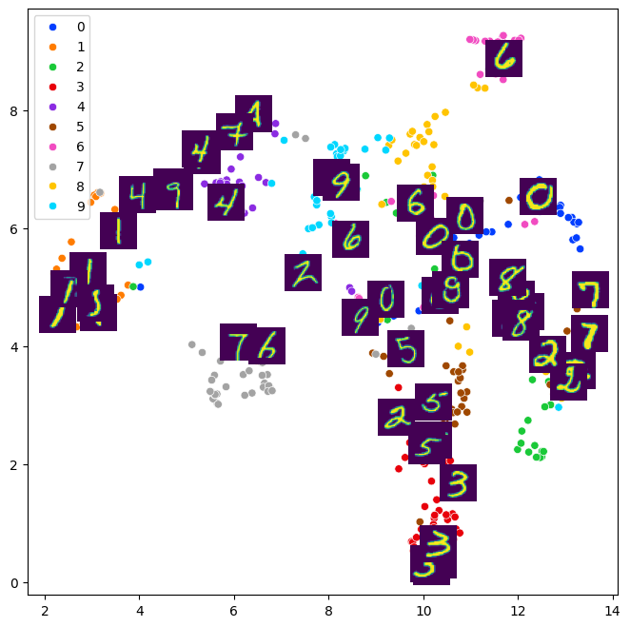
Results on MNIST Feature Maps from CNN
MDS
ISOMAP
LLE
t-SNE
UMAP

Slide 12
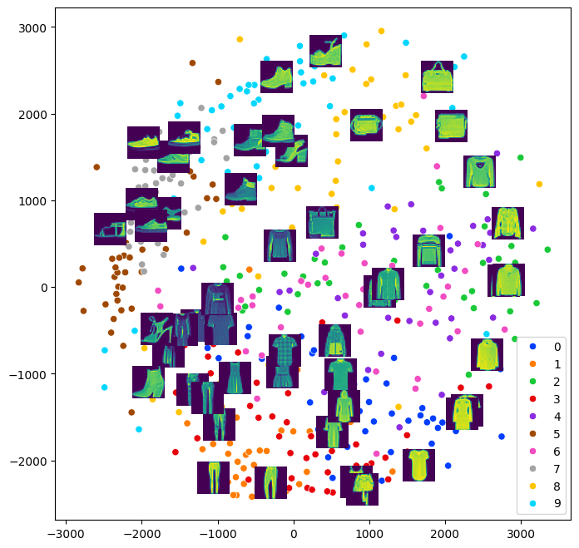
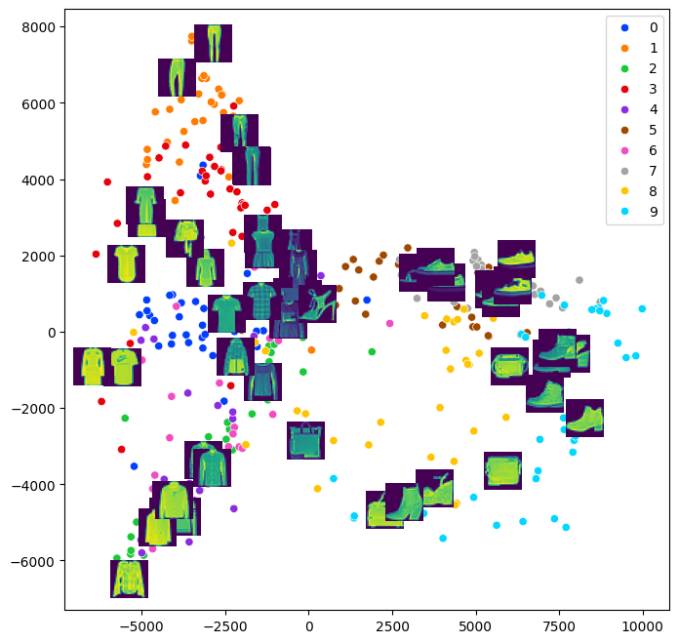
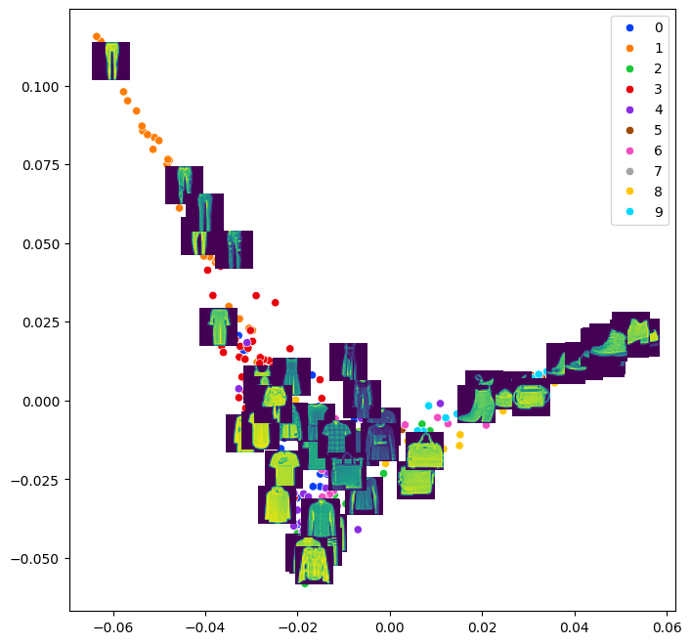
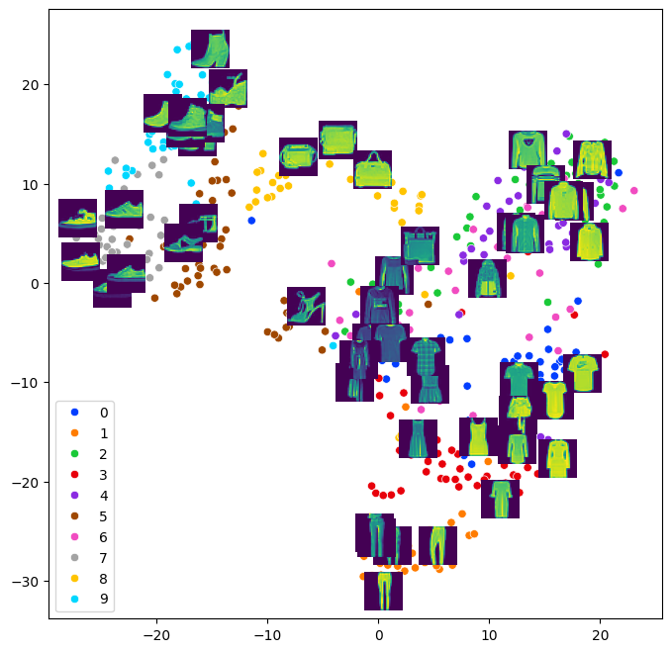
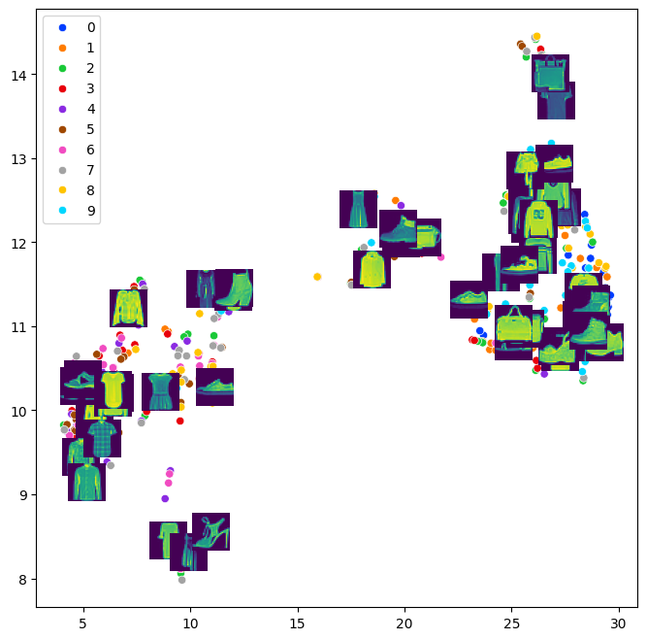
Results on Fashion-MNIST Images
MDS
ISOMAP
LLE
0 T-shirt/top
1 Trouser
2 Pullover
3 Dress
4 Coat
5 Sandal
6 Shirt
7 Sneaker
8 Bag
9 Ankle boot
t-SNE
UMAP

Slide 13
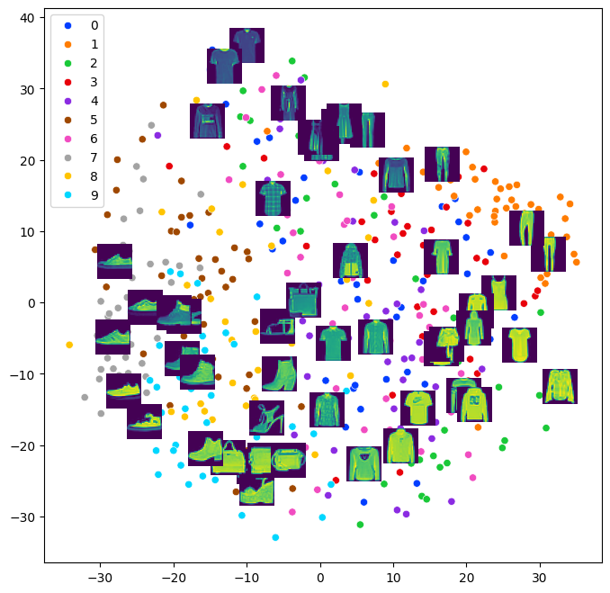
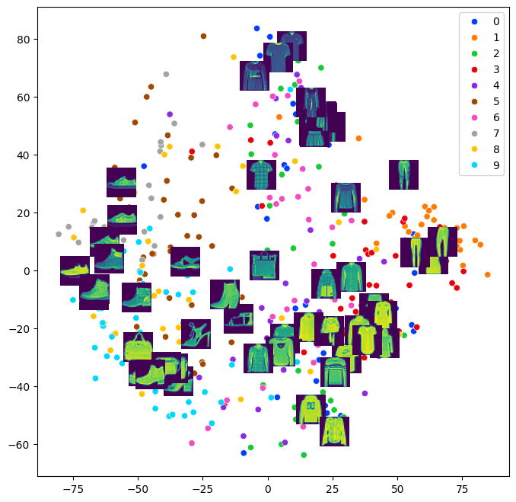
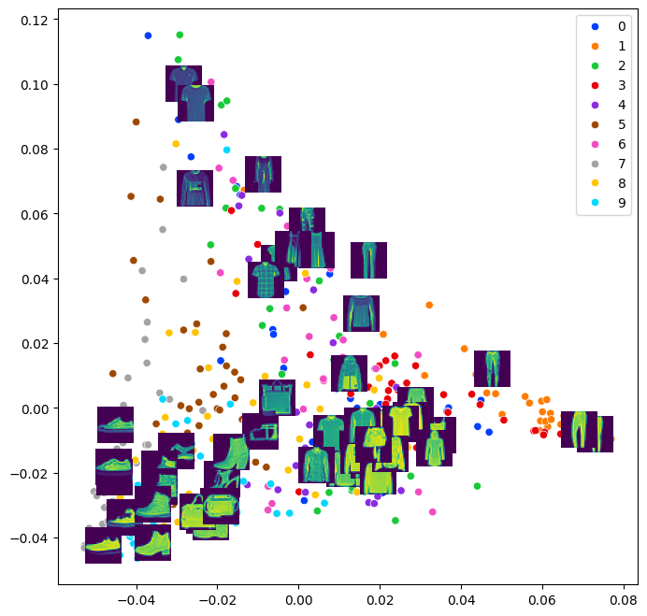
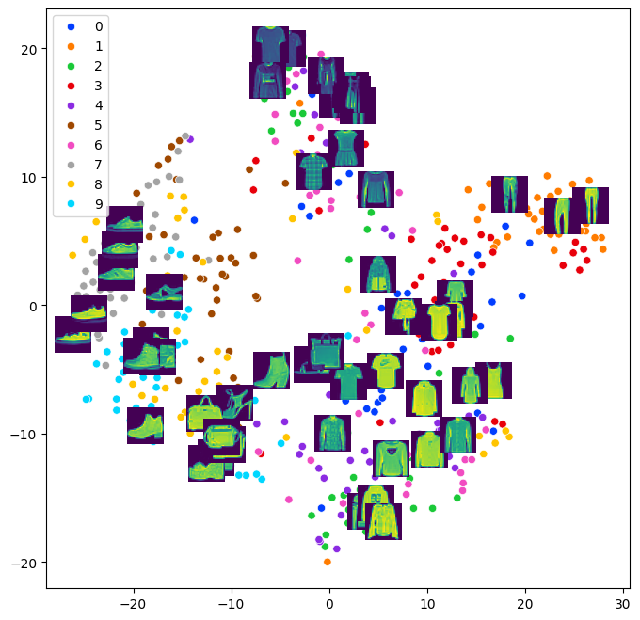
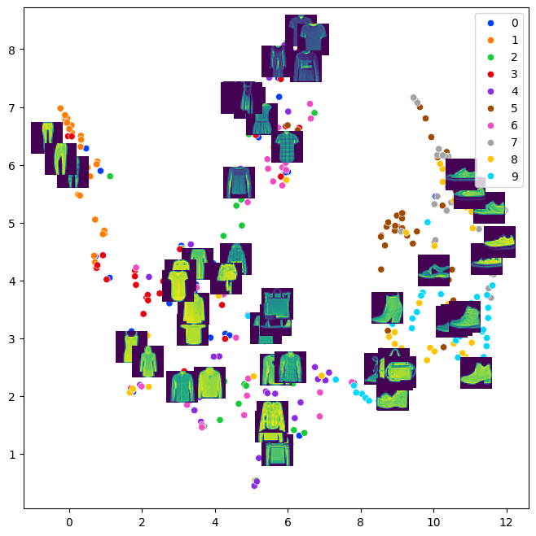
Results on Fashion-MNIST Feature Maps from CNN
MDS
ISOMAP
LLE
0 T-shirt/top
1 Trouser
2 Pullover
3 Dress
4 Coat
5 Sandal
6 Shirt
7 Sneaker
8 Bag
9 Ankle boot
t-SNE
UMAP

Slide 14
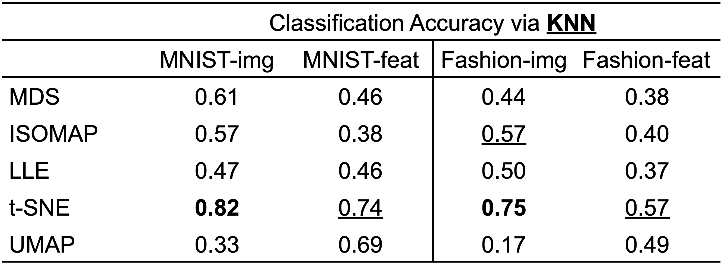
Results
Quantitative evaluation of classification on projected data via KNN

Slide 15
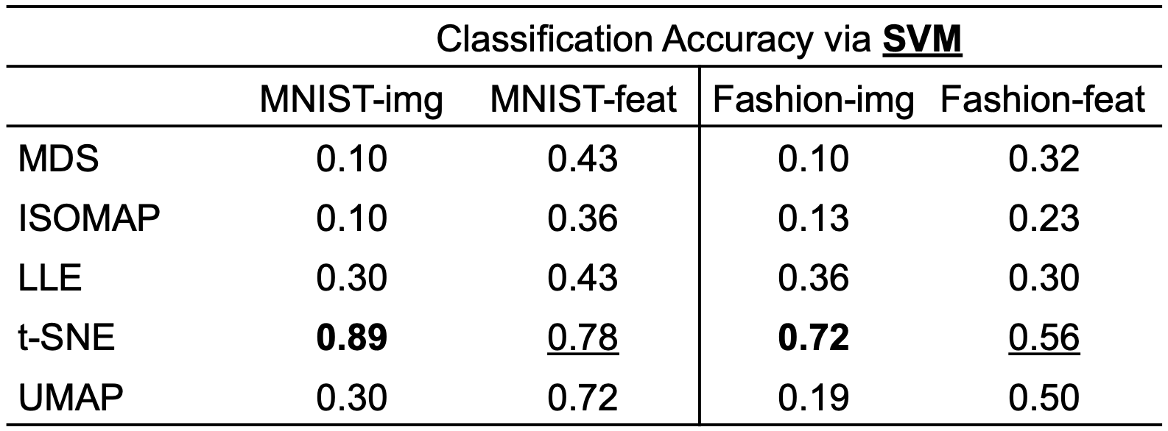
Results
Quantitative evaluation of classification on projected data via SVM

Slide 16
Conclusion
Importance of selecting appropriate dimensionality reduction techniques
to enhance data visualization and model interpretability
t-SNE achieves the best qualitative and quantitative separations

Slide 17
Contributions
LEE, Young Kyu: Initial Pipeline Setup
MA, Jiabo: Result Refinement
JIN, Cheng: Poster Design
KIM, Jaehyeok: Poster Refinement & Slides Making

