Slide 1
G-Research Crypto Forecasting MATH5470: Statistical Machine Learning Final Project
Shuang Wu (swucg@connect.ust.hk) Department of Mathematics
Yuhao Yan (yyanaz@connect.ust.hk) Department of Industrial Engineering and Decision Analytics
Haowei Yang (hyangaz@connect.ust.hk) Department of Mathematics

Slide 2

Introduction
Market Size: Cryptocurrencies have a substantial daily trading volume exceeding USD 40 billion.
Volatility: Characterized by high volatility, making them popular among investors and speculators.
Opportunities and Risks: The market's volatility presents opportunities for significant gains but also comes with substantial risks.
Research Focus: Exploring the potential of machine learning models to predict rapid price changes in cryptocurrencies.
Goal: Aim to potentially stabilize or enhance investment strategies through predictive analytics.

Slide 3

Purpose of the study
Objective: Utilize advanced machine learning models to forecast short-term returns for 14 key cryptocurrencies.
Models Used: Focus on Long Short-Term Memory (LSTM) networks and other large language models.
Data Analysis: Examination of a vast dataset of high-frequency market data spanning from 2018 to present.
Source of Data: Data provided through the G-Research Crypto Forecasting competition on Kaggle.
Research Aims: Identify patterns in the data that could predict future price movements of cryptocurrencies.
Expected Impact: Provide investors with critical insights to help mitigate the risks associated with cryptocurrency investments.

Slide 4
Methods Overview
We explored two approaches for predicting cryptocurrency prices:
1. LSTM Model: We improved an LSTM network, achieving good predictive accuracy by enhancing its design and parameter settings.
2. LLM Approach: We tested Large Language Models adapted for numerical data, which yielded moderate results.
The LSTM model proved more effective for this financial time-series forecasting task.

Slide 5
LSTM Model Details
In our enhanced LSTM model, we incorporated several key modifications to improve its predictive accuracy for short-term cryptocurrency price movements:
Added Features:
1.Upper Shadow, Lower Shadow, Spread: Differences between various high, low, opening, and closing prices within a minute.
2.Mean Trade: Average units of cryptocurrency traded per transaction within a minute.
3.Log Price Change: Logarithm of the ratio of closing to opening price.
Dataset Construction:
1.We utilized a TimeseriesGenerator-like approach for efficient time-series data handling.
Model Structure and Loss Function:
1.The model featured two LSTM layers and one fully connected layer.
2.We applied a masking method in the loss function to ignore records with zero target values, avoiding bias.

Slide 6
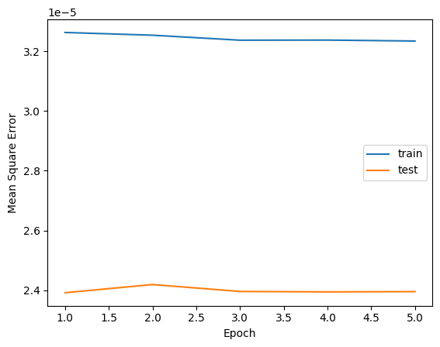
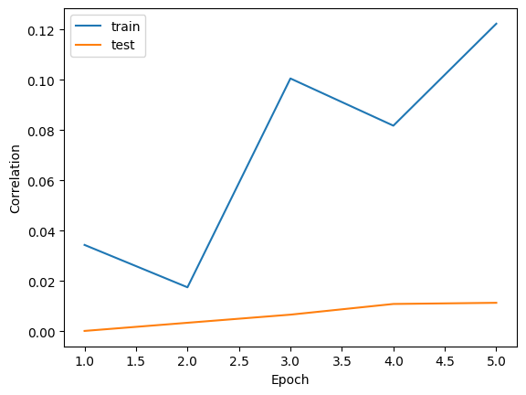
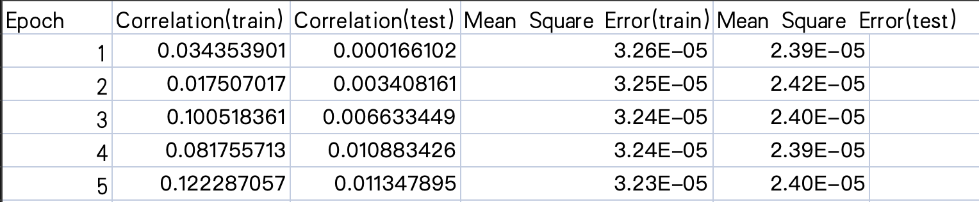
Experiment and results
We cannot attend the Kaggle competition, but we managed to compare our results to the winners. Our enhanced LSTM model ranked approximately 60th in a Kaggle competition, showcasing its effectiveness in cryptocurrency market prediction.

Slide 7
LLM Model Details
Objective:
Explore the capability of a Large Language Model (LLM) to predict market trends using textual and numerical data.
Methodology:
Model Used: Employed Qwen1.5-0.5B, a smaller-scale LLM, due to GPU constraints.
Data: Fine-tuned on 15% of available training data, using past 15-minute snapshots of 12 assets to predict future prices expressed as a 16-digit decimal.
Key Findings:
Initial Results: The preliminary outcomes did not confirm the model's effectiveness in making reliable financial predictions.
Ongoing Work: Back testing is still in progress, which may provide further insights into the model's performance.
Insights:
Although current results are underwhelming, the scaling laws of LLMs suggest potential improvements in predictive accuracy with increased model parameters.

Slide 8
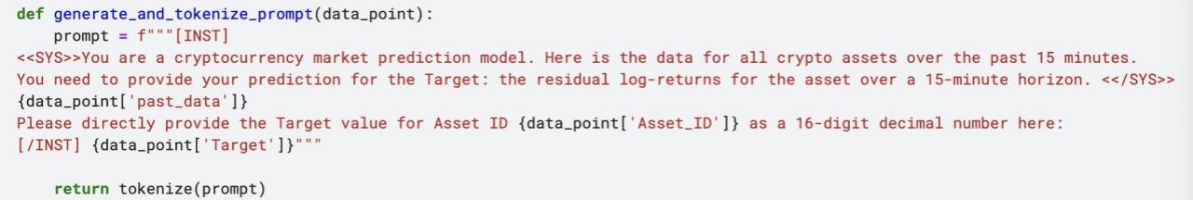
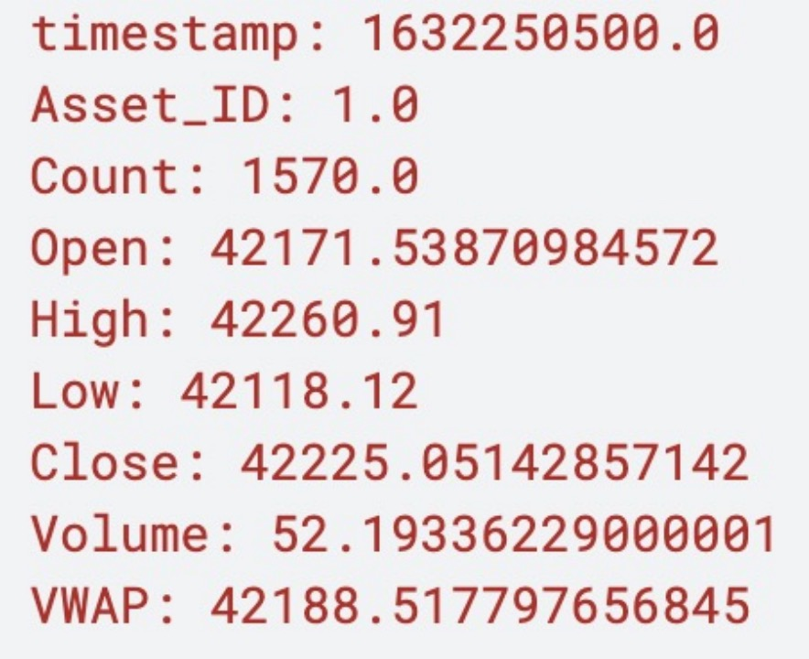
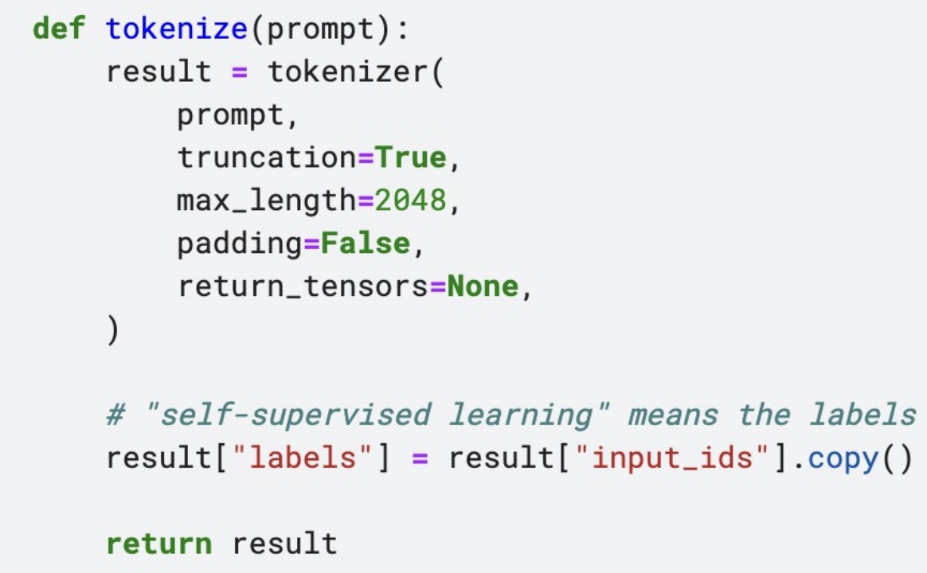
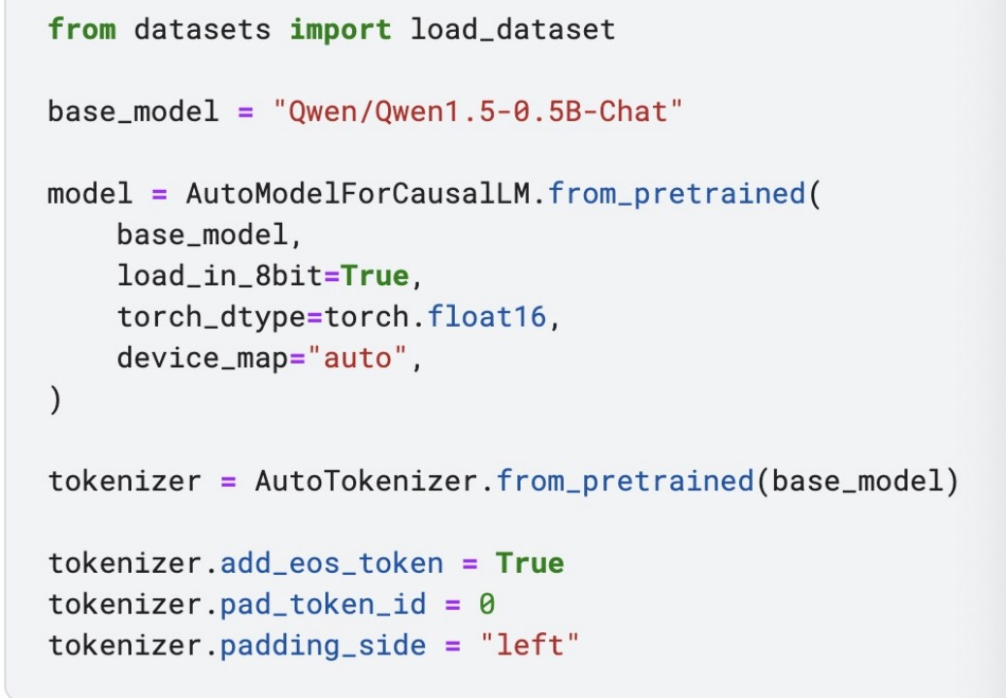
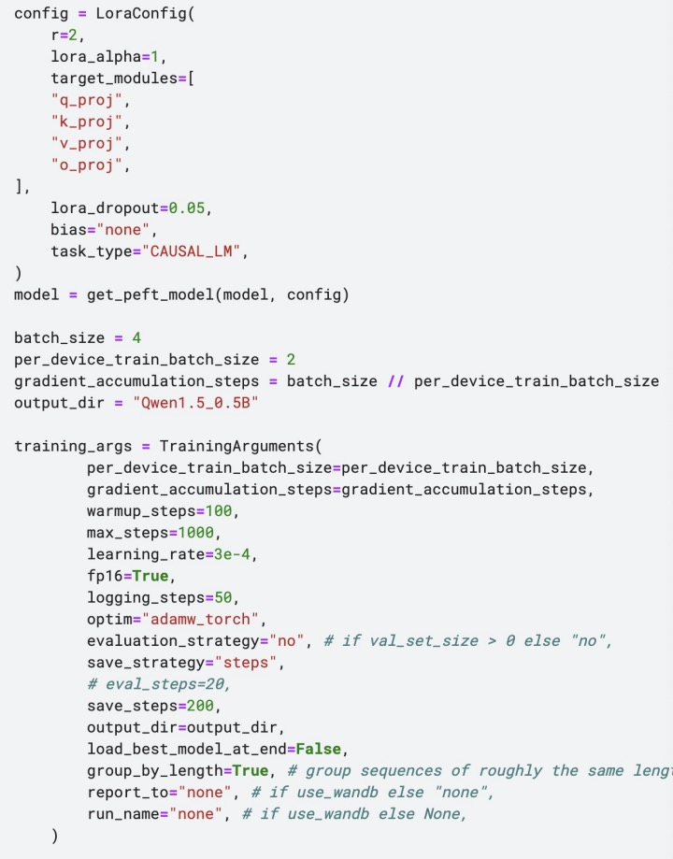
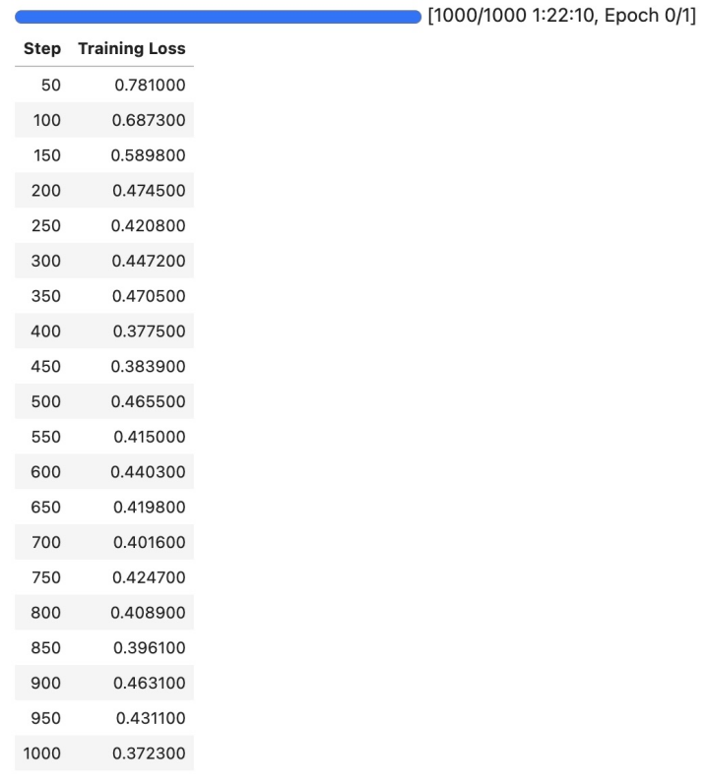
Experiment and results
Prompt
Key parameters
Our LLM model did not achieve competitive results due to:
Data Volume: Difficulty in processing extensive data.
Compute Limitations: Insufficient GPU resources.
Training details

Slide 9
Conclusion
Enhanced with additional market features and a structured network, the LSTM model demonstrated improved accuracy in short-term price forecasting, proving its effectiveness.
Despite using a smaller-scale model due to resource limitations, initial results have not validated the LLM's effectiveness in market prediction. However, potential improvements could be realized with larger models.
Both approaches offer valuable insights into the capabilities and challenges of applying advanced modeling techniques to financial forecasting. The LSTM model currently outperforms the LLM, highlighting areas for further research and development in the application of large language models in financial analytics.

Slide 10
Contribution
Yuhao Yan : LSTM approach experiment and research
Haowei Yang : LLM approach experiment and research
Shuang Wu : poster, PPT, summary and conclusion

