Slide 1
HodgeRank-based Analysis of Crowdsourced Data
Chen Liu
Hangyu Lin
Department of Mathematics

Slide 2
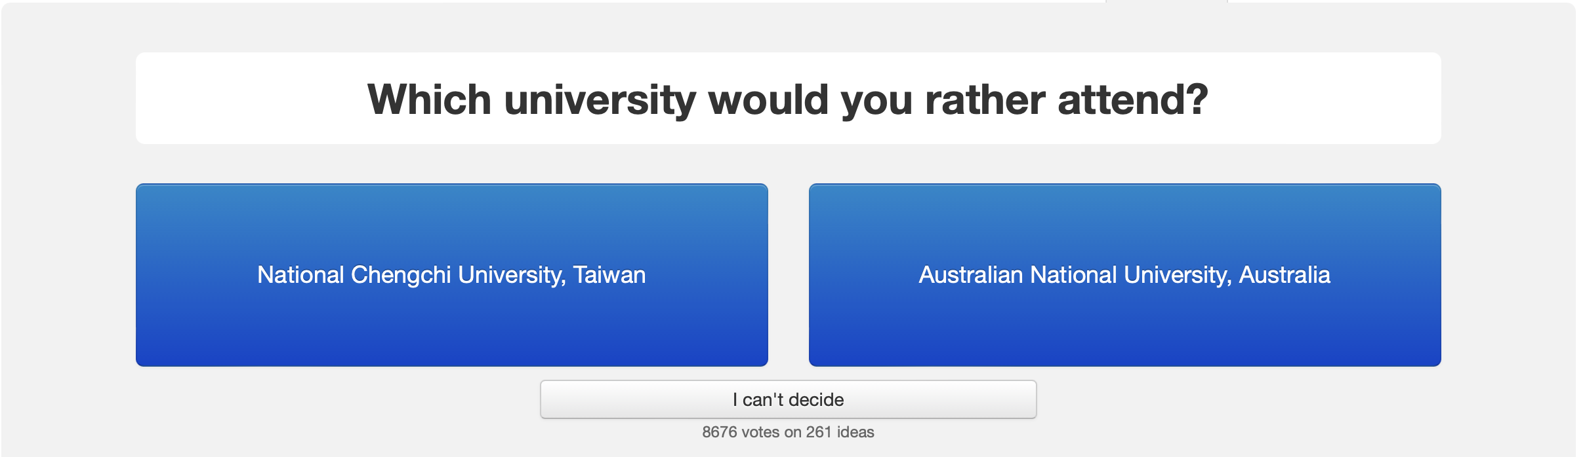
Research Problems
Analyzing Crowdsourced Data, e.g., WorldCollege, HumanAges

Slide 3
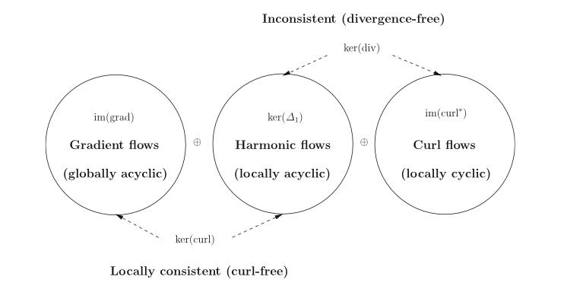
Research Problems
HodgeRank

Slide 4
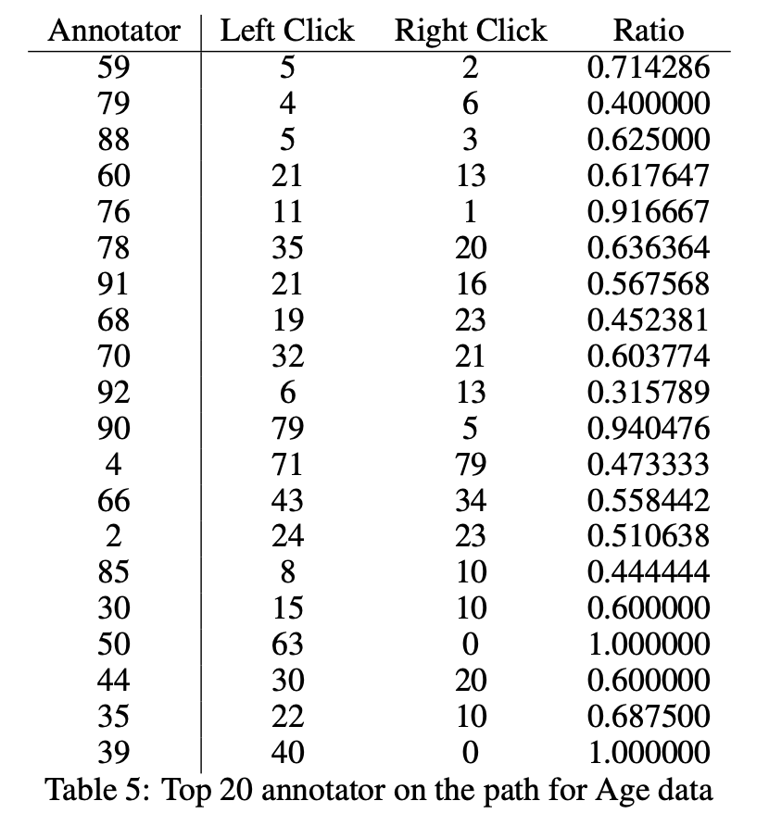
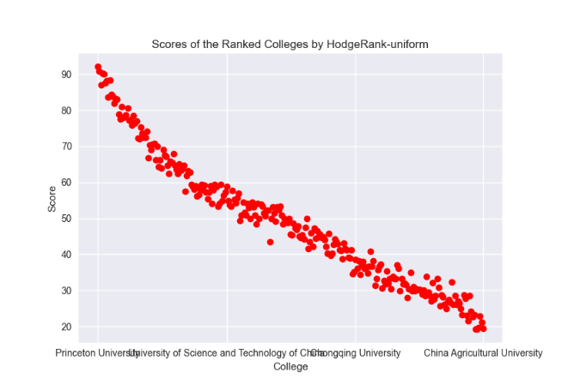
Research Problems
User Preference & Positional Bias

Slide 5
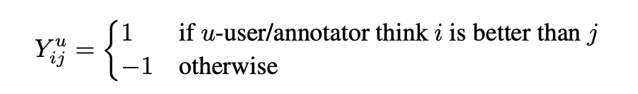
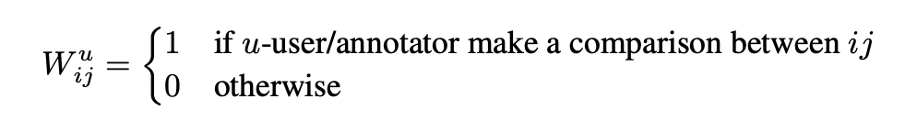
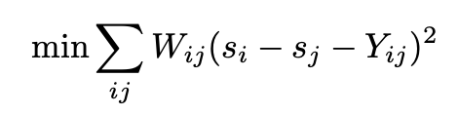
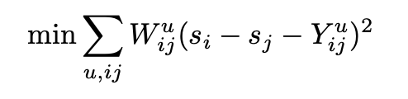

Methodology
HodgeRank

Slide 6

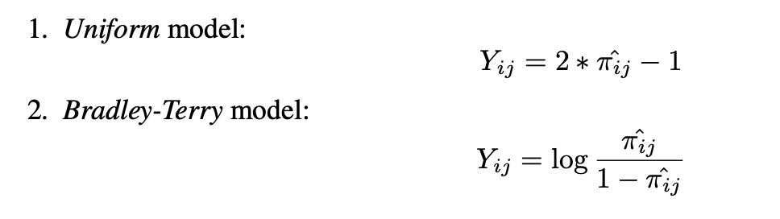
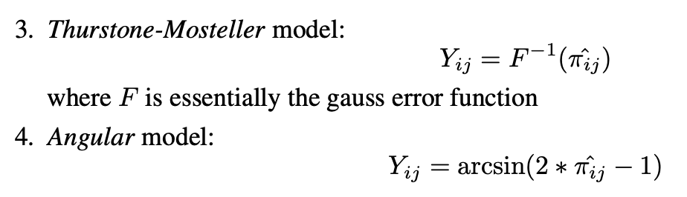
Methodology
HodgeRank-Generalized Linear Model

Slide 7
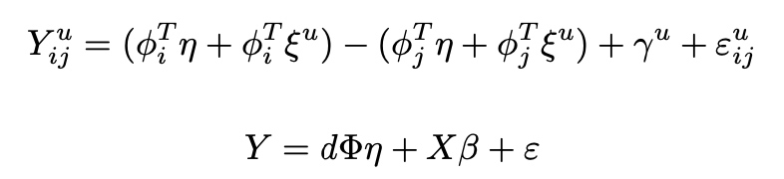
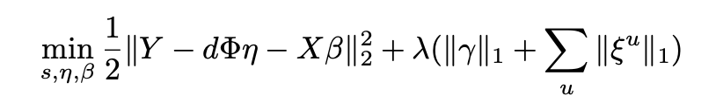
Methodology
HodgeRank-Mixed Effect Model

Slide 8
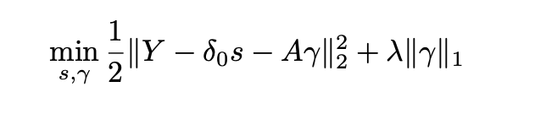
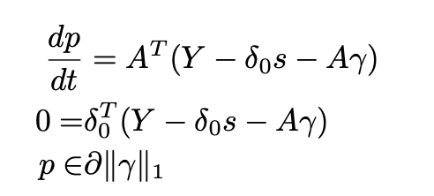
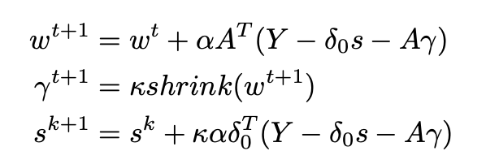
Methodology
HodgeRank-Linearized Bregman Iteration

Slide 9
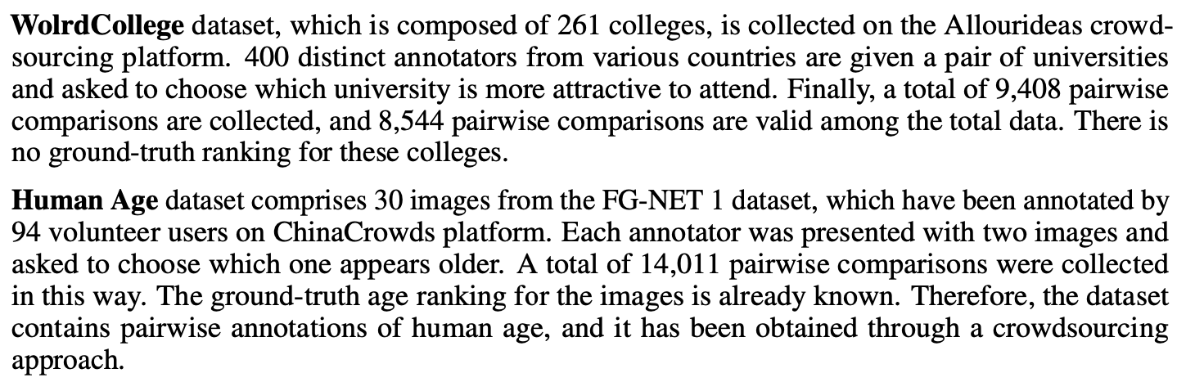
Main Results
Datasets

Slide 10
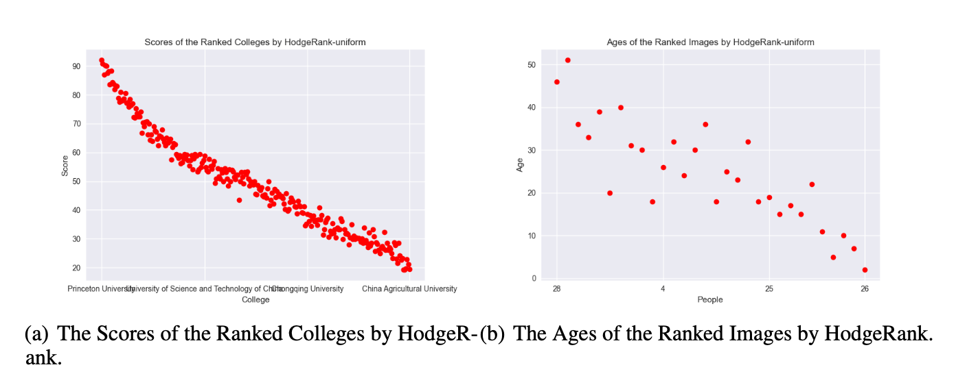
Main Results
Global Ranking Results

Slide 11

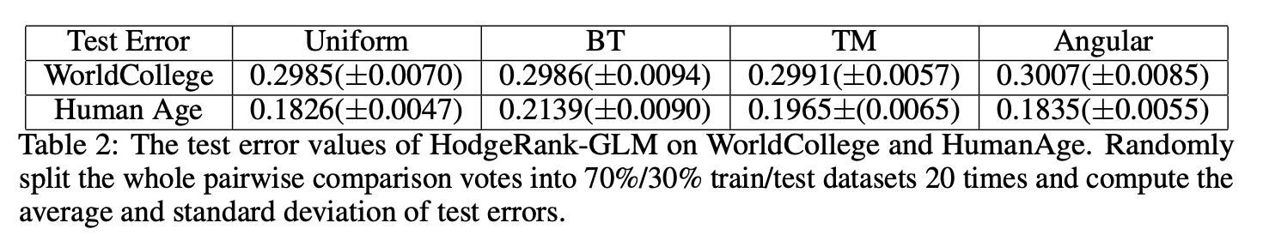
Main Results
Global Ranking Results

Slide 12
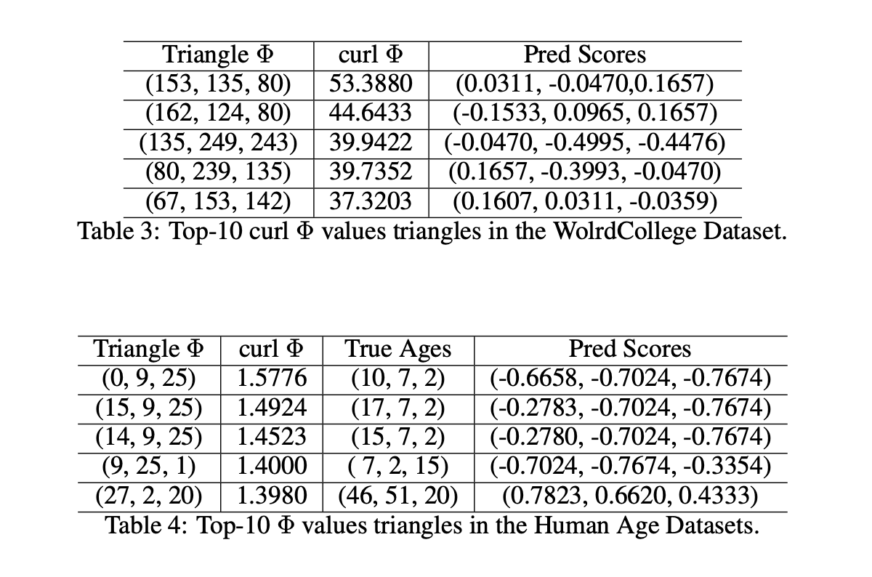
Main Results
Inconsistency Analysis

Slide 13
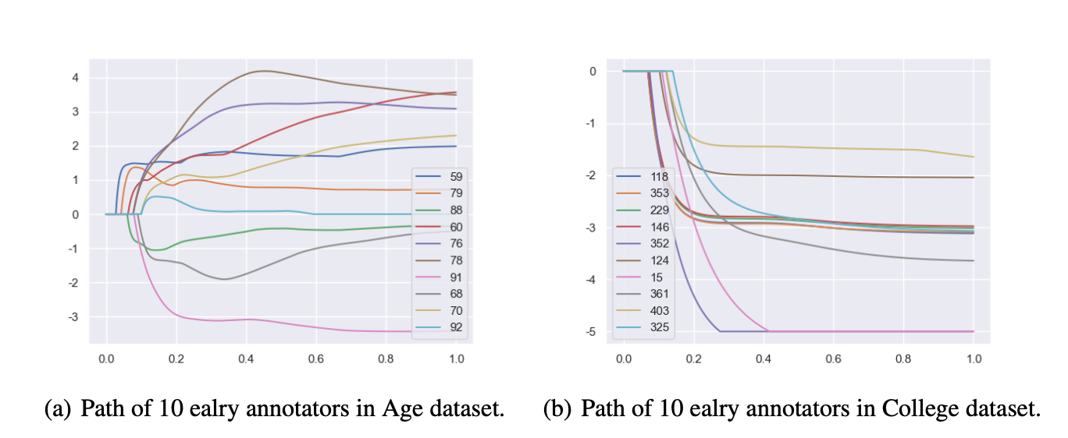
Main Results
Regularization-LBI

Slide 14
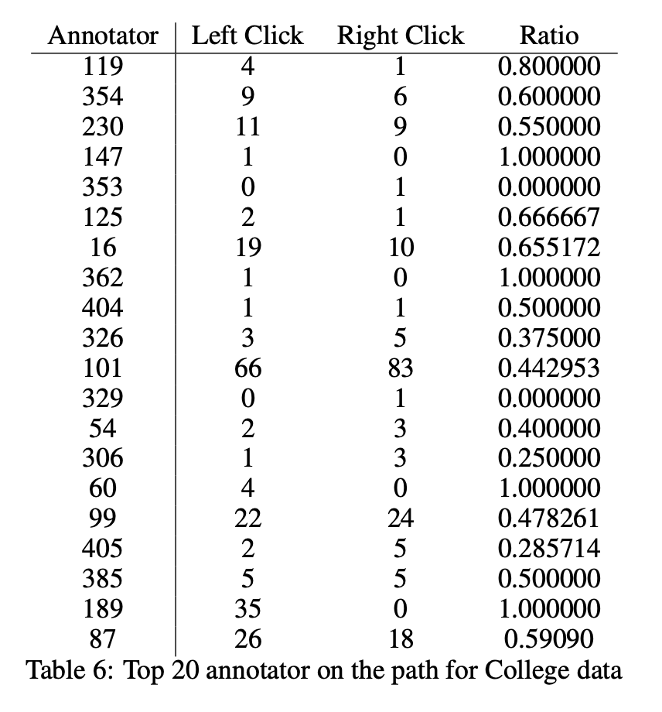
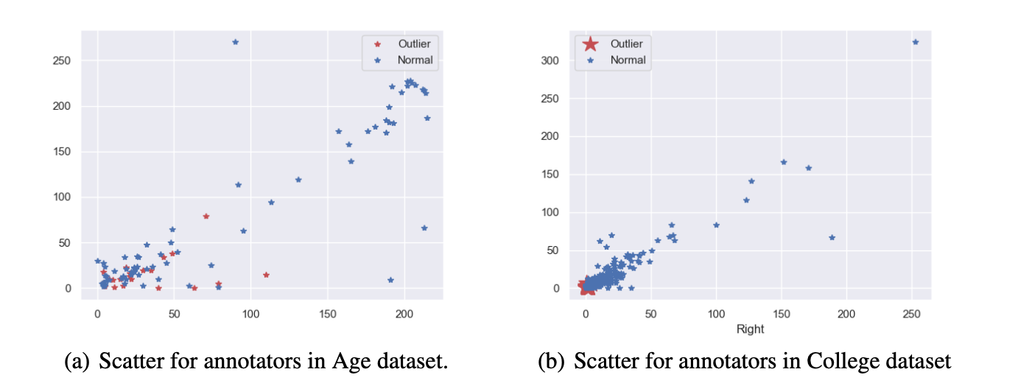
Main Results
Positional Bias & Preference Bias

Slide 15
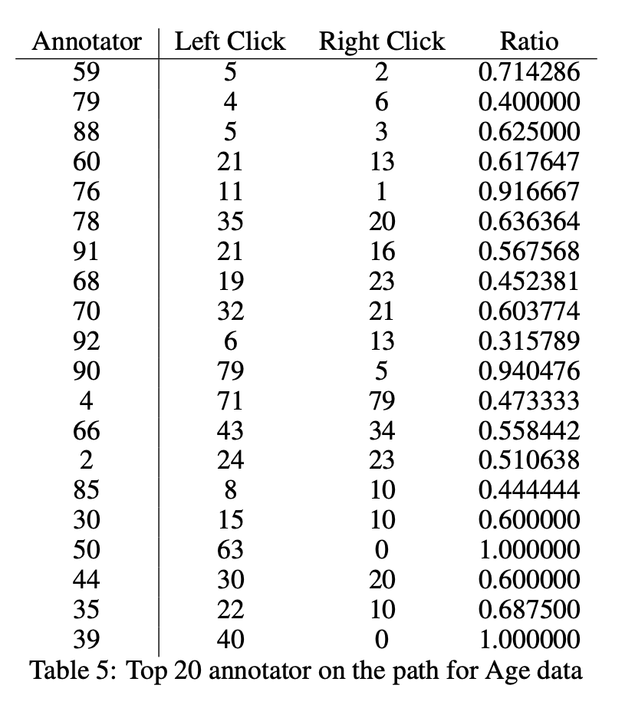
Main Results
Positional Bias & Preference Bias

Slide 16
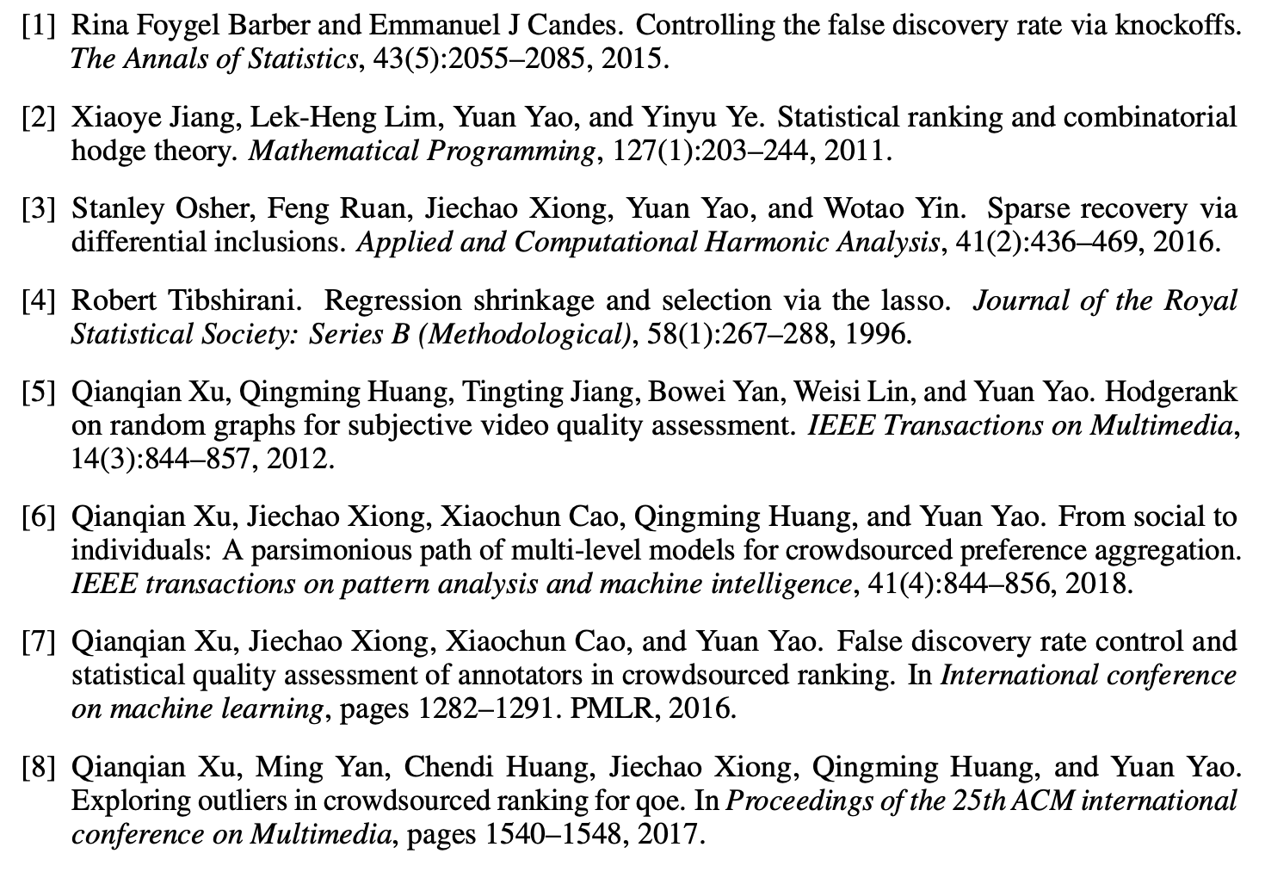
Reference

