Slide 1
Application and Analysis of HodgeRank on Crowdsourced Datasets
Yuxuan Chen
Department of Mathematics

Slide 2
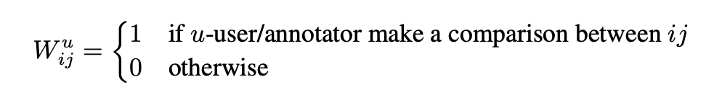

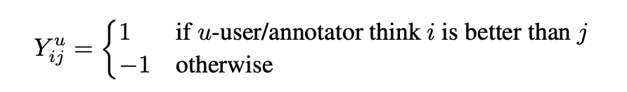
Research Problem
Weighted matrix:
Pairwise comparison data:
Problem: Find a global ranking for all users.

Slide 3
Datasets
World College Dataset, composed of 261 colleges and their corresponding scores (not ground-truth), 9408 pairwise comparisons given by 409 distinct annotators from various countries who are given a pair of universities and asked to choose which university is more attractive to attend. After combining the comparisons of all the annotators, there are 8175 distinct comparisons and 41402 triangles.
Human Age Dataset, contains 30 images from the FG-NET 1 dataset, which have been annotated by 94 volunteer users on ChinaCrowds platform. There are 12778 pairwise comparisons given by annotators who are presented with two images and asked to choose which one appears older. After combining the comparisons of all the annotators, there are 435 distinct comparisons and 4060 triangles, which means that every pair of the images has been compared. The ground-truth ages for the images are also included in the dataset.

Slide 4
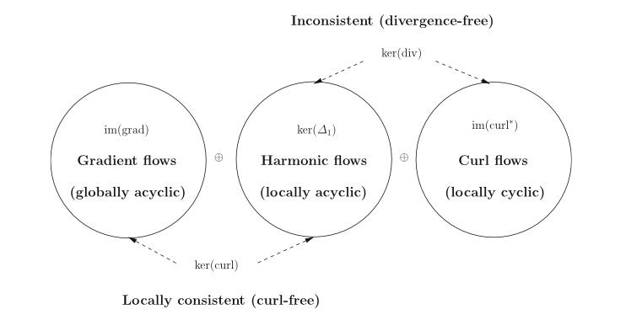
Methodology
Hodge Decomposition Theorem

Slide 5
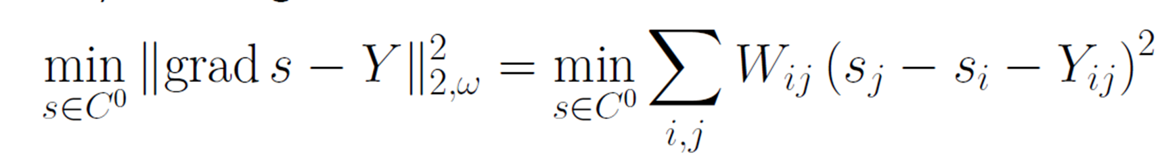



Methodology
HodgeRank
where . Global ranking is the ranking of global score .
Cyclic ranking component:

Slide 6


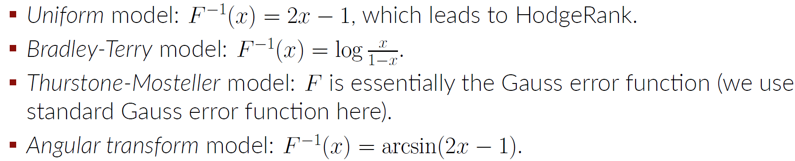
Methodology
HodgeRank-GLM

Slide 7

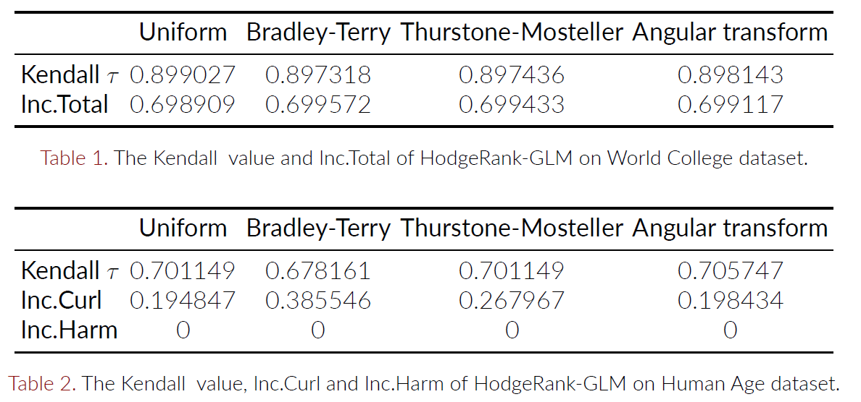
Main Results
Global Ranking Results

Slide 8
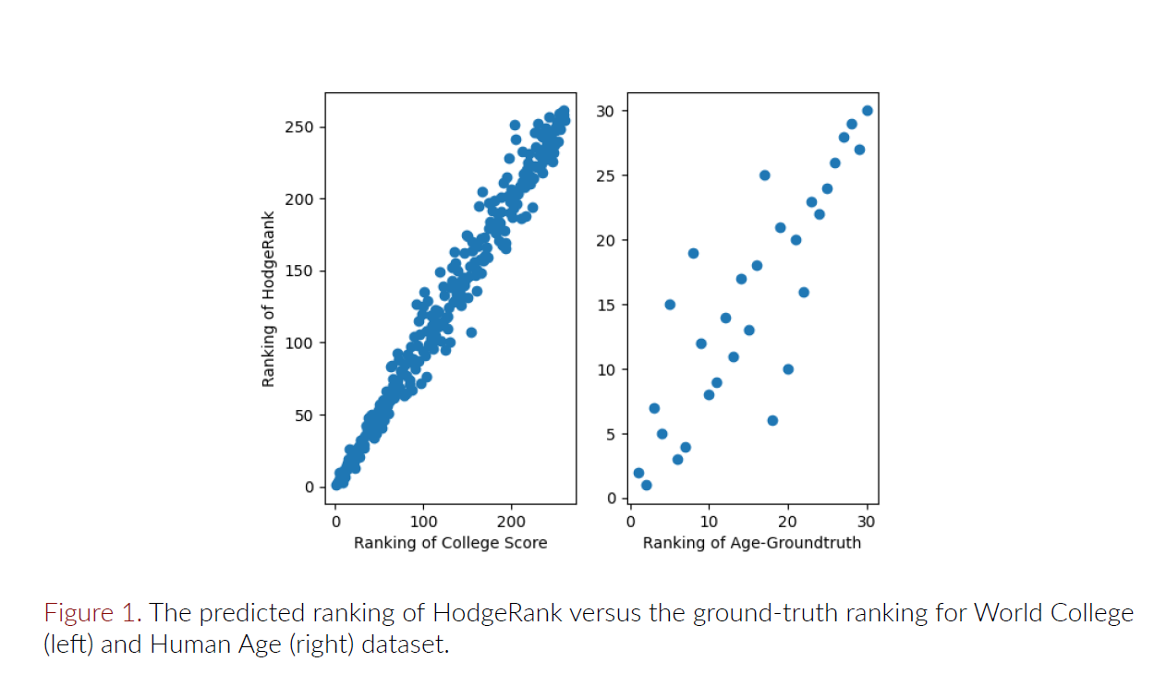
Main Results
Global Ranking Results

Slide 9
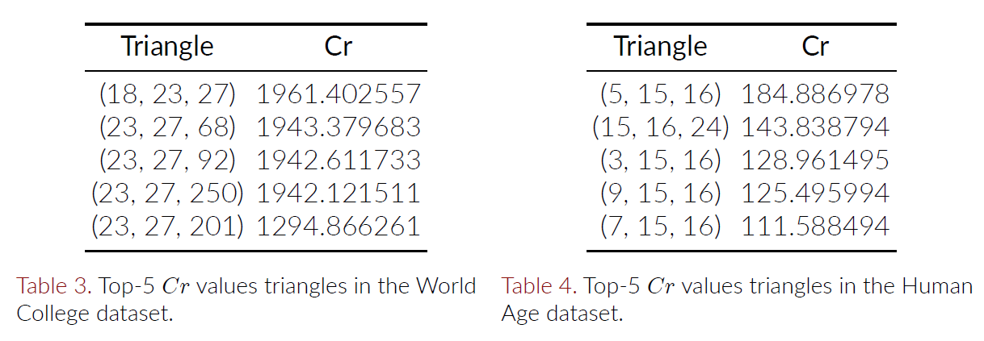
Main Results
Inconsistency Analysis

Slide 10
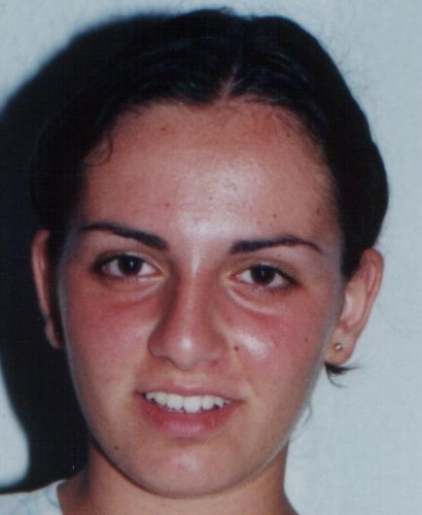

Main Results
Inconsistency Analysis
College 23: University of Michigan, USA
College 27: University of Washington, USA
Image 15 (Age 15):
Image 16 (Age 17):

Slide 11
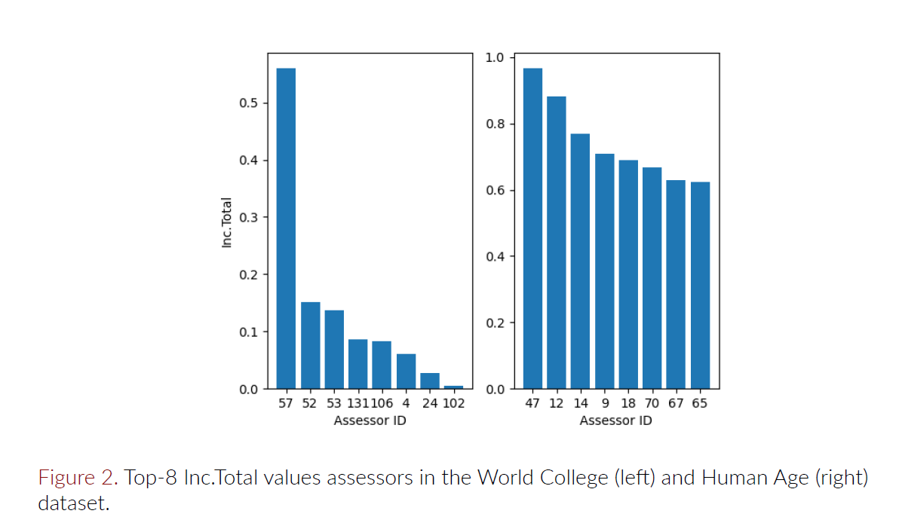
Main Results
Assessment of Assessor’s Reliability

Slide 12
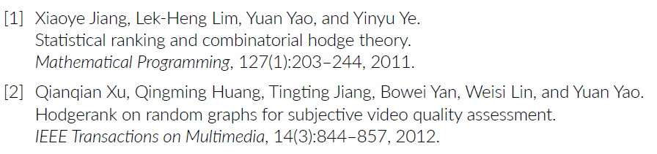
Reference

