Slide 1
Recommender System Based on Matrix Factorization with Incorporation of Movie Genre Information
CAI Bibi, Qiu Zhenyu, WANG Zhiwei
Department of Mathematics, HKUST
May 18, 2023

Slide 2
Outline
Background
Our model
Fitting the model
Results

Slide 3




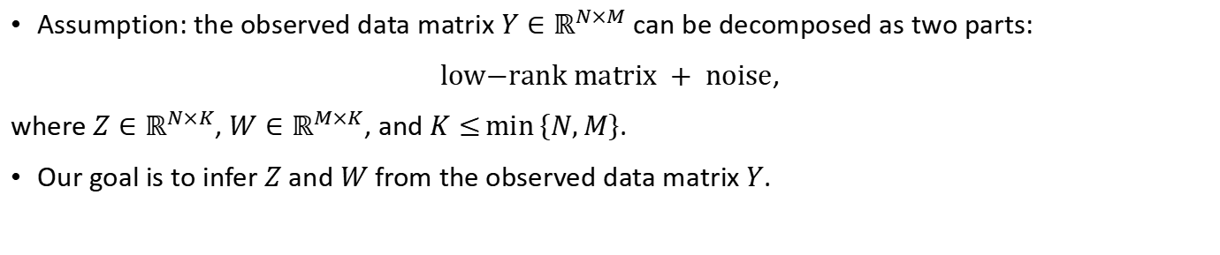
Matrix factorization via low-rank modelling
$$Y$$
$$Z$$
$$W^{T}$$
$$\text{Noise}$$
Assumption: the observed data matrix $Y∈ℝ^{N×M}$ can be decomposed as two parts:
$\text{l}\text{ow}\text{−}\text{r}\text{ank} \text{m}\text{atrix} + \text{noise}$,
where $Z∈ℝ^{N×K}$, $W∈ℝ^{M×K}$, and $K≤\text{min}\left\{N,M\right\}$.
Our goal is to infer $Z$ and $W$ from the observed data matrix $Y$.

Slide 4
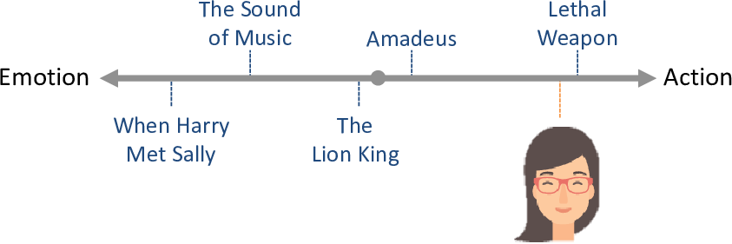
Netflix Prize
 | User 1 | User 2 | User 3 | …
Movie 1 | 5 | 2 | 4
Movie 2 | Missing | 5 | Missing
Movie 3 | 4 | Missing | Missing
Movie 4 | 3 | 3 | Missing
…
$$Z$$
$$W^{T}$$
$$\text{Noise}$$

Slide 5
Challenge
Matrix factorization methods suffer from poor data quality
High data sparsity
Low signal-to-noise ratio (SNR)
 | User 1 | User 2 | User 3 | …
Movie 1 | 5 | 2 | 4
Movie 2 | Missing | 5 | Missing
Movie 3 | 4 | Missing | Missing
Movie 4 | 3 | 3 | Missing
…
A small fraction of active users and popular movies account for a large fraction of data.
The famous MovieLens 100K dataset has only 100K observed ratings of 1,682 movies from 943 users, resulting in 94% of entries missing in the rating matrix.

Slide 6
Movie genre information
A promising way is to leverage the side information!
Movie information is always available!
Action | War | Comedy
1 | 0 | 0
0 | 0 | 1
1 | 0 | 0
0 | 1 | 0
 | User 1 | User 2 | User 3 | …
Movie 1 | 5 | 2 | 4
Movie 2 | Missing | 5 | Missing
Movie 3 | 4 | Missing | Missing
Movie 4 | 3 | 3 | Missing
…
Assumption: the movies’ factors are associated with their genres.
Movies with same genres may have similar audiences.

Slide 7

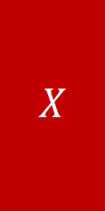
How to incorporate side information?
$$X$$
$$Y$$
$$Z$$
$$W^{T}$$
$$\text{Noise}$$
Genre matrix $X∈ℝ^{N×C}$
Matrix factorization framework

Slide 8
Outline
Background
Our model
Fitting the model
Results

Slide 9
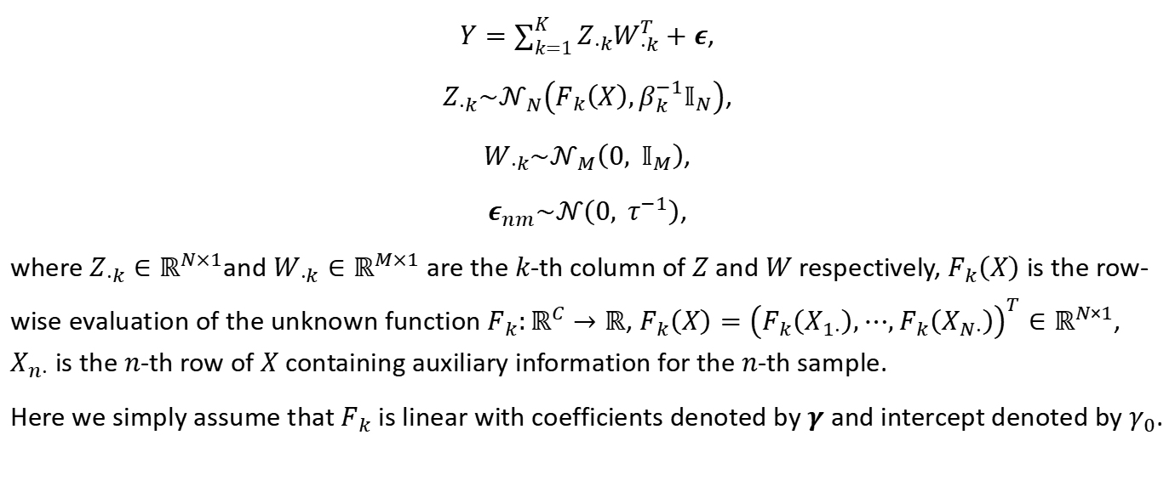
Our model
$Y=\sum_{k=1}^{K}{Z_{⋅k}W_{⋅k}^{T}}+ε$,
$Z_{⋅k}\sim 𝒩_{N}\left(F_{k}\left(X\right),β_{k}^{−1}𝕀_{N}\right)$,
$W_{⋅k}\sim 𝒩_{M}\left(0, 𝕀_{M}\right)$,
$ε_{nm}\sim 𝒩\left(0, τ^{−1}\right)$,
where $Z_{⋅k}∈ℝ^{N×1}$and $W_{⋅k}∈ℝ^{M×1}$ are the $k$-th column of $Z$ and $W$ respectively, $F_{k}\left(X\right)$ is the row-wise evaluation of the unknown function $F_{k}:ℝ^{C}→ℝ$, $F_{k}\left(X\right)={\left(F_{k}\left(X_{1⋅}\right),⋯,F_{k}\left(X_{N⋅}\right)\right)}^{T}∈ℝ^{N×1}$, $X_{n⋅}$ is the $n$-th row of $X$ containing auxiliary information for the $n$-th sample.
Here we simply assume that $F_{k}$ is linear with coefficients denoted by $γ$ and intercept denoted by $γ_{0}$.

Slide 10
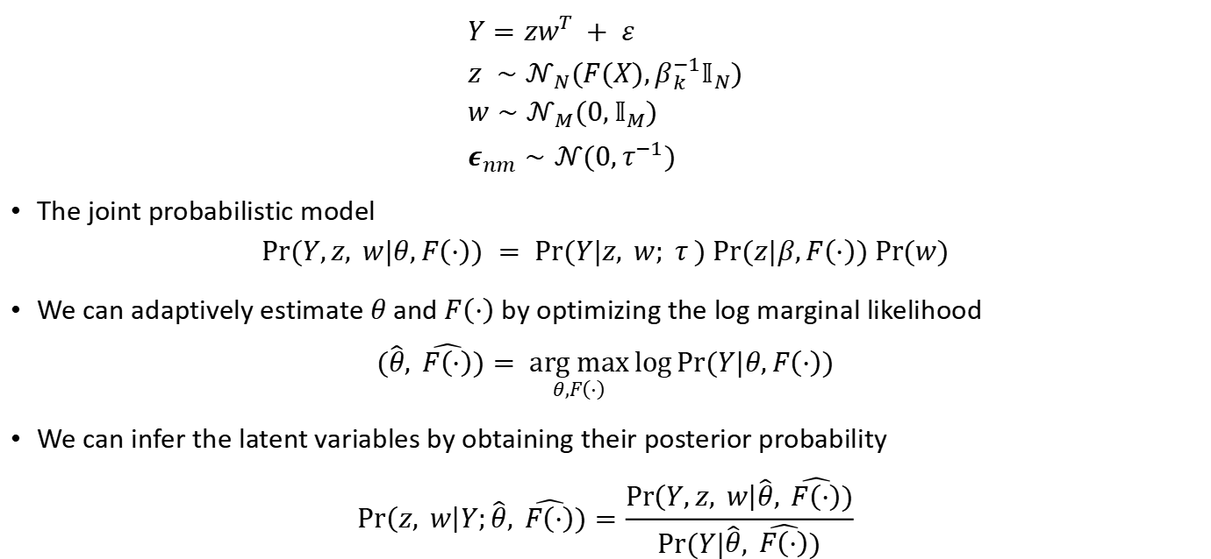
Single-factor case
$$Y=zw^{T} + ε \\ z ∼𝒩_{N}(F(X),β_{k}^{−1}𝕀_{N}) \\ w∼𝒩_{M}(0,𝕀_{M}) \\ ε_{nm}∼𝒩(0,τ^{−1})$$
The joint probabilistic model
$$Pr(Y,z, w|θ,F\left(⋅\right)) = Pr(Y|z, w; τ ) Pr(z|β,F\left(⋅\right)) Pr⁡(w)$$
We can adaptively estimate $θ$ and $F\left(⋅\right)$ by optimizing the log marginal likelihood
$$(\hat{θ}, \hat{F\left(⋅\right)})= \underset{θ,F\left(⋅\right)}{arg max}{\log{Pr(Y|θ,F\left(⋅\right))}}$$
We can infer the latent variables by obtaining their posterior probability
$$Pr\left(z, w\right|Y;\hat{θ}, \hat{F\left(⋅\right)})=\frac{Pr\left(Y,z, w\right|\hat{θ}, \hat{F\left(⋅\right)})}{Pr(Y|\hat{θ}, \hat{F\left(⋅\right)})}$$

Slide 11
Outline
Background
Our model
Fitting the model
Results

Slide 12
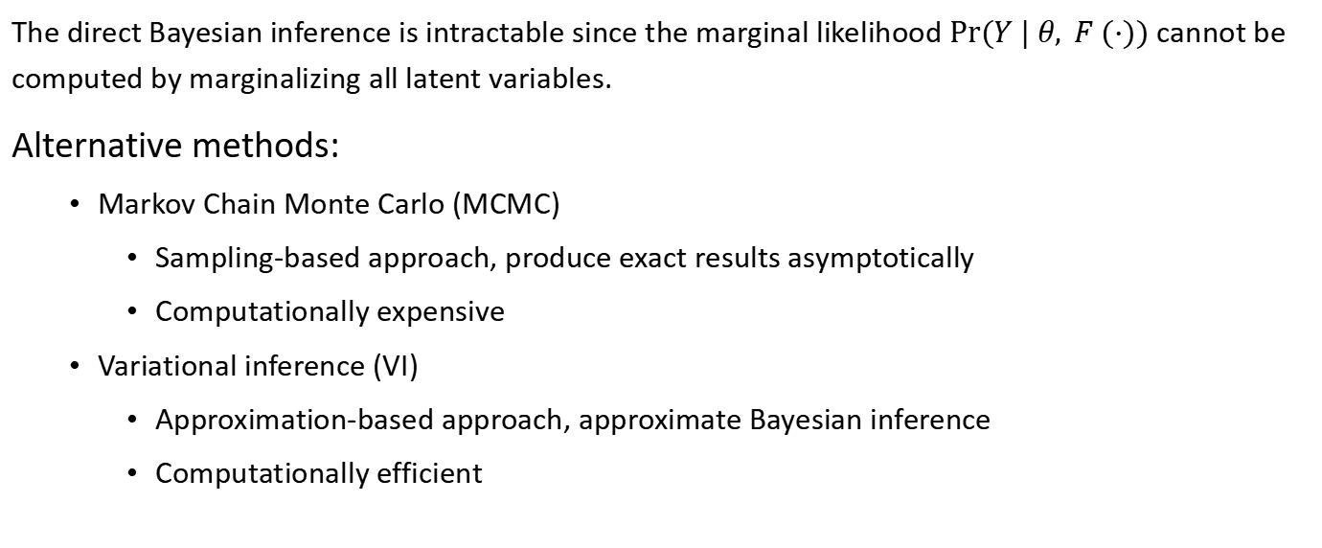
Intractable Bayesian inference problem
The direct Bayesian inference is intractable since the marginal likelihood $Pr⁡(Y | θ, F (·))$ cannot be computed by marginalizing all latent variables.
Alternative methods:
Markov Chain Monte Carlo (MCMC)
Sampling-based approach, produce exact results asymptotically
Computationally expensive
Variational inference (VI)
Approximation-based approach, approximate Bayesian inference
Computationally efficient
✓

Slide 13
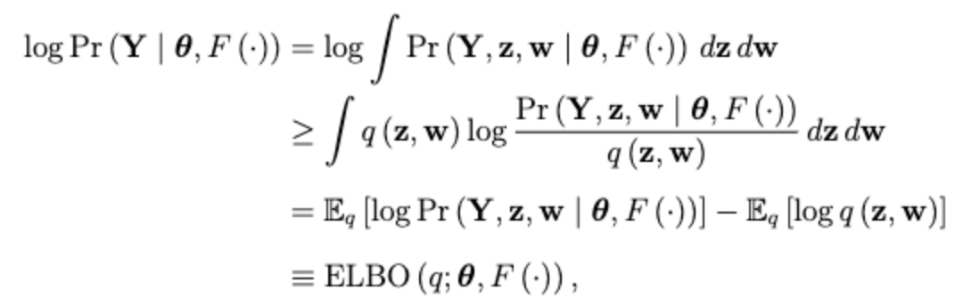
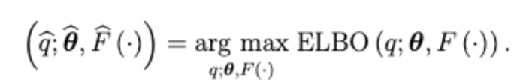
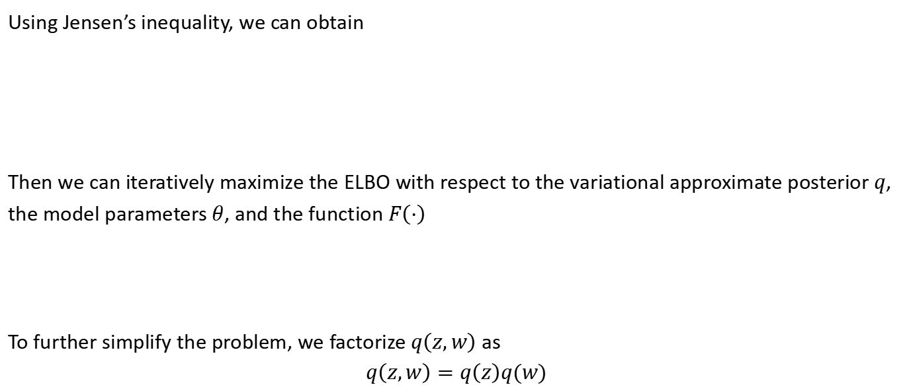
Evidence lower bound (ELBO)
Using Jensen’s inequality, we can obtain
Then we can iteratively maximize the ELBO with respect to the variational approximate posterior $q$, the model parameters $θ$, and the function $F\left(⋅\right)$
To further simplify the problem, we factorize $q\left(z,w\right)$ as
$$q\left(z,w\right)=q\left(z\right)q(w)$$

Slide 14
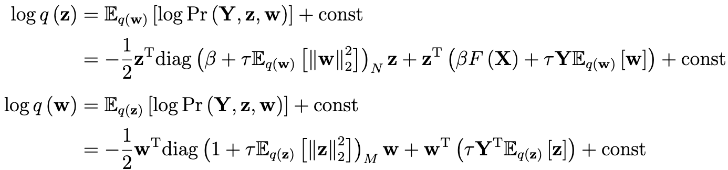



Approximate posterior’s form
The optimal solutions of $q(z)$ and $q\left(w\right)$ are given by
The quadratic form indicates that both $z$ and $w$ follow Gaussian distribution

Slide 15
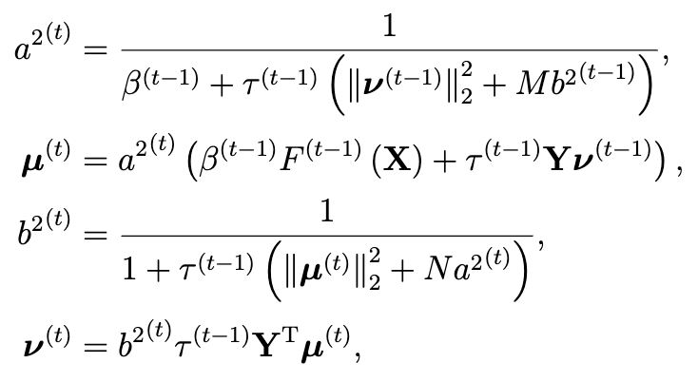

E-step
Suppose that we are at the $t$-th step of the variational EM algorithm, and we have obtained variational parameters $\{μ^{\left(t−1\right)}, a^{2^{\left(t−1\right)}};ν^{t−1}, b^{2^{(t−1)}}\}$, model parameters $θ^{(t−1)}=$ $\{τ^{\left(t−1\right)}, β^{(t−1)}\}$, and function $F^{\left(t−1\right)}(⋅)$ at the $(t−1)$-th step. Then the updating equations for the variational parameters in the $t$-th step are given as

Slide 16

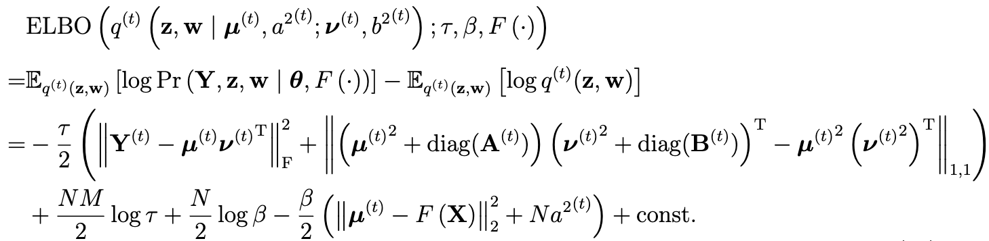

M-step
With the variational approximation $q^{(t)}$ updated in the $t$-th E-step, we need to update model parameters $θ=\{τ, β\}$and function $F\left(⋅\right)$ in the M-step
where

Slide 17
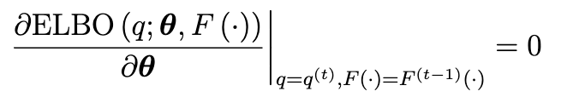
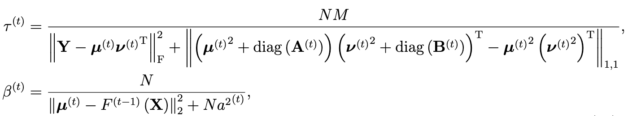

Updating model parameters
We first consider optimizing model parameters with the estimate of the function $F^{(t−1)}\left(⋅\right)$ fixed.
By solving
We obtain the updating equations for parameter estimation in the $t$-th M-step

Slide 18


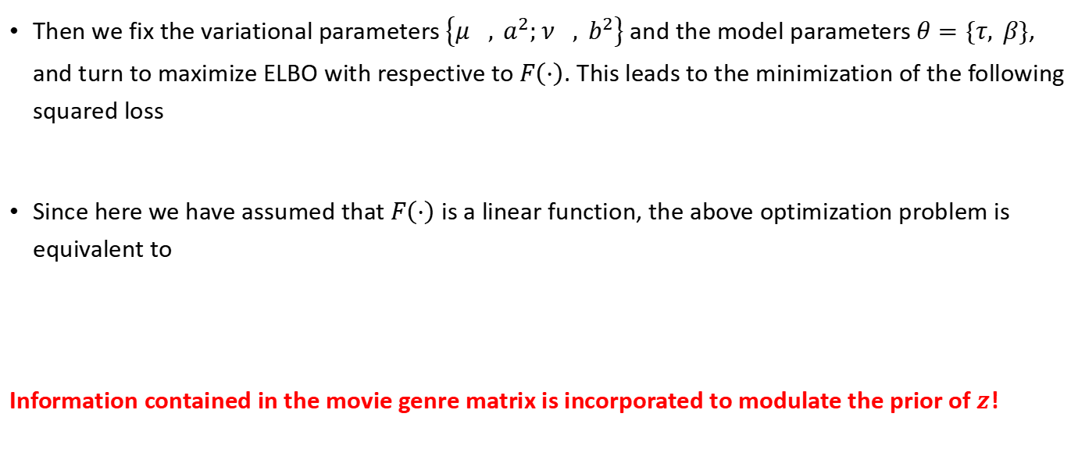
Updating function
Then we fix the variational parameters $\left\{μ^{}, a^{2};ν^{}, b^{2}\right\}$ and the model parameters $θ=\{τ, β\}$, and turn to maximize ELBO with respective to $F\left(⋅\right)$. This leads to the minimization of the following squared loss
Since here we have assumed that $F\left(⋅\right)$ is a linear function, the above optimization problem is equivalent to
Information contained in the movie genre matrix is incorporated to modulate the prior of $z$!

Slide 19
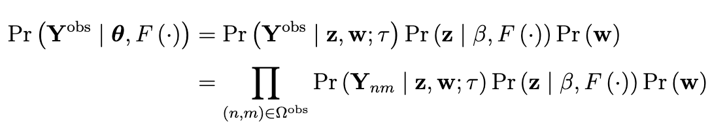
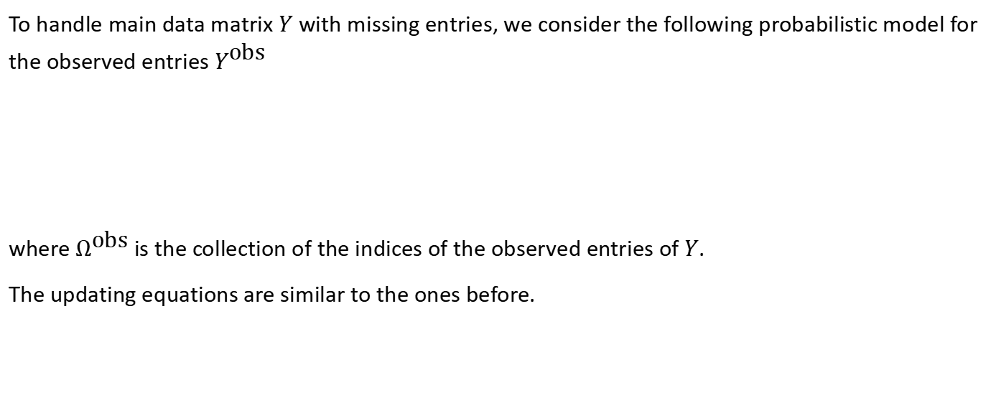
Missing data
To handle main data matrix $Y$ with missing entries, we consider the following probabilistic model for the observed entries $Y^{\text{obs}}$
where $Ω^{\text{obs}}$ is the collection of the indices of the observed entries of $Y$.
The updating equations are similar to the ones before.

Slide 20
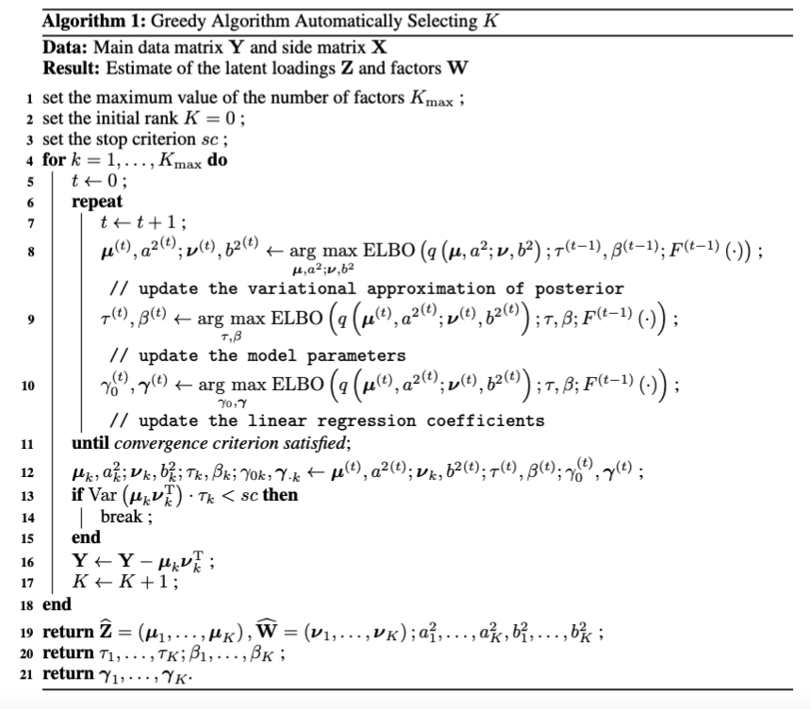
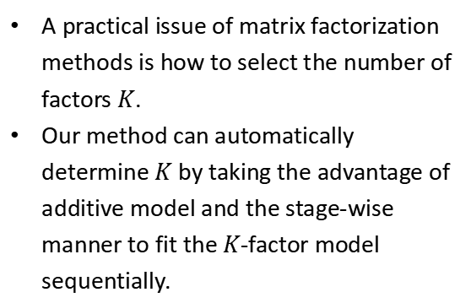
Proposed algorithm
A practical issue of matrix factorization methods is how to select the number of factors $K$.
Our method can automatically determine $K$ by taking the advantage of additive model and the stage-wise manner to fit the $K$-factor model sequentially.

Slide 21
Outline
Background
Our model
Fitting the model
Results

Slide 22
Compared methods
Funk SVD:
SoftImpute:
Truncated SVD: , for k < rank (X)
KNN

Slide 23
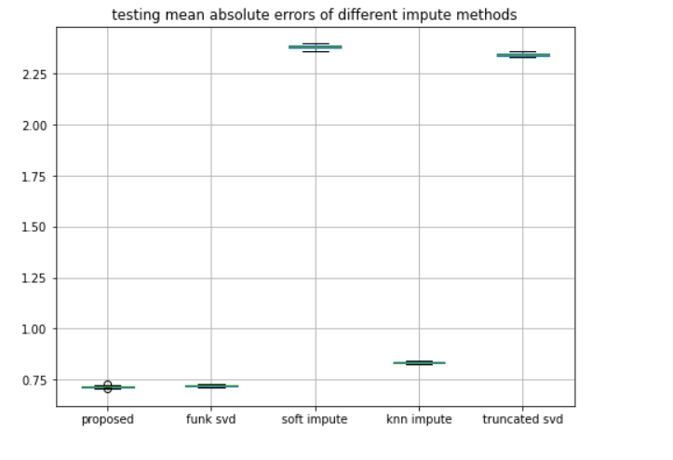
Imputation accuracy
our model achieves higher prediction accuracy compared to other methods with the utilization of movie genre inform.

Slide 24
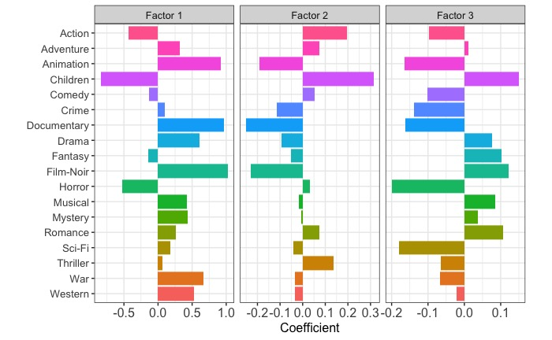
Enrichment of movie genres in MovieLens 100K data
Leading genres in Factor 1: Animation, Children, Documentary, Drama, Film-Noir, War;
Leading genres in Factor 2: Action, Animation, Children, Documentary, Film-Noir, War;
Leading genres in Factor 3: Action, Animation, Children, Crime, Documentary, Film-Noir, Horror, Sci-Fi.

Slide 25
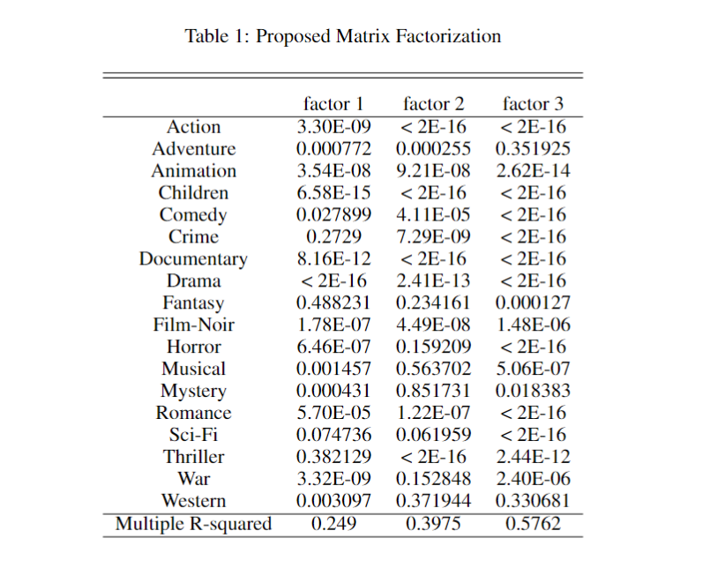
Significance
P-values of most coefficients are significantly, which means the movie’s laten factors are highly coerrelated to the movie genres;
R-squared also reflects that our linear models fit well;

Slide 26
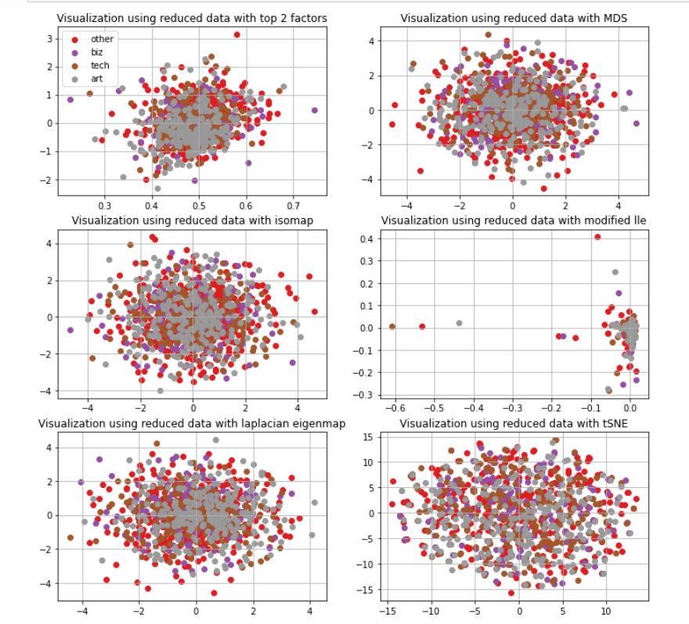
Visualization of user preference factor
The results shows that the users’ preferences on movies seem to have no obvious relationship with gender, age, and occupation.

Slide 27
Summary
Probabilistic matrix factorization framework with the incorporation of movie genre information.
Advantages
Achieves higher prediction accuracy compared to other methods with the utilization of movie genre information.
Allows the model parameters to be automatically estimated under the empirical Bayes framework.
Computationally efficient and scalable to large datasets by exploiting variational inference.

Slide 28
Thank you!

