Slide 1

聚类分析与生物分子动力学
I
姚 远
高等统计选讲
2009.9.18

Slide 2
摘 要
分子动力学仿真数据特点
聚类分析

Slide 3

合作伙伴
Mathematics
Gunnar Carlsson
Yuan Yao
Michael Lesnick
Gurjeet Singh
Stanford University
Chemistry/Biophysics
Vijay Pande
Xuhui Huang
Greg Bowman
Sergio Bacallado
Computer Science
Leo Guibas
Jian sun

Slide 4
Guibas-Carlsson-Pande Collaboration
Mathematics
Gunnar Carlsson
Yuan Yao
Michael Lesnick
Gurjeet Singh
Topological
and Geometric Algorithms
Design and Implementation
Chemistry/Biophysics
Vijay Pande
Xuhui Huang
Greg Bowman
Sergio Bacallado
Massive Datasets
Computer Science
Leo Guibas
Jian sun
Biology

Slide 5
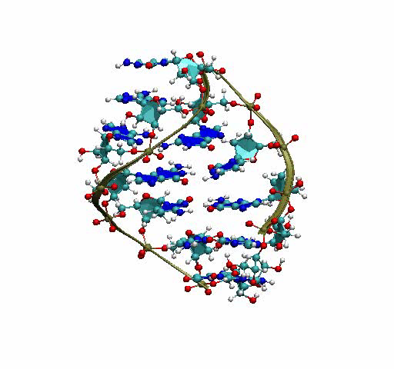
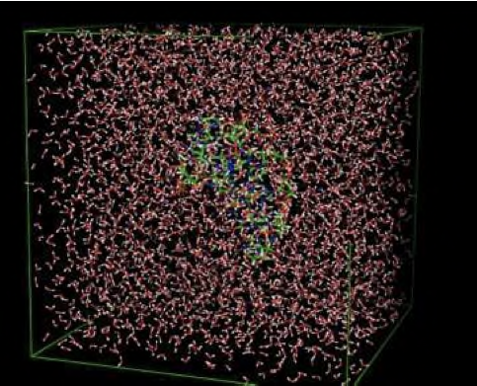
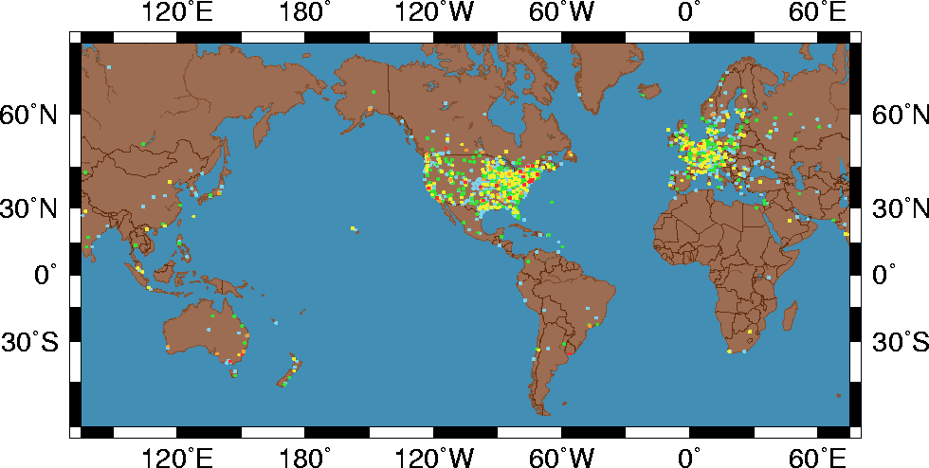

生物分子动力系统仿真
Shirts and Pande, Science, 290, 1903 , 2000

Slide 6
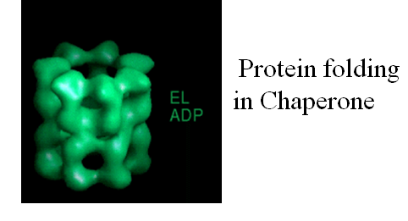
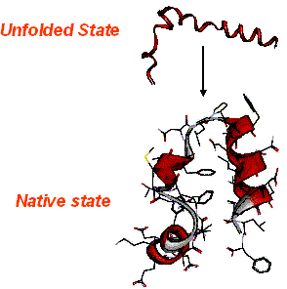
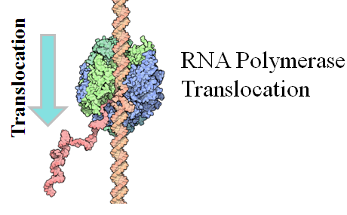
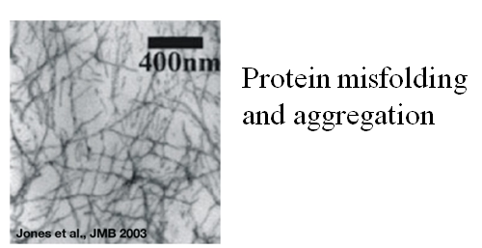
生物问题: Conformational Changes
Protein Folding
Illustrations by David Goodsell
Notes:
We are interested in conformational changes because they play a variety of important roles.
Here, I will give you a few striking examples.
Biomolecular folidng is one type of conformational changes. Peoteins have to undergo conformationl changes in order to fold into its native structure from an extended chain. This process can be assisted and occurred in the confinemaent of chaperone in the cell.
The first example is the RNA transcription, the synthesis of RNA from DNA. During transcription, the enzyme RNA polymerase has to translocate on the DNA template in order to transcript the downstream DNA. This process is associated with the conformaitonal changes of template DNA, newly snthesised RNA, and RNA polymerase itself. This is the first example of conformational changes..
When protein midfold, it can aggregrae into fiberils. This has beliived to be the cause of many diseases such as Alzimer’s disease and Hungon’s disease.
These are just a few examples showing that understanding conformaitonal changes is important. In my talk, I will focus on folding of small biomolecues. In particulae, I will discussed the protein misfolding related to the Hungtiungton’s disease. But the tools I developed are applicable to any these types of conformaitonal changes.
ATP binds in one chamber of GroEL
Then the misfolded protein binds in that chamber; the GroES cap binds
Hydrolysis of ATP provides the energy to change the interior residues and refold the captured protein.
Binding of ATP in the other chamber causes a conformational change releasing the GroES and the refolded protein
The cycle repeats
____________________
During synthesis of RNA from DNA, the enzyme RNA polymerase has to translocate on the DNA template in order to keep transcribing the downstreame DNA (distiguish the systems I am wokding on or not)
Motors such as myosin have to walk on the filement
Proteins have to undergo conformational changes in order to fold into their native structures, that process could occure in the confinement of chaperon in the cell.
Proteins can also misfold and aggregrate into fibrils, that could cause many neuodegentive disorders diseases such as Alzimer’s diseases and hungtinton’s diseases.
These are just a few examples of conformational changes, and I will dicuss in more details for a couple of them later in my talk.

Slide 7
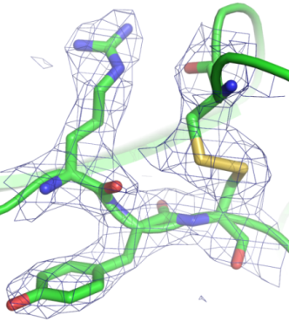
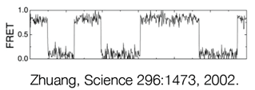
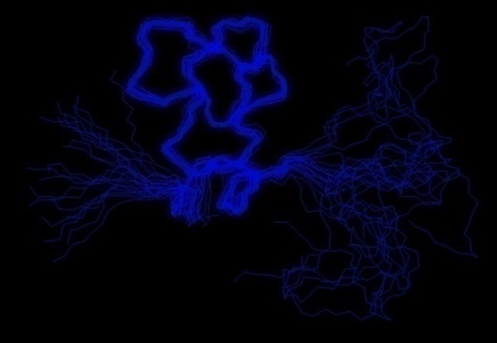
Understanding Conformational Changes at Atomic Resolution is Difficult Experimentally
Computer simulations may complement experiments!
X-ray
structures are static snapshots
Single Molecule FRET
Provide information of an order parameter
NMR
can provide dynamics, but difficult for large systems
Notes:
Understanding conformational changes is important, however, it is difficult. A lot of biomedical, genetic and structual experiments can be applied to study conformaitonal changes. However, it is difficult for the experitmental techniques to provide dynamic information of conformational changes at atomic resolution.
For example, X-ray structures are only staitc snapshots of molecules in motion. NMR is able to provide dynamics, but is difficult to be applied to the large systems.
Single Molecle FRET is another type of experimetal techniques which is able to provide the dynamics information of conformaitonal changes. However, it can only provide informaiton along certain order parameters such as distances between a pair of probes.
Without understanding atomic details it is impossible to understand the fundamental chemistry they perform.
Computer simulaitons may complenent experimetns and provide dynamics information at atomic resolution,
Using computer simulations to study these conformaitonal changes are not easy, since there is a gap between the timescale we can simulate (nanosecond) and the timescale when the biological reveleant conformational changes occure that is always at microseconds or longer. My research is focused on developing and applying novel algorithms which enhances conformaitonal sampling and bridge the gap between the experiments and simulaitons to help understand conformational changes for the biological macromolecules.
.
In addition to structures, nuclear magnetic resonance can yield information on the dynamics of various parts of the protein. This usually involves measuring relaxation times such as T₁ and T₂ to determine order parameters, correlation times, and chemical exchange rates. NMR relaxation is a consequence of local fluctuating magnetic fields within a molecule. Local fluctuating magnetic fields are generated by molecular motions. In this way measurements of relaxation times can provide information of motions within a molecule on the atomic level. In NMR studies of protein dynamics thenitrogen-15 isotope is the preferred nucleus to study, because its relaxation times are relatively simple to relate to molecular motions, which however requires isotope labeling of the protein. The T₁ and T₂ relaxation times can be measured using various types of HSQC based experiments. The types of motions, which can be detected, are motions that occur on a time-scale ranging from about 10 picoseconds to about 10 nanoseconds. In addition slower motions, which take place on a time-scale ranging from about 10 microseconds to 100 milliseconds can also be studied. However, since nitrogen atoms are mainly found in the backbone of a protein, the results mainly reflect the motions of the backbone,
NMR: claudio fernadez
________________________
In this case, computer simulations may complent experimrnts to study conformaitonal changes and provide dyanmics informaiton at atomic resolution.
Emphasize the difficulty, what is my role.. New conformations sampling tools….
Using computer simulations to study these conformaitonal changes are not easy, since there is a gap between the timescale we can simulate (nanosecond) and the timescale when the biological reveleant conformational changes occure. My research is focused on developing and applying novel algorithms which enhances conformaitonal sampling and bridge the gap between the experiments and simulaitons.
Tune contrast for NMR pic, more connections to exp
A lot of biochemic, genitic and structural expriments can be applied to study these conformational changes. However, it is very difficult to experimentally probe the mechanisms of conformaitonal changes at atomic resolution. For example. …
Without these atomic details it is impossible to understand the fundamental chemistry they perform.
Computer simulaitons may complenent experimetns and provide dynamics information at atomic resolution,
My research goal is to use computaional tools to help understand conformational changes in the biological macromolecules.
Main idea up, talk about I am working on small peptide folding, but will eventuallty move on to the biological revelent system.
Computer simulations may complement experiments by providing dynamic information at an atomic level, and make new predictions which can be tested by experimetns

Slide 8
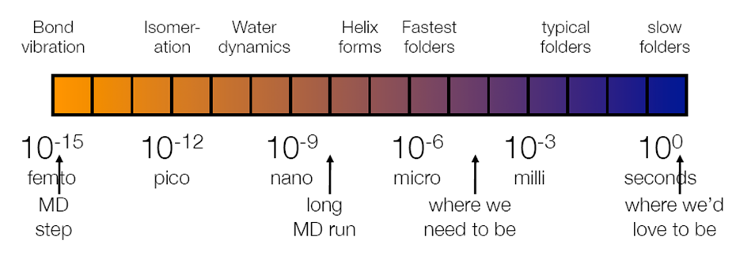
Key Challenge: Timescale Gap
Atomistic Simulations
Experiments
Solution:
Use short simulations to predict long timescale dynamics
Notes:
Coarse graining simulations. MSM model

Slide 9
Conformational Dynamics:
Nearly Uncoupled Markov Chains
Each Markov chain corresponds to a meta-stable state
Zwanzig, J. Stat. Phys. 1983
Chodera. et. al. J. Chem. Phys. 2007
Noé. et.al. J. Chem. Phys. 2007
Huang et.al. 2009, Hummer, Shuttle....
Figure Courtesy John Chodera
Notes:
Our MD simjulaitons are sampled from an underlined free energy landscape. In the free energy landscapes , there are many free energy basins separated by free energy barriers. If we look at this from the dynamics point of view, the transitions within the same basin is fast, while transitions across the barriers will be slow. Therefore, the conformational dynamics can be viewed as nearly uncoupled Markov chains. Each of this markov chain corresponds to a long-lived metstable state. Such a separation of timescales allow us to partition the configuration space into a set of non-overlapping metastable states. Dynamics to be modeled by stochastic transitions among these metastable states governed by memoyless master equation or first-order kinetics.

Slide 10
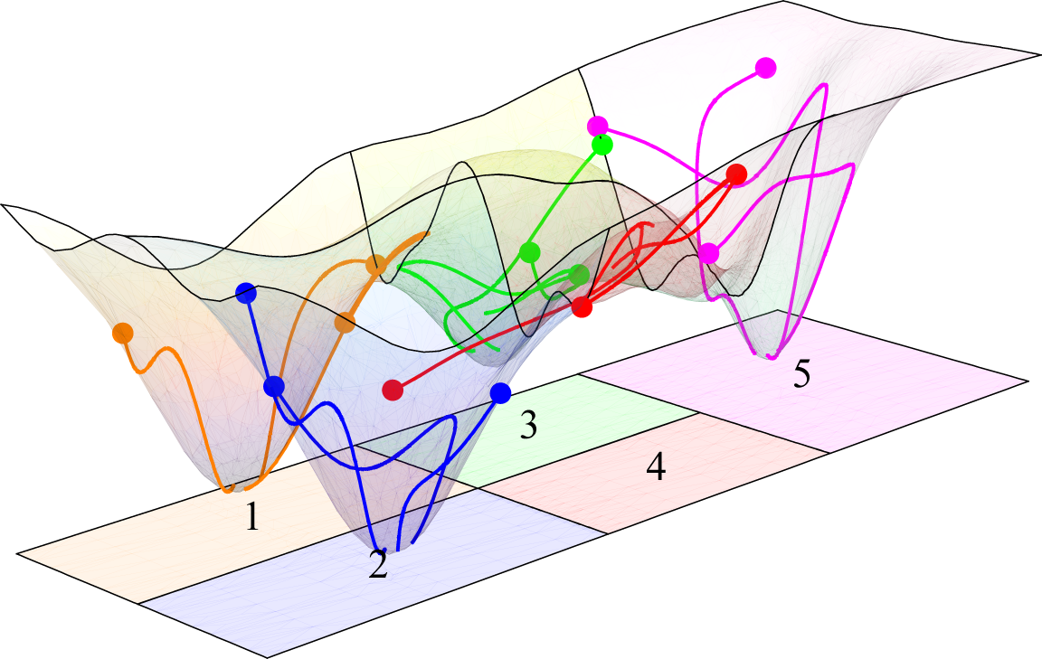
Markov State Models (MSMs)
The configuration space is decomposed into non-overlapping states
Define transition probabilities between states
We can extract long time dynamics from MSMs built from short simulations
The time is coarse-grained in τ
Notes:
As I mentioned before, obtaining a good state decomposition is difficult. A popular approach is to first divide all the conformations into a large number of small sets of very structurally similar, and therefore likely kinetically similar, conformations called microstates. We then used spectral clustering lump microstates that can interconvert rapidly into larger states called metastable states.
The dynamics can be described by a discrete time markov process using the transition matrix.
Get rid of this slide
The configuration space has been decomposed into a set of non-overlapping states. The memory can be short with the coarse graining of time, satisfying the Markov property.

Slide 11
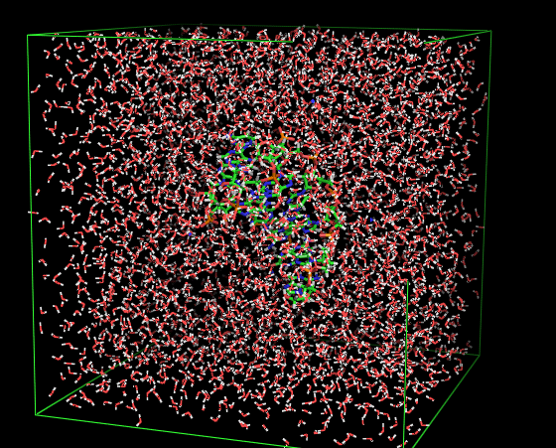
How to construct MSMs?
Dataset: Multiple trajectories with a lot of conformations.
Trajectory 1
Trajectory 2
Trajectory 3
time
Trajectory
Conformation
Notes:
Levy model: within the temperature, the forward backward microscopic rate contant equal 1. The states reflect the thermodynamics of the system in that their density at each temperature is related to the energy according to the Boltzmann distribution. We choose microscopic rate constants so that the kinetic model preserves this distribution at equilibrium for each replica exchange temperature.
Rate constants

Slide 12
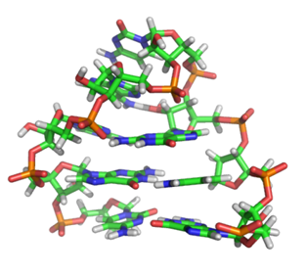
Example: 8-RNA hairpin
An eight nucleotide RNA GCAA hairpin
2,543 TIP3P waters and 7 Na⁺ ions
9963 45ns simulations
> 2.3 million conformations in total
Notes:
Levy model: within the temperature, the forward backward microscopic rate contant equal 1. The states reflect the thermodynamics of the system in that their density at each temperature is related to the energy according to the Boltzmann distribution. We choose microscopic rate constants so that the kinetic model preserves this distribution at equilibrium for each replica exchange temperature.

Slide 13
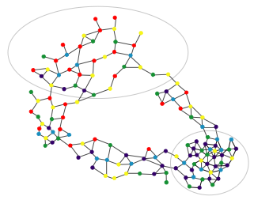
How to construct MSMs?
800,000 nodes, 7.4 billion edges
Data: A large amount of conformations
Directly work on conformations
Network nodes are snapshots from multiple simulations.
Very Expensive!
Andrec, Felts, Gallicchio & Levy (2005) PNAS, 102, 6801
Notes:
Levy model: within the temperature, the forward backward microscopic rate contant equal 1. The states reflect the thermodynamics of the system in that their density at each temperature is related to the energy according to the Boltzmann distribution. We choose microscopic rate constants so that the kinetic model preserves this distribution at equilibrium for each replica exchange temperature.
Rate constants

Slide 14
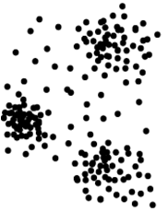
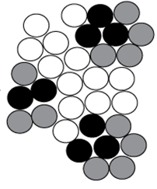
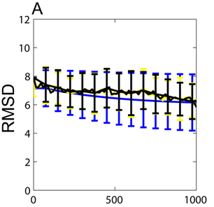
How to construct MSMs?
Conformations
Microstates
Geometric Clustering
(K-means/K-center)
Conformations within the same microstate interconvert quickly
with distance metric (RMSD …)
Construct MSMs on microstates:
# of microstates is huge.
Difficult for studying
folding mechanisms!
10,000 states model
Bowman, Beauchamp, Boxer, and Pande. Methods 2009.
Notes:
Mention the RMSD

Slide 15
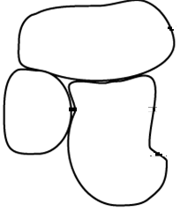
How to construct MSMs?
Geometric
Clustering
(Splitting)
Spectral
Clustering
(Lumping)
Conformations
Microstates
Macrostates
Spectral clustering to lump kinetically related microstates
Chodera. et. al. J. Chem. Phys. 2007
Noé. et.al. J. Chem. Phys. 2007
Deuflhard and Weber, ZIB-report, 2003
Weber, ZIB-report, 2004
Bowman, Huang, and Pande. Methods 2009.
Notes:
A popular approach is to first cluster all the conformations into a large number of small sets of very structurally similar, and therefore likely kinetically similar, conformations called microstates. We then used spectral clustering lump microstates that can interconvert rapidly into larger states called metastable states while conformations separated by large free energy barriers are grouped into different states

Slide 16
分子动力系统中的聚类分析
Geometric Clustering (距离度量)
  K-means/K-medoids vs. K-center, etc.
Kinetic Clustering
  Spectral clustering, etc.
聚类分析的性质
  Flat clustering vs. Hierarchical clustering
  Batch vs.Streaming (online) data
  近似算法和计算复杂性
  统计性质

Slide 17
几何聚类分析
GEOMETRIC CLUSTERING

Slide 18
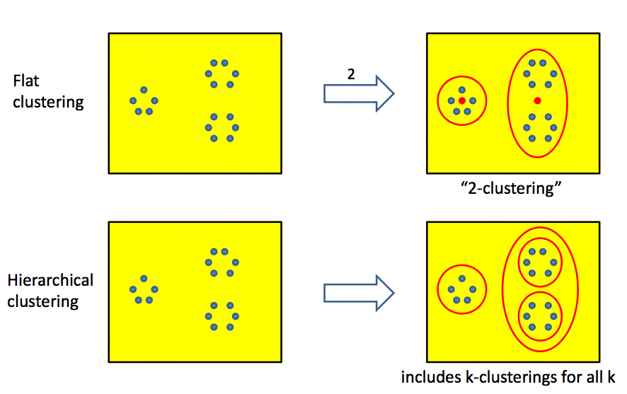
Two Types of Clustering

Slide 19
How is the data presented
Batch
n data point, all at once
(can store all of them in memory)
Online/streaming
n or endless data point, one at once
(o(1) or o(n) memory, can NOT store all of them)
Molecular dynamics data is online/streaming in nature!

Slide 20
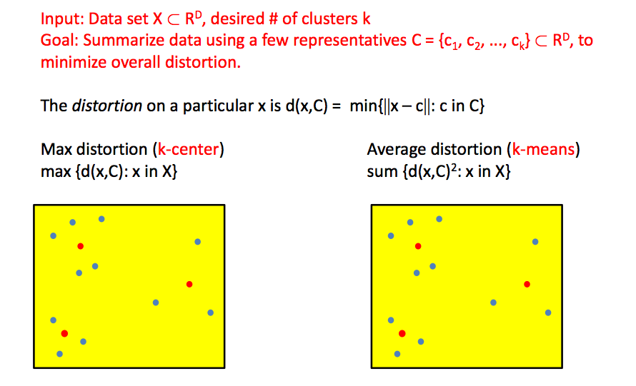
K-center vs. K-means

Slide 21
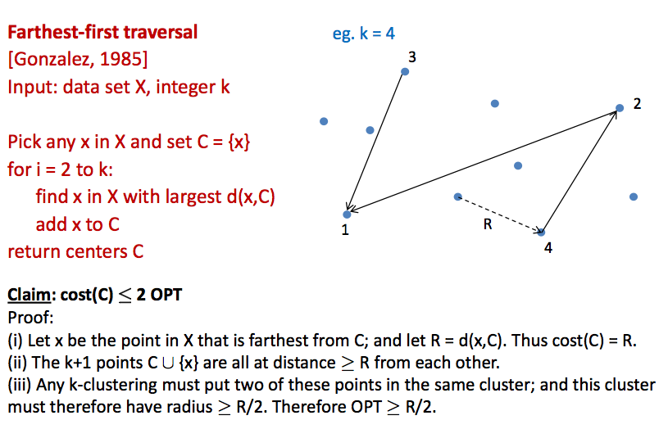
A Greedy Algorithm for K-center

Slide 22
K-center 几何性质
K-center形成了样本空间的一个epsilon-net
  Any two points in C are R-distance away
  Points in C form a R-cover of sample space
只依赖于度量结构
K-center is NP-hard, but greedy algorithm is O(kn)
K-center在ISOMAP(TdL’2000, Science)中被采用，称为Landmark技术
Molecular dynamics application [Sun, Y, Huang, et al. JPC, 09]
缺点：
  对样本空间边缘的outlier和noise比较敏感

Slide 23
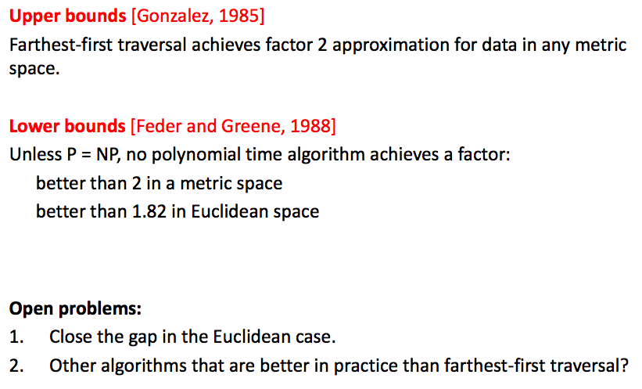
Approximability of K-center

Slide 24
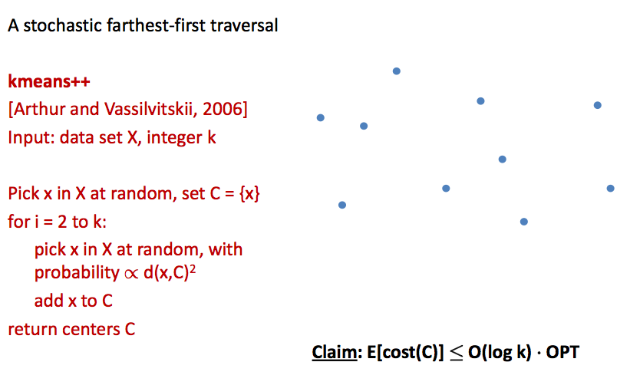
A Greedy Algorithm for K-means

Slide 25
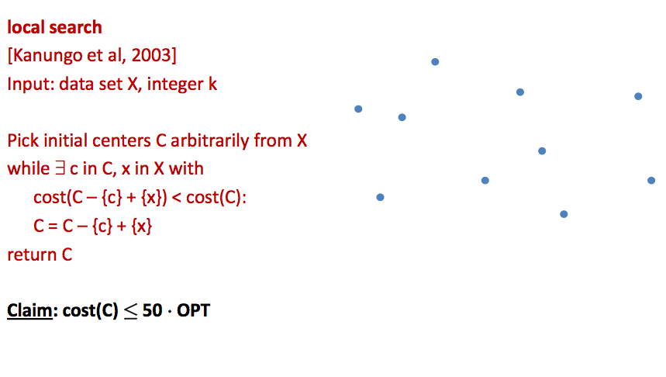
A Constant-factor Approximation

Slide 26
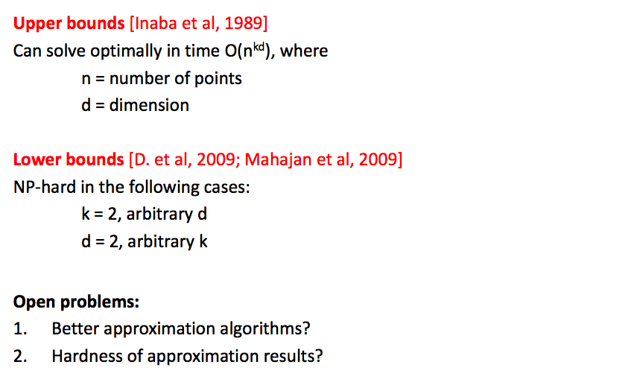
Complexity of K-means

Slide 27
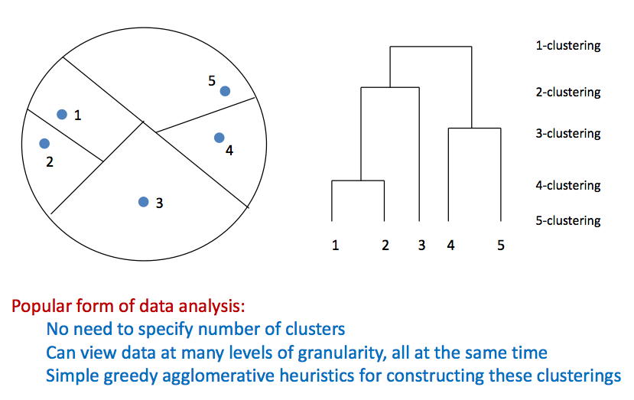
Hierarchical Clustering

Slide 28
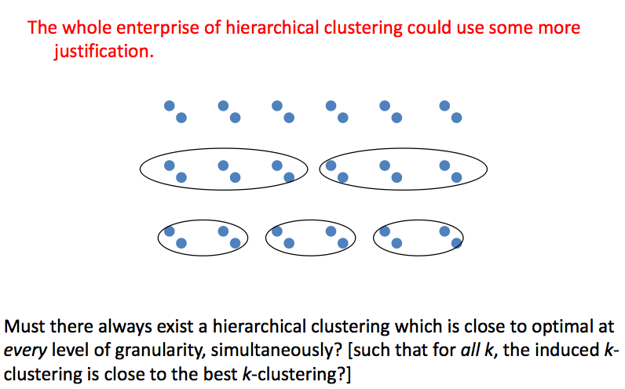
A Basic Existence Problem

Slide 29
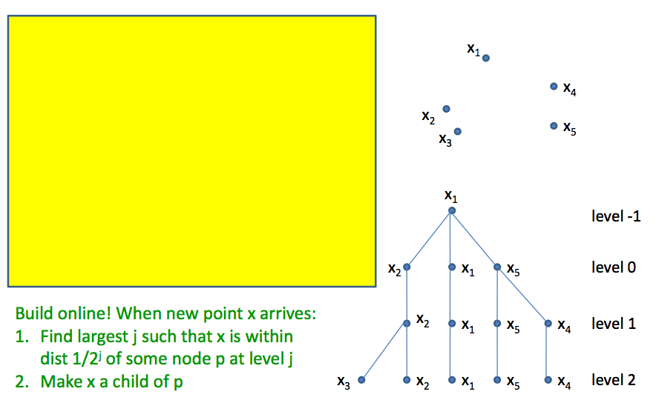
Hierarchical K-center

Slide 30
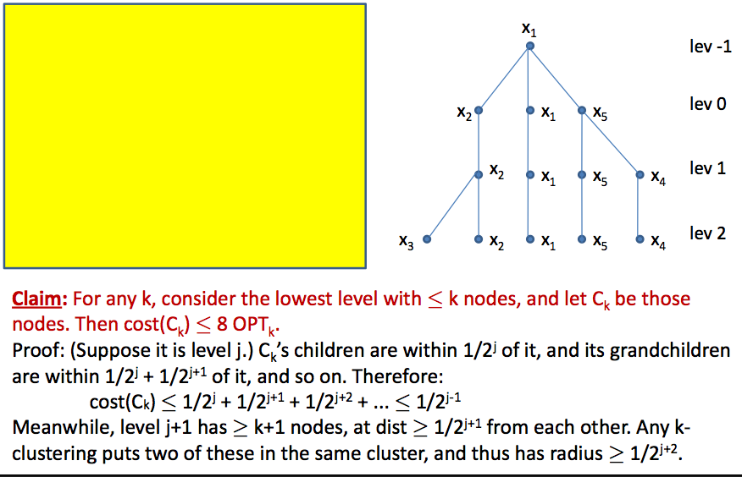
Hierarchical K-center: Complexity

Slide 31
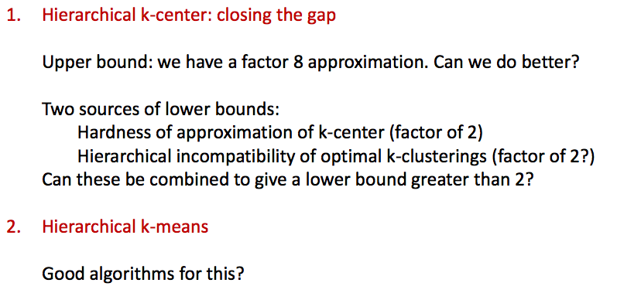
Hierarchical Clustering: Open Problems

Slide 32
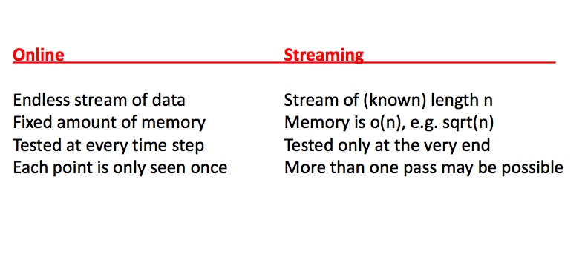
Clustering online/streaming data

Slide 33
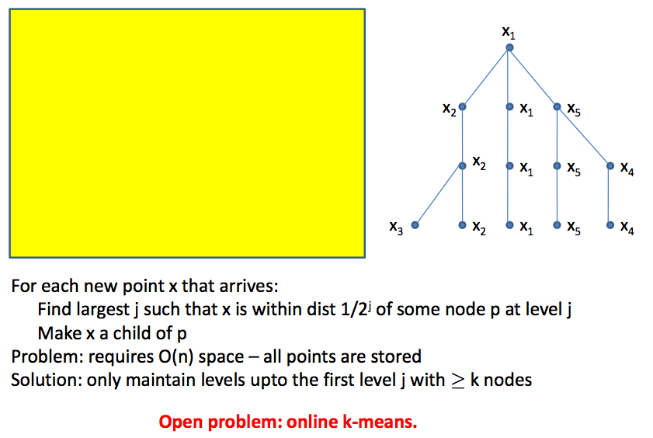
Online K-center

Slide 34
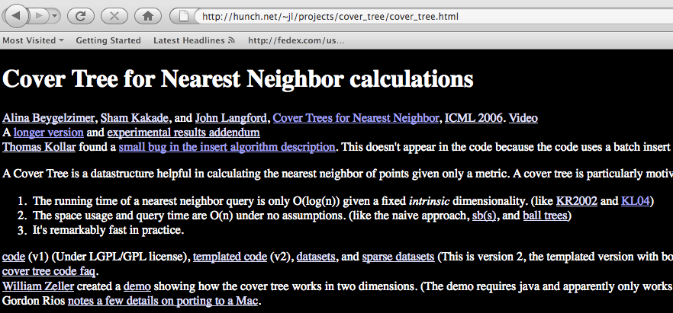
Online K-center Implementation
Cover Tree

Slide 35
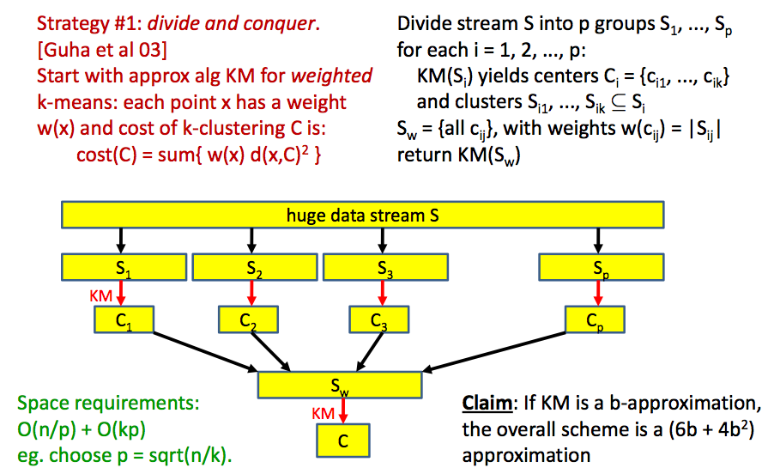
Streaming K-means: I

Slide 36
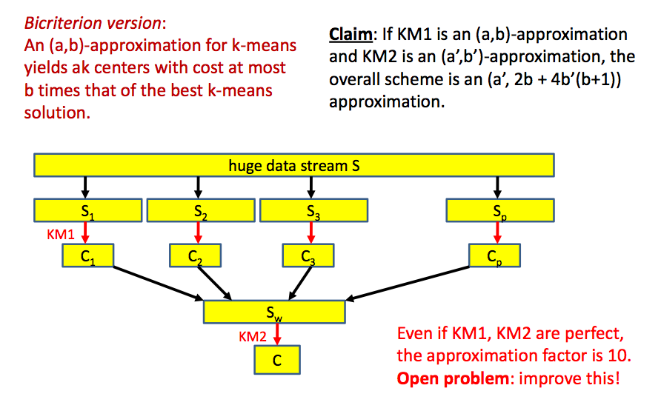
Streaming K-means: I (bicriterion)

Slide 37
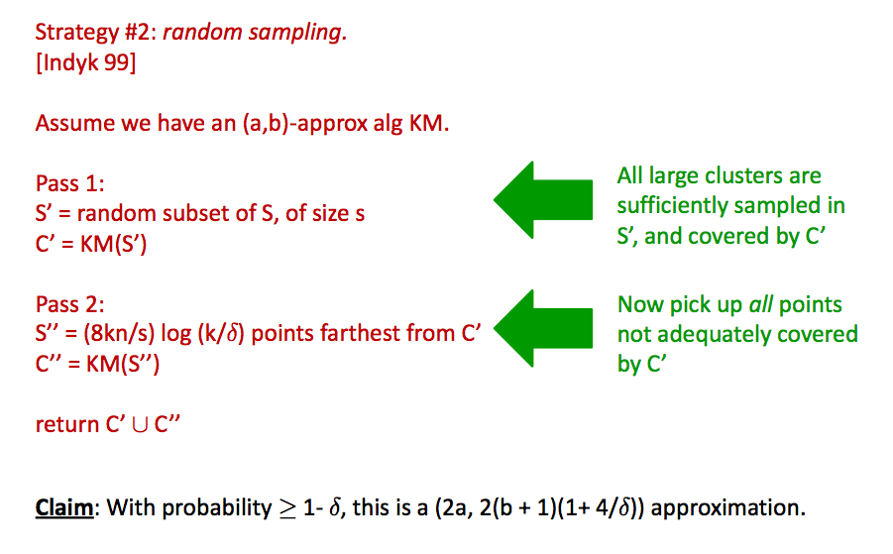
Streaming K-means: II

Slide 38
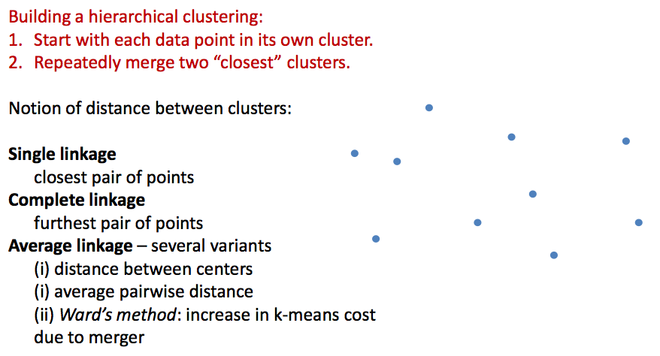
Hierarchical Agglomerative Clustering

Slide 39
Guarantees for Agglomerative Clustering
Complete linkage has underlying k-center cost function.
Approximability characterization: for all k, the induced k-clustering is within factor α(k) of the optimal k-center solution… what is α(k) ?
Claim: [Dasgupta 09] k ≤ a(k) ≤ k^log3
[Recall: cover tree has a(k) = 8.]
Open Problem: Ward’s method of average linkage has the underlying k-means cost function… what is its approximation ratio?

Slide 40
Statistical Theory for Clustering
I. Consistency of K-means
II. Density Cluster Tree and Consistency of Single-linkage

Slide 41
Consistency of K-means
Suppose data D_{n}={X_{i}: I=1,…,n} is drawn iid from an underlying distribution P.
Let C_{k} be the optimal k-means centers with respect to P.
Let C_{nk} be the optimal k-means centers for D_{n}.
Claim: [Pollard 81] If C_{j} is unique for 1≤j≤k,then dist(Ck,Cnk)->0 a.s. Here dist(S,T) =
Issues:
C_{nk} is NP-hard to compute.
Is C_{k} something truly useful?

Slide 42
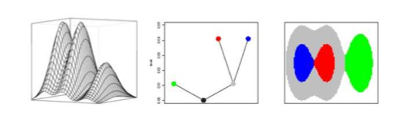
Density Cluster Tree
For any density p(x), consider the super-level set {x: p(x) ≥ r} and let C_{r} be the connected components of this super-level set.
Claim: [Hartigan 81] If r ≤ s,then C_{s} ⊆ C_{r}, ie Hierarchical clustering with tree structure.

Slide 43
Which clustering converges to Cluster Tree
Robust Single Linkage: Build a neighborhood graph G_{r},
nodes {X_{i}},
edges {(i,j): dist(X_{i}, X_{j}) ≤ r},
discard nodes with degree < c log n,
Let C_{nr} be the connected components of such a graph.
Claim: [Stuetzle 03, Zhou-Wong 08] C_{nr} converges to density cluster tree.
In fact: this is equivalent to the 1-skeleton Rips complex with persistent 0-homology, a special case in computational topology.
Other methods: Witness complex?

Slide 44
Bibliography I
D. Arthur, B. Manthey, and H. Roglin. k-Means has polynomial smoothed complexity. arXiv:0904.1113v1, 2009.
D. Arthur and S. Vassilvitskii. k-means++: the advantages of careful seeding. ACM-SIAM Symposium on Discrete Algorithms, 2007.
A. Beygelzimer, S. Kakade, and J. Langford. Cover trees for nearest neighbor, 23rd International Conference on Machine Learning, pp. 97-104, 2006.
S. Dasgupta and Y. Freund. Random projection trees for vector quantization. IEEE Transactions on Information Theory, 55(7), 2009.
D. Arthur, B. Manthey, and H. Roglin. k-Means has polynomial smoothed complexity. arXiv:0904.1113v1, 2009.
T. Feder and D.H. Greene. Optimal algorithms for approximate clustering. ACM Symposium on Theory of Computing, pp 434-444, 1988.
T.F. Gonzalez. Clustering to minimize the maximum intercluster distance. Theoretical Computer Science, 38:293-306, 1985.
S. Guha, A. Meyerson, N. Mishra, R. Motwani, and L. O’Callaghan. Clustering data streams: theory and practice. IEEE Transactions on Knowledge and Data Engineering, 15(3):515- 528, 2003.
J.A. Hartigan. Consistency of single linkage for high-density clusters. Journal of the American Statistical Association, 76:388-394, 1981.
M. Inaba, N. Katoh, H. Imai. Variance-based k-clustering algorithms by Voronoi diagrams and randomization. IEICE Transactions on Information and Systems, E83-D:1199-1206, 2000.
P. Indyk. Sublinear time algorithms for metric space problems. ACM Symposium on Theory of Computing, 1999.
T. Kanungo, D.M. Mount, N. Netanyahu, C. Piatko, R. Silverman, and A.Y. Wu. A local search approximation algorithm for k-means clustering. Computational Geometry: Theory and Applications, 28:89-112, 2004.
R. Krauthgamer and J.R. Lee. Navigating nets: simple algorithms for proximity search. ACM-SIAM Symposium on Discrete Algorithms, 2004.

Slide 45
Bibliography II
J. MacQueen. Some methods for classification and analysis of multivariate observations. Proceedings of the 5thBerkeley Symposium on Mathematics, Statistics, and Probability, pp 281-296, 1967.
M. Mahajan, P. Nimbhorkar, and K.R. Varadarajan. The planar k-means problem is NP-hard. Proceedings of 3rd Annual Workshop on Algorithms and Computation, pp.274--285, 2009.
R. Nugent and W. Stuetzle. A Generalized Single Linkage Method for Estimating the Cluster Cluster Tree of a Density. Journal of Classification, 20(5): 25-47, preprint.
D. Pollard. Strong consistency of k-means clustering. Annals of Statistics, 9(1):135-140, 1981.
W. Stuetzle. Estimating the cluster tree of a density by analyzing the minimal spanning tree of a sample. Journal of Classification, 20(5):25-47, 2003.
J. Sun, Y. Yao, X. Huang, V. Pande, G. Carlsson, and L. Guibas, A Fast Geometric Clustering Method on Conformation Space of Biomolecules, submitted to Journal of Physical Chemistry, 2009
A. Vattani. k-means requires exponentially many iterations even in the plane. ACM Symposium on Computational Geometry, 2009.
J.H. Ward. Hierarchical grouping to optimize an objective function. Journal of the American Statistical Association, 58(201):236-244, 1963.
Q. Zhou and W.-H. Wong. Reconstructing the energy landscape of a distribution from Monte Carlo samples. Annals of Applied Statistics, 2(4): 1307-1331, 2008. doi: 10.1214/08-AOAS196.

Slide 46
Acknowledgement
Part of slides courtesy to
  Sanjoy Dasgupta (UCSD)
  Xuhui Huang (Stanford & HKUST)
  Jian Sun (Stanford & Princeton)

