Slide 1

Unfolding Manifolds:
ISOMAP vs. LLE
--几何数据处理初步
姚 远
高等统计选讲
2009.10.14

Slide 2
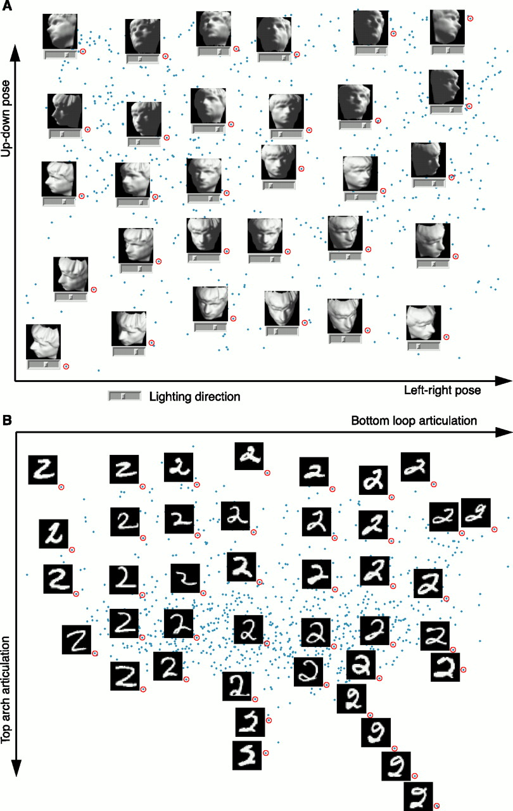
Example…

Slide 3
Dimensionality Reduction
Need to analyze large amounts multivariate data.
  Human Faces.
  Speech Waveforms.
  Global Climate patterns.
  Gene Distributions.
Difficult to visualize data in dimensions just greater than three.
Discover compact representations of high dimensional data.
  Visualization.
  Compression.
  Better Recognition.
  Probably meaningful dimensions.

Slide 4
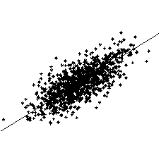
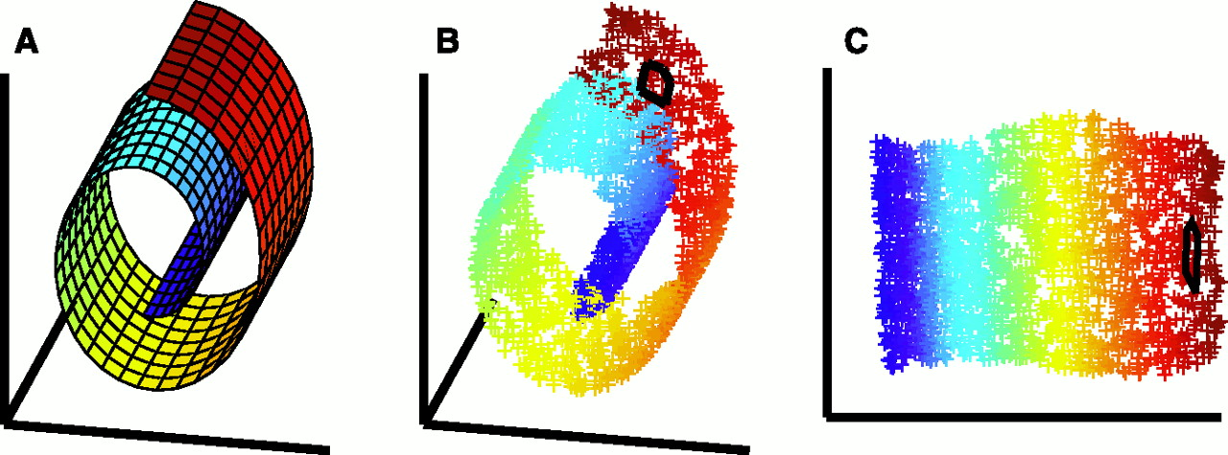
Types of structure in multivariate data..
Clusters.
  Density Estimation Techniques.
On or around low Dimensional Manifolds
  Linear：Principal Component Analysis
  NonLinear: ISOMAP, LLE, Laplacian Eigenmap, Diffusion Map, etc.

Slide 5
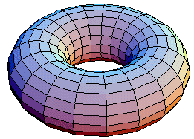
Concept of Manifolds
“A manifold is a topological space which is locally Euclidean.”
In general, any object which is nearly "flat" on small scales is a manifold.
Euclidean space is a simplest example of a manifold.
Concept of submanifold.
Manifolds arise naturally whenever there is a smooth variation of parameters [like pose of the face in previous example]
The dimension of a manifold is the minimum integer number of co-ordinates necessary to identify each point in that manifold.
Concept of Dimensionality Reduction:
Embed data in a higher dimensional space to a lower dimensional manifold

Slide 6
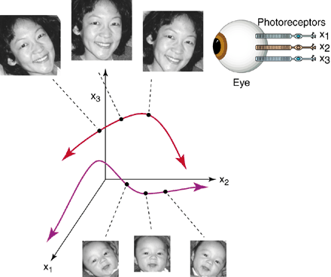

Manifolds of Perception..Human Visual System
You never see the
same face twice.
Preceive constancy when
raw sensory inputs are in flux..

Slide 7
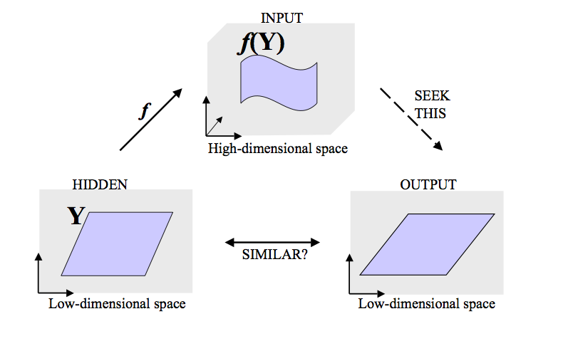
Generative Models in Manifold Learning

Slide 8
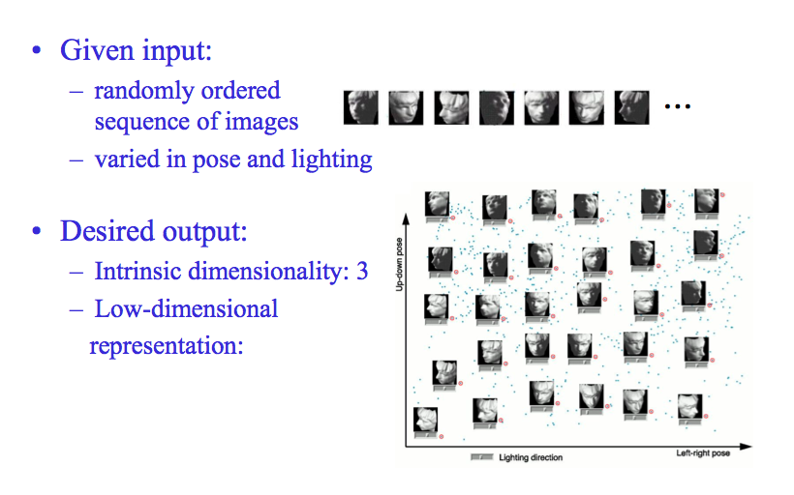
Example: faces

Slide 9
Linear methods..
Principal Component Analysis (PCA)
One Dimensional
Manifold

Slide 10
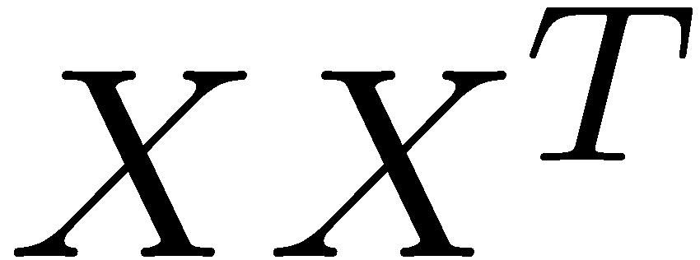
MultiDimensional Scaling..
Here we are given pairwise distances instead of the actual data points.
  First convert the pairwise distance matrix into the dot product matrix
  After that same as PCA.
If we preserve the pairwise distances do we preserve the structure??

Slide 11
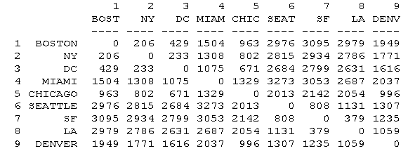
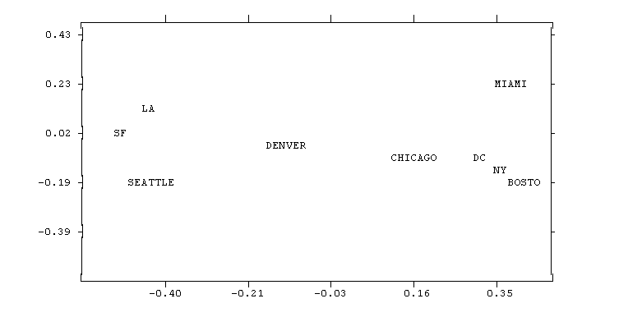
Example of MDS…

Slide 12
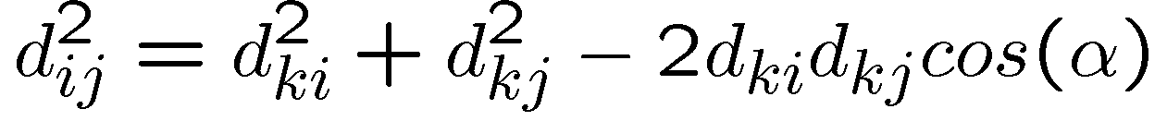
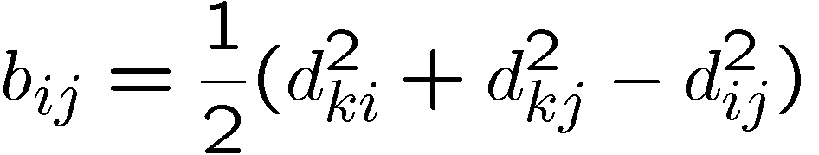
How to get dot product matrix from pairwise distance matrix?
i
k
j

Slide 13
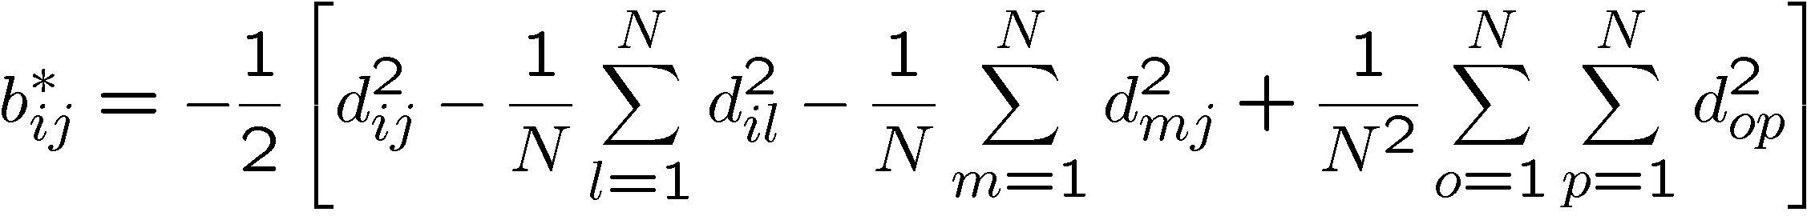
MDS..
MDS—origin as one of the points and orientation arbitrary.
Centroid as origin

Slide 14
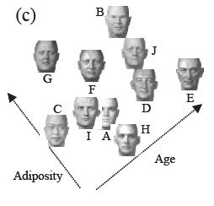
MDS is more general..
Instead of pairwise distances we can use paiwise “dissimilarities”.
When the distances are Euclidean MDS is equivalent to PCA.
Eg. Face recognition, wine tasting
Can get the significant cognitive dimensions.

Slide 15
Nonlinear Manifolds..
A
PCA and MDS see the Euclidean
distance
What is important is the geodesic distance
Unfold the manifold

Slide 16
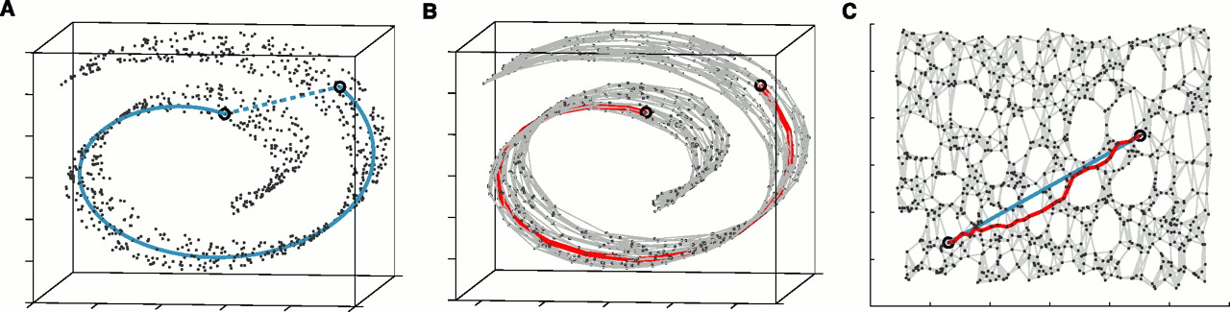
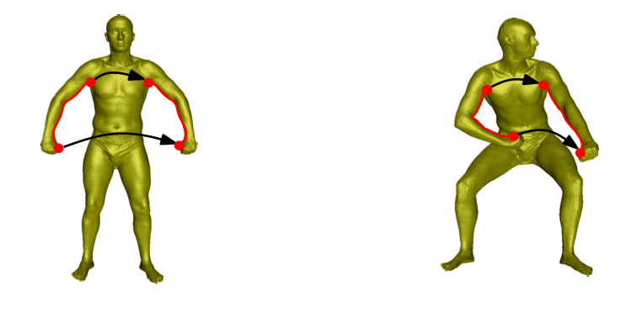
Intrinsic Description..
To preserve structure, preserve the geodesic distance and not the euclidean distance.

Slide 17
Two Basic Geometric Embedding Methods
Tenenbaum et.al’s Isomap Algorithm
  Global approach.
  On a low dimensional embedding
    Nearby points should be nearby.
    Farway points should be faraway.
Roweis and Saul’s Locally Linear Embedding Algorithm
  Local approach
    Nearby points nearby

Slide 18
Isomap
Estimate the geodesic distance between faraway points.
For neighboring points Euclidean distance is a good approximation to the geodesic distance.
For farway points estimate the distance by a series of short hops between neighboring points.
  Find shortest paths in a graph with edges connecting neighboring data points
Once we have all pairwise geodesic distances use classical metric MDS

Slide 19
Isomap - Algorithm
Determine the neighbors.
  All points in a fixed radius.
  K nearest neighbors
Construct a neighborhood graph.
  Each point is connected to the other if it is a K nearest neighbor.
  Edge Length equals the Euclidean distance
Compute the shortest paths between two nodes
  Floyd’s Algorithm
  Djkastra’s ALgorithm
Construct a lower dimensional embedding.
  Classical MDS

Slide 20
Isomap

Slide 22
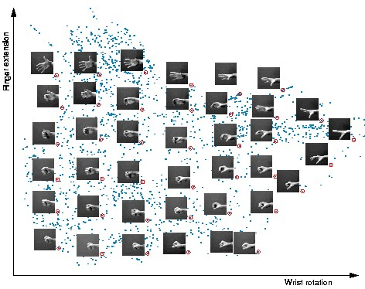

Slide 23
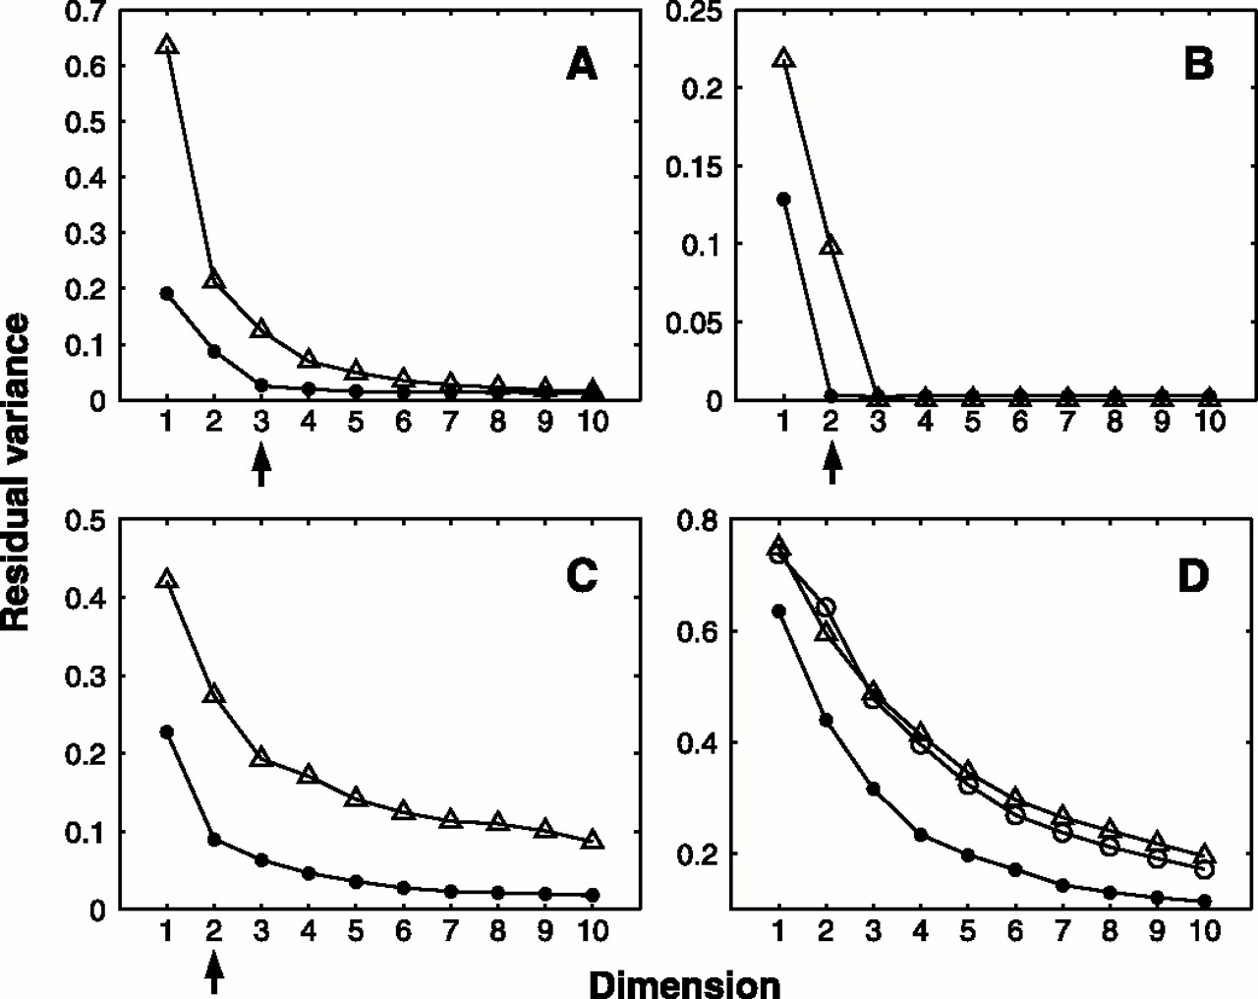
Residual Variance
Face Images
SwisRoll
Hand Images
2

Slide 24
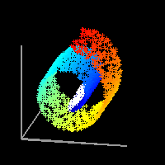
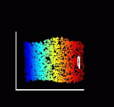
Locally Linear Embedding
manifold is a topological space which is locally Euclidean.”
Fit Locally , Think Globally

Slide 25
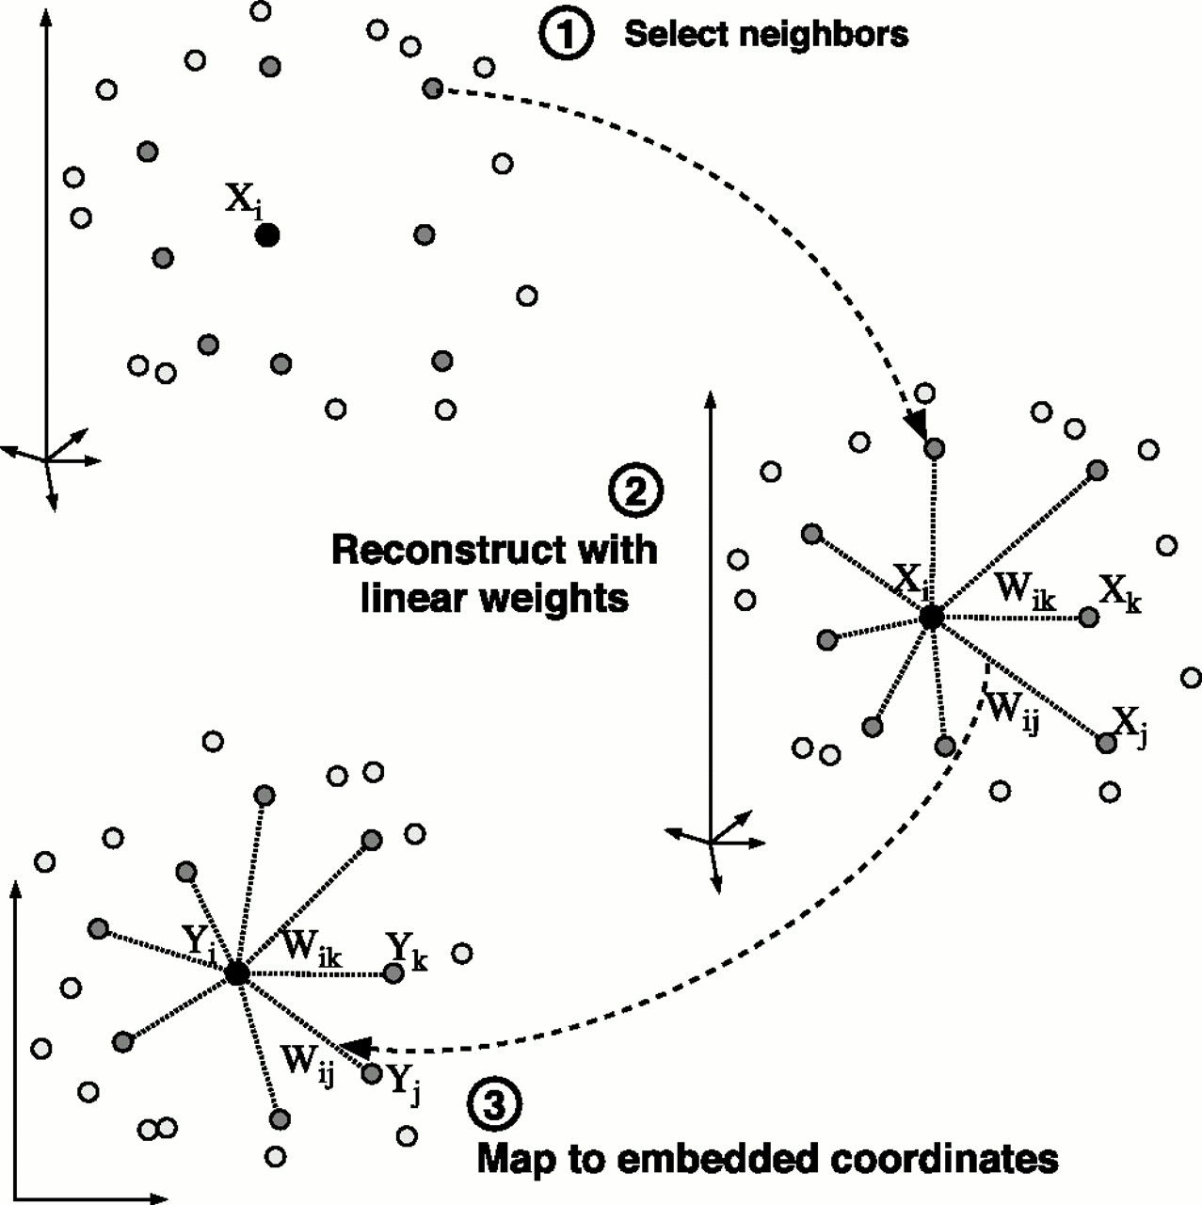
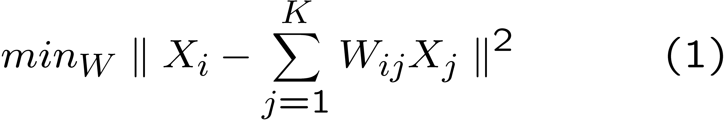
Fit Locally…
We expect each data point and its
neighbours to lie on or close
to a locally linear patch of the
manifold.
Each point can be written as a linear combination of its neighbors.
The weights choosen to
minimize the reconstruction
Error.
Derivation on board

Slide 26
Important property...
The weights that minimize the reconstruction errors are invariant to rotation, rescaling and translation of the data points.
  Invariance to translation is enforced by adding the constraint that the weights sum to one.
The same weights that reconstruct the datapoints in D dimensions should reconstruct it in the manifold in d dimensions.
  The weights characterize the intrinsic geometric properties of each neighborhood.

Slide 27
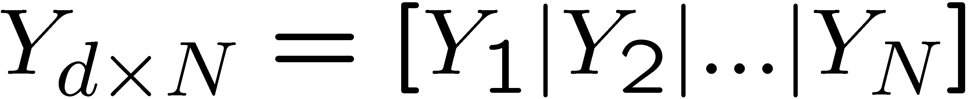
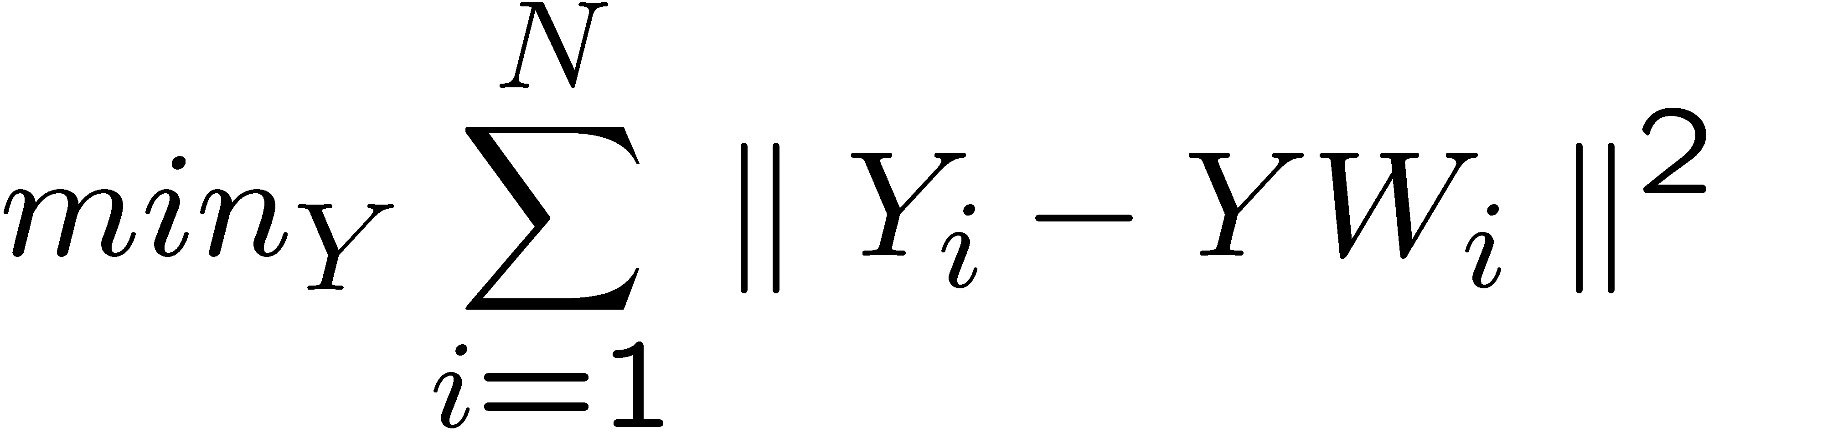
Think Globally…

Slide 28
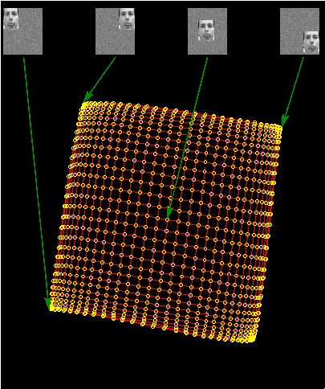

Slide 29
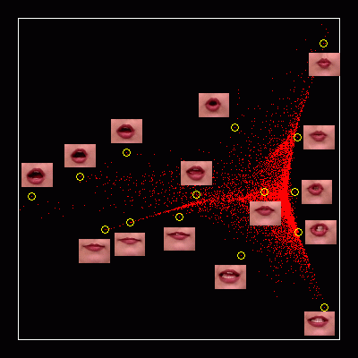

Slide 30
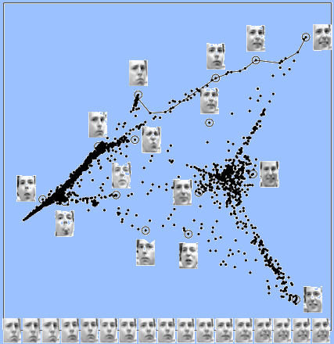

Slide 31
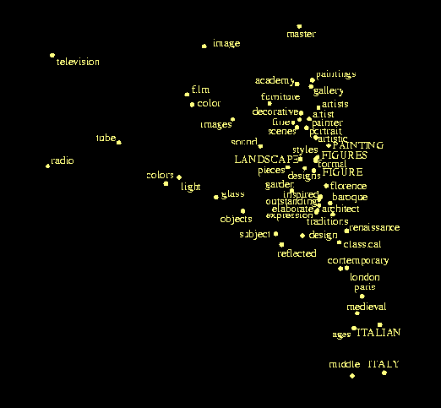
Grolliers Encyclopedia

Slide 32
Summary..
ISOMAP | LLE
Do MDS on the geodesic distance matrix. | Model local neighborhoods as linear a patches and then embed in a lower dimensional manifold.
Global approach | Local approach
Might not work for nonconvex manifolds with holes | Nonconvex manifolds with holes
Extensions: Conformal & Isometric ISOMAP | Extensions: Hessian Eigenmaps, Laplacian Eigenmaps etc.
Both needs manifold finely sampled.

Slide 33
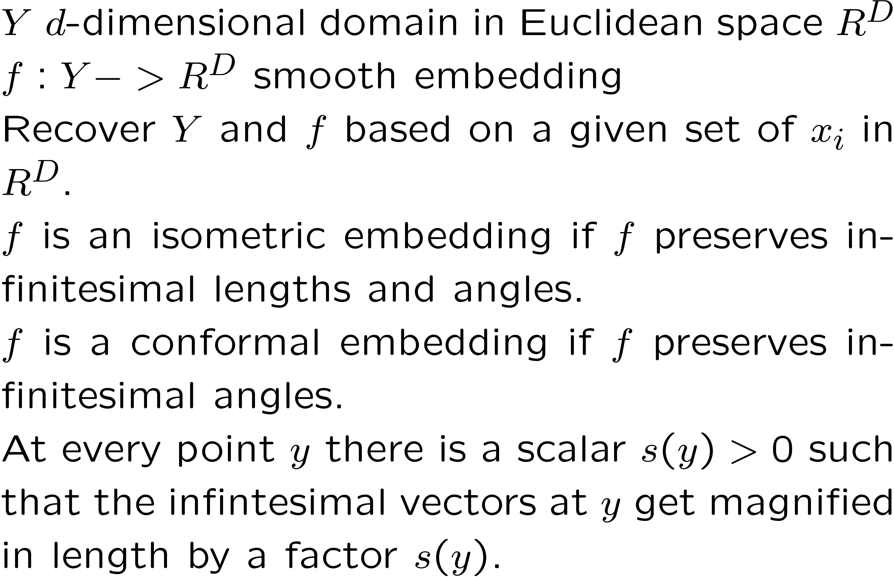
Conformal & Isometric Embedding

Slide 34
Isometric Mapping and C-Isomap
Isometric mapping
  Intrinsically flat manifold
  Invariants??
    Geodesic distances are reserved.
    Metric space under geodesic distance.
Conformal Embedding
  Locally isometric upto a scale factor s(y)
  Estimate s(y) and rescale.
  C-Isomap
  Original data should be uniformly dense

Slide 35
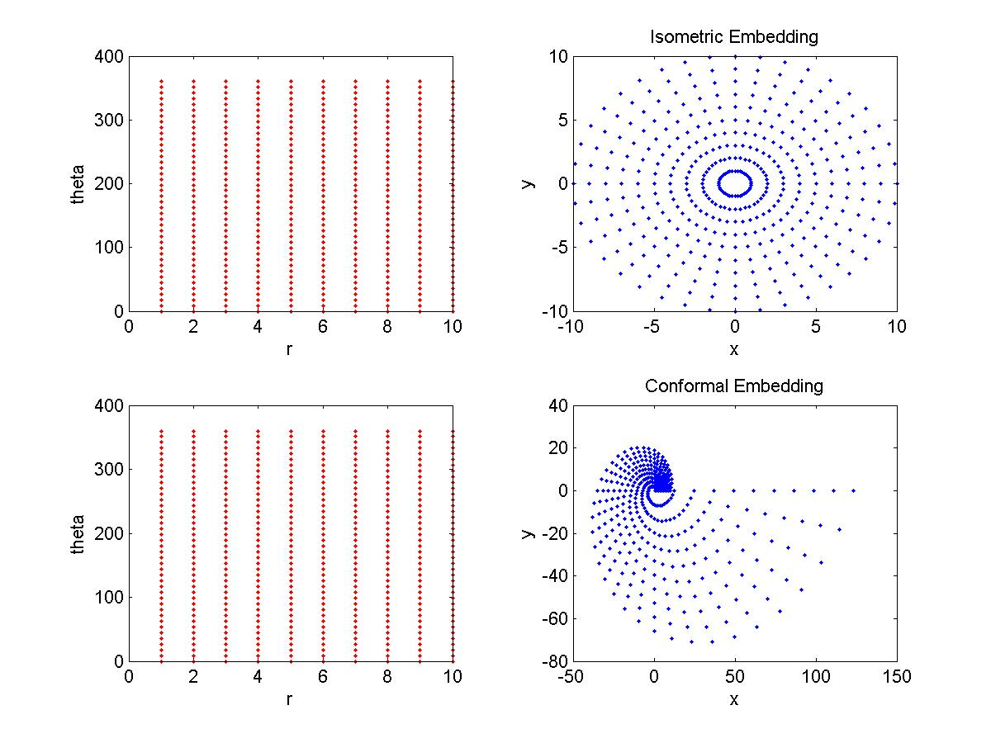

Slide 36
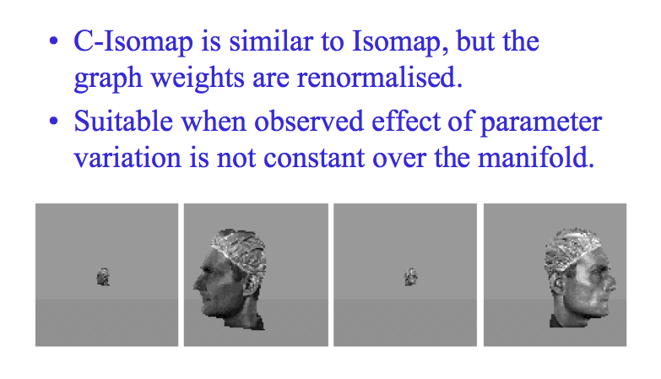
C-Isomap

Slide 37
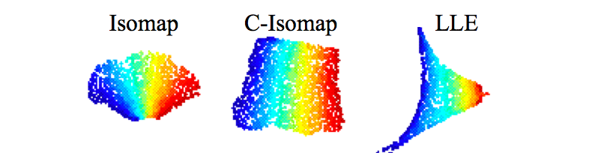
More Example: C-Isomap
C-Isomap succeeds when
  Y is a convex subsets of Euclidean space
  Data are densely sampled, uniformly over Y
  F is a conformal embedding

Slide 38
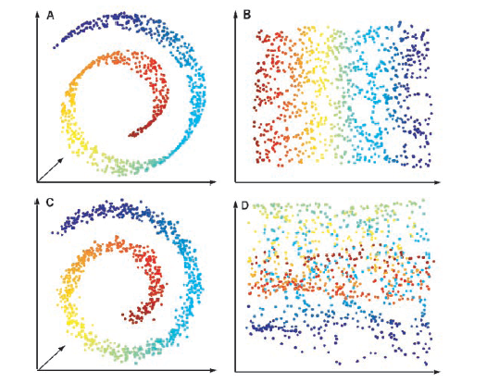
Short Circuit Problem???
  Unstable?
  Only free parameter is
  How many neighbours?
  How to choose neighborhoods.
    Susceptible to short-circuit errors if neighborhood is larger than the folds in the manifold.
    If small we get isolated patches.

Slide 39
???
Isomap might not work on closed manifold, manifolds with holes?
Noisy Data?
Sparse Data?
Develop Multiscale analysis
to solve some of those ‘?’.

Slide 40
Acknowledgement
Slides stolen from Vikas C. Raykar, Vin de Silva, et al.

