Slide 1
Open target DebiasIng
MATH 5470 Final Project
Yue Cui, Qichen Tan, Jing Zhao

Slide 2
Content
Introduction
Background
Related work
Motivation
Problem formulation
Method
Evaluation

Slide 3
Background
Machine learning algorithms can be demographically unfair:
Black people were more likely to be assessed as having a higher risk of recidivism when using commercial prediction tools such as COMPAS.
Wall Street Journal investigators showed that Staples’ online pricing algorithm discriminated against lower-income people.
……

Slide 4
Related work
In general, there are three types of fairness:
Group fairness: Treats different groups equally
Subgroup fairness: All subgroups should be treated the same as the full population
Individual fairness: Gives similar predictions to similar individuals
The mainstream debiasing methods can be categorized into three groups:
pre-process based approaches: transform or re-weight the training data to remove underlying discrimination;
in-processing approaches: adopt model tuning or regularization methods to tailor model training;
post-processing methods: process the model output with certain algorithms or access an external dataset that is not used for training for fairness.

Slide 5
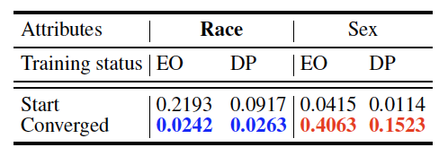
motivation
The majority works on group fairness debias on a limited number of pre-defined protected groups. However…
The bias in a dataset is hard to be known in advance or even be detected
The bias may shift to invisible groups during debiasing, e.g.,

Slide 6
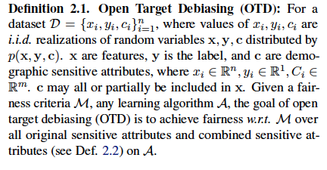
Open target Debiasing (OTD)

Slide 7
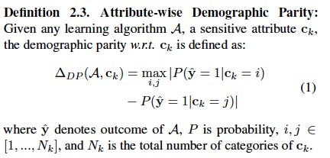
Challenges
the number of protected groups could be enormous
detecting and debiasing dynamically on an in-training decision algorithm (i.e., auditing-based subgroup fairness algorithms) might lead to divergence and instability when the iteration cost is low (Kearns et.al., 2020)
provably guarantee is still a blank area in OTD
Note: We reckon our setting as group fairness because the OTD fairness metric is extended from group fairness and thus intrinsically different from the mainstream definition of subgroup fairness.

Slide 8
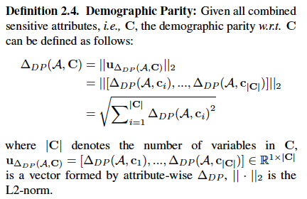
Preliminary
The maximum discrepancy of demographic groups regarding an attribute
1st level combined attribute (original sensitive attribute) :
A, B, C
AB, BC, AC
2nd level combined attribute
ABC
3rd level combined attribute
number of groups under an attribute

Slide 9
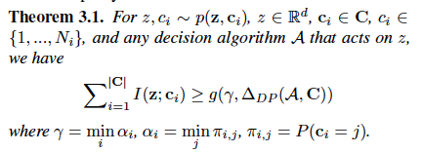

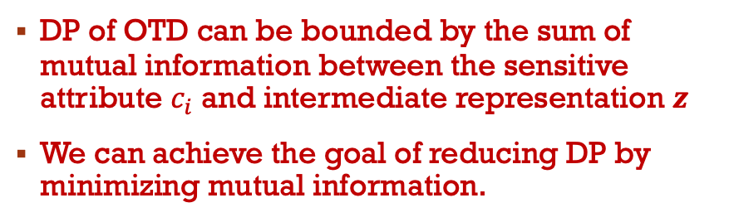
Method
DP of OTD can be bounded by the sum of mutual information between the sensitive attribute $c_{i}$ and intermediate representation $z$
We can achieve the goal of reducing DP by minimizing mutual information.
Theorem 3.1 results in the following objective:

Slide 10
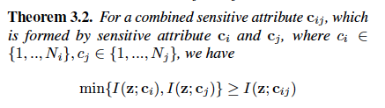

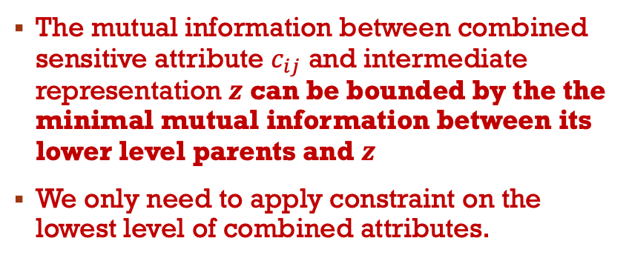
Method
Deal with the challenges of exponential number of protected groups
The mutual information between combined sensitive attribute $c_{ij}$ and intermediate representation $z$ can be bounded by the the minimal mutual information between its lower level parents and $z$
We only need to apply constraint on the lowest level of combined attributes.
The objective of OTD:

Slide 11

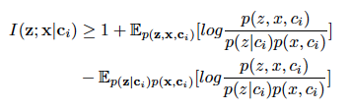
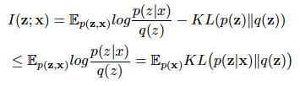
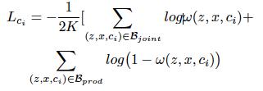

Method
Estimate the mutual information
estimate I(y; z)
estimate $\sum_{i=1}^{|C_{1}|}{\text{I}\text{(}\text{z}\text{; }c_{i}\text{) }}$by decomposing to $\text{I}\text{(}\text{z}\text{;}x\text{) }$and $−\text{I}\text{(}\text{z}\text{;}x|c_{i}\text{) }$
Training objective: cross entropy loss of the classification task
Training objective:
Training objective:
KL loss
(generator-discriminator based estimation)

Slide 12
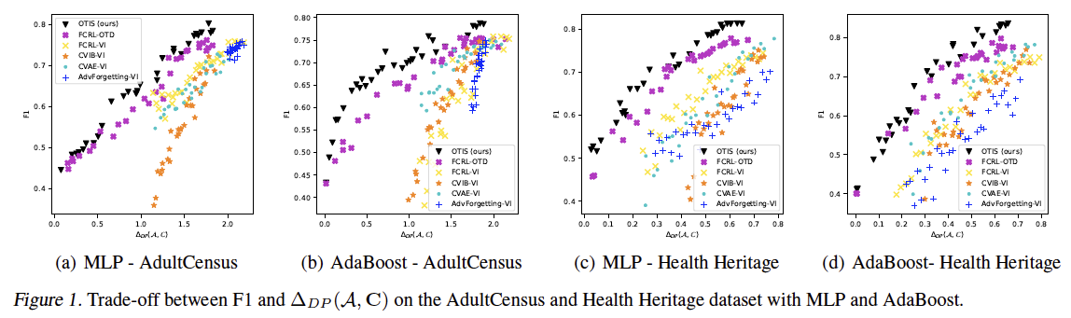
Experiment
We evaluate OTIS on AdultCensus and Health Heritage datasets across four classification models: Logistic Regression, MLP, AdaBoost, and Random Forest.

Slide 13
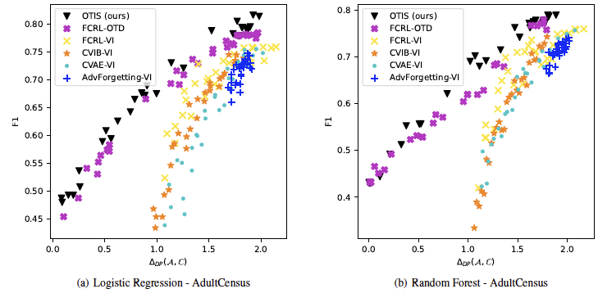
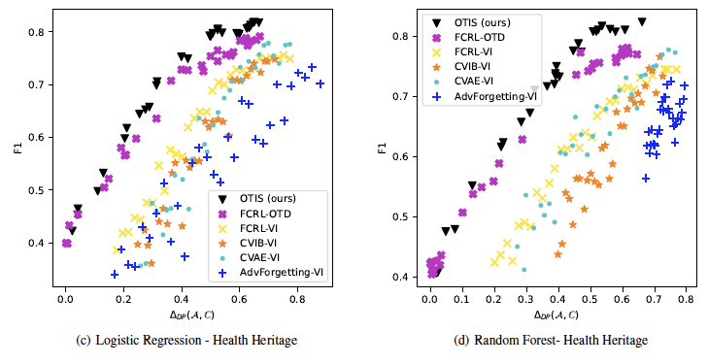
Experiment
We evaluate OTIS on AdultCensus and Health Heritage datasets across four classification models: Logistic Regression, MLP, Adaboost, and Random Forest.

Slide 14
Thanks for your attention!
MATH 5470 Final Project
Yue Cui, Qichen Tan, Jing Zhao

