Slide 1

Detect the disrupted brain connectivity in type-II diabetes patients
MATH 5470 project
WEI, Yue & XIE, Weiyan

Slide 2
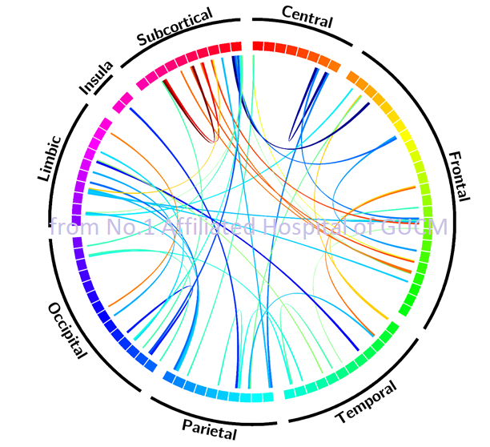
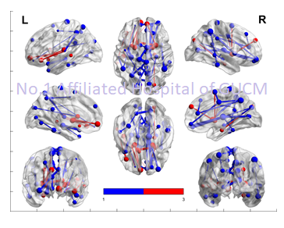
Background
Type-II diabetes and Alzheimer's disease
It is confirmed that Type-II diabetes patient has higher risk of getting Alzheimer's disease
Research revealed that the brain connectivity strength changed in Type-II diabetes patients even before they showed impairment in cognition
MRI can collect the brain connectivity strength between each pair of brain regions
Following figure showed the brain connectivity strength changes in Type-II diabetes patient (from data collected by No.1 Affiliated Hospital of GUCM, unpublished work)
Permutation test with FWA correction:
Red – patient > control, p<0.025
Blue –patient < control, p<0.025

Slide 3
Scientific questions
Can we use brain connectivity features to distinguish type-II diabetes and healthy people in control group?
Can we use brain connectivity features to predict clinical symptoms of type-II diabetes?
With so many connectivity features, which are the top 5/10 features that contributed most to the classification & symptom prediction of type-II diabetes?

Slide 4
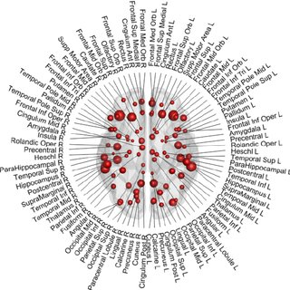
Data structure (X)
Brain connectivity feature (for each subject):
Pairwise connection between AAL90 brain regions
Weighted by Fractional anisotropy (FA): f1=90*90=8100
Weighted by fiber number (FN): f2=90*90=8100
Brain nodal feature(for each subject):
ROI surface size: f3=90
ROI voxel size:f4=90
*This is a dataset collected by No.1 Affiliated Hospital of GUCM which co-worked with WEI Yue, we have one under reviewing paper on this dataset, not published yet.

Slide 5
Data structure (Y)
Subject groups (G=2):
Patient (N1=47)
Control (N2=47)
Clinical symptoms (continuous data):
duration
FBG
BMI
HbA1c
*This is a dataset collected by No.1 Affiliated Hospital of GUCM which co-worked with WEI Yue, we have one under reviewing paper on this dataset, not published yet.

Slide 6
Methods
Dimension Reduction:
Principal Component Analysis (PCA)
Canonical Correlation Analysis (CCA)
Building Classification and Prediction Models:
Logical Regression (with Subset Selection: Forward/Backward Stagewise)
Decision Tree
Adaboost
Random Forest
Support Vector Machine
A small neural network

Slide 7
Methods
Explaining the ''black-box'' methods:
We expect that the methods with higher flexibility, like SVM and Neural Network, may give better classification performance. The issue with these methods is that they are ‘’black-box’’ and not self-explainable.
As our final goal is not only to train a model with good classification performance, we are also interested in what features are important to the classification. Therefore, some Explainable AI (XAI) methods will be used to explore the feature importance in the ‘’black-box’’ methods.
XAI methods planned to use:
Local Interpretable Model-Agnostic Explanations (LIME);
SHapley Additive exPlanations (SHAP).

Slide 8
Plan
Stage 1 – Data Visualization and Some Basic Data Explorations
Stage 2 – Dimension Reduction
Stage 3 – Model Buildings and Comparisons
Stage 4 – Understanding the Models
Stage 5 – Report and Presentation

