Slide 1
Introduction to
“Empirical Asset Pricing via
Machine Learning”
By
Shihao Gu
University of Chicago
Bryan Kelly Yale University, AQR Capital Management, and NBER
Dacheng Xiu University of Chicago Booth School of Business

Slide 2
An Empirical Study of US Equity
Risk premium is difficult to measure: market efficiency forces return variation to be dominated by unforecastable news that obscures risk premiums.
This paper uses machine learning methods to predict asset’s excess return.
Linear models: OLS, elastic net
Dimension reduction: PLS, PCR
Generalized linear model
Tree model: Gradient boosted regression tree, random forest
Neural network
Data and feature
Monthly total individual equity returns for all firms listed in NYSE, AMEX, NASDAQ. Data traverses 60 years from 1957 to 2016.
94 firm characteristics
8 macroeconomic predictors
74 industry dummies

Slide 3
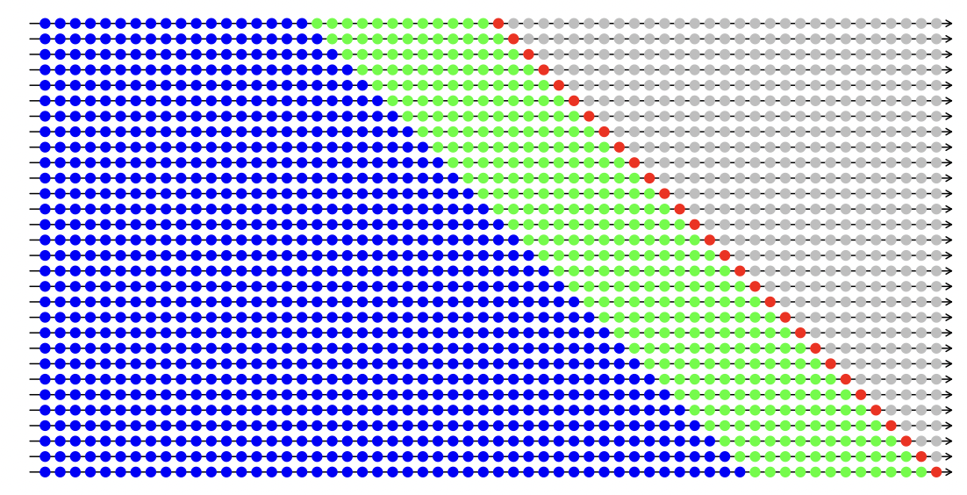
A Recursive Evaluation Method
Divide the 60 years of data into 18 years of training sample (1957-1974), 12 years of validation sample (1975-1986), and the remaining 30 years for out-of-sample testing (1987-2016).
Adopt a recursive performance evaluation scheme.

Slide 4
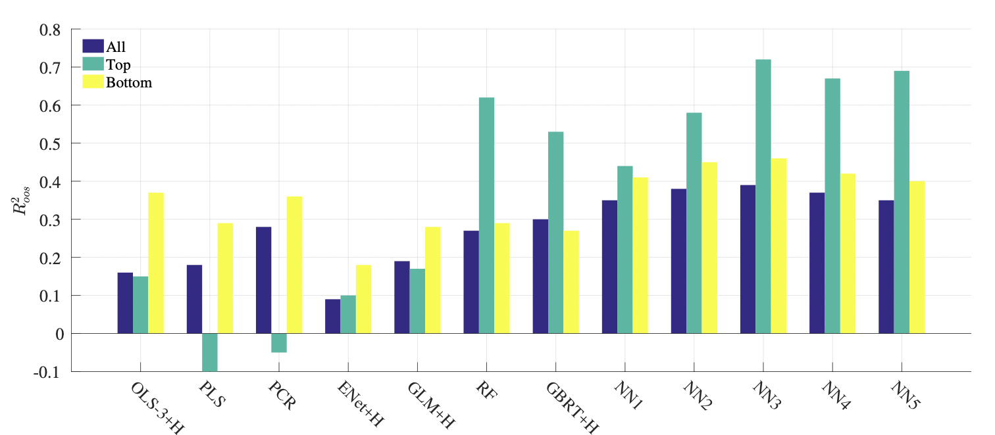
Individual Stock Returns Prediction
Empirical results are not optimized over hyperparameters, and therefore are more conservative.

Slide 5
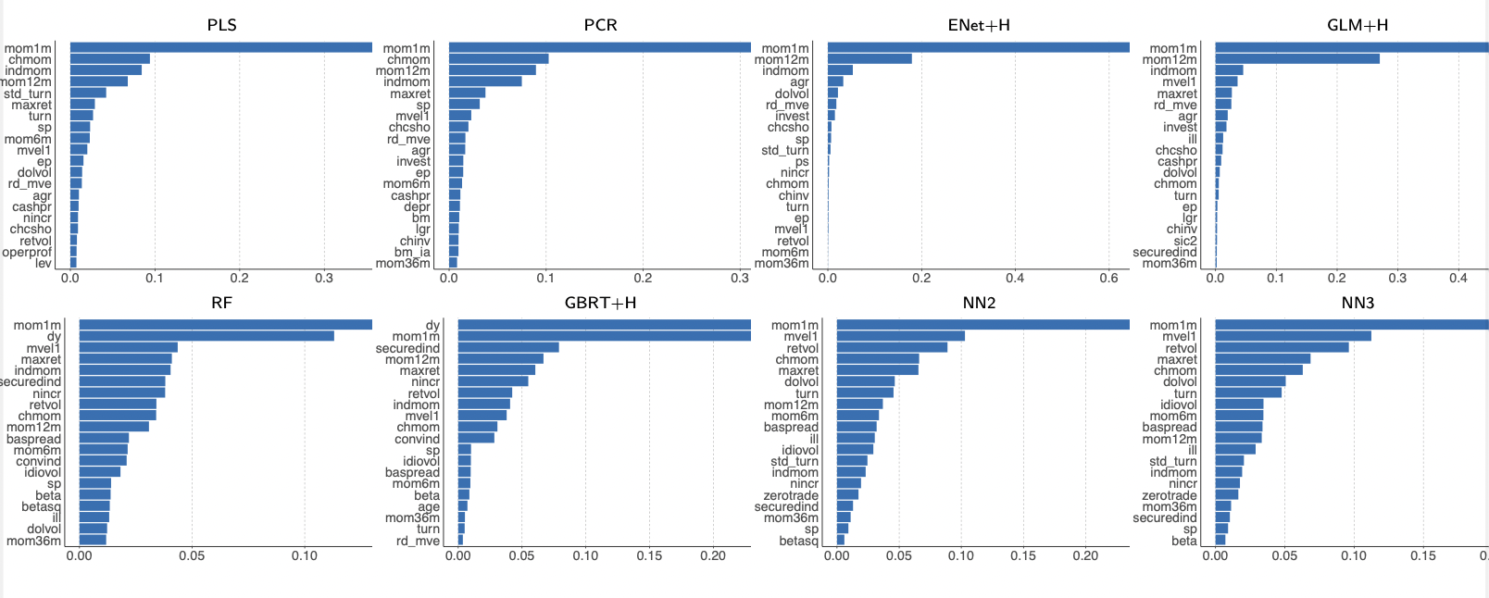
Characteristic Importance

Slide 6
Requirements for replication
Replicate at least 6 methods (e.g., OLS, elastic net, PLS, PCR, random forest, neural network), and analyze your results carefully. Hints of parameter chosen are presented in the paper.
Include the variable importance in your analysis.
Adopt the ‘recursive evaluation method’ described above.
You do not need to replicate the results of section 2.4: Portfolio forecast.
Supplementary material can be helpful to you.

