Slide 1
Protein structure reconstruction with contact map
Chen, Tianhao

Slide 2
Approach
Use Chroma as structural prior
Chroma is a diffusion model trained on protein structure generation task.
Use contact map as condition
Extends based on condition mechanisms of Chroma
Use gradient of conditioner to guide diffusion process
The conditioner gives a loss between target contact map and current contact map. The gradient of this loss guides the diffusion process, which samples a protein.

Slide 3
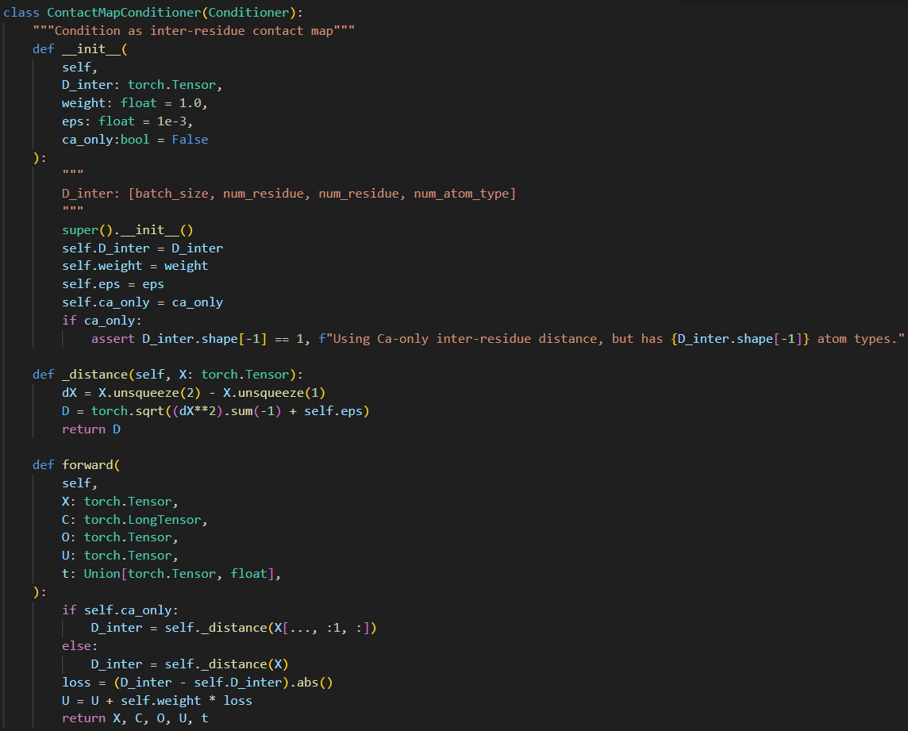
Custom contact map conditioner
Extends based on Chroma’s framework

Slide 4
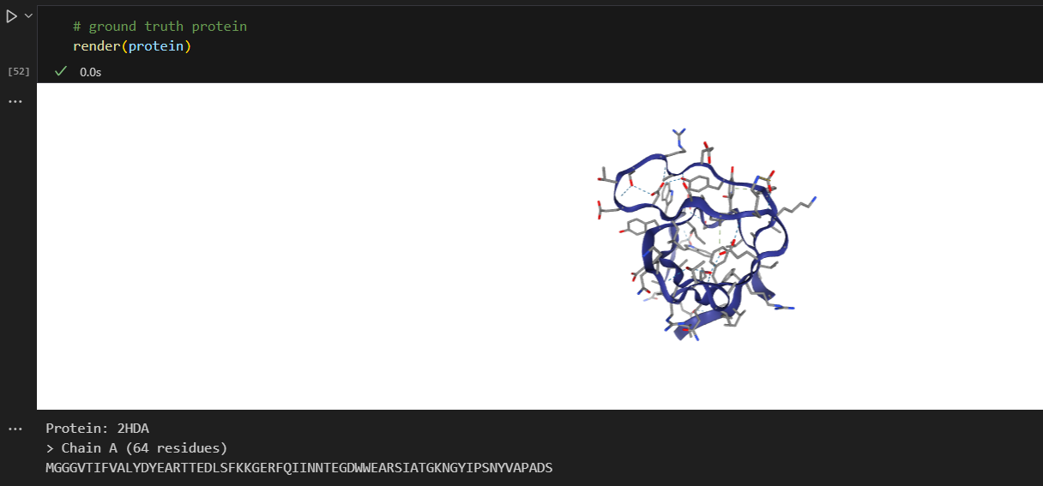
Ground truth protein

Slide 5
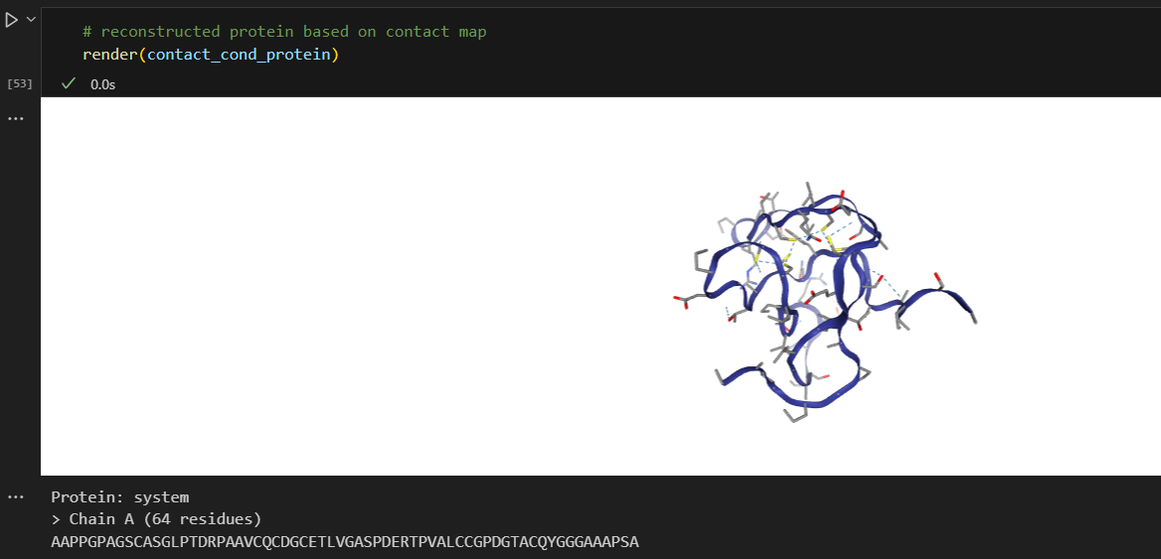
Recovered protein

Slide 6
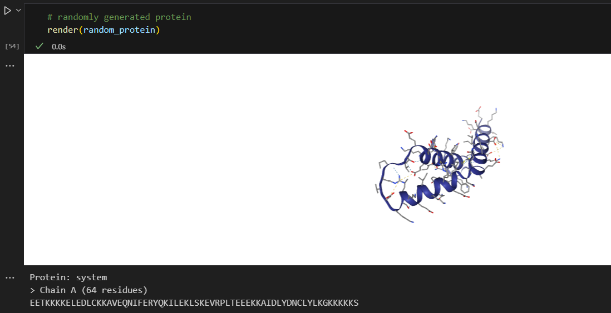
Random protein

Slide 7
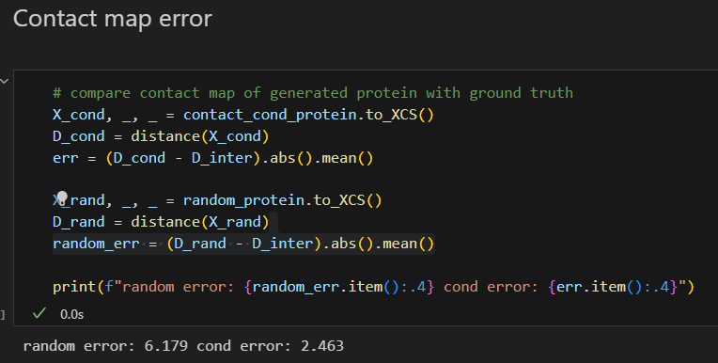
Contact map error
Difference between contact map of ground truth protein and recovered protein
Random error is around 6~8, while conditioned error is 1~3 Angstroms

Slide 8
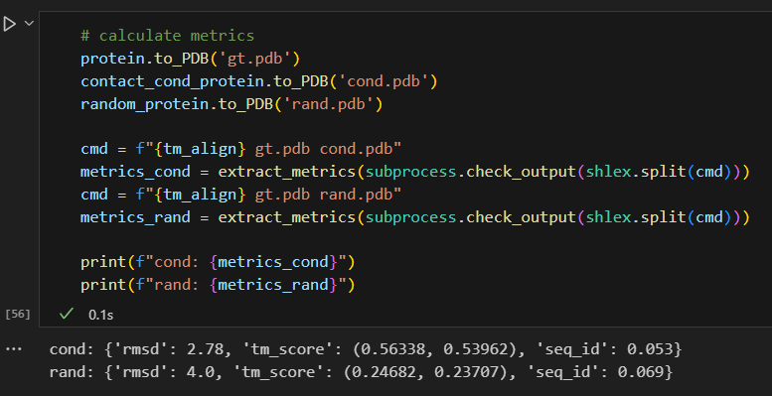
Structural similarity
Between ground truth and recovered protein
TM-align score, RMSD, Sequence Identity

