Slide 1
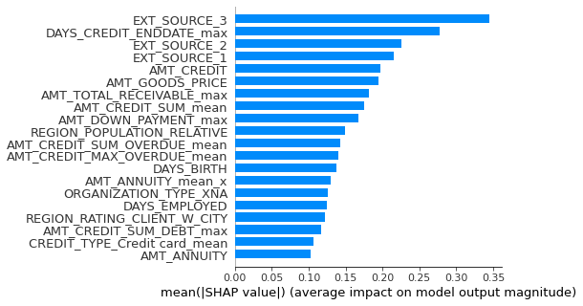
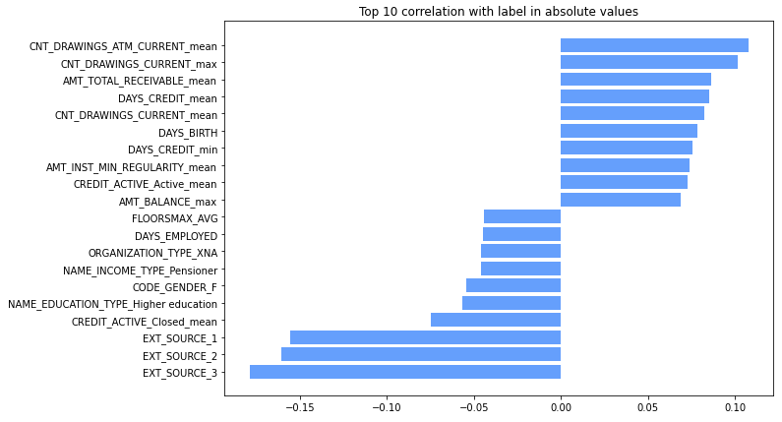
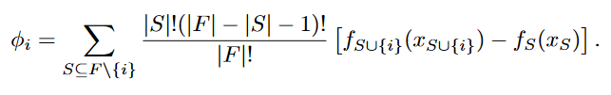
MSBD 5013 Project 1: Midterm - Kaggle Contest: Home Credit Default Risk
CHENG, Pak Hei(20795962) and LO, Ngai Hung(20787771)
1. Introduction
4. Model selection
Introduction
Model Selection & Training
We have applied various technics on data pre-processing and feature engineering, like feature correlation analysis, feature integration, one hot vector transformation.
After that, decision tree model is applied on this classification task. To increase the model accuracy and prevent overfitting, k-fold cross validation is used.
Due to the heterogeneity and imbalance data, decision tree, like XGBoost & LightGBM, is selected as the model, which is suitable to handle mixed data type.
We applied L1-regularization to prevent overfitting
Stratified 5-fold cross validation is used to assess model performance across the entire dataset. Predictions on test set are obtained by averaging logits from model trained in each fold
Data Analysis
There are 220 features (before engineering), excluding the label.
Label is imbalanced, the negative-positive class ratio is about 11:1
Most features have small correlation with the target. Only 4 features had >0.1 absolute correlation with the target
Experimental Results
 | ROC* | F1-Score* | Precision* | Recall*
KNN (K=30) | 0.589 | 0.000 | 0.000 | 0.000
LightGBM | 0.782 | 0.301 | 0.200 | 0.610
Random Forest | 0.755 | 0.003 | 0.622 | 0.001
XGBoost | 0.735 | 0.294 | 0.224 | 0.426
Discussion
Misalignment between feature importance and correlation ranking means the important features correlations with the label are likely not linear.
The abundance of credit history features chosen as important, suggests default risk is an autoregressive risk.
The usage of ROC as a metric might not be appropriate for a real-life credit risk scoring system. In fact, it does not factor in the risk appetite of the credit issuing entity. A more appropriate metric should be expected LGD (Loss Given Default). We will assessment under this metric for future work
*Average of 5-fold stratified cross validation
Kaggle public/ private ROC using LightGBM: 0.77701​/ 0.77984
Feature Importance
Feature Engineering
SHAP[1] is a model agnostic technique to interpret model outputs. We average the SHAP values of individual prediction over the test set to calculate feature importance globally. We chose our best model (LightGBM) for feature importance analysis.
Contribution
Features with correlation coefficient close to zero with the label would be dropped.
Removing binary features that are 90% dominated by 1 category
Features are removed if more than 60% of the samples are “NaN”
One-hot encode categorical features
If more than 90% of samples belong to same value in a binary feature, it would be removed.
Use sum / std / mean to integrate similar feature
Use mean / min / max / sum to combine previous behavior data
CHENG, Pak Hei:
Model Training (KNN, Random Forest), Feature Importance, EDA
LO, Ngai Hing:
Model Training (XGBoost & LightGBM), Feature Engineering
References
[1] S. Lundberg and S. Lee, "A Unified Approach to Interpreting Model Predictions", arXiv:1705.07874 [cs.AI], May 2017

