Slide 1
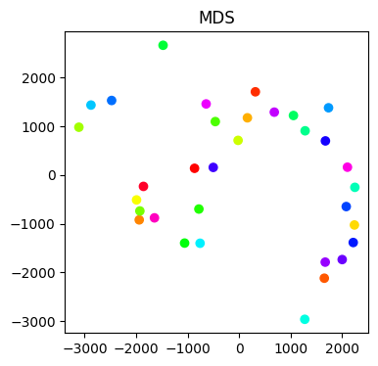
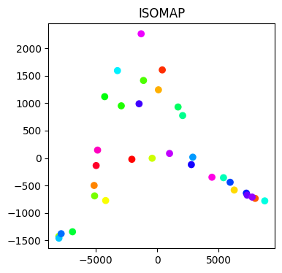
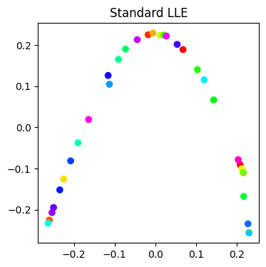
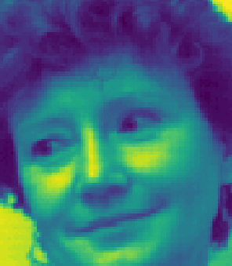
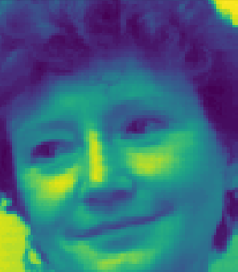
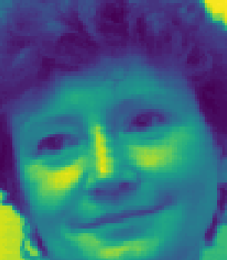
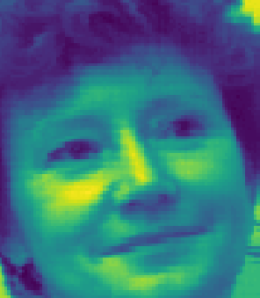
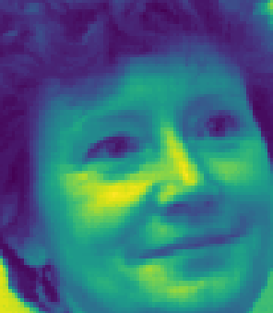
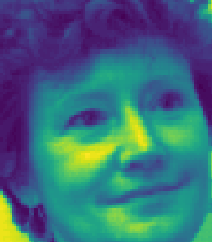
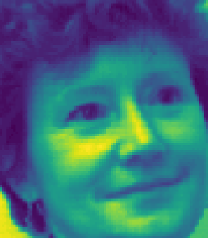
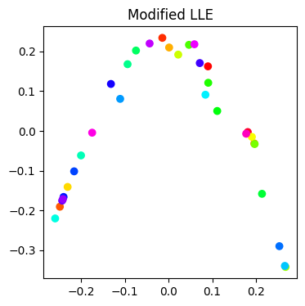
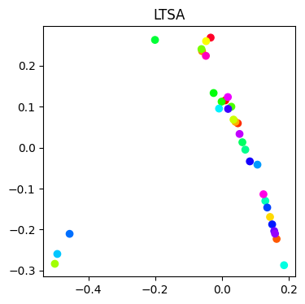
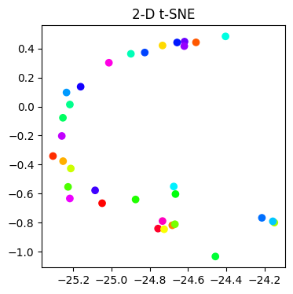
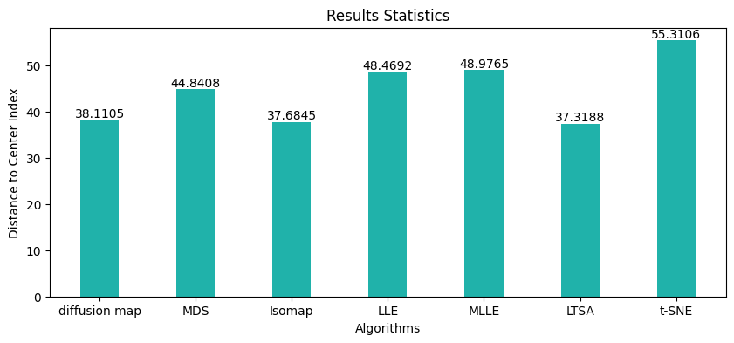
MATH5473/CSIC5011 Project 2: Sequential Face Ordering With Manifold Learning Algorithms
Shunpeng Yang syangcp@connect.ust.hk
Department of Civil and Environmental Engineering
Introduction
Experiment
Results Comparison
Face pose determination is a crucial task in the field of human-computer interaction as it enables the detection of a person's head orientation, which in turn can provide insights into their focus of attention. Manifold learning methods can be used to enhance the traditional methods by reducing the dimensionality of the feature space and identifying underlying structures that capture the variations in head orientation.
2-D Embedding with chosen algorithms for all images
Reorder the images to reveal the motion trajectory of head pose.
--The analysis of the performance index indicates that the order index obtained through the method LTSA exhibits the highest proximity to the center of all computed order indices, while the order index obtained by t-SNE displays the furthest distance from the center.
--Additionally, it was observed that the MDS, Locally Linear Embedding (LLE), Maximum LLE (MLLE) methods exhibit similar performance in this task.
--Furthermore, the two-dimensional embedding results are presented in the accompanying figures, which reveal an intriguing phenomenon wherein the shape of the data point profile appears to resemble a rotated "V" shape in the two-dimensional space except MDS embedding.
Unordered Face Dataset
The dataset consists of 33 images that capture the face of a particular person from different angles. However, the images are currently presented in an unordered manner, which can make it difficult to analyze and interpret the dataset.
Performance Index
Method
Consider the order index as a coordinate in a multidimensional space corresponding to each method and compute the center of these coordinates. The performance of each method can be assessed by calculating the Euclidean distance between the center and their coordinates, given that the true order of the images is unknown. This distance metric serves as an index of the methods' performance in accurately ordering the images.
In the task of ordering a sequence of face images, one feasible approach is to employ manifold learning techniques to extract the underlying structure of the dataset and project the images onto a lower-dimensional space. This procedure can effectively uncover patterns and relationships among the images that may not be readily discernible in their high-dimensional representation. In the course of this project, various commonly used algorithms will be applied to this task and compared based on their performance in accurately capturing the intrinsic structure of the dataset and generating a meaningful ordering of the images.
Chosen Algorithms: Diffusion Map, Multiple Dimensions Scalling (MDS), Isomap, Locally Linear Embedding (LLE) and its improved version modified LLE (MLLE), Local Tangent Space Alignment (LTSA) and T-distributed Stochastic Neighbor Embedding (t-SNE)
References
Pless, Robert, and Richard Souvenir. "A survey of manifold learning for images.“
Raytchev, Bisser, Ikushi Yoda, and Katsuhiko Sakaue. "Head pose estimation by nonlinear manifold learning."
BenAbdelkader, Chiraz. "Robust head pose estimation using supervised manifold learning.“

