Slide 1
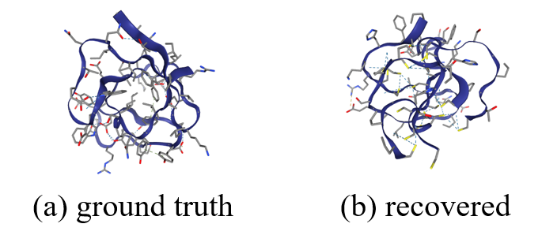
Protein structure reconstruction with contact map guidance
CHEN, Tianhao
2024/5/8

Slide 2
Contents
Background (protein)
Problem statement
Approach overview
Chroma and diffusion
Conditional generation
Contact map conditioner

Slide 3
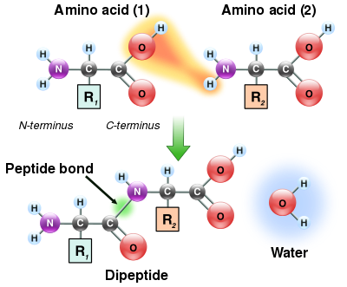
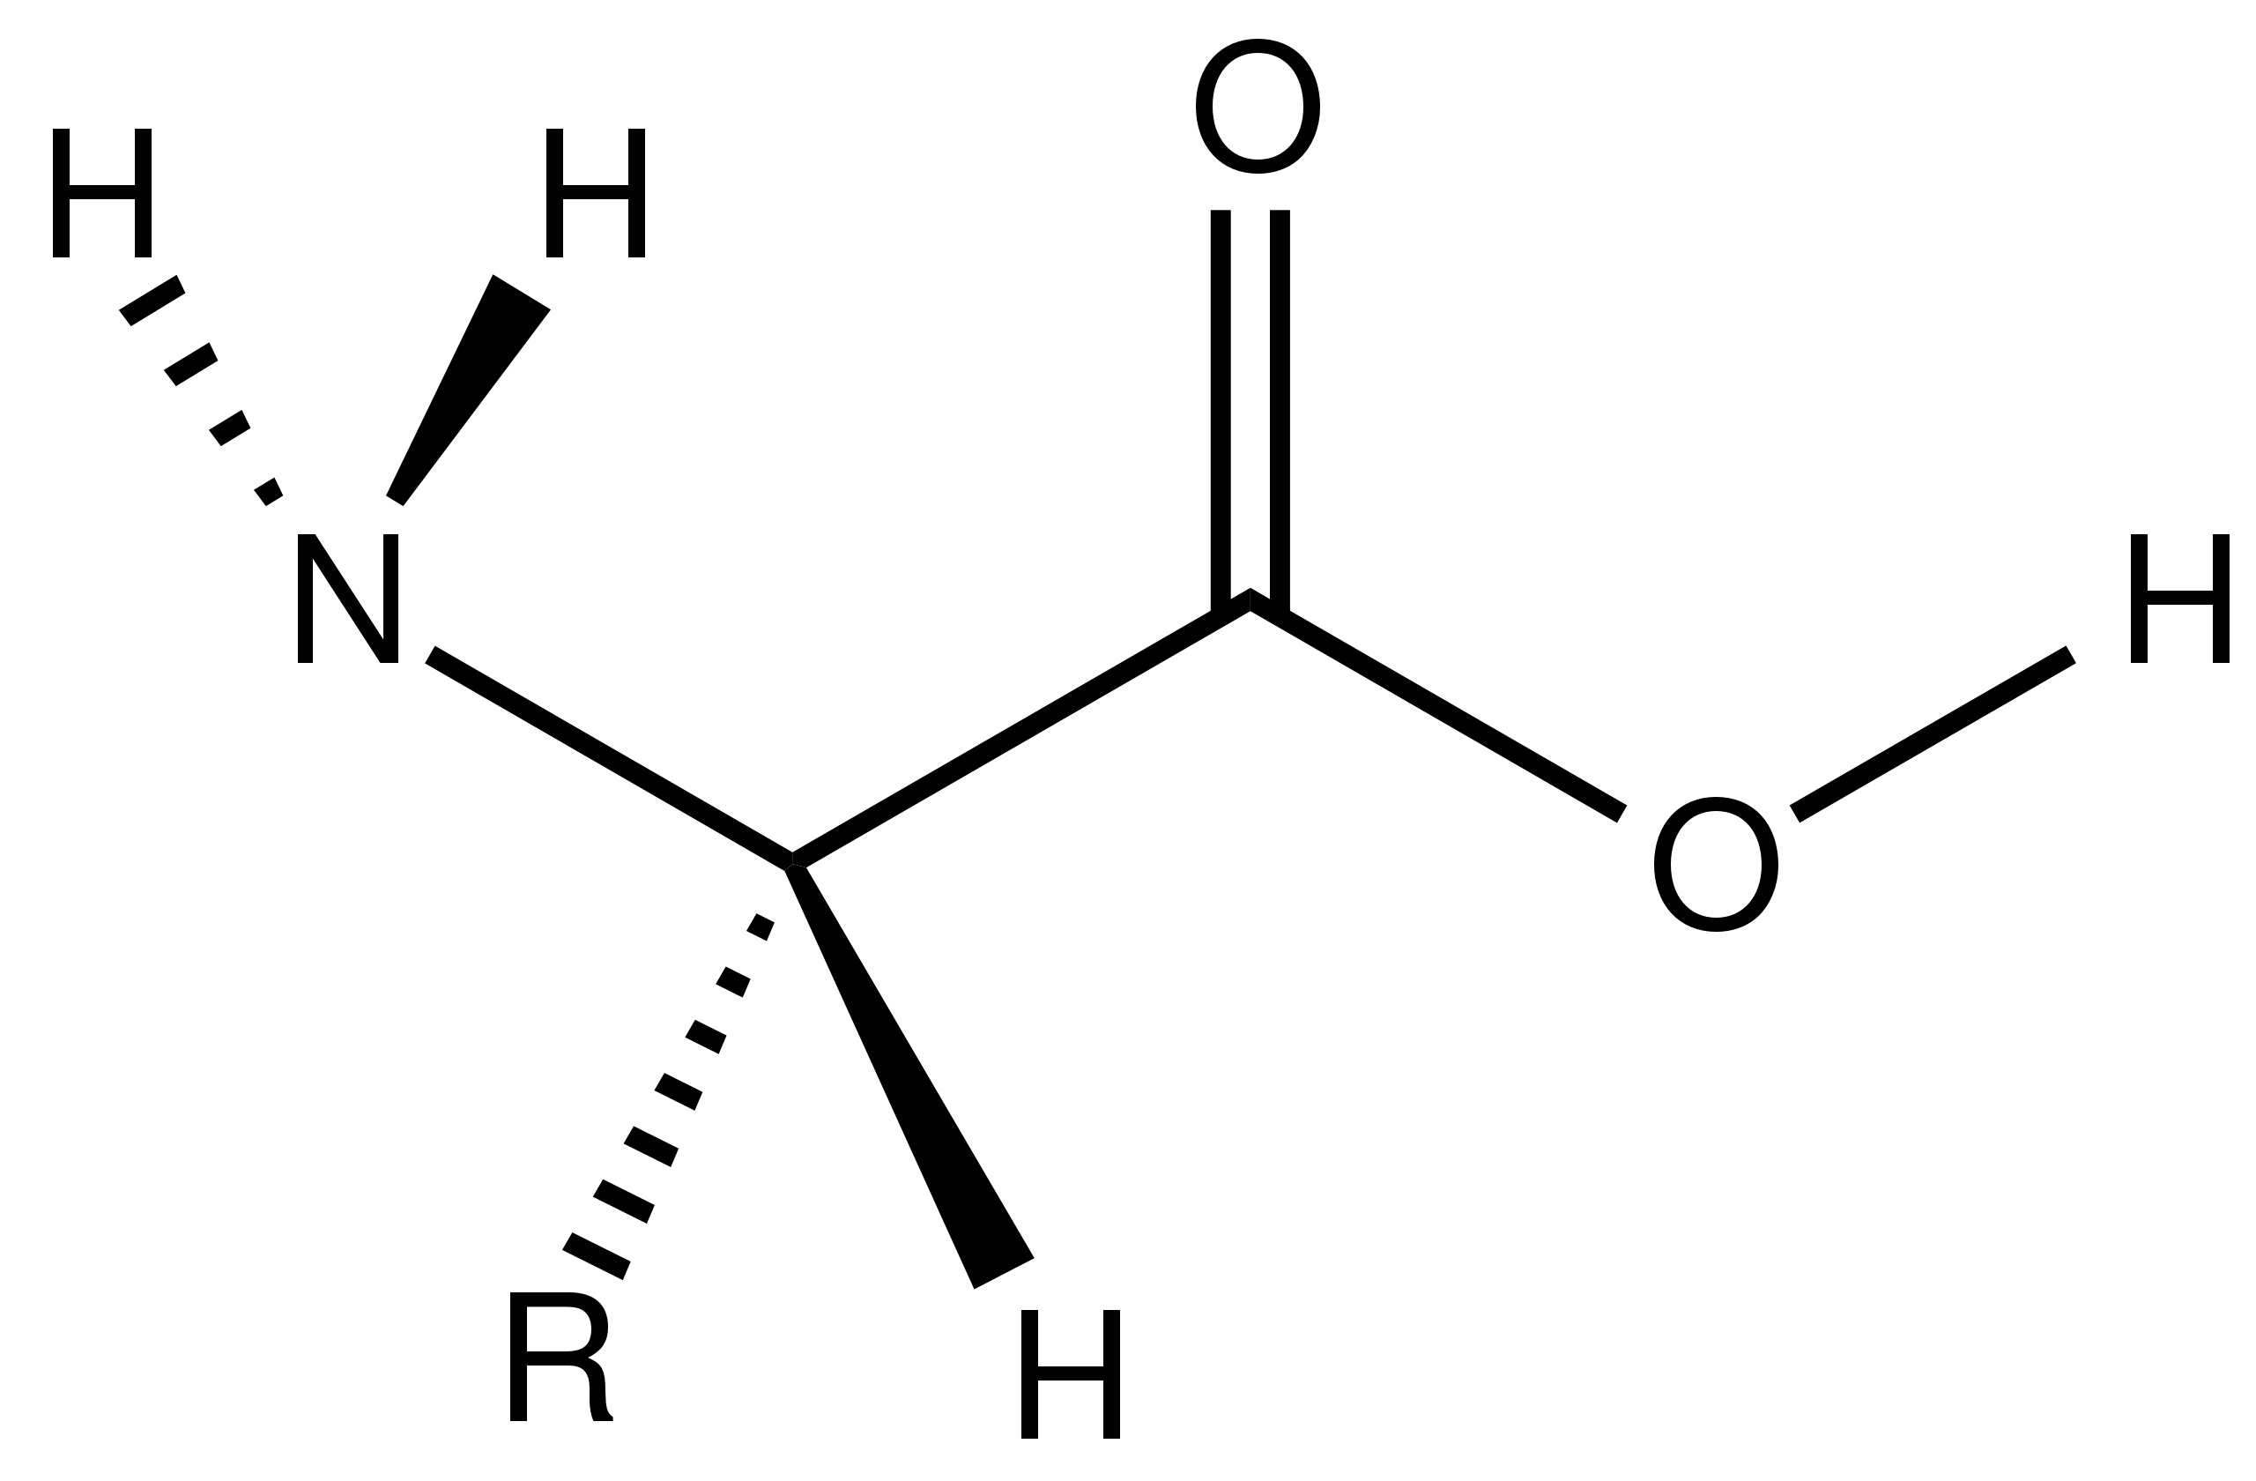
Amino acids and proteins
Amino acid:
Ca: alpha carbon
NH2: amino group
R: sidechain
COOH: carboxyl group
Formation of peptide bond
Peptide bond joins amino acids sequentially to form a protein sequence

Slide 4
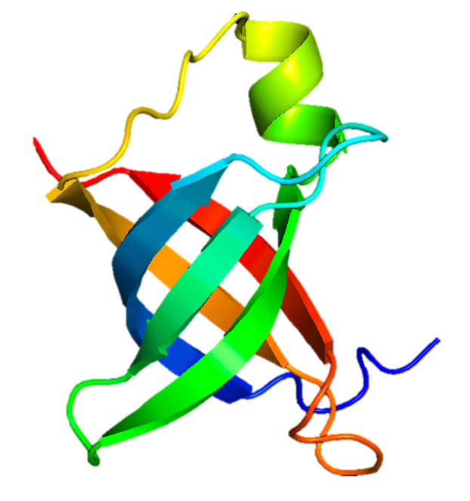
Protein Modalities
MAKEDTLEFPGVVKELLPNATFRVELDNGHELIAVMAGKMRKNRIRVLAGDKVQVEMTPYDLSKGRINYRFK
Stabilizes the binding of IF-2 and IF-3 on the 30S subunit...
Belongs to the IF-1 family. Subcellular location: Cytoplasm.
Amino acid sequence
3D structure
Biological functions and properties

Slide 5
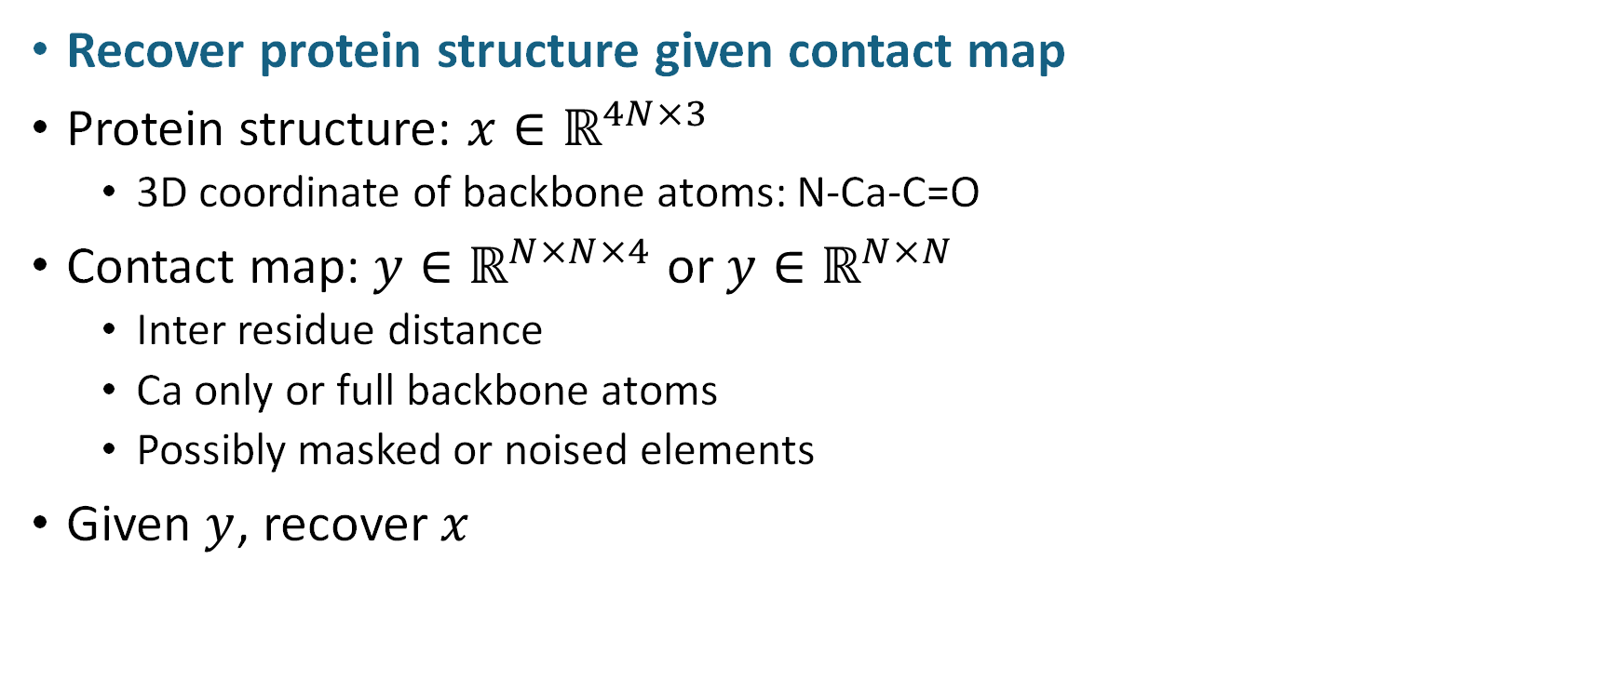
Problem statement
Recover protein structure given contact map
Protein structure: $x∈ℝ^{4N×3}$
3D coordinate of backbone atoms: N-Ca-C=O
Contact map: $y∈ℝ^{N×N×4}$ or $y∈ℝ^{N×N}$
Inter residue distance
Ca only or full backbone atoms
Possibly masked or noised elements
Given $y$, recover $x$

Slide 6
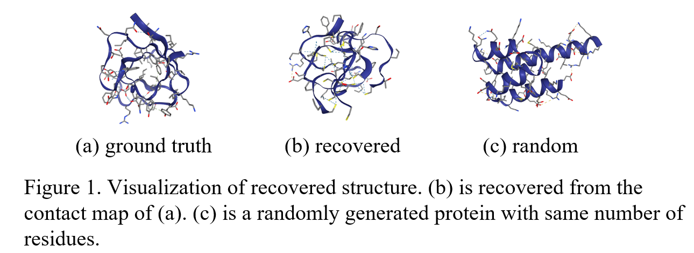
Approach: overview
Use Chroma as structural prior
Chroma is a diffusion model trained on protein structure generation task.
Use contact map as condition
Conditional reverse diffusion process
Use gradient of conditioner to guide diffusion process
The conditioner gives a loss between target contact map and current contact map. The gradient of this loss guides the diffusion process, which samples a protein.

Slide 7
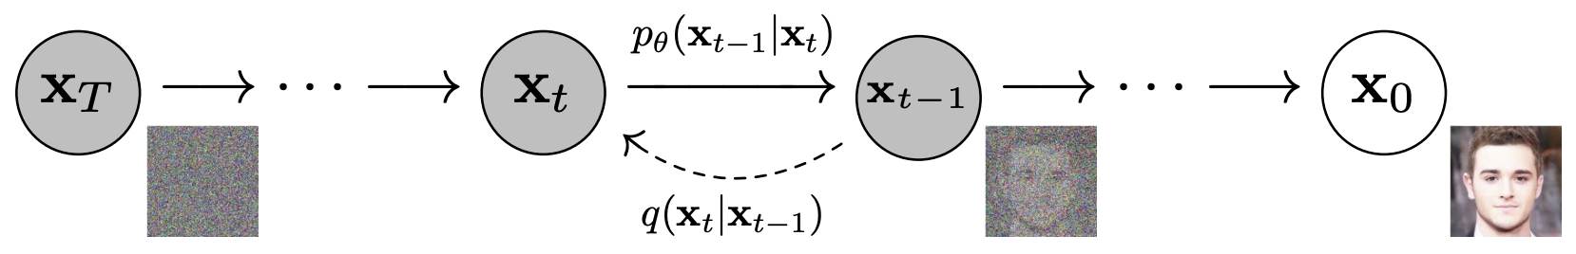





Diffusion
Overview
Generate novel samples from a learned distribution
Learns a distribution by learning to denoise a noised data
Denoising process is broken down into many small steps for easier learning
Forward process: gradually add (gaussian) noise to data
Reverse process: gradually denoise noisy data
Sampling: start from pure noise, do reverse process
Notes:
为什么reverse process也用gaussian：reversal of diffusion is also a diffusion (from stochastic processes)
Point of this page: 概述diffusion组成成分
随着t增加，alpha_t趋于0，x_0的信号越来越小，noise越来越多。实际sample时，x_0未知，所以先从x_t估计出x_0，再代入到q(x_{t-1}|x_t, x_0)采样得到x_t。
为什么不直接用从x_t估计出的x_0：因为效果不好；但也不是不行，比如consistency models
类比：雕刻大理石，和往雕像上抹粘土

Slide 8
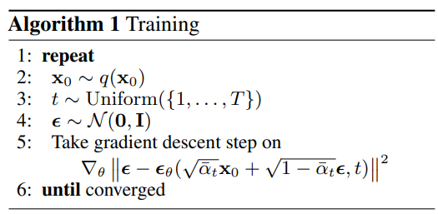

Diffusion: training
Train on ELBO of $log p_{θ}(x_{0})$
Regard $x_{1}, …, x_{T}$ as latent variable
$p_{θ}(x_{0:T})$ is the reverse process, parameterized by neural network
$q(x_{1:T}|x_{0})$ is the forward process, replaces intractable $p_{θ}(x_{1:T}|x_{0})$
Essentially train on denoising loss / reconstruction loss
Notes:
为了让p(x_0)接近q(x_0)，p(x_{t-1}|x_t)也应该更接近q(x_{t-1}|x_t, x_0)，这个可以由ELBO的推导得出
P_theta is parameterized by neural network (denoising backbone) 解释p_theta(x_0)是什么：x_0:T的联合分布关于x_0的边缘分布
Q is simply the forward process
There are also other objectives for training a diffusion model

Slide 9
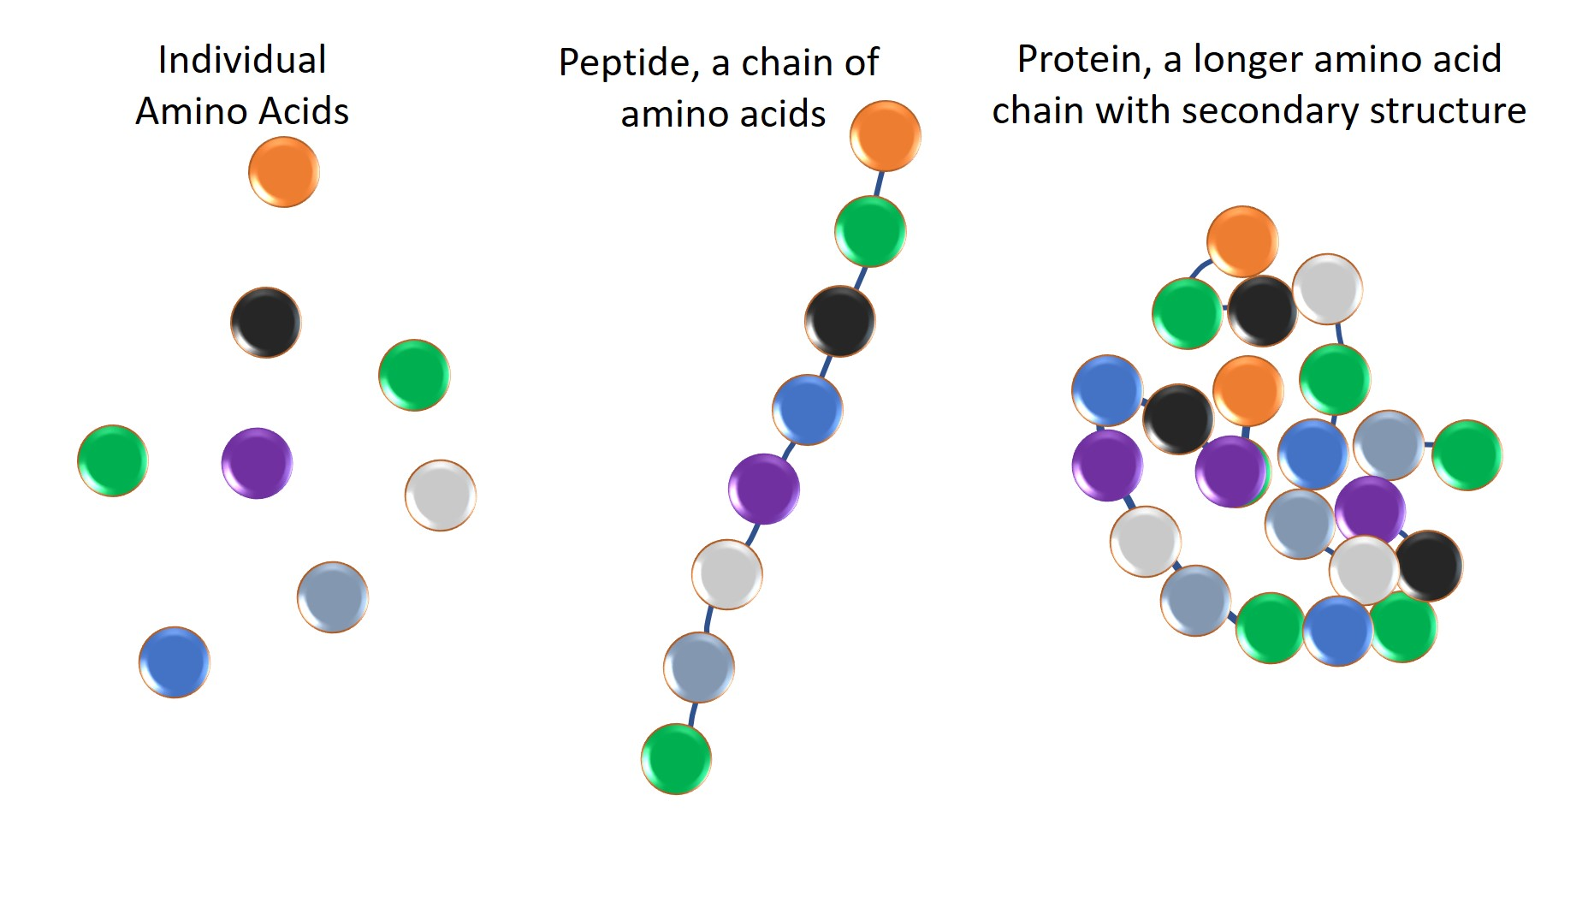

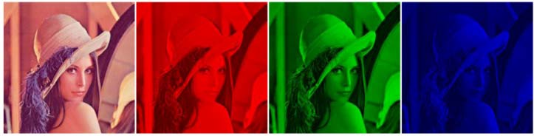
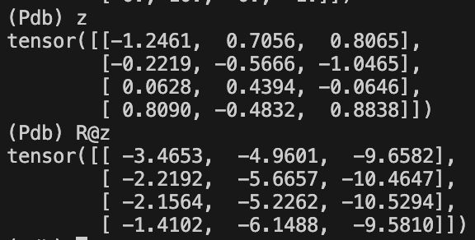
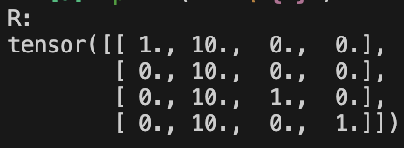

Diffusion: Chroma
Diffusion on backbone coordinates
N-Ca-C=O
$x∈ℝ^{4N×3}$
Diffusion with correlated noise
Intuition: removes simple correlation in data, and diffusion learns the residual
Correlation: backbone atoms of the same residue have similar coords
Analogy: RGB channels of an image are usually correlated
Amino acid diameter: 4~10 Å
Bond lengths: 1~2 Å
Notes:
TODO: correlated noise效果有进步吗？
以CA坐标为基准衡量氨基酸之间的距离，对于同一个氨基酸，比如N的坐标可以是CA的坐标加上一个小的扰动
一句话总结：forward process加噪声应以氨基酸为单位，而不应该直接将氨基酸的各个原子扩散太远；以CA的扰动为主，其余原子的扰动为辅

Slide 10
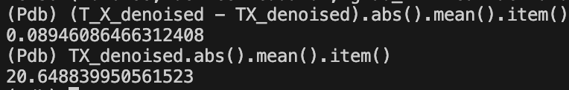
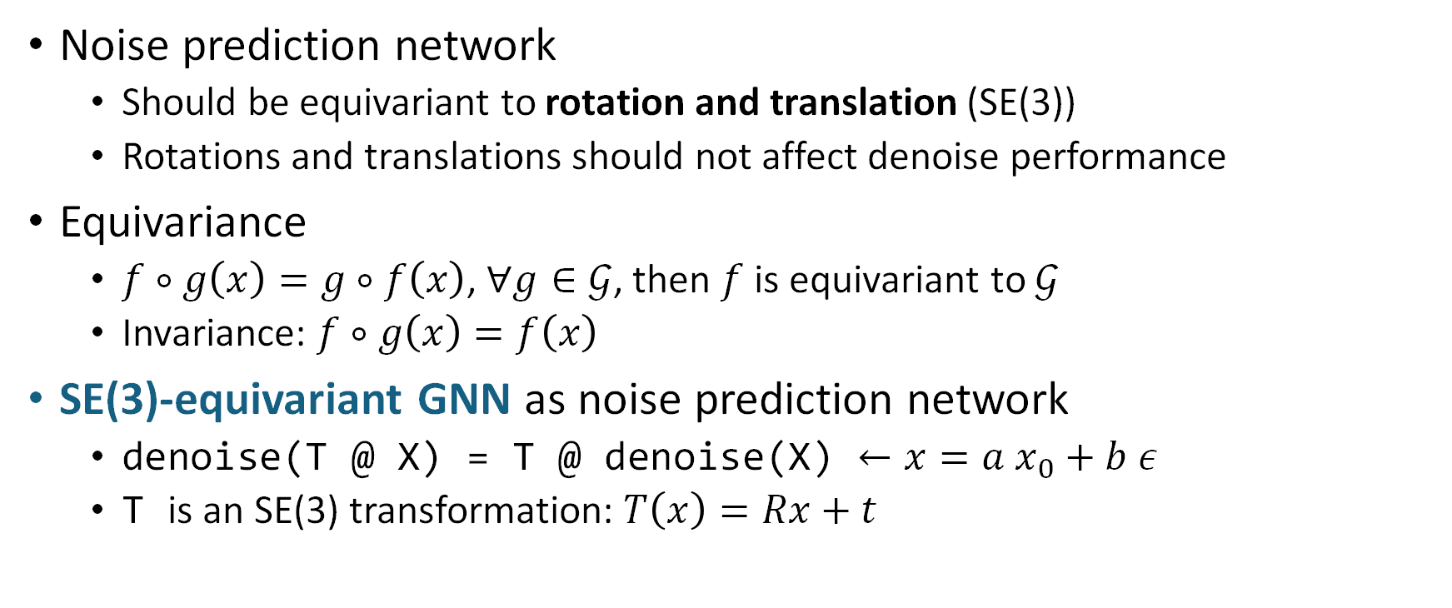
Diffusion: Chroma
Noise prediction network
Should be equivariant to rotation and translation (SE(3))
Rotations and translations should not affect denoise performance
Equivariance
$f∘g\left(x\right)=g∘f\left(x\right)$, $∀g∈𝒢$, then $f$ is equivariant to $𝒢$
Invariance: $f∘g\left(x\right)=f\left(x\right)$
SE(3)-equivariant GNN as noise prediction network
denoise(T @ X) = T @ denoise(X) $←x=a x_{0}+b ε$
T is an SE(3) transformation: $T\left(x\right)=Rx+t$
Notes:
X = a X0 + b eps
直觉：对输入进行旋转，不应影响denoiser的性能，于是一种方式就是让旋转后预测的noise等于预测noise做相同的旋转

Slide 11
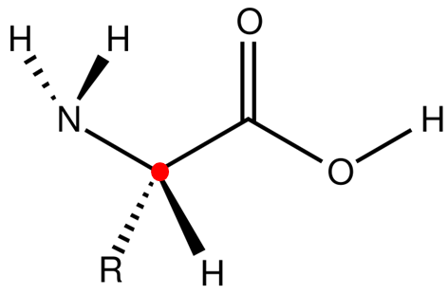
Equivariant GNN
Backbone coords [N, 4, 3]
output
Build O-atom
Backbone coords [N, 3, 3]
Apply transform
Averaged transforms [N, 3, 3] [N, 3]
idealized coord [1, 3, 3]
Invariant coords
Average transforms
Composed transforms [N, 60, 3, 3] [N, 60, 3]
Equivariant OP
Compose transforms
Neighbor transforms [N, 60, 3, 3] [N, 60, 3]
Extracted transforms [N, 3, 3] [N, 3]
Predict transforms with edge (neighbors)
Extract transforms
Edge features [N, 60, 256]
Node features [N, 512]
MPNN
Edge features [N, 60, 256]
Node features [N, 512]
Invariant features
Backbone coords [N, 4, 3]
input
Notes:
先结合这个图说明等变性的大致原理
Key：compose和average transforms都是equivariant的
解释什么是transforms

Slide 12
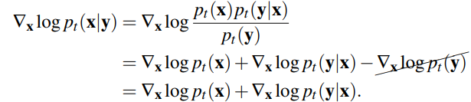

Conditional generation
General method: Conditional reverse process
Unconditional generation: sample from $p_{θ}(x_{t−1}|x_{t})$
Conditional generation: sample from $p_{θ}(x_{t−1}|x_{t}, y)$
$y$ is the condition
In reverse sampling, use score of sample distribution
Conditional score
Unconditional score + conditional gradient

Slide 13
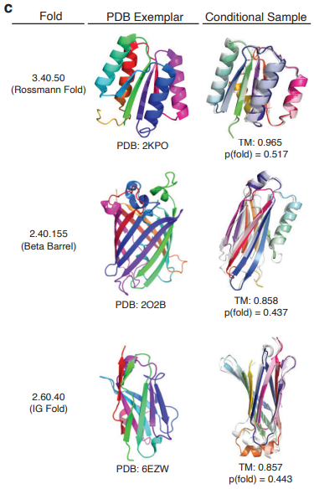
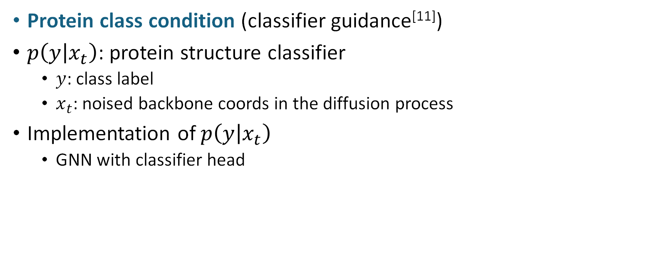
Conditional generation: Chroma
Protein class condition (classifier guidance^{[11]})
$p\left(y | x_{t}\right)$: protein structure classifier
$y$: class label
$x_{t}$: noised backbone coords in the diffusion process
Implementation of $p\left(y | x_{t}\right)$
GNN with classifier head

Slide 14
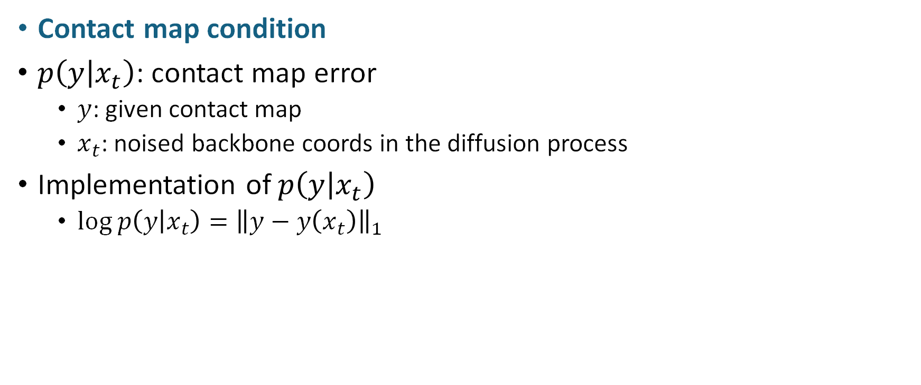
Conditional generation: our method
Contact map condition
$p\left(y | x_{t}\right)$: contact map error
$y$: given contact map
$x_{t}$: noised backbone coords in the diffusion process
Implementation of $p\left(y | x_{t}\right)$
$log p\left(y | x_{t}\right)={\left\|y−y\left(x_{t}\right)\right\|}_{1}$

Slide 15
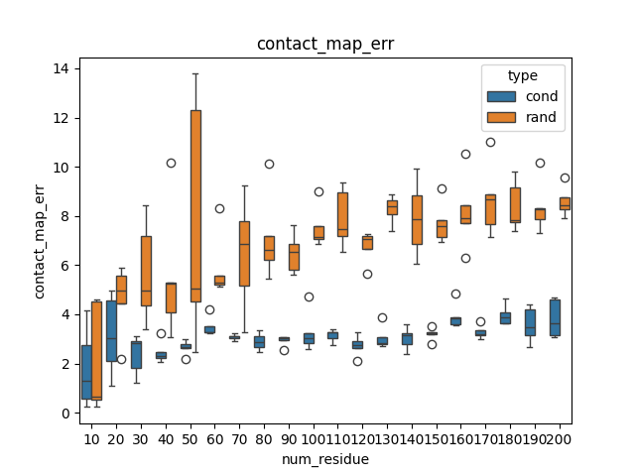
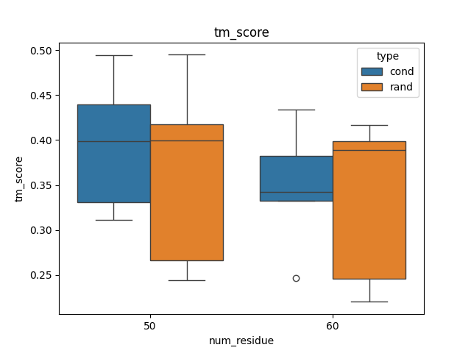
Conditional generation: our method
Contact map condition

Slide 16
Conclusion
Use Chroma as generative prior on protein structure
Use gradient of contact map MAE to guide diffusion process
Recovered protein structure has a much lower contact map MAE than random protein, and is structurally similar based on structure similarity measures

Slide 17
Thank you!

