Slide 1
Machine Learning on predicting survival of Titanic’s passengers by using SVM model
Lee Cheuk YIn

Slide 2
Introduction
Predict survival of the passengers based on given information
Use SVM to perform Machine Learning on Titanic data

Slide 3
Data preprocessing

Slide 4
Counting unfilled value
“Cabin” : 687
“Age”: 177
“Embarked”: 2

Slide 5
Handling unfilled value
“Embarked”: delete the 2 passengers having empty embarked value.
“Age”: fill the missing value with median of the age of other passengers
“Cabin”: will be mentioned later

Slide 6
Digitize categorical variable
“Sex”: encode male as 0, female as 1
“Embarked”: “C”, “S”, “Q” as 0, 1, 2

Slide 7
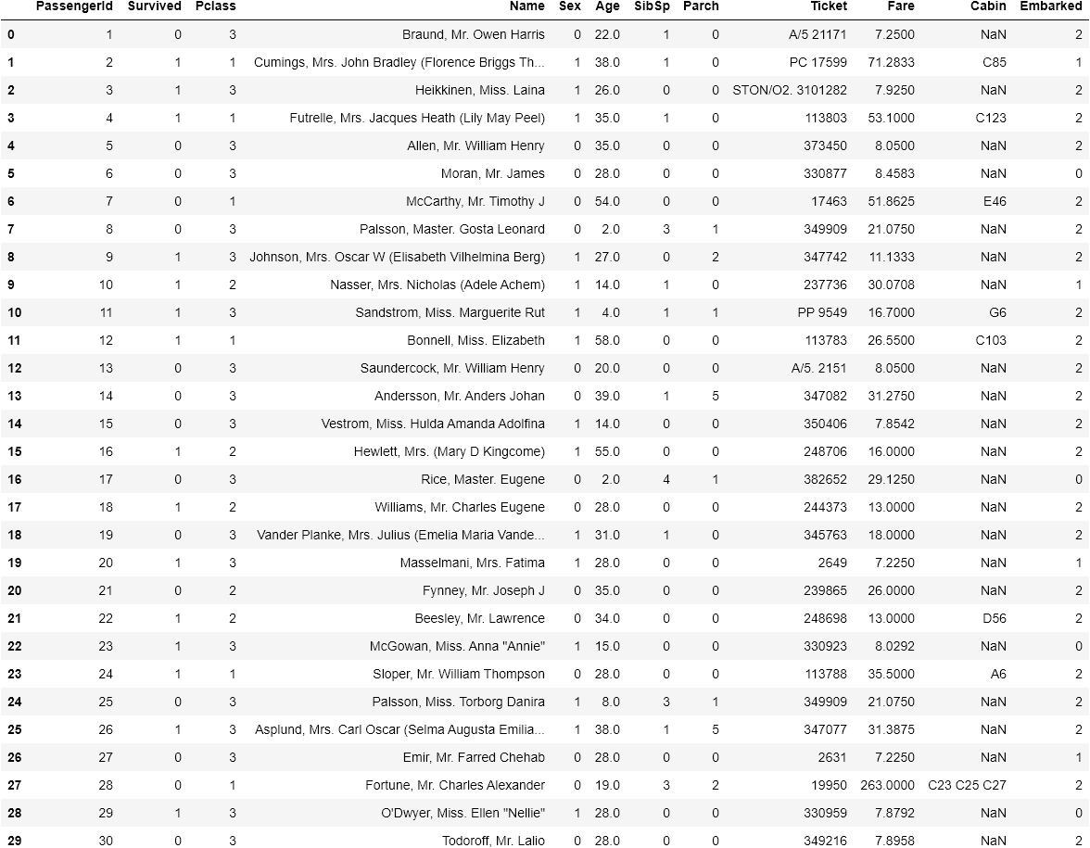
Data up to this part (partial)

Slide 8
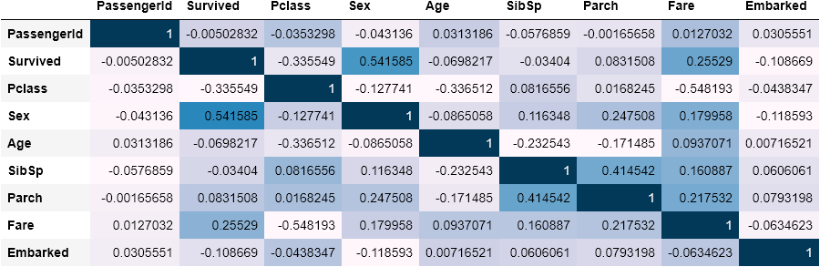
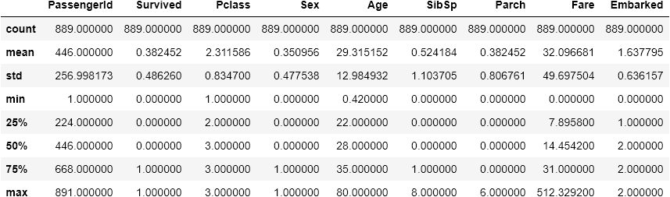
Data Summary

Slide 9
Data cleansing
“Name”, “Ticket” and “PassengerId” : remove because having no relationship with survival of passengers
“Cabin”: there are so many missing values and haven’t shown obvious correlation with passengers survival
* “Embarked”: after digitize the variable, the values of number will generate uneccessary weighting to the model, in fact it doesn’t have numeric meaning, so need to remove

Slide 10
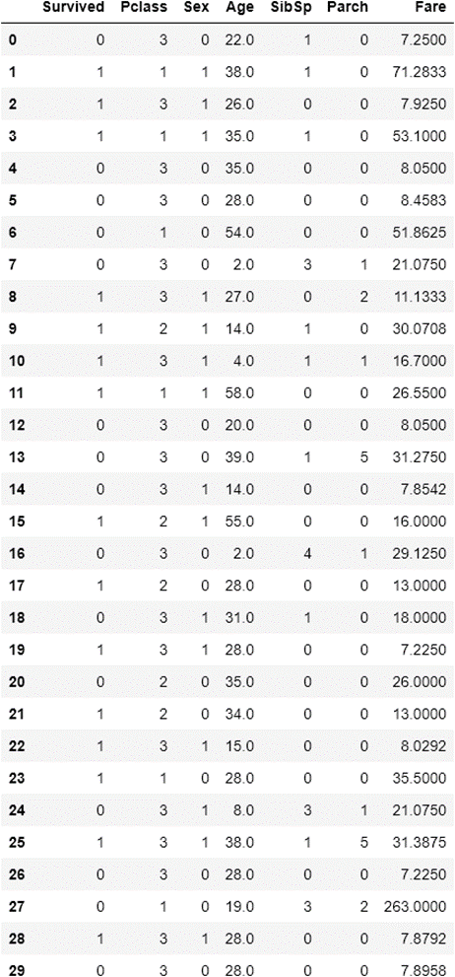
Data After cleansing (partial)

Slide 11
Splitting data
Set the “Survived” column be Y and other features as X
Split the X and Y into X_train, X_test, Y_train, Y_test into 30% test-ratio

Slide 12
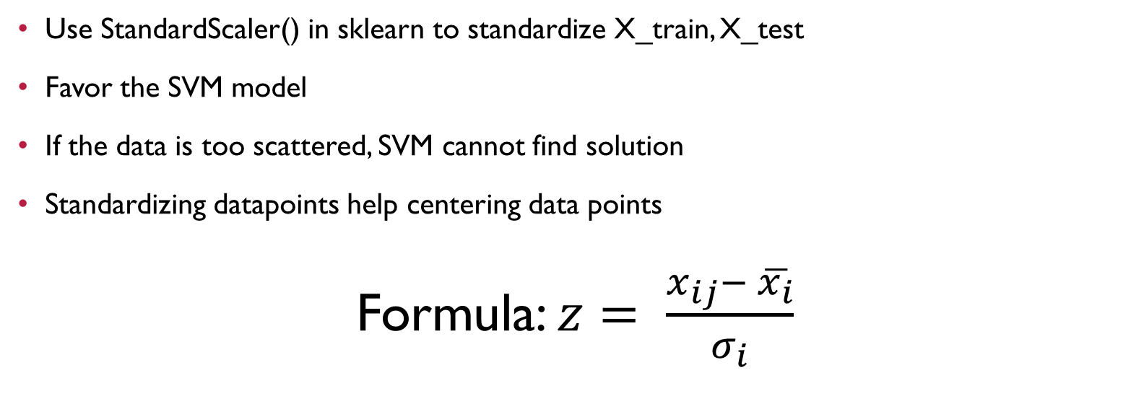
Standardize X_test, X_train
Use StandardScaler() in sklearn to standardize X_train, X_test
Favor the SVM model
If the data is too scattered, SVM cannot find solution
Standardizing datapoints help centering data points
Formula: $z= \frac{x_{ij}− \overline{x_{i}}}{σ_{i}}$

Slide 13
Model training by SVM

Slide 14
SVM model
relative new (1990’s)
project the vectors on higher dimensional vector space
use kernel function to apply on data points, to make it linear separable
Use linear (most simple kernel) and radial basis function (a.k.a. rbf) kernel (one of most popular kernel) of SVM model
Being regarded as one of the best ML model, want to test its “power”

Slide 15
Model performance

Slide 16
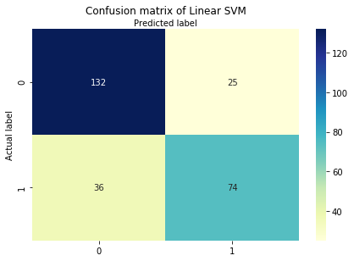
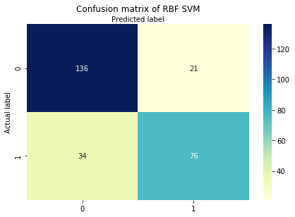
confusion matrix

Slide 17
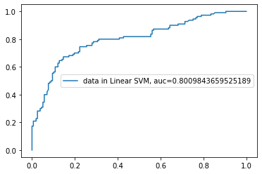
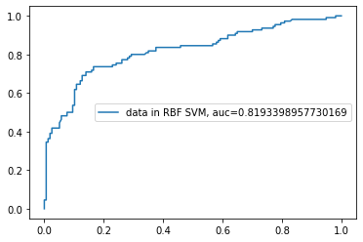
Roc curve (by mapping y_test and prediction result using x-test)

Slide 18
scores
Linear svm
Rbf kerneled SVM
Accuracy: 0.7715355805243446
Precision: 0.7474747474747475
Recall: 0.6727272727272727
Kaggle score: 0.77272
Accuracy: 0.7940074906367042
Precision: 0.7835051546391752
Recall: 0.6909090909090909
Kaggle score: 0.77511

Slide 19
Model analysis
In terms of auc, rbf kerneled svm better than linear svm
The distribution of data points may tends to look like a circle
The performance of svm for using different kernel is performance sensitive
The recall scores in both rbf-kerneled SVM and linear SVM is lower than accuracy and precision score
The model generate more false negative cases than false positive one
Major reason of harming auc
Test data is also biased towards the “dead” category

Slide 20
Conclusion
The Kaggle scores in both linear and rbf kerneled SVMs are not deviated with their accuracy and precision scores obtained by predicting test data
The SVMs gives a so-so performance
Maybe the more detailed feature engineering process or using other model can further improve the accuracy on solving this problem
In SVM case, if the data are concentrating at certain position or having nice geometry that best match the kernel, it will make the computation time becomes shorter
Feel satisfied for experiencing SVM’s “power” by myself

Slide 21
The End

