Slide 1
Chapter 10 Boosting
May 6, 2010

Slide 2

Outline
Adaboost
Ensemble point-view of Boosting
Boosting Trees
Supervised Learning Methods

Slide 3
AdaBoost
Freund and Schapire (1997).
Weak classifiers
  Error rate only slightly better than random guessing
  Applied sequentially to repeatedly modified versions of the data, to produce a sequence {G_{m}(x) | m = 1,2,…,M} of weak classifiers
Final prediction is a weighted majority vote G(x) = sign( Σ_{m} [α_{m} G_{m}(x)] )

Slide 4
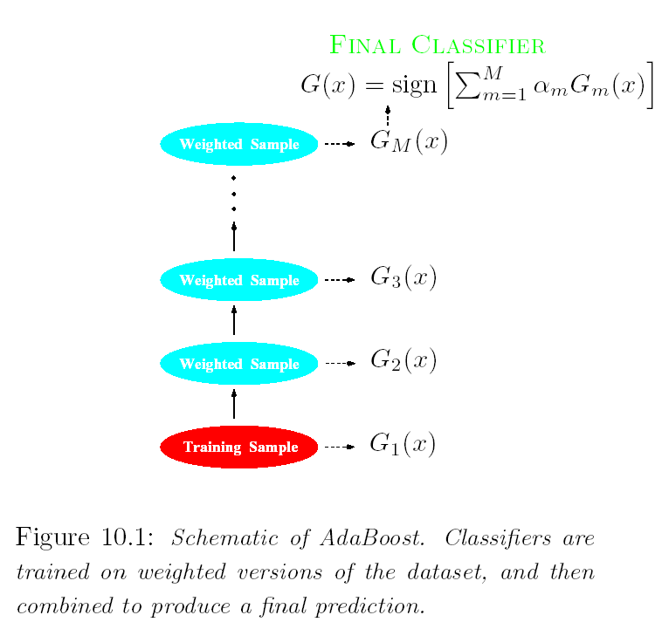

Re-weighting Samples

Slide 5
Data Modification and
Classifier Weightings
Apply weights (w₁,w₂,…,w_{N}) to each training example (x_{i},y_{i}), i = 1, 2,…,N
Initial weights w_{i} = 1/N
At step m+1, increase weights of observations misclassified by G_{m}(x)
Weight each classifier G_{m}(x) by the log odds of correct prediction on the training data.

Slide 6
Algorithm for AdaBoost
Initialize Observation Weights
  w_{i} = 1/N, i = 1,…,N
For m = 1 to M:
  Fit a classifier G_{m}(x) to the training data using weights w_{i}
  Compute
  Compute
  Set
Output

Slide 7
Simulated Example
X₁,…,X₁₀ iid N(0,1)
Y = 1 if Σ X_{j} > χ²₁₀ (0.5) = 9.34 = median
Y = -1 otherwise
N = 2000 training observations
10,000 test cases
Weak classifier is a “stump”
  two-terminal-node classification tree
Test set error of stump = 46%
Test set error after boosting = 12.2%
Test set error of full RP tree = 26%

Slide 8
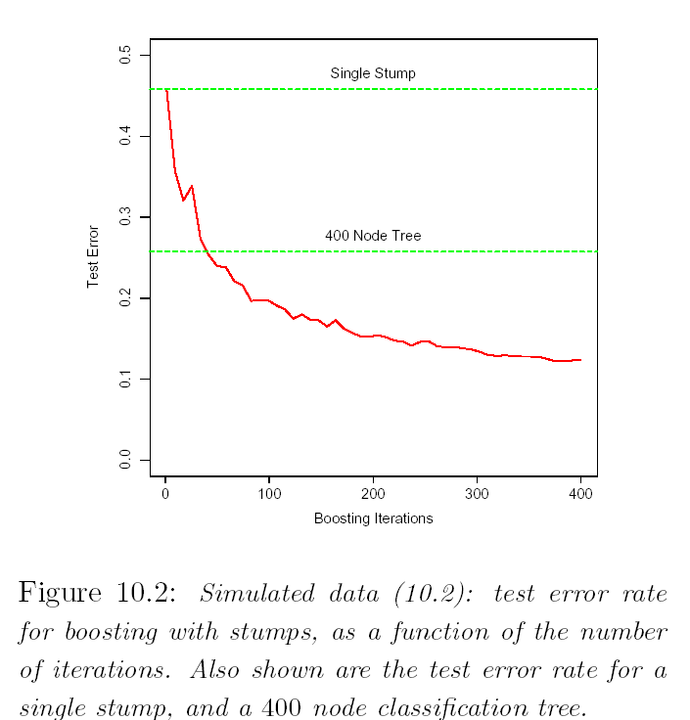
Error Rate

Slide 9
Boosting Fits an Additive Model
Model Choice of basis
Single Layer Neural Net σ(γ₀ + γ₁(x))
Wavelets γ for location & scale
MARS γ gives variables & knots
Boosted Trees γ gives variables & split points

Slide 10
Forward Stagewise Modeling
Initialize f₀(x) = 0
For m = 1 to M:
  Compute
  Set
Loss: L[y,f(x)]
  Linear Regression: [y - f(x)]²
  AdaBoost: exp[-y*f(x)]

Slide 11
Exponential Loss
For exponential loss, the minimization step in forward stage-wise modeling becomes
In the context of a weak learner G, it is
Can be expressed as

Slide 12

Solving Exponential Minimization
For any fixed β > 0, the minimizing G_{m} is the {-1,1} valued function given by
Classifier that minimizes training error loss for the weighted sample.
Plugging in this solution gives

Slide 13
Insights and Outline
AdaBoost fits an additive model where the basis functions G_{m}(x) optimize exponential loss stage-wise
Population minimizer of exponential loss is the log odds
Decision trees don’t have much predictive capability, but make ideal weak/slow learners
  especially stumps
Generalization of Boosting Decision Trees - MART
Shrinkage and slow learning
Connection between forward stage-wise shrinkage and Lasso/LAR
Tools for interpretation
Random Forests

Slide 14
General Properties of Boosting
Training error rate levels off and/or continues to decrease VERY slowly as M grows large.
Test error continues to decrease even after training error levels off
This phenomenon holds for other loss functions as well as exponential loss.

Slide 15
Why Exponential Loss?
Principal virtue is computational
Minimizer of this loss is (1/2) log odds of P(Y=1 | x),
  AdaBoost predicts the sign of the average estimates of this.
In the Binomial family (logistic regression), the MLE of P(Y=1 | x) is the solution corresponding to the loss function
  Y’ = (Y+1)/2 is the 0-1 coding of output.
  This loss function is also called the “deviance.”

Slide 16
Loss Functions and Robustness
Exponential Loss concentrates much more influence on observations with large negative margins y f(x).
Binomial Deviance spreads influence more evenly among all the data
Exponential Loss is especially sensitive to misspecification of class labels
Squared error loss places too little emphasis on points near the boundary
If the goal is class assignment, a monotone decreasing function serves as a better surrogate loss function

Slide 17
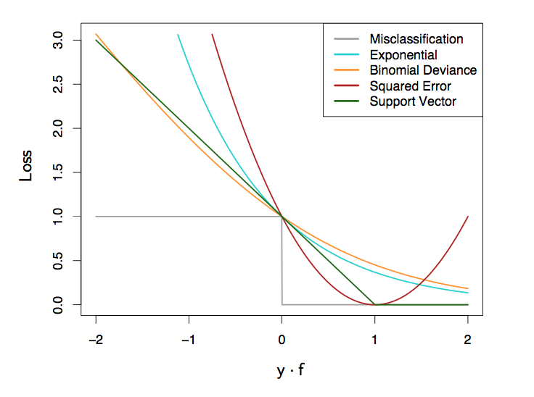
Exponential Loss: Boosting Margin
Larger margin Penalty over negative range than positive range

Slide 18
Boosting Decision Trees
Decision trees are not ideal tools for predictive learning
Advantages of Boosting
  improves their accuracy, often dramatically
  Maintains most of the desirable properties
Disadvantages
  Can be much slower
  Can become difficult to interpret (if M is large)
  AdaBoost can lose robustness against overlapping class distributions and mislabeling of training data

Slide 19
Ensembles of Trees
Boosting (forward selection with exponential loss)
TreeNet/MART (forward selection with robust loss)
Random Forests (trade-off between uncorrelated components [variance] and strength of learners [bias])

Slide 20
Boosting Trees
Forward Selection:
Note: common loss function L applies to growing individual trees
and to assembling different trees.

Slide 21
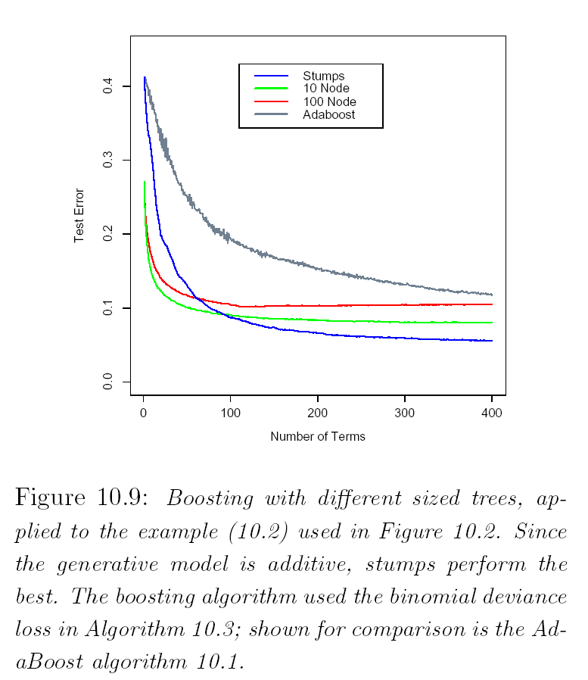
Which Tree to Boost

Slide 22
Random Forests
“Random Forests” grows many classification trees.
  To classify a new object from an input vector, put the input vector down each of the trees in the forest. Each tree gives a classification, and we say the tree "votes" for that class.
  The forest chooses the classification having the most votes (over all the trees in the forest).

Slide 23
Random Forests
Each tree is grown as follows:
  If the number of cases in the training set is N, sample N cases at random - but with replacement, from the original data. This sample will be the training set for growing the tree.
  If there are M input variables, a number m<<M is specified such that at each node, m variables are selected at random out of the M and the best split on these m is used to split the node. The value of m is held constant during the forest growing.
  Each tree is grown to the largest extent possible. There is no pruning.

Slide 24
