Slide 1
Support Vector Machines
Chapter 12

Slide 2
Outline
Separating Hyperplanes – Separable Case
Extension to Non-separable case – SVM
Nonlinear SVM
SVM as a Penalization method
SVM regression

Slide 3
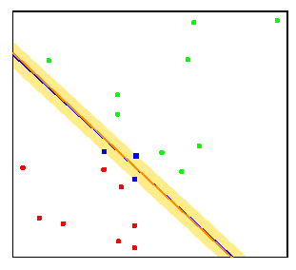
Separating Hyperplanes
The separating hyperplane with maximum margin is likely to perform well on test data.
Here the separating hyperplane is almost identical to the more standard linear logistic regression boundary

Slide 4
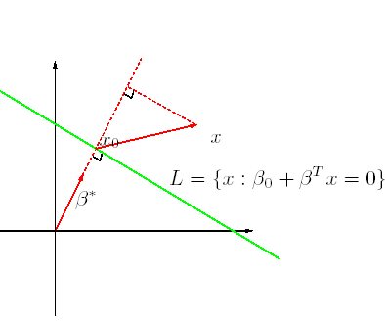
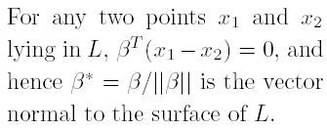
Distance to Hyperplanes
For any point x₀ in L,
β^{T} x₀ = -β₀
The signed distance of any point x to L is given by

Slide 5
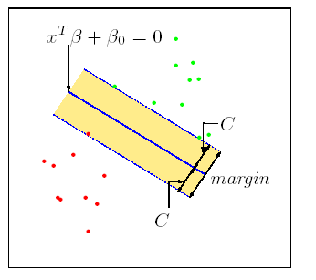
Maximum Margin Classifier
Found by quadratic programming (Convex optimization)
Solution determined by just a few points (support vectors) near the boundary
  Sparse solution in dual space
Decision function

Slide 6
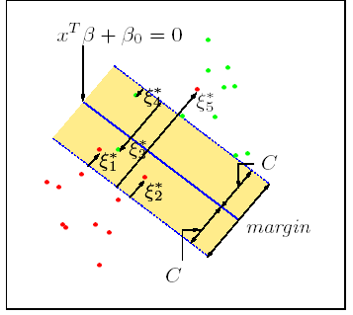
Non-separable Case: Standard Support Vector Classifier
This problem computationally equivalent to

Slide 7
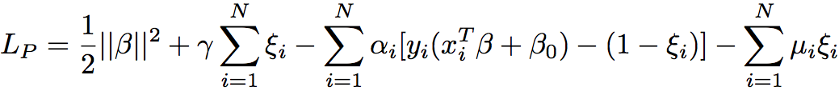
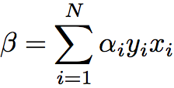
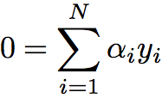
Computation of SVM
Lagrange (prime) function:
Minimize w.r.t β, β₀ and ξ_{i,} a set derivatives to zero:

Slide 8
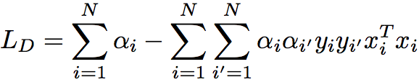

Computation of SVM
Lagrange (dual) function:
with constraints: 0 ≤ α_{I} ≤ γ and ∑^{Ν}_{i=1}α_{i}y_{i} = 0
Karush-Kuhn-Tucker conditions:

Slide 9
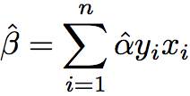

Computation of SVM
The final solution:

Slide 10
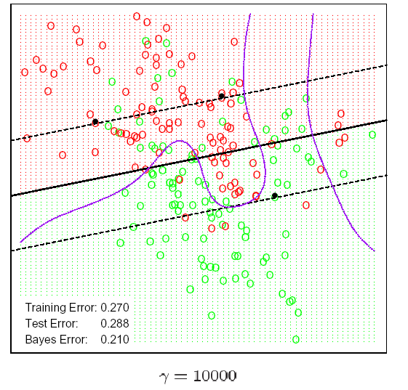
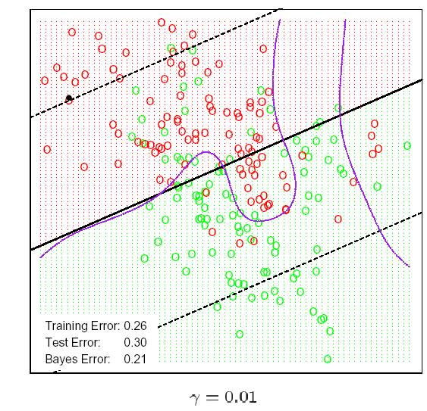
Example-Mixture Data

Slide 11
SVMs for large p, small n
Suppose we have 5000 genes(p) and 50 samples(n), divided into two classes
  Many more variables than observations
  Infinitely many separating hyperplanes in this feature space
SVMs provide the unique maximal margin separating hyperplane
Prediction performance can be good, but typically no better than simpler methods such as nearest centroids
All genes get a weight, so no gene selection
  May overfit the data

Slide 12
Non-Linear SVM via Kernels
Note that the SVM classifier involves inner products <x_{i}, x_{j}>=x_{i}^{T}x_{j}
Enlarge the feature space
Replacing x_{i}^{T} x_{j} by appropriate kernel K(x_{i},x_{j}) = <φ(x_{i}), φ(x_{j})> provides a non-linear SVM in the input space

Slide 13
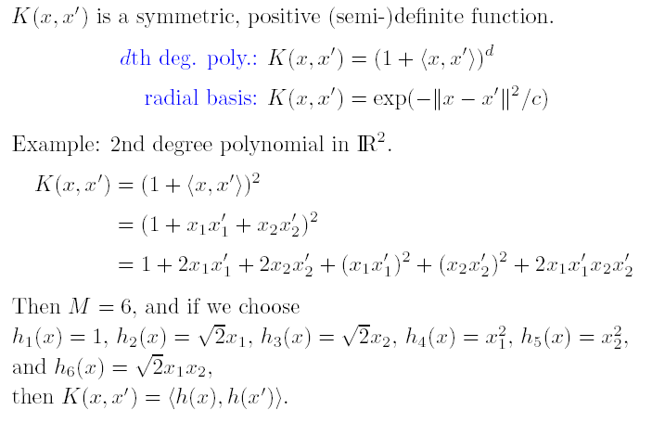
Popular kernels

Slide 14
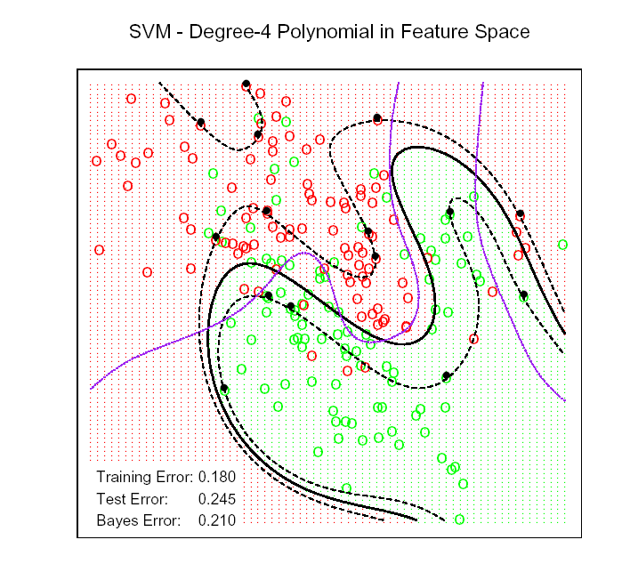
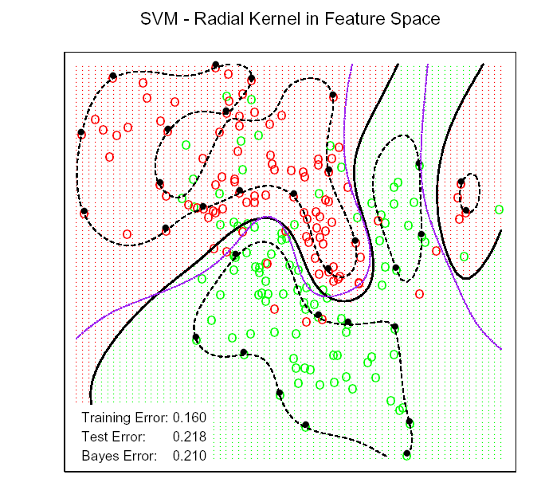
Kernel SVM-Mixture Data

Slide 15
Radial Basis Kernel
Radial Basis function has infinite-dim basis: φ(x) are infinite dimension.
Smaller the Bandwidth c, more wiggly the boundary and hence Less overlap
Kernel trick doesn’t allow coefficients of all basis elements to be freely determined

Slide 16
SVM as penalization method
For , consider the problem
Margin Loss + Penalty
For , the penalized setup leads to the same solution as SVM.

Slide 17
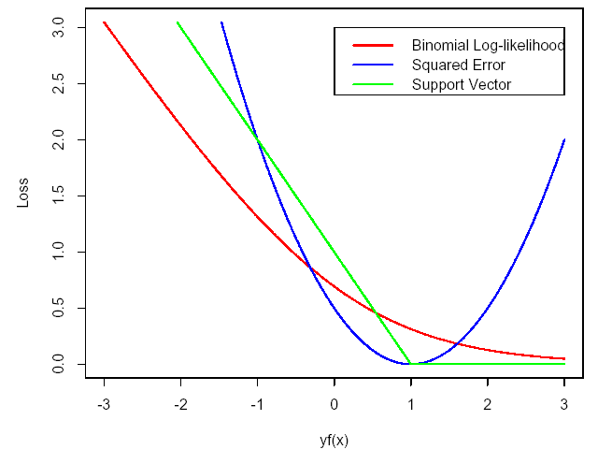
SVM and other Loss Functions

Slide 18
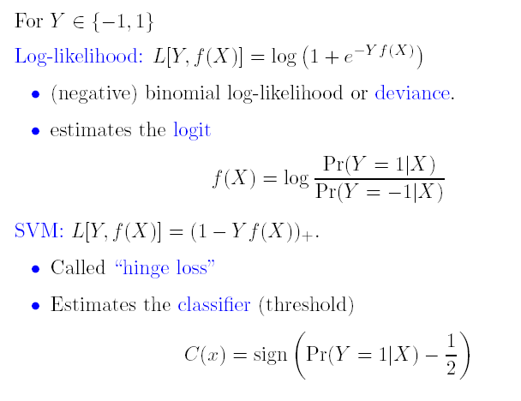
Population Minimizers for Two Loss Functions

Slide 19
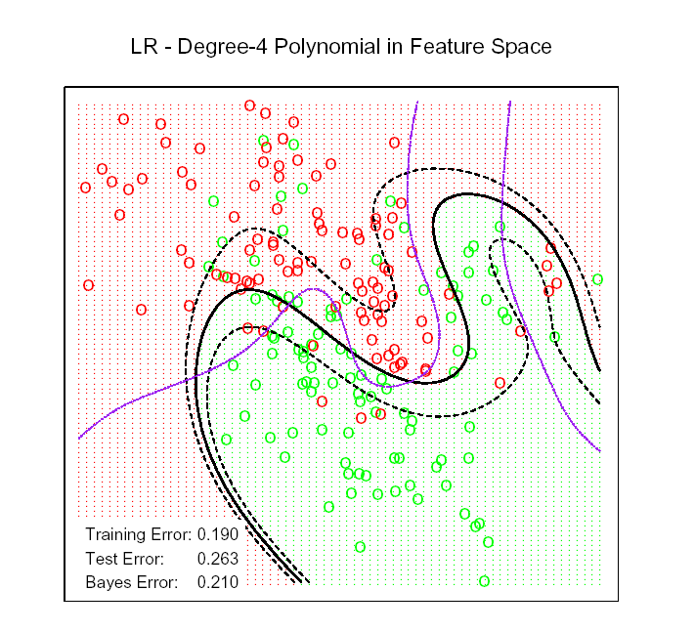
Logistic Regression with Loglikelihood Loss

Slide 20
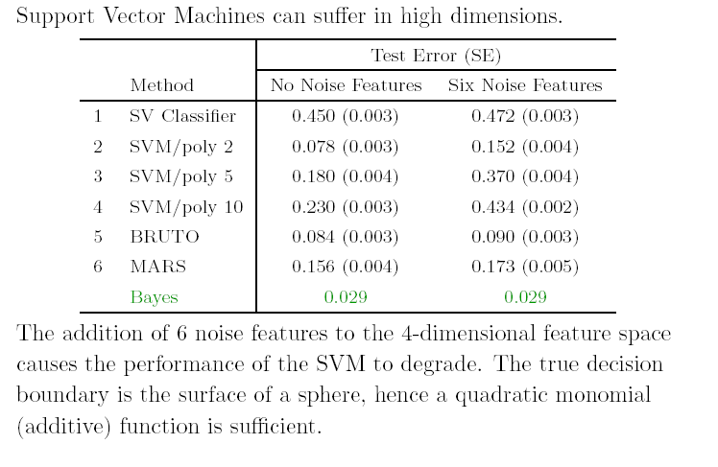
Curse of Dimensionality in SVM

Slide 21
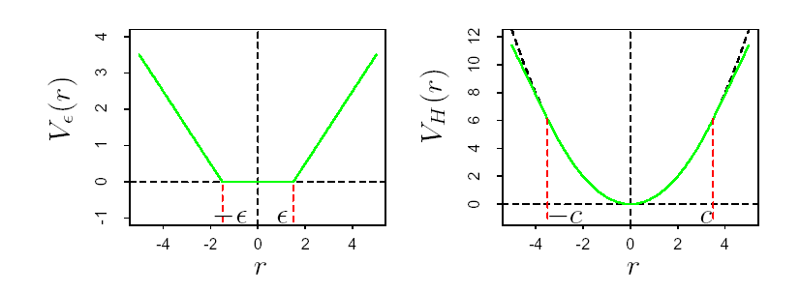
SVM Loss-Functions for Regression

Slide 22
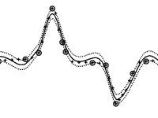
Example

Slide 23
Example

Slide 24
Example

Slide 25
Generalized Discriminant Analysis
Chapter 12

Slide 26
Outline
Flexible Discriminant Analysis(FDA)
Penalized Discriminant Analysis
Mixture Discriminant Analysis (MDA)

Slide 27



Linear Discriminant Analysis
Let P(G = k) = π_{k} and P(X=x|G=k) = f_{k}(x)
Then
Assume f_{k}(x) ~ N(μ_{k}, Σ_{k}) and Σ₁ = Σ₂ = …= Σ_{K}= Σ
Then we can show the decision rule is (HW#1):

Slide 28


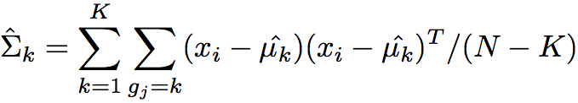
LDA (cont)
Plug in the estimates:

Slide 29
LDA Example
Data
Prediction Vector
In this three class problem, the middle
class is classified correctly

Slide 30
LDA Example
11 classes and X ∈ R¹⁰

Slide 31
Virtues and Failings of LDA
Simple prototype (centriod) classifier
  New observation classified into the class with the closest centroid
    But uses Mahalonobis distance
Simple decision rules based on linear decision boundaries
Estimated Bayes classifier for Gaussian class conditionals
    But data might not be Gaussian
Provides low dimensional view of data
  Using discriminant functions as coordinates
Often produces best classification results
  Simplicity and low variance in estimation

Slide 32
Virtues and Failings of LDA
LDA may fail in number of situations
  Often linear boundaries fail to separate classes
  With large N, may estimate quadratic decision boundary
  May want to model even more irregular (non-linear) boundaries
    Single prototype per class may not be insufficient
  May have many (correlated) predictors for digitized analog signals.
    Too many parameters estimated with high variance, and the performance suffers
    May want to regularize

Slide 33
Generalization of LDA
Flexible Discriminant Analysis (FDA)
  LDA in enlarged space of predictors via basis expansions
Penalized Discriminant Analysis (PDA)
  With too many predictors, do not want to expand the set: Already too large
  Fit LDA model with penalized coefficient to be smooth/coherent in spatial domain
  With large number of predictors, could use penalized FDA
Mixture Discriminant Analysis (MDA)
  Model each class by a mixture of two or more Gaussians with different centroids, all sharing same covariance matrix
    Allows for subspace reduction

Slide 34
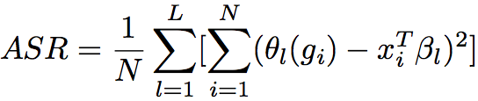
Flexible Discriminant Analysis
Linear regression on derived responses for K-class problem
  Define indicator variables for each class (K in all)
  Using indicator functions as responses to create a set of Y variables
  Obtain mutually linear score functions as discriminant (canonical) variables
  Classify into the nearest class centroid
    Mahalanobis distance of a test point x to kth class centroid

Slide 35
Flexible Discriminant Analysis
Mahalanobis distance
of a test point x to kth
class centroid
We can replace linear regression fits by non-parametric fits, e.g., generalized additive fits, spline functions, MARS models etc., with a regularizer or kernel regression and possibly reduced rank regression

Slide 36
Computation of FDA
Multivariate nonparametric regression
Optimal scores
Update the model from step 1 using the optimal scores

Slide 37
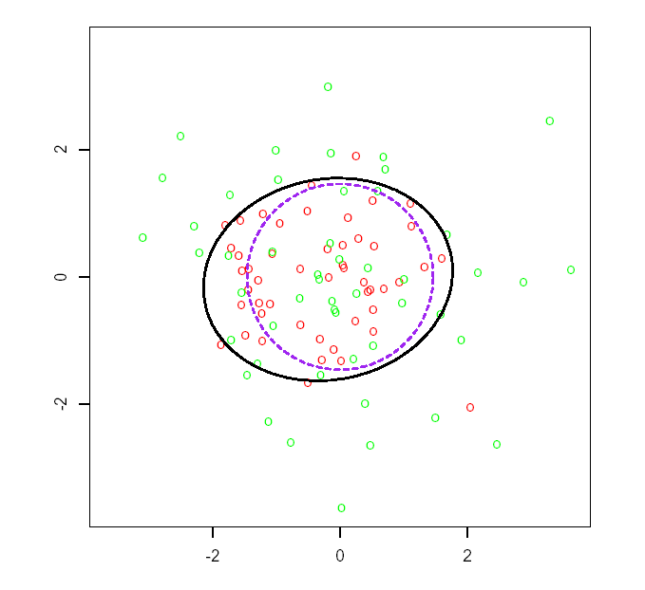
Example of FDA
N(0, I)
N(0, 9I/4)
Bayes decision boundary
FDA using degree-two
Polynomial regression

Slide 38
Speech Recognition Data
K=11 classes
  spoken vowels sound
p=10 predictors extracted from digitized speech
FDA uses adaptive additive-spline regression (BRUTO in S-plus)
FDA/MARS Uses Multivariate Adaptive Regression Splines; degree=2 allows pairwise products

Slide 39
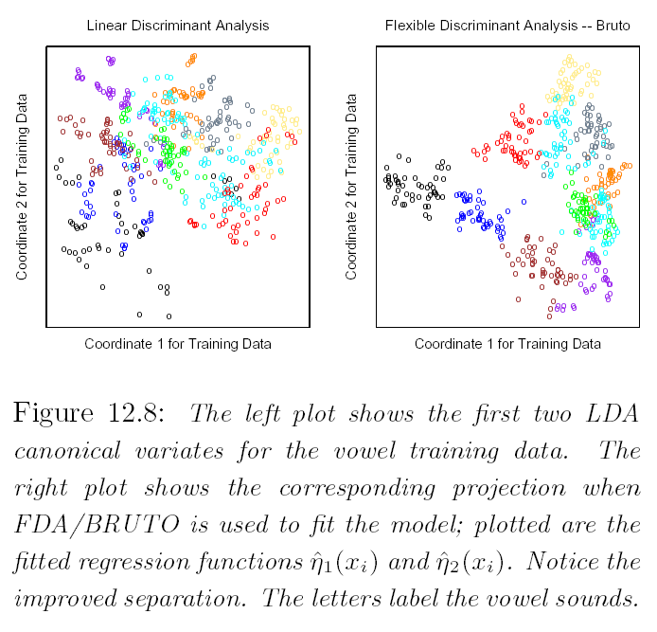
LDA Vs. FDA/BRUTO

Slide 40
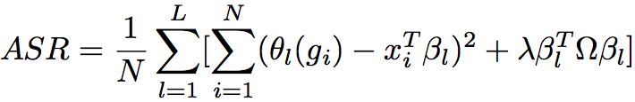
Penalized Discriminant Analysis
PDA is a regularized discriminant analysis on enlarged set of predictors via a basis expansion

Slide 41
Penalized Discriminant Analysis
PDA enlarge the predictors to h(x)
Use LDA in the enlarged space, with the penalized Mahalanobis distance:
with Σ_{W} as within-class Cov

Slide 42


Penalized Discriminant Analysis
Decompose the classification subspace using the penalized metric:
max w.r.t.

Slide 43
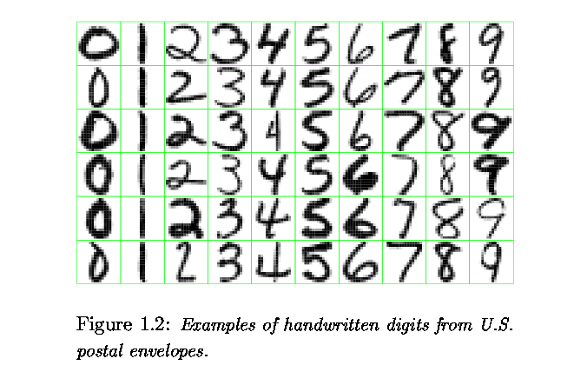
USPS Digit Recognition

Slide 44
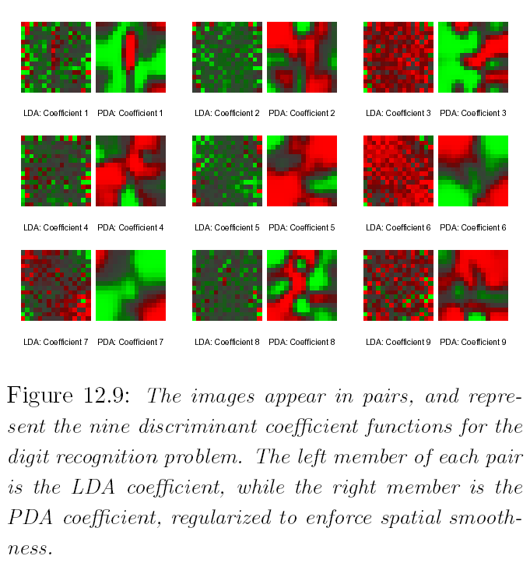
Digit Recognition-LDA vs. PDA

Slide 45
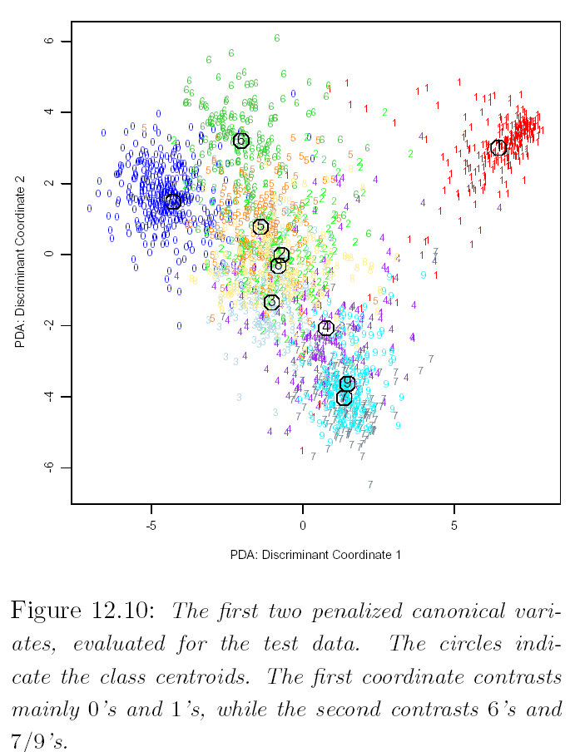
PDA Canonical Variates

Slide 46
Mixture Discriminant Analysis
The class conditional densities modeled as mixture of Gaussians
  Possibly different # of components in each class
  Estimate the centroids and mixing proportions in each subclass by max joint likelihood P(G, X)
  EM algorithm for MLE
Could use penalized estimation

Slide 47
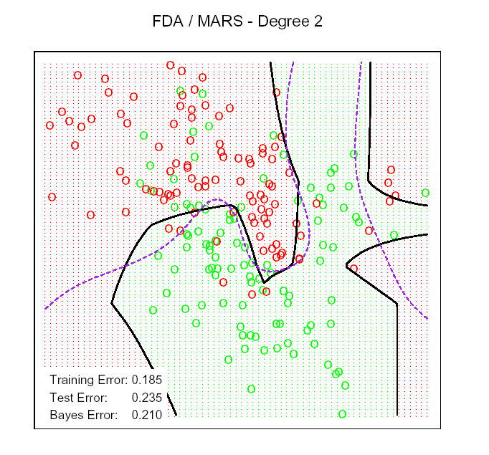
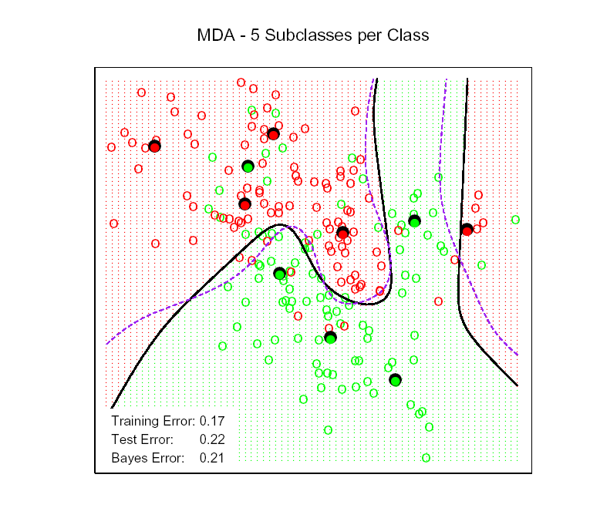
FDA and MDA

Slide 48
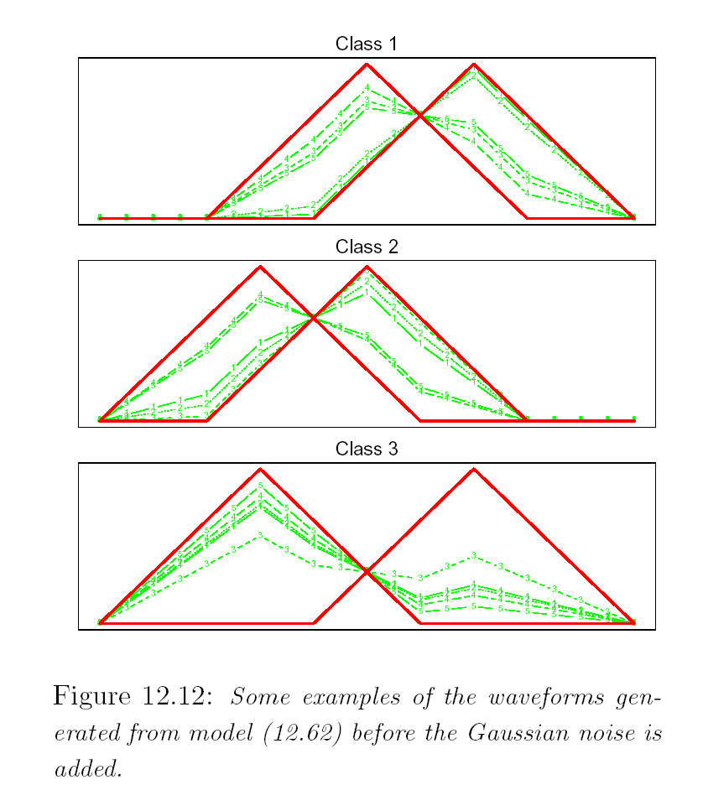
Wave Form Signal with Additive Gaussian Noise
Class 1: X_{j} = U h₁(j) + (1-U)h₂(j) +ε_{j}
Class 2: X_{j} = U h₁(j) + (1-U)h₃(j) +ε_{j}
Class 3: X_{j} = U h₂(j) + (1-U)h₃(j) +ε_{j}
Where j = 1,L, 21, and U ~ Unif(0,1)
h₁(j) = max(6-|j-11|,0)
h₂(j) = h₁(j-4)
h₃(j) = h₁(j+4)

Slide 49
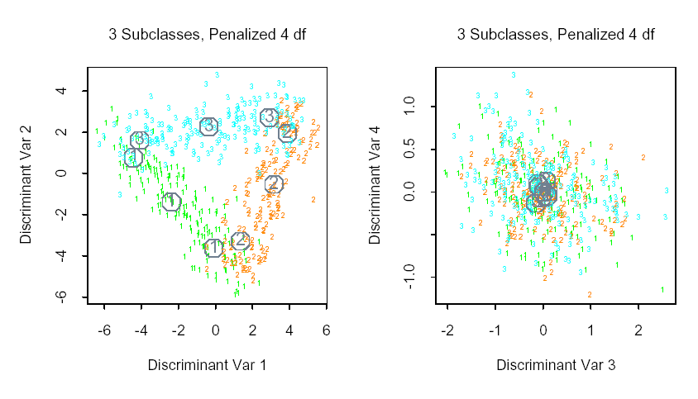
Wave From Data Results

