Slide 1
Basis Expansions and
Regularization
Part II

Slide 2
Outline
Review of Splines
Wavelet Smoothing
Reproducing Kernel Hilbert Spaces

Slide 3
Smoothing Splines
Among all functions with two continuous derivatives, find the f that Minimizes penalized RSS
It is the same to find an f in the Sobolev space of functions with finite 2nd derivatives.
Optimal solution is a natural spline, with knot at unique values of input data points. (Exercise 5.7, [Theorem 2.3 in Green-Silverman 1994])

Slide 4
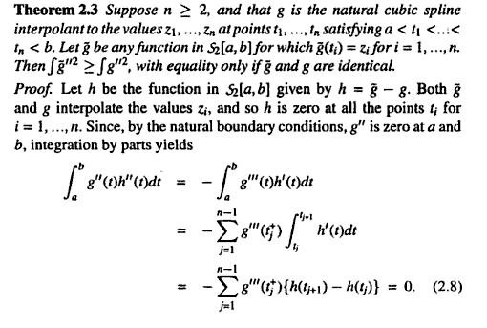
Optimality of Natural Splines
Green, Silverman, Nonparametric Regression and Generalized Linear Models, p.16-17, 1994.

Slide 5
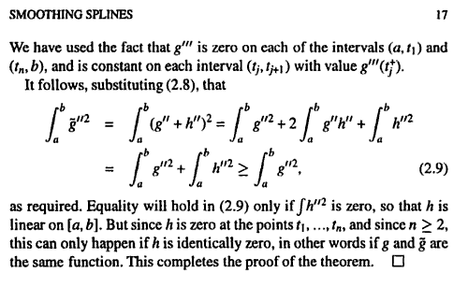
Optimality of Natural Splines
Continued…
Green, Silverman, Nonparametric Regression and Generalized Linear Models, p.16-17, 1994.

Slide 6
Multidimensional Splines
Tensor products of one-dim basis functions
  Consider all possible products of these basis elements
    Get M1*M2*…*Mk basis functions
    Fit coefficients by LS
    Dimension grows exponentially
      Need to select some of these (MARS)
  Provides flexibility, but introduces more spurious structures
Thin-Plate splines for two dimensions
  Generalization of smoothing splines in one dim
    Penalty (integrated quad form in Hessian)
    Natural extension to 2-dim leads to a solution with radial basis functions
    High Computational complexity

Slide 7
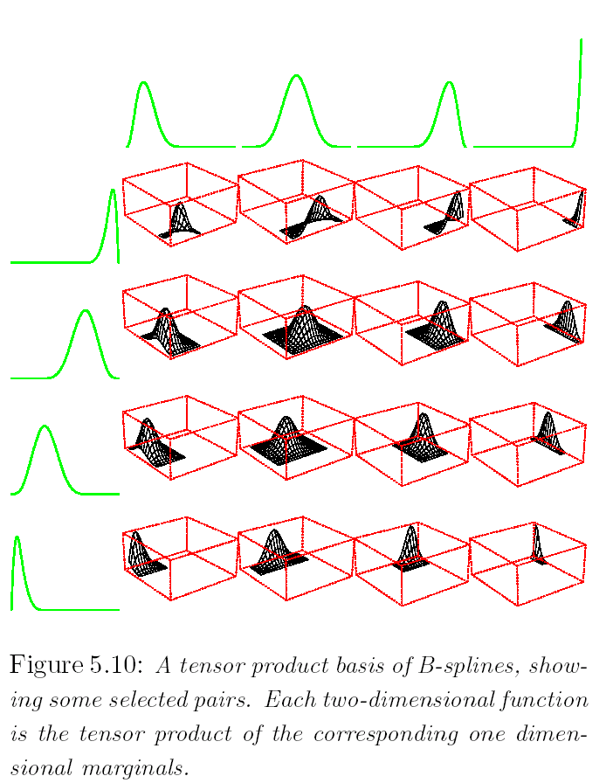
Tensor Product

Slide 8
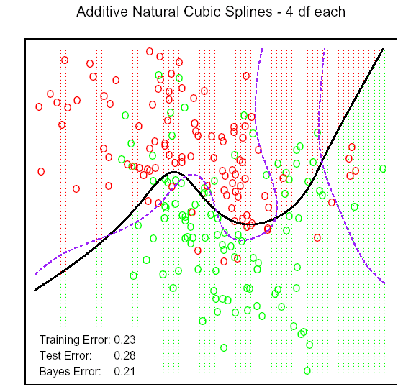
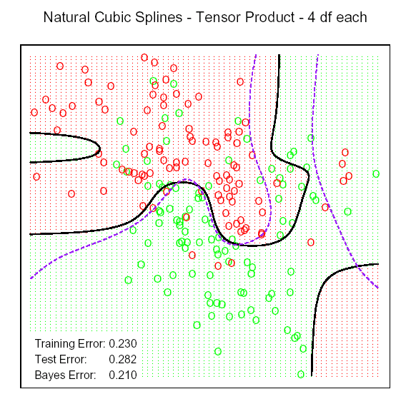
Additive v.s. Tensor Product
More Flexiable

Slide 9
Thin-Plate Splines
Min RRS + λ J(f)
It leads to thin-plate splines if

Slide 10
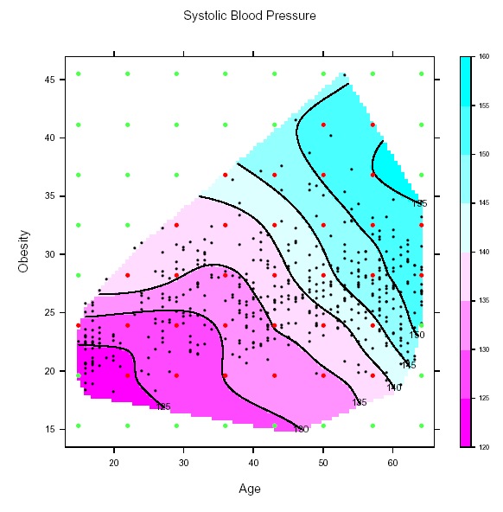
Thin-Plate Splines
Contour Plots for Heart Disease Data
Response: Systolic BP,
Inputs: Age, Obesity
  Data points
  64 lattice points used as knots
    Knots inside the convex hull of data (red) should be used carefully
    Knots outside the data convex hull (Green) can be ignored

Slide 11
Back to Spline
The minimization problem is
written as:
By solving it, we get:
N(x): the natural
spline basis

Slide 12

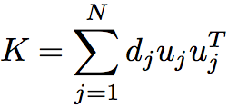
Properties of S_{λ}
S_{λ} can be written in the Reinsch form S_{λ} = (Ι− λΚ)⁻¹ while K is the penalty matrix. It is equivalent to say S_{λ}y is the solution of
Κ can be represented as the eigenvectors and eigenvalues of Κ:

Slide 13
Properties of S_{λ}
ρ_{i} =1/(1+λd_{i}) is shrunk towards zero, which leads to S*S ≤ S.
For comparison, the eigenvaules of a projection matrix in regression are 1 or 0, since H*H = H
The first two eigenvalues of S_{λ} are always one, since d₁=d₂=0, corresponding to linear terms.
The sequence of u_{i}, ordered by decreasing ρ_{i}, appear to increase in complexity.

Slide 14
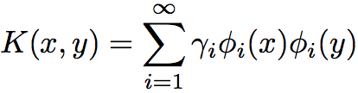
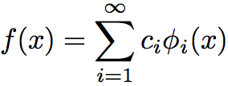
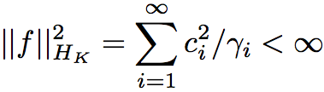
Reproducing Kernel Hilbert Space
A RKHS H_{K} is a functional space generated by a positive definite kernel K
with γ_{i}≥0 and Σ γ_{i}²< ∞.
Elements of H_{K} have an expansion in terms of the eigen-function:
with constraint that

Slide 15

Example of RK
Polynomial Kernel in R²: K(x,y) = (1+<x, y>)²
which corresponds to
Gaussian Radial Basis Functions

Slide 16
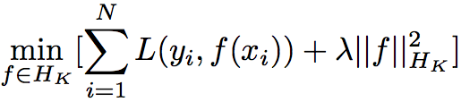

Regularization in RKHS
Solve
Representer Thm: optimizer lies in finite dim space
where
and K_{nxn}= K(x_{i}, x_{j})

Slide 17
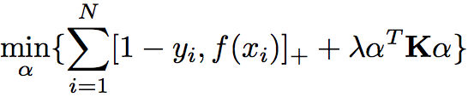
Support Vector Machines
SVM for a two-class classification problem has the
form f(x) =α₀+Σ α_{I} K(x,x_{i}) where parameter α’s are
chosen by
Most of the α’s are zeros in the solution, and the non-zero α’s are called support vectors.

Slide 18
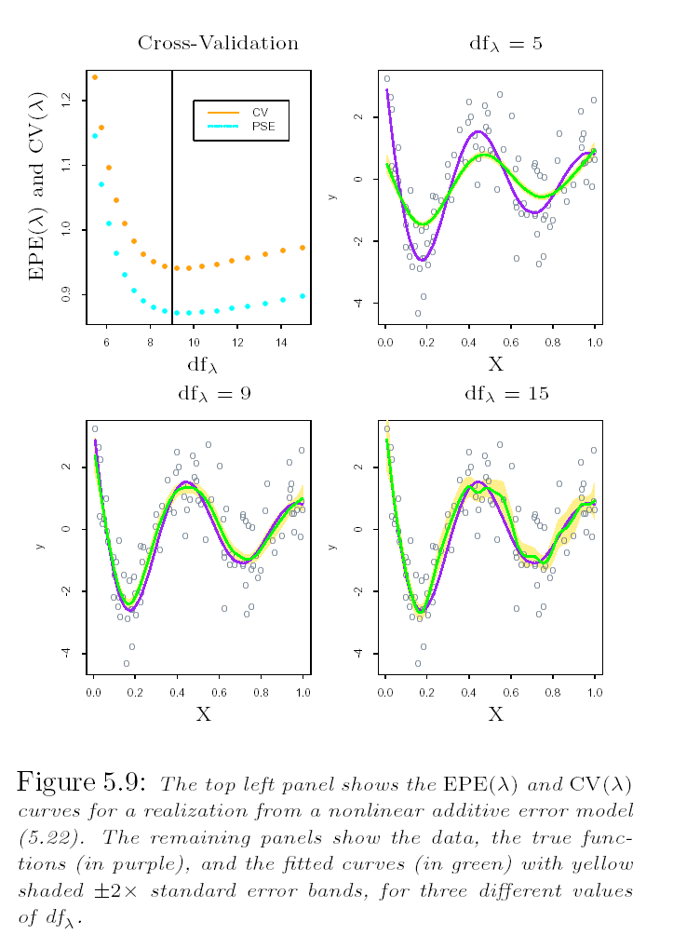
Choose λ
True Function
Fitted Function

Slide 19
Nuclear Magnetic Resonance Signal
Spline Basis is still too smooth to capture local spikes/bumps

Slide 20
Haar Wavelet Basis
Father wavelet φ(x)
Mother wavelet ψ(x)
Haar Wavelats

Slide 21
Haar Father Wavelet
Let φ(x) = I(x ∈ [0,1]), define
φ_{0,k}(x) = φ(x-k)
V₀ = {φ_{0,k}(x) ; k = … -1, 0, 1, …}
φ_{j,k}(x) = 2 ^{j/2} φ(2^{j}x - k)
Father wavelet φ(x)
V_{j} = {φ_{j,k}(x) ; k = … -1, 0, 1, …}
Then
L ⊃ V₁ ⊃ V₀ ⊃ V ₋₁ ⊃ L

Slide 22
Haar Mother Wavelet
Let W_{j} be the orthogonal complement
of V_{j} to V_{j+1} :
V_{j+1} = V_{j} + W_{j}
Let ψ(x) = φ(2x) - φ(2x-1), then
ψ_{j,k}(x) = 2^{j/2} ψ(2^{j}x - k) form a basis
for W_{j}
Father wavelet φ(x)
We have V_{j+1} = V_{j} + W_{j}
= V_{j-1} + W_{j-1} + W_{j}
Thus, V_{J} = V₀ + W₁ + L + W_{J-1}
Mother wavelet ψ(x)

Slide 23
Daubechies Symmlet-p Wavelet
Father wavelet φ(x)
Mother wavelet ψ(x)
Symmlet Wavelats

Slide 24
Wavelet Transform
Suppose N = 2^J in one-dimension
Let W be the N x N orthonormal wavelet
basis matrix, then y* = W^{T} y is called
the wavelet transform of y
In practice, the wavelet transform is
NOT performed by matrix multiplication
as in y* = W^{T} y
Using clever pyramidal schemes, y* can
be obtained in O(N) computations, faster
than fast Fourier transform (FFT)
Haar Wavelats

Slide 25
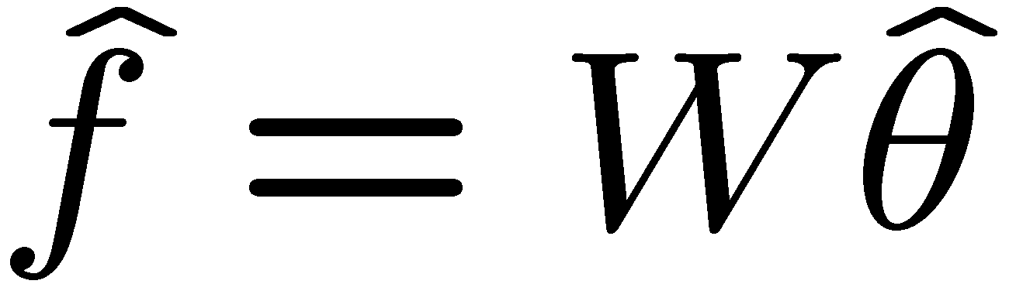
Wavelet Smoothing
Stein Unbiased Risk Estimation (SURE) shrinkage
This leads to the simple solution:
The fitted function is given by

Slide 26
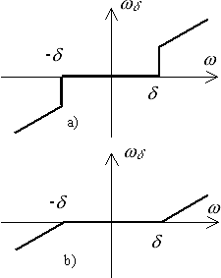

Soft Thresholding v.s Hard Thresholding
λ
θ
λ
θ
Soft thresholding
Hard thresholding
(LASSO)
(Subset Selection)

Slide 27
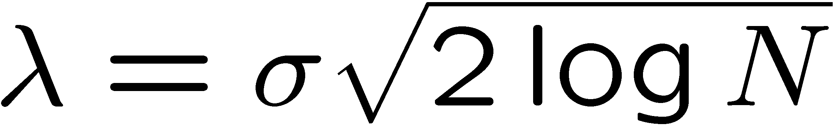
Choice of λ
Adaptive fitting of λ, a simple choice
(Donoho and Johnstone, 1994)
with σ as an estimate of the standard deviation of the noise
Motivation: for white noise Z₁, L, Z_{N}, the expected maximum of |Z_{j}| is approximately

Slide 28
Wavelet Coef. of NMRS
Signal
W₉
W₈
W₇
W₆
W₅
W₄
V₄
Original Signal
Wavelet decomposition
WaveShurnk Signal

Slide 29
Nuclear Magnetic Resonance Signal
Wavelet shrinkage fitted line in green

Slide 30


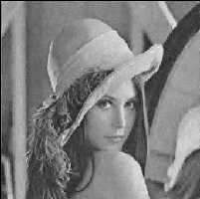
Wavelet Image Denoising
Original
Noise Added
Denoised
JPEG2000 uses WTT

Slide 31
Summary of Wavelet Smoothing
Wavelet basis adapt to smooth curve and local bumps
Discrete Wavelet Transform (DWT) and Inverse Wavelet Transform computation is O(N)
Data denoising
Data compression: sparse presentation
Lots of applications …

