Slide 1
Introduction to
“(Re-)Imag(in)ing Price Trends”
By
Jingwen Jiang
University of Chicago
Bryan Kelly Yale University, AQR Capital Management, and NBER
Dacheng Xiu University of Chicago Booth School of Business

Slide 2
Background
This paper considers using methods that flexibly learn price patterns that are most predictive of future returns to forecast future returns.
The raw predictor data are images from which authors model the predictive association between images and future returns using a convolutional neural network (CNN).
They claim by using CNN they can automatically identify context-independent predictive patterns which can give more accurate return predictions, translate into more profitable investment strategies and are robust to variations.

Slide 3
Brief Intro
In the empirical designs, they first embed 1D time-series data into 2D images depicting price and volumes.
Then they feed each training sample into CNN to estimate the probability of a positive subsequent return over short(5-day), medium(20-day), and long (60day) horizons.
Afterward, they use CNN-based out-of-sample predictions as signals in several asset pricing analyses.
Finally, they attempt to interpret the predictive patterns identified by the CNN.

Slide 4
Replication task
Mainly focus on:
Data Preparation
Model Design
Workflow Design
Performance Evaluation
Interpretation

Slide 5
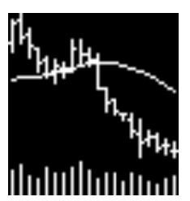
Data
The sample runs from 1993-2019 shows daily opening, high, low prices. The original paper constructs datasets consisting of three scales of horizons(5-day, 20-day, 60-day). Here we just collect the 20-day version. The total size of data is 8.6G.
We already transferred the OHLC charts into images following the same procedures. Current images have the same resolution (64 * 60) and added with moving average lines(MA) and volume bars(VB).

Slide 6
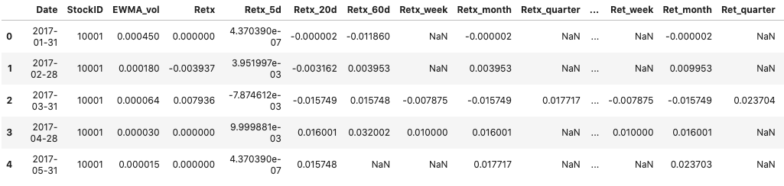
Data
Images labels take value 1 for positive returns ('up') and 0 for non-positive returns ('down'). In addition, we use 2 to mark the NaN value.

Slide 7
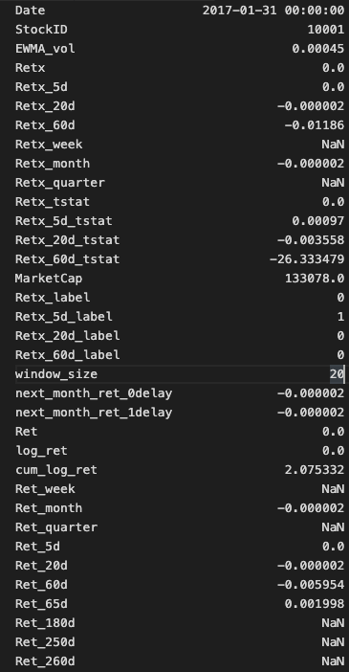
Data: Label Format
Retx_20d: < 0
Retx_20d_label: 0

Slide 8
Architecture Design
A core building block consists of three operations:
convolution
activation
pooling
In the paper, for 20-day images, they build a baseline CNN architecture with 3 conv blocks and connected with a fully connected layer as a classifier head.

Slide 9
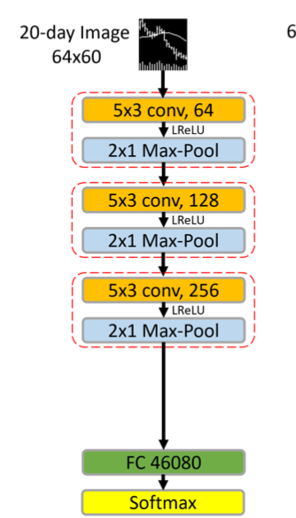
You should refer to the design of the conv block in the original paper (including the selection of the size of the convolution kernel, the selection of the convolution method, the design of the pooling layer and the selection of the activation function, etc.)

Slide 10
Working Flow
Data Split
Consider dividing the entire sample into training, validation and testing samples.
In the original paper, they use the first seven-year sample (1993-1999) to train and validate the model, in which 70% of the sample are randomly selected for training and the remaining 30% for validation. The remaining twenty years of data comprise the out-of-sample test dataset.

Slide 11

Loss and evaluation
You can simply treat the prediction analysis as a classification problem. Use Cross Entropy Loss
To measure the classification accuracy, a true positive (TP) or true negative (TN) occurs when a predicted “up” probability of greater than 50% coincides with a positive realized return and a probability less than 50% coincides with a negative return. False positives and negatives (FP and FN) are the complementary outcomes.
For more evaluation metrics or methods, like Sharpe Ratio, please refer to the original paper.

Slide 12
Train Process
The author adopts several ways to combat over-fitting issue and aid efficient computation.
They applied the Xavier initialization for weights in each layer, which guarantees faster convergence by scaling the initial weights.
Other techniques like applying dropout, using batch normalization and early stopping also assists better performance.
We recommend referring to the training details mentioned in the paper 3.3 when training the baseline model.

Slide 13
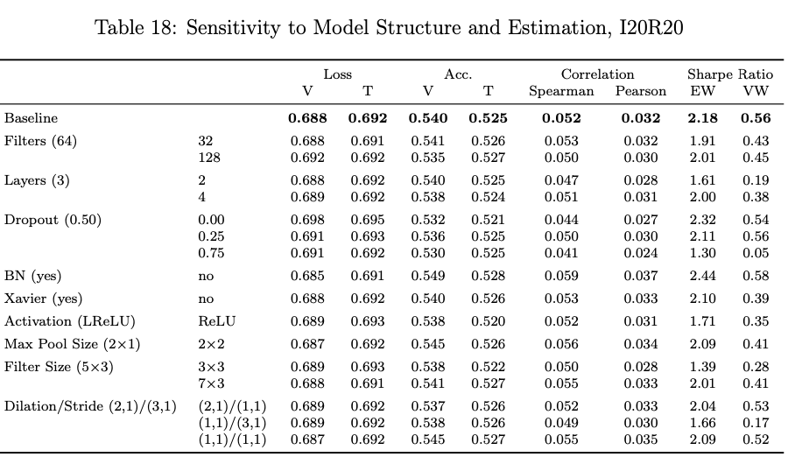
Extensions
Ablation studies and test robustness,
For example, you can perform the sensitivity analysis of the CNN prediction model to alternate choices in model architecture (e.g., varying the number of filters in each layer or varying the number of layers, like the paper shows in Table 18)

Slide 14
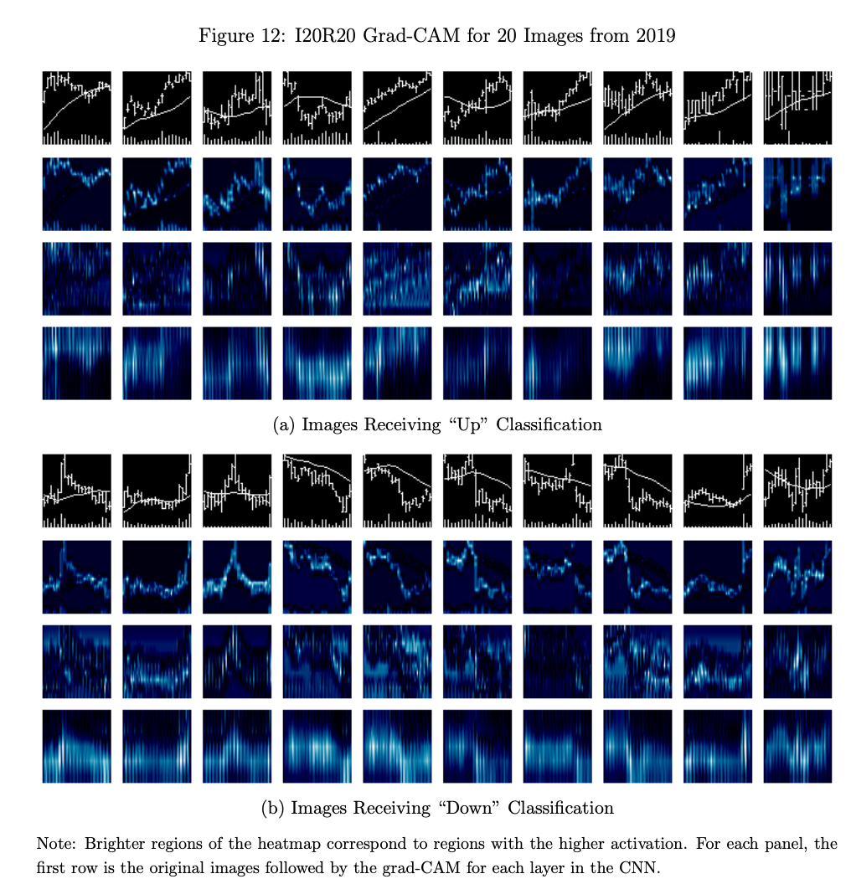
Exploring of the interpretability of the CNN model
Using a visualization method (Grad-CAM) to understand how different image examples activate the regions of the CNN to trigger 'up' or 'down' return predictions.

Slide 15
What's more
We encourage you not limited to simple binary classification tasks, since the label files we provided consist of more meaningful attributes, containing both categorical and numerical values.
For example, you can use the same 20-day horizon images to train your model to predict the return trend of different subsequent y-days even the detailed return values. (y can be 5, 20 even larger).

Slide 16
Introduction to
“Empirical Asset Pricing via
Machine Learning”
By
Shihao Gu
University of Chicago
Bryan Kelly Yale University, AQR Capital Management, and NBER
Dacheng Xiu University of Chicago Booth School of Business

Slide 17
An Empirical Study of US Equity
Risk premium is difficult to measure: market efficiency forces return variation to be dominated by unforecastable news that obscures risk premiums.
This paper uses machine learning methods to predict asset’s excess return.
Linear models: OLS, elastic net
Dimension reduction: PLS, PCR
Generalized linear model
Tree model: Gradient boosted regression tree, random forest
Neural network
Data and feature
Monthly total individual equity returns for all firms listed in NYSE, AMEX, NASDAQ. Data traverses 60 years from 1957 to 2016.
94 firm characteristics
8 macroeconomic predictors
74 industry dummies

Slide 18
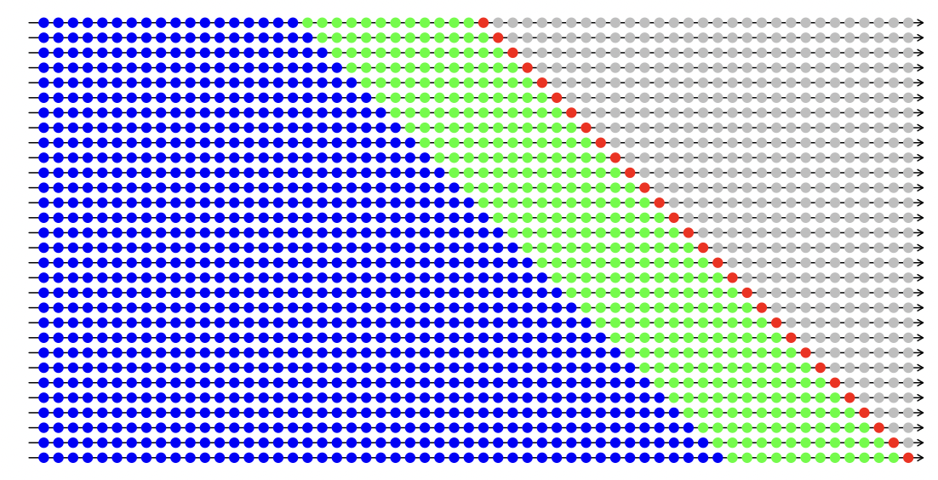
A Recursive Evaluation Method
Divide the 60 years of data into 18 years of training sample (1957-1974), 12 years of validation sample (1975-1986), and the remaining 30 years for out-of-sample testing (1987-2016).
Adopt a recursive performance evaluation scheme.

Slide 19
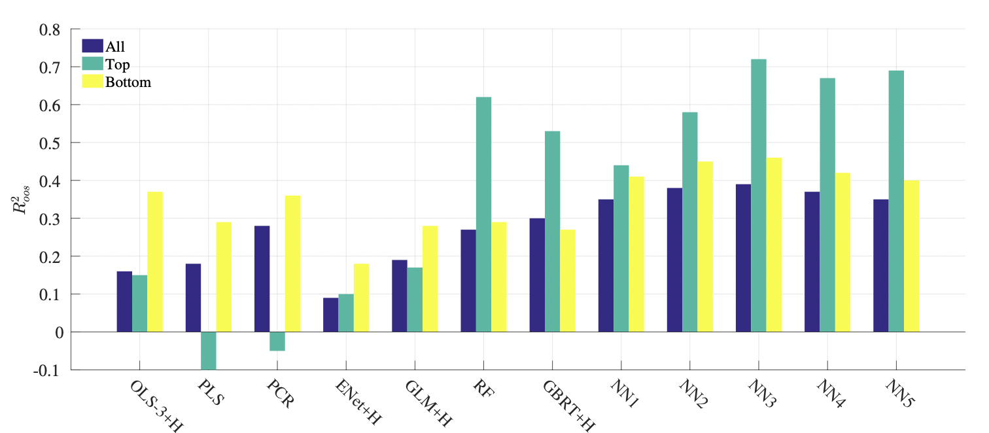
Individual Stock Returns Prediction
Empirical results are not optimized over hyperparameters, and therefore are more conservative.

Slide 20
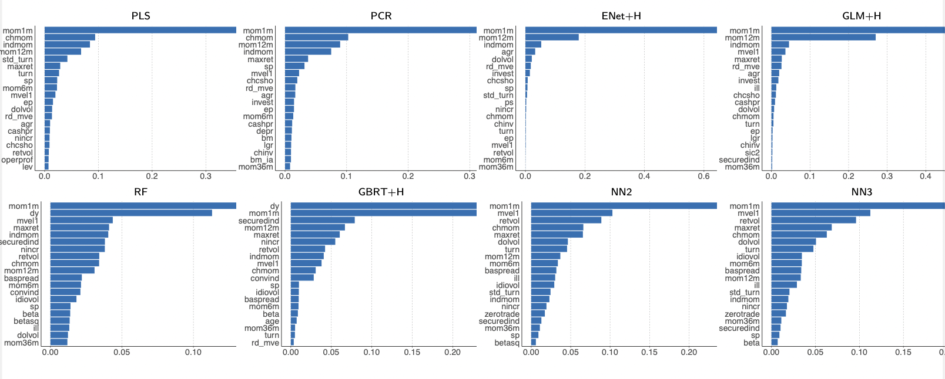
Characteristic Importance

Slide 21
Requirements for replication
Replicate at least 6 methods (e.g., OLS, elastic net, PLS, PCR, random forest, Gradient Boosting, neural network, etc.), and analyze your results carefully. Hints of parameter chosen are presented in the paper.
Include the variable importance in your analysis.
Adopt the ‘recursive evaluation method’ described above.
You do not need to replicate the results of section 2.4: Portfolio forecast.
Supplementary material can be helpful to you.

