Slide 1

Home Credit Default Risk
A Rigorous Machine Learning Framewor
Presented By :
MSDM5054 Mini-Project
Ziyue Peng (ID: 21411927)

Slide 2
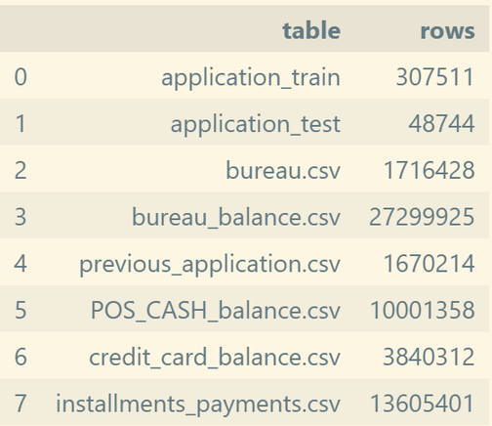
Introduction
EDA
Data Processing
Methodology
Results and Analysis
Page
02
🔍 Goal
⚠ Challenge
  Extreme class imbalance (only ~8% are defaulters).
  Static application data alone is not enough.
  Predict severe delinquency (TARGET = 1 means default)
  Multi-source, highly imbalanced tabular data
🎯 Two Research Questions
📊 Dataset Overview
  RQ1: Are static features sufficient?
→ Need temporal behavioral features for better boundary
  RQ2: How to handle extreme class imbalance (~8%)?
→ Ensemble + dynamic threshold calibration
for F1
  307,511 training applications
  48,744 test applications
  1 main table + 6 child tables (bureau, bureau_balance, prev_app, POS, credit_card, installments)

Slide 3
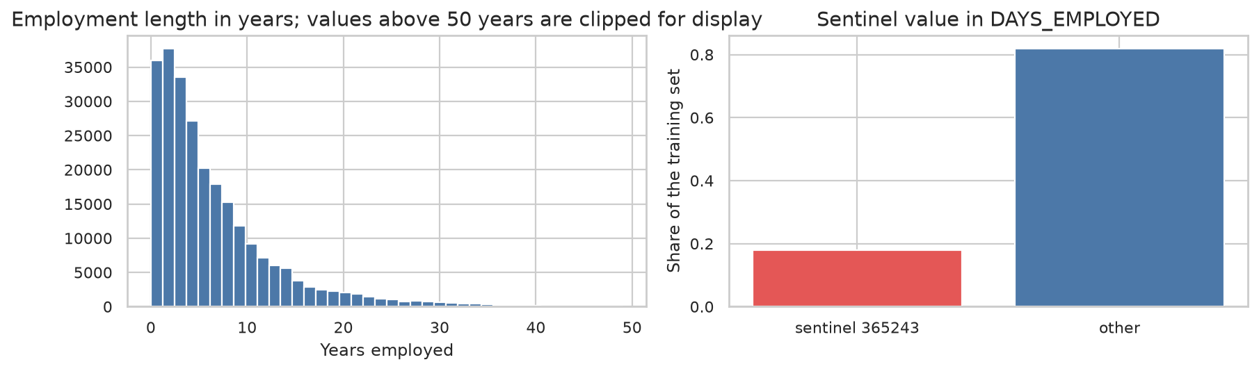
Introduction
EDA
Data Processing
Methodology
Results and Analysis
Page
03
Exploratory Data Analysis
Missing Values
DAYS_EMPLOYED Anomaly
  Sentinel = 365,243 days
  Affects 18.01% of rows
  Default rate:
    anomaly group 5.40%
    normal group 8.66%
  Fix: replace → NaN + add binary flag DAYS_EMPLOYED_ANOM
  67 / 122 columns have missing values
  Building features (COMMONAREA, LANDAREA) > 60% missing
  Strategy: keep as missingness indicator

Slide 4
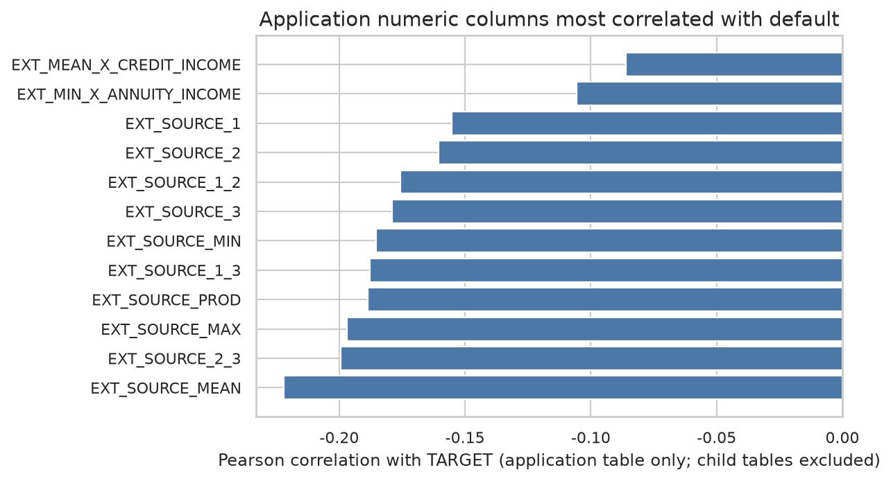
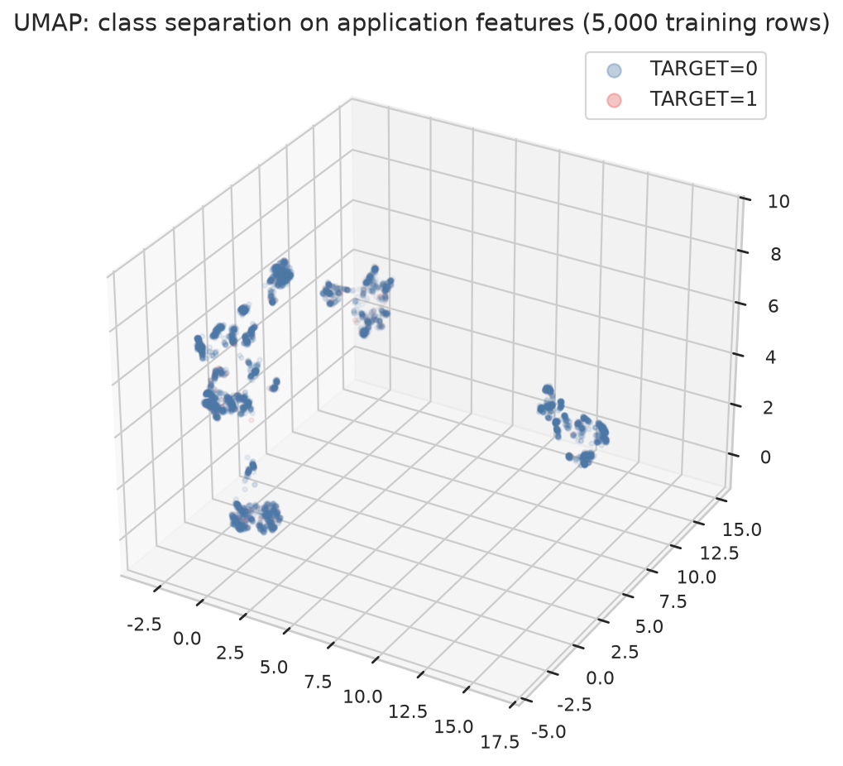
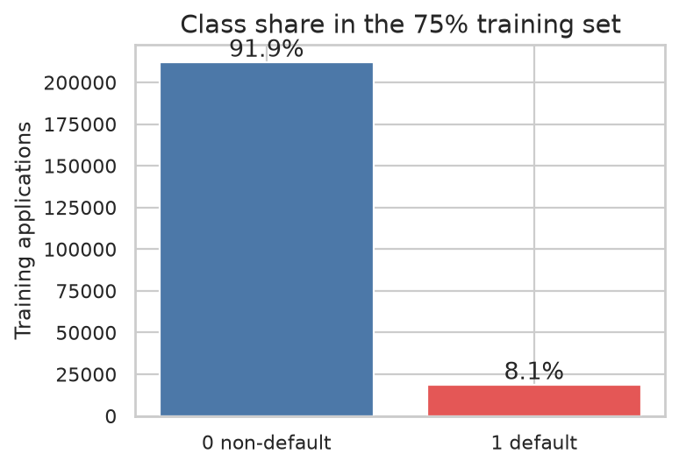
Introduction
EDA
Data Processing
Methodology
Results and Analysis
Page
04
Class Separability
Top Predictive Features
  SentinelTwo classes heavily overlap
  No clear linear or low-dim boundary
  Static features alone are NOT sufficient
  ⟹ Motivates temporal /
  behavioral features (RQ1)
  EXT_SOURCE_1/2/3 strongest negative corr. (up to −0.22)
  Derived: EXT_MEAN, EXT_PROD, EXT_MIN
  Burden ratios: CREDIT_INCOME_RATIO ANNUITY_INCOME_RATIO

Slide 5
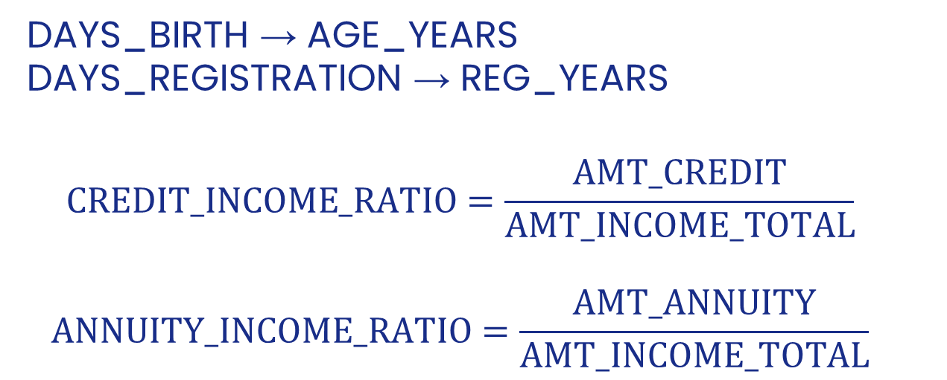
Introduction
EDA
Data Processing
Methodology
Results and Analysis
Page
05
Application-Level Cleaning & Derived Features
① Sentinel Correction
② Temporal & Ratio Features
  DAYS_BIRTH → AGE_YEARS
  DAYS_REGISTRATION → REG_YEARS
  $$CREDIT_INCOME_RATIO=\frac{AMT_CREDIT}{AMT_INCOME_TOTAL}$$
  $$ANNUITY_INCOME_RATIO=\frac{AMT_ANNUITY}{AMT_INCOME_TOTAL}$$
DAYS_EMPLOYED = 365,243
→ set to NaN
+ add DAYS_EMPLOYED_ANOM
Code:
df["DAYS_EMPLOYED_ANOM"] = (df["DAYS_EMPLOYED"] == 365243).astype(np.int8)
df.loc[df["DAYS_EMPLOYED_ANOM"] == 1, "DAYS_EMPLOYED"] = np.nan
df["CREDIT_INCOME_RATIO"] = df["AMT_CREDIT"] / income
df["ANNUITY_INCOME_RATIO"] = df["AMT_ANNUITY"] / income
df["EXT_SOURCE_MEAN"] = df[ext].mean(axis=1)
df["EXT_SOURCE_PROD"] = df["EXT_SOURCE_1"] * df["EXT_SOURCE_2"] * df["EXT_SOURCE_3"]
③ External Score Statistics
EXT_SOURCE_1/2/3
→ MEAN, MIN, MAX, PROD
→ robust to single-source missing

Slide 6
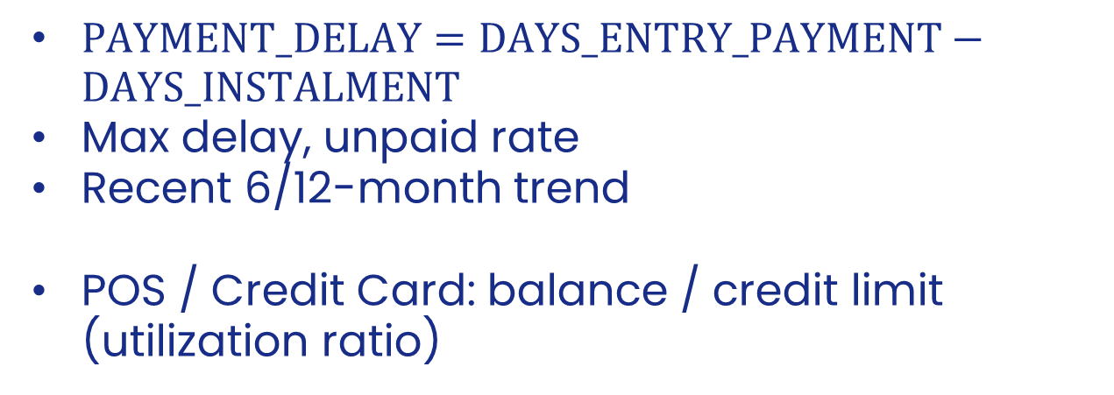
Introduction
EDA
Data Processing
Methodology
Results and Analysis
Page
06
Multi-Table Aggregation: Trend-Based Framework
Core Formula:
$$ΔM=M_{recent}−M_{all}$$
positive $ΔM$ in overdue → recent financial deterioration
Installments & Monthly Balances
Bureau & Prev Applications
  $PAYMENT_DELAY=DAYS_ENTRY_PAYMENT−DAYS_INSTALMENT$
  Max delay, unpaid rate
  Recent 6/12-month trend
  POS / Credit Card: balance / credit limit (utilization ratio)
Loan amount, overdue ratio, credit diversity
Split: active vs. closed
Approval ratio, avg interest rate

Slide 7
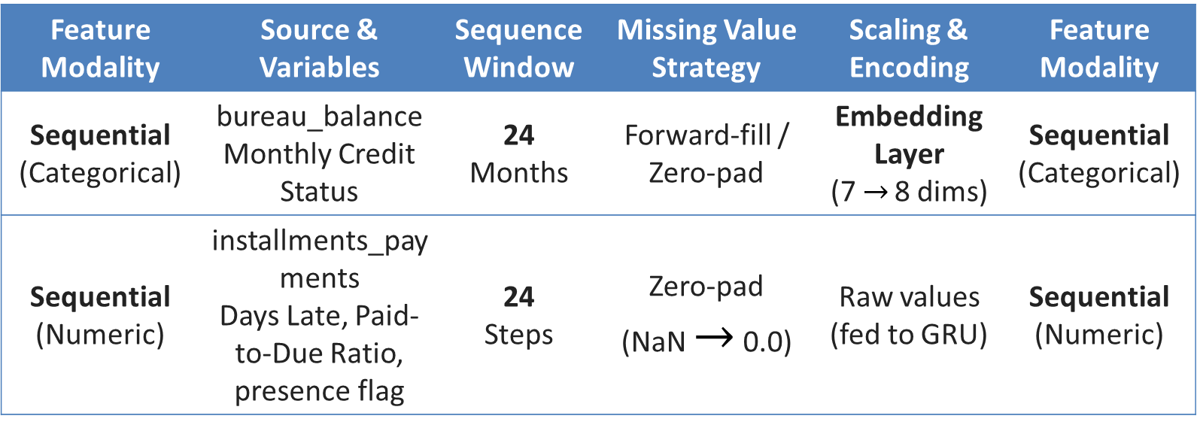
Introduction
EDA
Data Processing
Methodology
Results and Analysis
Page
07
Sequence Features
Imputation & Scaling
Source tables:
  bureau_balance
  installments_payments
  Fixed-length: last 24 months
  Missing months:
  → forward-fill / zero-pad
① Regression-Based Imputation
EXT_SOURCE_3 (~60% missing)
→ train linear model on non-missing samples
→ predict missing values
Feature Modality | Source & Variables | Sequence Window | Missing Value Strategy | Scaling & Encoding | Feature Modality
Sequential (Categorical) | bureau_balance Monthly Credit Status | 24 Months | Forward-fill / Zero-pad | Embedding Layer (7 $→$ 8 dims) | Sequential (Categorical)
Sequential (Numeric) | installments_payments Days Late, Paid-to-Due Ratio, presence flag | 24 Steps | Zero-pad (NaN $→$ 0.0) | Raw values (fed to GRU) | Sequential (Numeric)
② Quantile Transformer
Map each feature → N(0, 1)
Handles heavy tails
Robust to outliers
Helps gradient-based optimizers converge

Slide 8
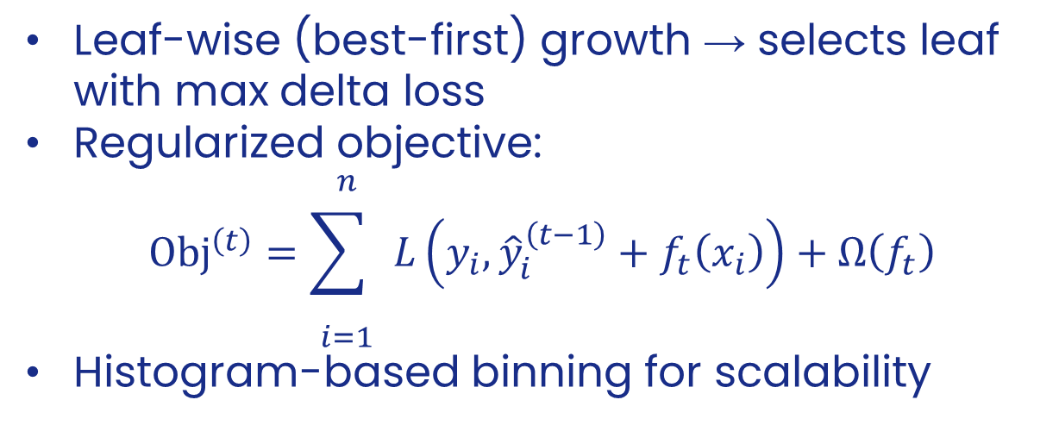
Introduction
EDA
Data Processing
Methodology
Results and Analysis
Page
08
Interaction LightGBM
Key Design
Purpose
Leaf-wise (best-first) growth → selects leaf with max delta loss
Regularized objective:
$${Obj}^{\left(t\right)}=\overset{n}{\underset{i=1}{\sum{ }}} L\left(y_{i} , {\hat{y}}_{i}^{\left(t−1\right)}+f_{t}\left(x_{i}\right)\right)+Ω\left(f_{t}\right)$$
Histogram-based binning for scalability
  Capture high-order non-linear interactions among 148 engineered numeric features
  Inputs: trend features, burden ratios, external scores, aggregated child-table stats
Training Protocol
model = LGBMClassifier(
objective="binary", n_estimators=3000,
num_leaves=24, min_child_samples=300,
subsample=0.7, colsample_bytree=0.6,
reg_lambda=1.0, learning_rate=0.05, verbose=-1,
)
model.fit(X_tr, y_tr, eval_set=[(X_va, y_va)],
eval_metric="auc", callbacks=[early_stopping(100)])
Inner 20% validation for hyperparameter search (4 random trials)
5-fold stratified CV → OOF probabilities
Early stopping: patience = 100 rounds

Slide 9
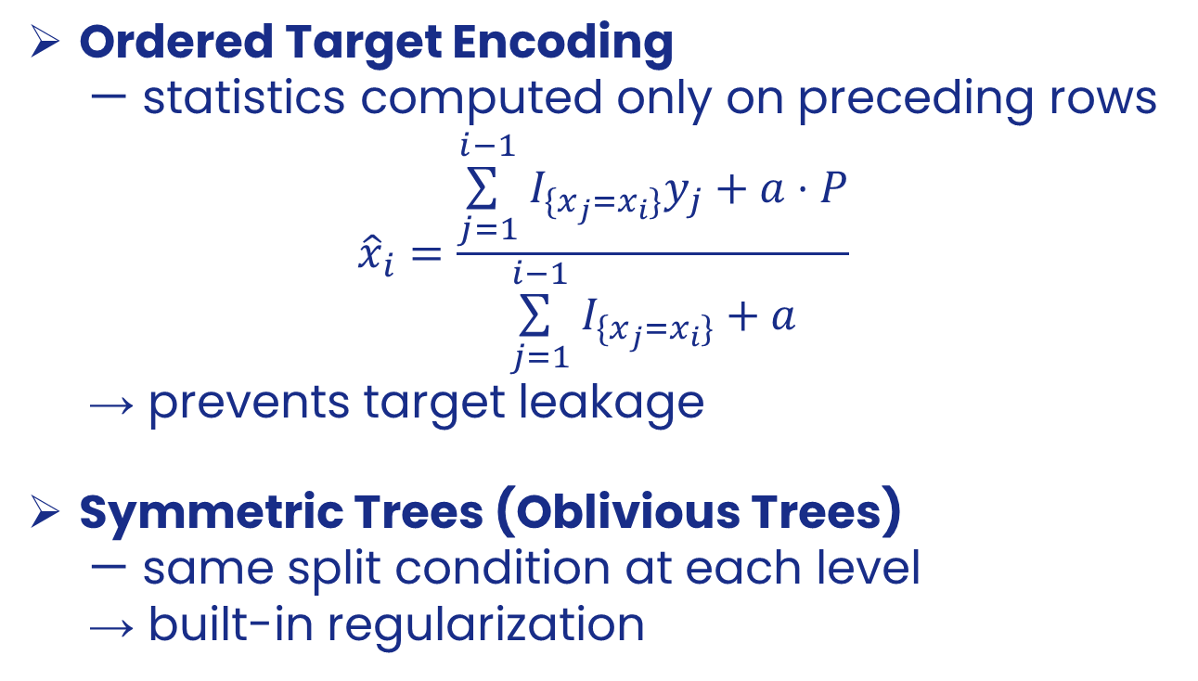
Introduction
EDA
Data Processing
Methodology
Results and Analysis
Page
09
Categorical CatBoost
Purpose
Key Design
Native handling of high-cardinality categoricals
    OCCUPATION_TYPE, ORGANIZATION_TYPE, rejection reason, product combination, etc.
Complementary inductive bias to LightGBM
Features: 13 categorical columns + 58 numeric columns (external scores, burden ratios, aggregated differences)
Ordered Target Encoding
— statistics computed only on preceding rows
$${\hat{x}}_{i}=\frac{\overset{i−1}{\underset{j=1}{\sum{ }}} I_{\{x_{j}=x_{i}\}}y_{j}+a⋅P}{\overset{i−1}{\underset{j=1}{\sum{ }}} I_{\{x_{j}=x_{i}\}}+a}$$
→ prevents target leakage
Symmetric Trees (Oblivious Trees)
— same split condition at each level
→ built-in regularization

Slide 10
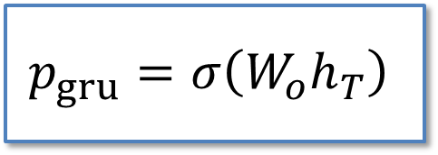
Introduction
EDA
Data Processing
Methodology
Results and Analysis
Page
10
GRU Trajectory Network + LightGBM
Purpose: Address RQ1 — capture temporal behavioral dynamics
Inputs per applicant (latest 24 months)
Bureau status sequence: 24 timesteps, embedding dim = 8
Installment sequence: 24 × 3 (days_late, paid_to_due ratio, presence flag)
Static features: AGE_YEARS, EXT_SOURCE_MEAN, CREDIT_INCOME_RATIO
Static FC (3→8)
Status GRU
(8→16)
Install GRU
(3→16)
FC
(40→32 → 1)
$$p_{gru}=σ\left(W_{o}h_{T}\right)$$
GRU Gates:
$$z_{t}=σ\left(W_{z}⋅\left[h_{t−1} , x_{t}\right]\right){, r}_{t}=σ\left(W_{r}⋅\left[h_{t−1} , x_{t}\right]\right)$$
${\tilde{h}}_{t}=\tanh\left(W⋅\left[r_{t} , ⊙{h_{t−1}}x_{t}\right]\right), h_{t}=\left(1−z_{t}\right)⊙{h_{t−1}}+z_{t}⊙{{\tilde{h}}_{t}}$

Slide 11
Introduction
EDA
Data Processing
Methodology
Results and Analysis
Page
11
GRU Trajectory Network + LightGBM
class TrajectoryNet(nn.Module):
def __init__(self):
super().__init__()
self.status_emb = nn.Embedding(7, 8, padding_idx=0)
self.status_gru = nn.GRU(8, 16, batch_first=True)
self.inst_gru = nn.GRU(3, 16, batch_first=True)
self.static_fc = nn.Linear(3, 8)
self.head = nn.Sequential(nn.Linear(40, 32), nn.ReLU(), nn.Linear(32, 1))
def forward(self, status, inst, static):
_, h_s = self.status_gru(self.status_emb(status.long()))
_, h_i = self.inst_gru(torch.nan_to_num(inst, nan=0.0))
h_static = self.static_fc(torch.nan_to_num(static, nan=0.0))
return self.head(torch.cat([h_s[-1], h_i[-1], h_static], 1)).squeeze(1)

Slide 12
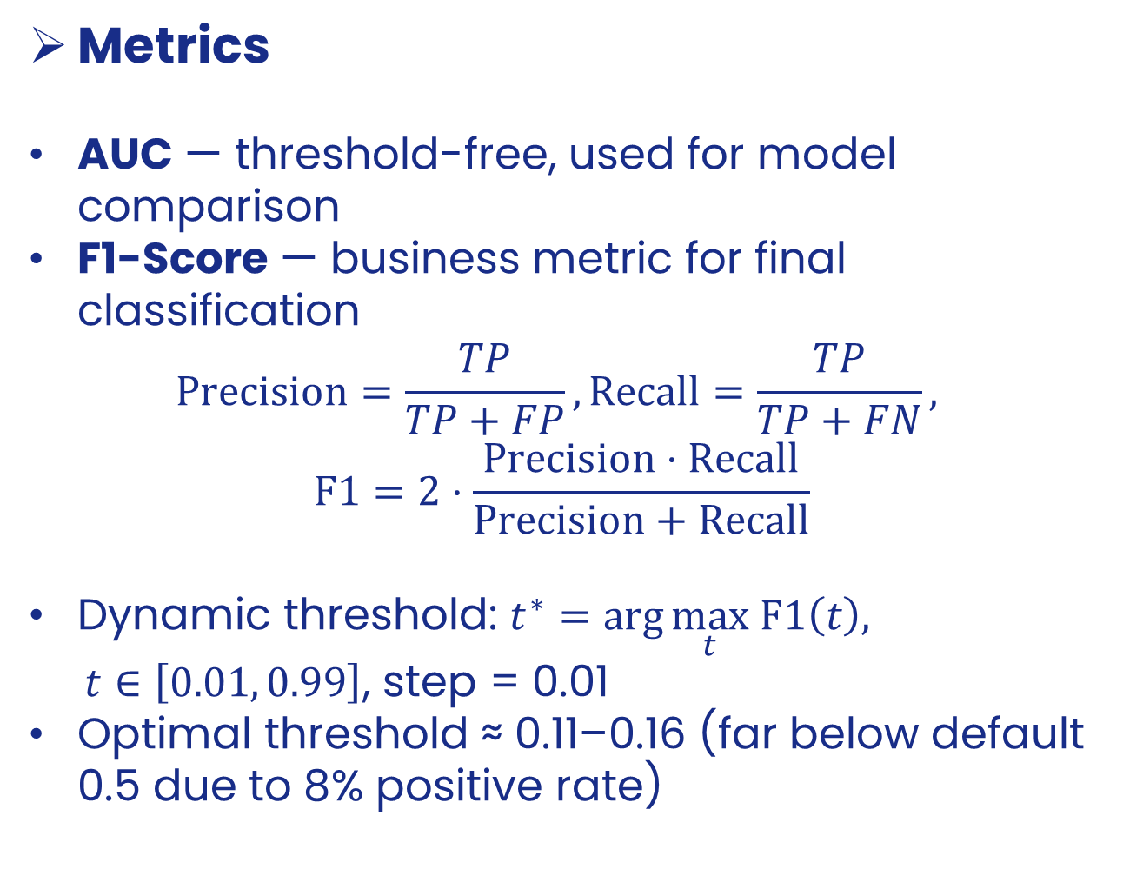
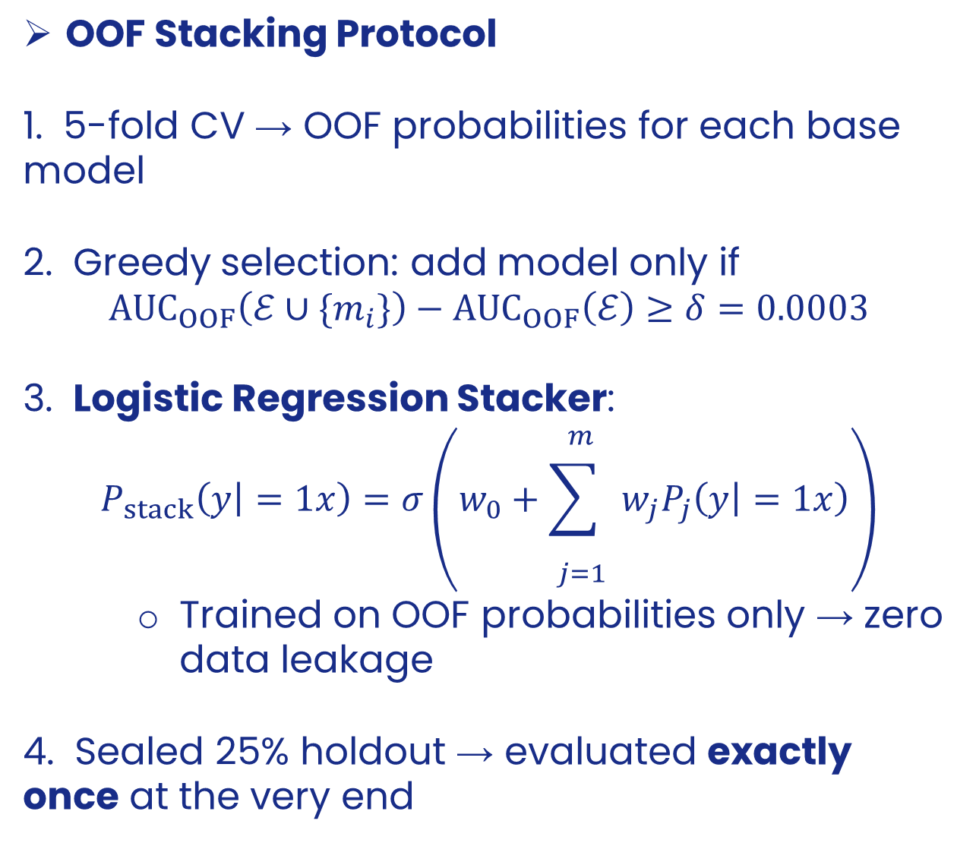
Introduction
EDA
Data Processing
Methodology
Results and Analysis
Page
12
Metrics & OOF Stacking Strategy
Metrics
AUC — threshold-free, used for model comparison
F1-Score — business metric for final classification
$$Precision=\frac{TP}{TP+FP}, Recall=\frac{TP}{TP+FN},$$
$$F1=2⋅\frac{Precision⋅Recall}{Precision+Recall}$$
Dynamic threshold: $t^{∗}=\arg{\max_{t}} F1\left(t\right),$
$t∈\left[0.01 , 0.99\right]$, step = 0.01
Optimal threshold ≈ 0.11–0.16 (far below default 0.5 due to 8% positive rate)
OOF Stacking Protocol
1. 5-fold CV → OOF probabilities for each base model
2. Greedy selection: add model only if
$${AUC}_{OOF}\left(ℰ∪\{m_{i}\}\right)−{AUC}_{OOF}\left(ℰ\right)≥δ=0.0003$$
3. Logistic Regression Stacker:
$$P_{stack}\left(y | =1x\right)=σ\left(w_{0}+\overset{m}{\underset{j=1}{\sum{ }}} w_{j}P_{j}\left(y | =1x\right)\right)$$
    Trained on OOF probabilities only → zero data leakage
4. Sealed 25% holdout → evaluated exactly once at the very end

Slide 13
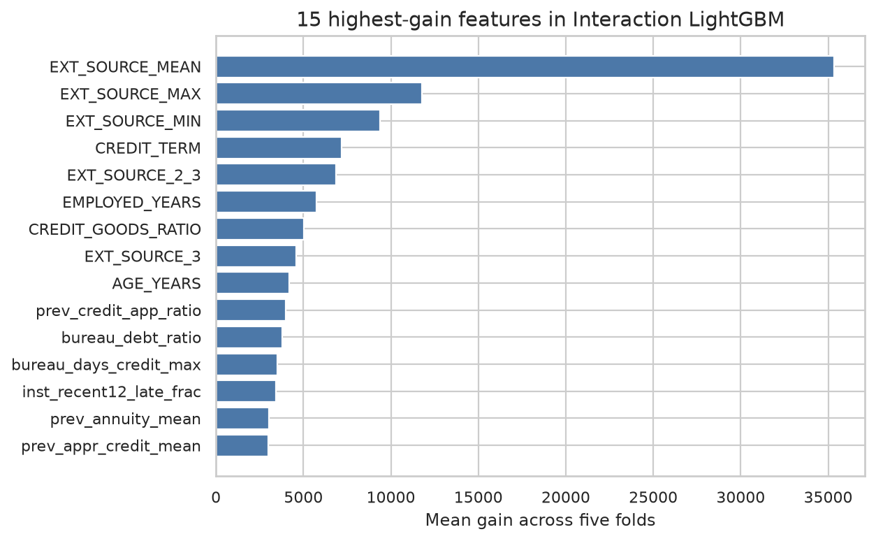
Introduction
EDA
Data Processing
Methodology
Results and Analysis
Page
13
Results: LightGBM Performance
Setup
LightGBM Results
Best inner AUC: 0.7806
5-fold OOF AUC: 0.7811
F1 threshold: 0.16 → F1 = 0.3301
75% train / 25% sealed holdout (stratified)
5-fold stratified CV inside 75%
Threshold calibrated on OOF probabilities by F1
Holdout evaluated exactly once
Best config:
-- Random search on inner 20% validation
leaves=24, min_child=300
subsample=0.7, colsample=0.6
reg_λ=1.0, lr=0.05

Slide 14
Introduction
EDA
Data Processing
Methodology
Results and Analysis
Page
14
Results: CatBoost & Trajectory Network
Categorical CatBoost
Trajectory Network
Depth search:
  depth 4 → AUC 0.7648
  depth 6 → AUC 0.7673 ✓
Final OOF AUC = 0.7701
F1 threshold = 0.15
F1 = 0.3203
Correlation with LightGBM OOF proba: r = 0.8780
→ similar but not identical
→ contributes diversity
Standalone trajectory:
OOF AUC = 0.7159
LightGBM + trajectory proba:
OOF AUC = 0.7817
Gain: +0.0006 AUC
⟹ Supports RQ1:
temporal patterns capture
something trees miss

Slide 15
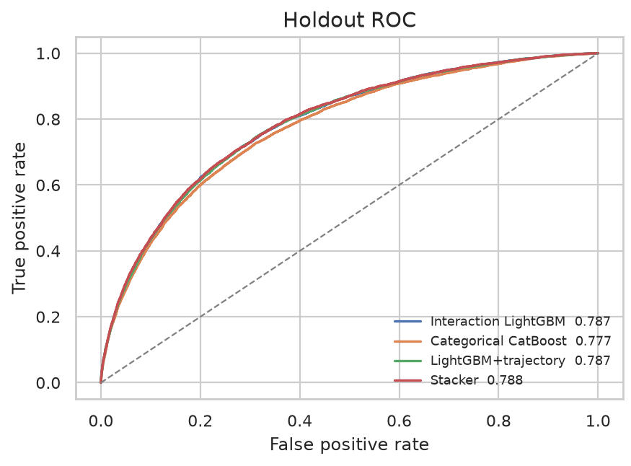
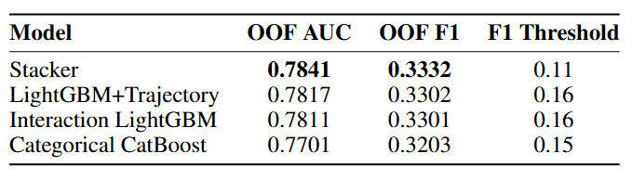
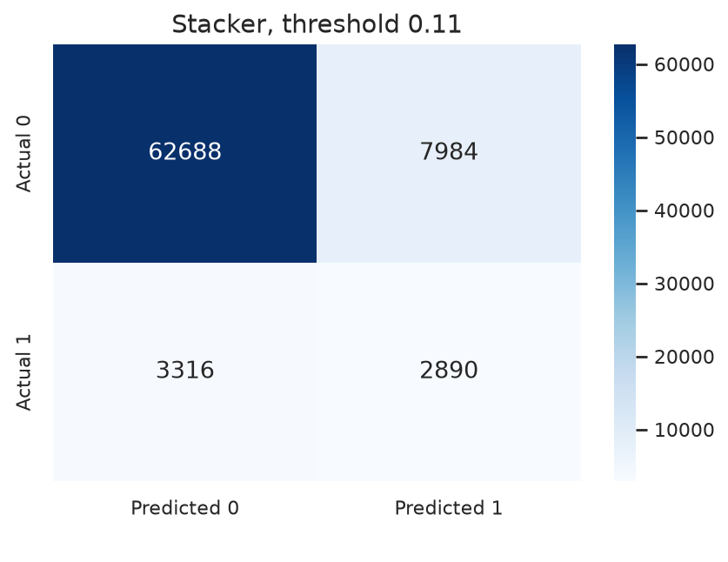
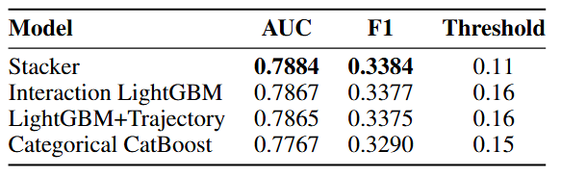
Introduction
EDA
Data Processing
Methodology
Results and Analysis
Page
15
Stacking Ensemble & Holdout Evaluation
Table 1: OOF Performance
Table 2: Holdout Performance

Slide 16
Thank you for your attention
Presented By :
MSDM5054 Mini-Project
Ziyue Peng (ID: 21411927)

