Slide 1
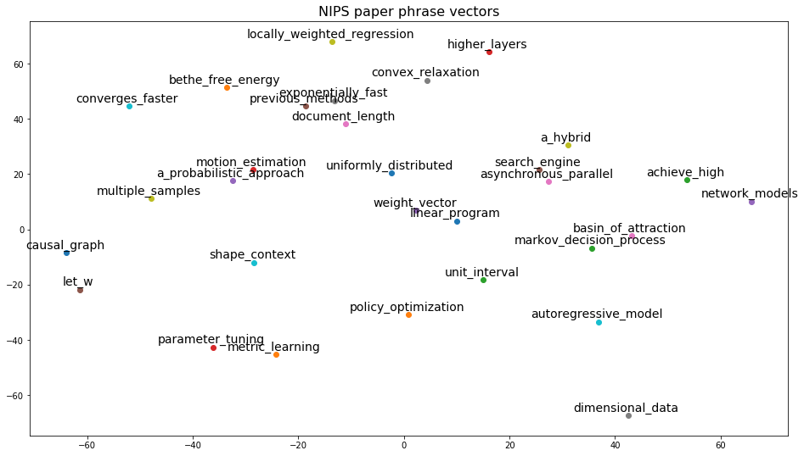
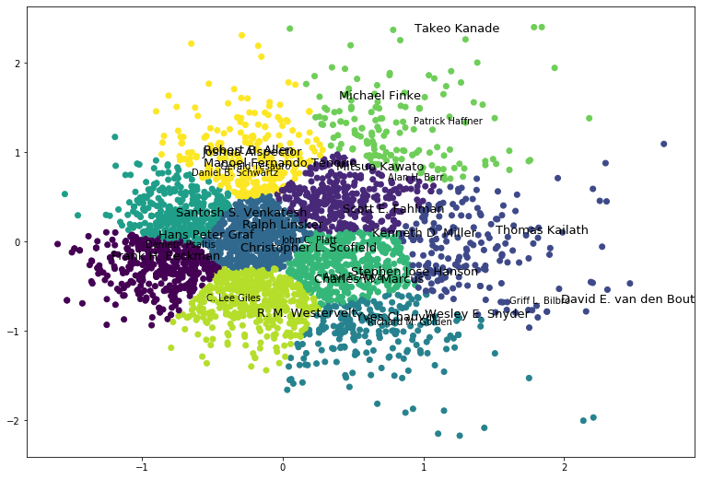
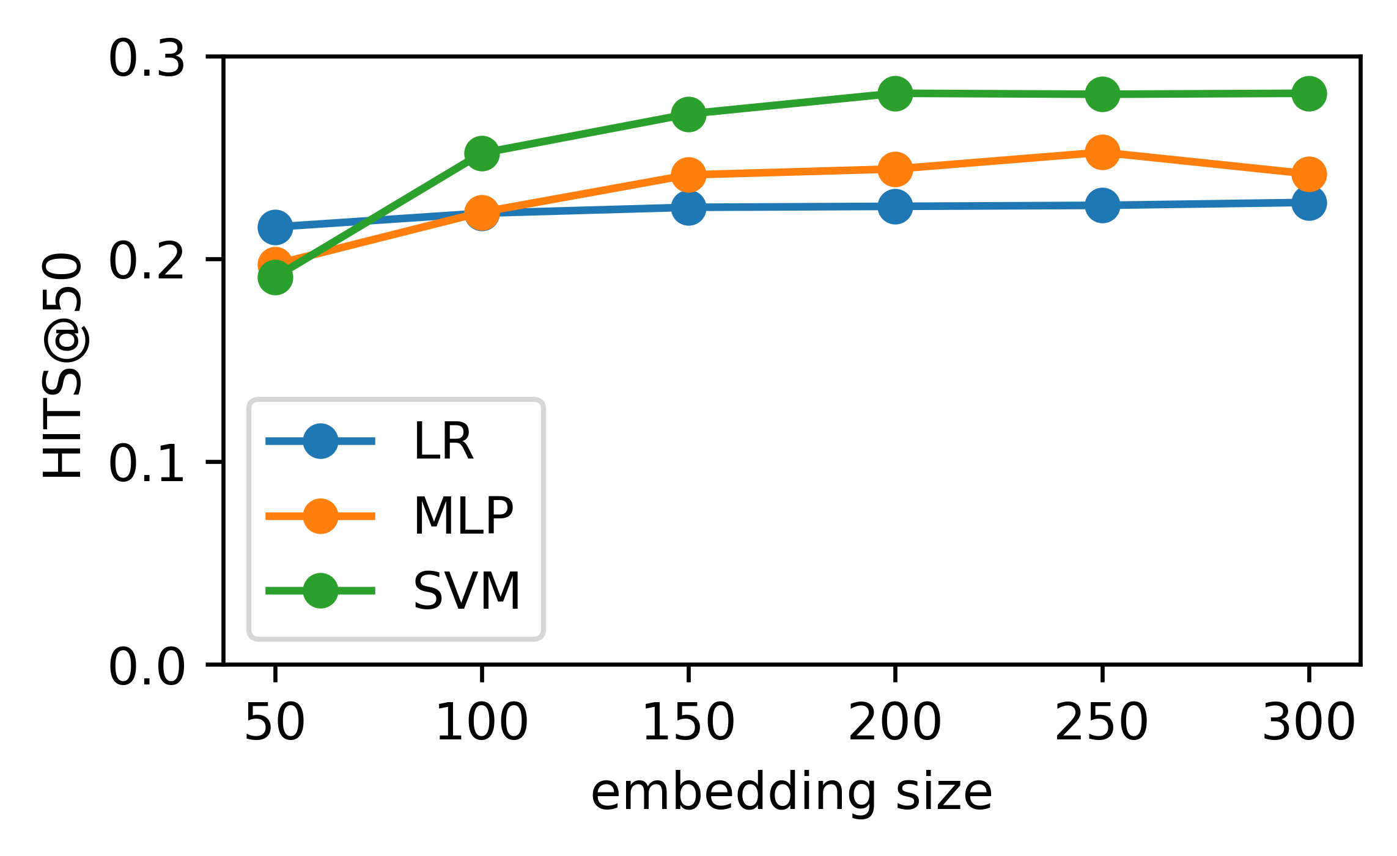
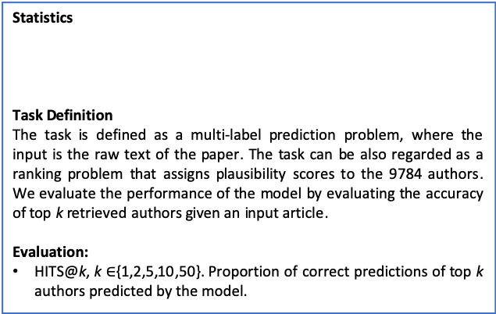
CSIC5011 Mini-Project 1: Identifying authors using word/phrase embedding of NIPS paper dataset
Changlong Yu¹, Tianqing Fang¹ {cyuaq, tfangaa}@ust.hk
¹: Department of Computer Science and Engineering, HKUST
1. Introduction
3. Methodology
Authors in the computer science area may have different patterns of word or phrase choices due to subarea or specific research problems when writing academic papers. We introduce the task of identifying authors given an academic article from the NIPS paper dataset. Technical terms have different meanings that are not easily inferred literally and we represent the paper text from the phrase granularity.
Representation of Text
Term Embedding
Word embeddings: Skip-ngram model(Gensim tool)
Phrase Embedding: Phrase Mining (AutoPhrase) then train Skip-ngram model.
Document Representation:
Average pooling over all term embeddings.
Classification Methods
LR/SVM: efficient classification baselines.
MLP: multi-layer perception (hidden size=100, num layer=2)
Multi-label Classification
Multi-label classification is more complicated than single-label ones. We adopt the idea of One vs. Rest method for our task. As we are conducting 9784-class classification, we train 9784 single-class classification models separately.
2. NIPS words dataset
Statistics
Task Definition
The task is defined as a multi-label prediction problem, where the input is the raw text of the paper. The task can be also regarded as a ranking problem that assigns plausibility scores to the 9784 authors. We evaluate the performance of the model by evaluating the accuracy of top k retrieved authors given an input article.
Evaluation:
HITS@k, k $∈${1,2,5,10,50}. Proportion of correct predictions of top k authors predicted by the model.
# author | # paper
9784 | 7241
# train | # dev | # test
5792 | 724 | 725
 | 1 | 2 | 5 | 10 | 50
Word | 5.87 | 9.31 | 13.91 | 17.45 | 28.16
Phrase | 6.45 | 9.45 | 14.64 | 18.42 | 28.26
4. Results and Visualization
Classification results
The above chart reports the HITS@k using word embeddings and phrase embeddings. According to Figure1, we select the hyper-parameters with the best validation accuracy, which is embedding size equaled 200 and SVM being the classifier. From the above table we can see that phrase embedding is superior to word embedding in the author identification task. This is in line with the assumption that phrases are more important in academic papers than words only.
Visualization
We also use PCA as dimension reduction to visualize the phrase embeddings and add another K-means clustering for detecting similar authors in visualization.
7. References
Mikolov, Tomas, et al. "Distributed representations of words and phrases and their compositionality." NIPS 2013.
Jingbo, Shang, et al ”Automated Phrase Mining from Massive Text Corpora”. TKDE 2018
HITS@50 vs. Embedding Dim.
Accuracy reaches maximum for all models when embed-ding dim equals 200. We select 200 as the final embed-ding size. We use word emb-edding here for illustration.
8. Contribution
Embedding Training and Visualization
Changlong Yu
Multi-label Classification and Result Visualization
Tianqing Fang
Figure 1

